Slide 1
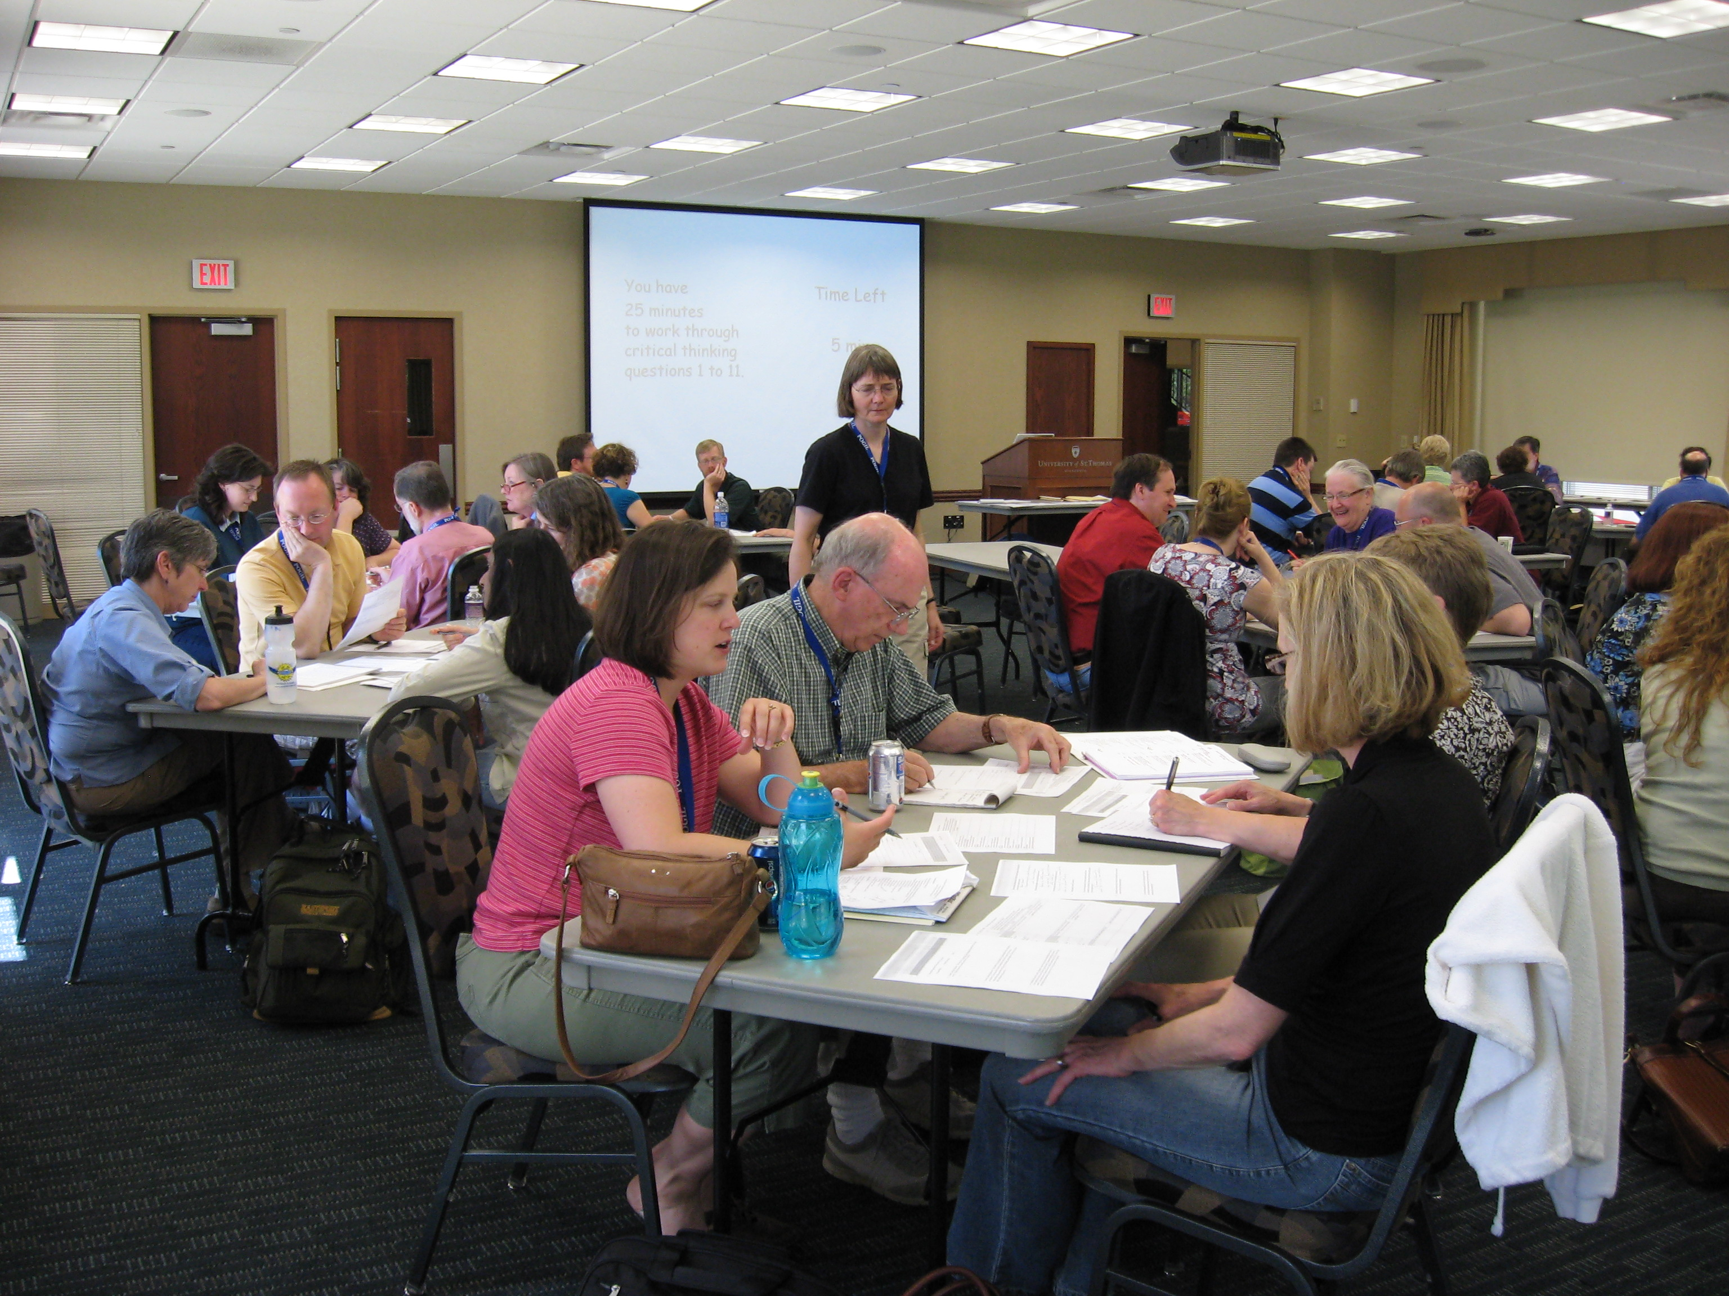
The POGIL Workshop – Welcome!
Please sit in groups of three or four, with people you do NOT know.
Please make the groups as heterogeneous as possible.
www.pogil.org
Notes:
#1 - This slide should be displayed as people are entering the room before the workshop officially begins.
Hand out RED FOLDERS TO MANAGERS a few minutes before the start time for the workshop. Optimally, all groups will have a manager and a red folder when the start time arrives.
Tell MANAGER that he/she should read the included instructions, share relevant information with the group and that the designated time for questions will be 5 minutes after the start of the workshop.

Slide 2
The POGIL Workshop
The Facilitation Team
Feb 10, 2011/ Pretoria
Eric J. Zuckerman Augusta State University
www.pogil.org
Notes:
#2 - At the designated time, (0:05) ask for questions from Managers.
Brief introduction of Facilitators.
Explain hand-raising, visual and audio cues to stop and pay attention
Explain procedure for questions – hold until end of section, write down so you don’t forget, questions often are answered as we proceed through a session.

Slide 3
The POGIL Project PIs and Senior Personnel
NSF CCLI DUE – 0618746, 0618758, 0618800
NSF CCLI DUE – 0231120
Rick Moog, Franklin & Marshall College, Lancaster PA
Jennifer Lewis, University of South Florida, Tampa, FL
Diane Bunce, The Catholic University of America, Washington, DC
Frank Creegan, Washington College, Chester, MD
David Hanson, Stony Brook University, Stony Brook, NY
Jim Spencer, Franklin & Marshall College, Lancaster, PA
Andrei Straumanis, College of Charleston / University of Washington, Seattle, WA
Troy Wolfskill, Stony Brook University, Stony Brook, NY
www.pogil.org
Notes:
#3 - RM, JL, and DB are the PI’s on the current NSF CCLI Phase III grant, funded Oct 2006-2010. FC, DH, JS, AS, TY (and RM, DB) were PI’s and Senior Personnel on the initial POGIL CCLI National Dissemination Grant, 2003-2006.
Many other people are involved in the Project as Steering Committee members, workshop facilitators, POGIL Office staff, participants, etc. Currently are over 7000 names in the participant database (meaning people who have had some interaction with the Project) and well over 1000 have indicated implementation of POGIL in some manner at high school and college level over the past few years.

Slide 4
A POGIL Classroom Experience
Managers: You speak for the group. In addition, you make sure the team is on track toward completion.
Presenters: You share your groups answers with the class or other groups.
Technicians: You use tools, draw graphs, compute with a calculator, etc.
Reflectors: You keep track of the team and how it interacts, noting strengths and areas of improvement.
www.pogil.org
Notes:
#5 - You will use either the Credit Default Swap Activity or other non-science activity as the classroom experience. Insert appropriate slides after this title slide

Slide 5
Warm-Up Activity
The Nuclear Atom
www.pogil.org
Notes:
#4 - You will use either the REAL / IDEAL activity or the Puzzle activity. Insert appropriate slides after this title slide.

Slide 6
Student Outcomes
Other than content knowledge, what might your students gain from this type of learning environment?
Individually – 1 minute
Group – 3 minutes
Presenters report out
www.pogil.org
Notes:
#11 – Have participants write down their responses individually for about a minute, then have the groups discuss for 3 minutes to generate a list for the Presenter to report from. When Presenter reports out, emphasize that the response should describe something that students gain, and perhaps rephrase or ask for rephrasing if unclear. For example, “working in a group” is not something that students gain, but “experience working in a group” or “teamwork skills” would be better. Also, steer participants away from any discussion of barriers to implementation or implementation questions. Keep the focus on student outcomes and gains. If time remains before break, ask for any general insights about teaching an learning that participants have gained so far.

Slide 8
Take a Break
Reconvene in 8 minutes
www.pogil.org
Notes:
#12 – Put in the appropriate time for people to return from Break. Although it is important to remain on schedule as much as possible, experience shows that it is essentially impossible to have a break that is shorter than 15 minutes.

Slide 9
What is POGIL?
Process
Oriented
Guided
Inquiry
Learning
www.pogil.org
Notes:
#13 – The next three slides provide the overall introduction to POGIL as a combination of “Process-Oriented”, with the seven original process skills that POGIL targeted, and “Guided Inquiry” based on constructivism and the Learning Cycle.

Slide 10
What is POGIL?
Process
Oriented
Guided
Inquiry
Learning
Process Oriented
(Cooperative Learning)
Conscious commitment to development of important process skills
www.pogil.org
Notes:
#14 – Focus on the “Process Oriented” piece, list of Process Skills follows on the next slide.

Slide 11
Process Skills
Information Processing
Critical Thinking
Problem Solving
Communication
Teamwork
Management
Assessment
www.pogil.org
Notes:
#15 – Emphasize that the “Process Oriented” piece means thinking explicitly about what process skills you want your students to gain, and how you are going to create an environment for them to further develop those skills. Can be done for each class meeting, each course, the entire major, etc. The listed process skills are the ones that the POGIL Project initially targeted, and they are the ones that are most generally developed through POGIL. But what is important is that each instructor think about the process skills goals that he/she has for his/her students in his/her unique context and work to create a learning environment that promotes growth of those goals.

Slide 12
What is POGIL?
Process
Oriented
Guided
Inquiry
Learning
Guided Inquiry
(Constructivism)
Learning Cycle Activities
www.pogil.org
Notes:
#16 – This slide introduces “Guided Inquiry” based on constructivism and the Learning Cycle.

Slide 13
Learning Cycle Activities
Exploration
Concept Invention
Application
I
A
E
www.pogil.org
Notes:
#17 – Guided Inquiry component is based on a constructivist view of learning. The Learning Cycle developed by Karplus, based on Piaget’s work, forms the basis for the structure of many of the activities. There will be more specifics on Guided Inquiry and the Learning Cycle later…

Slide 14
What is POGIL?
Process
Oriented
Guided
Inquiry
Learning
Process Oriented
(Cooperative Learning)
Conscious commitment to development of important process skills
Guided Inquiry
(Constructivism)
Learning Cycle Activities
www.pogil.org
Notes:
#18 – Summary to show both pieces…

Slide 15
Information Processing Model
Johnstone, A.H. (1997). Chemistry Teaching- Science or Alchemy? J. Chem. Educ., 74, 262 - 268.
Gazzaniga, M. S., Ivry, R. B., & Mangun, G. R. (2008). Cognitive Neuroscience: The Biology of the Mind (3rd ed.). New York: W. W. Norton &Company.
Perception
Working
Memory
Events
Observations
Instructions
X
Long
Term
Memory
Storing
Filter
Retrieving
Students
Instructor
previous knowledge biases
preferences likes
misconceptions dislikes
www.pogil.org
Notes:
#20 – Important Points: Information Processing model is ONE current model based on research in cognitive science. Johnstone reference is very useful and readable. Perception filter blocks MOST stimuli. Every person’s perception filter is unique. As long as I am talking, I have no idea what is getting through your perception filter into your head, and I have no idea what is already in your long term memory which is influencing your perception filter and also influencing how what gets to working memory is incorporated. But by setting up a situation in which I am not talking, but listening and observing students, then I learn something about their perception filters, and their misconceptions, previous knowledge, etc. and am in a better position to do something about it. That is what a cooperative learning structure does for the instructor.
Example of why one might believe this model (a bit chem-centric): giving a pre-lab lecture and then releasing the students to lab. When asked if they have any questions, they don’t have any, but when they get into lab, it is as if they weren’t present for the (brilliant, clear, complete) pre-lab lecture. PERCEPTION FILTER AT WORK! They don’t really know what to pay attention to and what to ask questions about because they don’t have much (if any) context for what the lecturer is talking about.

Slide 16
Constructivist Model of Learning
“Learning is not the transfer of material from the head of the teacher to the head of the learner intact, (but) the reconstruction of material in the mind of the learner.”
“It is an idiosyncratic reconstruction of what the learner…thinks she understands, tempered by existing knowledge, beliefs, biases, and misunderstandings.”
Johnstone, A.H. (1997). Chemistry Teaching- Science or Alchemy? J. Chem. Educ., 74, 262 - 268.
www.pogil.org
Notes:
#21 – These are the main points from Johnstone’s article. Presented here for emphasis on the key points of constructivism. This could be skipped if already mentioned.

Slide 17
New Paradigm
Knowledge results only through active participation in its construction.
Students teach each other and they teach the instructor by revealing their understanding of the subject.
Teachers learn by this process…by steadily accumulating a body of knowledge about the practice of teaching.
Teaching is enabling.
Knowledge is understanding.
Learning is active construction of subject matter.
Elmore, R. F. (1991). Foreward. In C. R. Christensen, D. A. Garvin, & A. Sweet (Eds.), Education for Judgment (pp. ix- ixi). Boston, MA: Harvard Business School Press.
www.pogil.org
Notes:
#22 – Further elaboration of the main ideas. This slide could be skipped if these points have been made.

Slide 18
Exploring the Structure of a POGIL Activity
The anatomy of an activity!!
www.pogil.org
Notes:
#23 – Introduce “Exploring a POGIL Activity” (Watershed activity). Keep track of time to keep the groups moving through this activity. It is probably more important that the groups finish the activity than that they get “perfect” content answers. However, if there is time, having one or more groups report out on their answer to “F” or “G” and then have groups choose which is better, or how it can be improved, etc. can provide an example of how an activity can be used to help develop written communication skills… Similarly, CTQ 7b is one that might be shared and critiqued.

Slide 19
Guided Inquiry Approach
Students work in groups
Students construct knowledge
Activities use Learning Cycle paradigm
Students teach/discuss/learn from students
Instructors facilitate learning
www.pogil.org
Notes:
#24 – Key points summary slide – main tenets in POGIL implementation

Slide 20
Learning Cycle (Karplus, Piaget)
inductive
deductive
E
I
A
Exploration
Concept Invention
(Term Introduction)
Application
Parallels the “scientific method”
Provides context for introduction of new terms
Explicitly provides opportunities for critical thinking
Karplus, K. & Thier., H.D. (1967). A New Look at Elementary School Science. Chicago: Rand McNally and Co.
Piaget, J. (1964). Part I: Cognitive development in children: Piaget development and learning. J. Res. Sci. Teach., 2, 176-186.
www.pogil.org
Notes:
#25 – Copies of this slide are in the red folders, so participants can take them out if they have not already done so. Reinforces the ideas that have just been developed. Can emphasize that this approach requires students to use both inductive and deductive reasoning, both of which are important skills to develop.

Slide 21
Anatomy of an Activity
Return to the activity you completed earlier.
Assign an E, CI, or A to each critical thinking question
Note: if you believe a CTQ has aspects of more than one learning cycle component, list all that apply.

Slide 22
Analysis of Student Outcomes
Data on the use of POGIL in a variety of academic settings.
www.pogil.org
Notes:
#26 – This is the title slide for the section on Student Outcomes / Data. There is a series of ( ) slides following this title. You should include at least 3 different studies in the presentation, to show different types of evidence for the effectiveness of the approach. Select those data slides that are most relevant to the particular audience for the workshop.

Slide 23
What is “Success”?
We define “success” as the achievement of a grade of C- or higher (ABC)
“Lack of success” includes grades in the D range, F range, and withdrawals (DFW)
More detailed grade distributions will be shown, but analysis will be based on this definition of “success”
Statistical significance is determined by chi-squared analysis using these two groupings: ABC and DFW
www.pogil.org
Notes:
#27 – This slide is useful if the following data includes statistical test of significant differences in performance.

Slide 24
POGIL - General Chemistry at Franklin & Marshall College
Sections of about 24 students
“Lecture” F1990 - S1994: n = 420
POGIL F1994 - S1998: n = 485
Students randomly placed Fall semester
Students designate preference Spring semester (but not guaranteed to get their choice)
Same instructors “before” and “after”
www.pogil.org
Notes:
If people ask: F&M people stopped collecting data in 1998 because the results were consistent from year to year in the POGIL implementations
Almost all of the students were first year students; almost all of the few other students were able to choose the section for the Fall semester.
Results from students in the classes of three instructors from both semesters are all combined, and; roughly equal numbers of students from each semester and roughly equal numbers of students from each of the three instructors.

Slide 25
POGIL General Chemistry at Franklin & Marshall College
8 years of data (n = 905)
Lecture
POGIL
Data from classrooms of Moog, Farrell and Spencer
Chi-squared = 40.9 alpha < 0.005
Farrell, J.J., Moog, R.S., & Spencer, J.N. (1999). A Guided Inquiry Chemistry Course. J. Chem. Educ., 76, 570-574.
www.pogil.org
Notes:
Only 1 F out of all of the POGIL students.
N=905 is for total of lecture and POGIL; roughly half and half

Slide 26
POGIL - Organic Chemistry at a Regional Liberal Arts College
Two sections - one “lecture”, one POGIL - taught at the same time
Students randomly placed in sections
Common exams - prepared and graded by both instructors
www.pogil.org
Notes:
Lecture instructor was VERY experienced as a lecturer and had experience using POGIL. But for purposes of this “experiment” agreed to give lectures in his classes.

Slide 27
POGIL – Organic Chemistry at a Regional Liberal Arts College
1998-1999, n = 40
Lecture
POGIL
Randomized enrollment, different instructors, single exam given concurrently, prepared and graded by both instructors
Chi-squared = 7.1 alpha < 0.01
www.pogil.org
Notes:
Note that the results here are qualitatively similar to the F&M data

Slide 28
POGIL - Organic I at a Large Public University
Two sections - one “lecture”, one POGIL - taught at the same time
Students randomly placed in sections
Midterm exams (not part of study) created and graded independently
Final exam (studied) created solely by “lecture” instructor
www.pogil.org
Notes:
Southwest US, large nonwhite population
Lecture instructor very experienced
Midterm exams were all multiple choice in lecture section; POGIL section had combination of short answer and a few multiple choice (because instructor knew that final would be all multiple choice)
POGIL instructor not involved in the writing of the multiple choice final exam; did not see the exam until shortly before administration

Slide 29
POGIL - Organic I at a Large Public University Withdrawals and Common Final Exam Scores - Fall 2000
LECTURE n = 109
POGIL n = 75
A
12%
Withdraw
12%
A
9%
1%
F
B
19%
D
15%
B
32%
Withdraw
47%
C
16%
C
31%
F
5%
D
1%
Chi squared = 19.1 Alpha <0.005
www.pogil.org
Notes:
At this institution, historical average is about 38% withdrawals for this course, so 47% is a little large, but not unusual – withdraw means that the students did not take the final exam and will not get a grade for the course. Not unusual at a large university for about a third of the students in this course to withdraw.
When you compare the two distributions, it is clear that the proportion of students who got ABC in each case is different. (statistical significance) if we assume that withdrawing is undesirable

Slide 30
POGIL – Year Long General Chemistry Small Liberal Arts College
1993 ACS General Chemistry Final Exam
n = ~40 Students
Previous 10 Years
Average % Correct = 55.5
Highest Average = 65.2 (2001)
Lowest Average = 47.0 (2003)
POGIL Class (2004)
Average % Correct = 68.5
www.pogil.org
Notes:
Gave the same exam for all of these years as the final exam in the second semester course - possibly only part of final exam – not exactly sure

Slide 31
Assessment Quiz for Organic 2
Large public university
Classes of about 250
Unannounced quiz given on first day of Org. 2
Some students took Org I with “lecture”; two different instructors
Some students were in a POGIL section of Org 1
www.pogil.org
Notes:
Suzanne Ruder data
Public university in SE US
Quiz authored by Organic 2 instructor – did not teach organic 1
Content was what the Org 2 instructor thought was important for students to be successful in Org 2

Slide 32
Retention of Learning: Organic 2 pre-quiz results (Lecture vs. POGIL Organic 1)
Ruder, S.M., & Hunnicutt, S.S. (2008). POGIL in Chemistry Courses at a Large Urban University: A Case Study. In R.S. Moog, & J.N. Spencer (Eds.),
Process-Oriented Guided Inquiry Learning: ACS Symposium Series 994 (pp. 133- 147). Washington, D.C.: American Chemical Society.
www.pogil.org
Notes:
Can point to 0-49 and indicate that this is “not good”
Reiterate that these students (or almost all of them) passed the Org 1 final less than a month earlier
About 250 students (we think)
This is the SECOND year this was done –first year POGIL instructor wrote quiz and got essentially similar results

Slide 33
POGIL - Organic II at a “Tier 1” Midwest Liberal Arts College
Comparison is of grades in a single section of Organic II
Some students took Organic I with Guided Inquiry
Some students took Organic I with “Lecture”
Not all students from Organic I enrolled in this section of Organic II
www.pogil.org
Notes:
Students were aware of differences in instructional method for the two sections of Organic I; because they had priority in registration, upper class (junior and senior) biology majors and declared sophomore chemistry majors were essentially all in “Lecture” Organic I. Guided Inquiry Organic I was essentially all sophomore biology majors.

Slide 34
Is Guided Inquiry Organic I Preparation for Organic II Lecture?
% of Students
Grade in Organic II – Winter Quarter
www.pogil.org
Notes:
Statistically, no evidence of difference in “success” of students in Organic II based on which Organic I they had.
However, note that this is based only on the performance of the students who enrolled in Organic II, and a much larger percentage of the students from the Lecture Organic I section did not continue on to Organic II.

Slide 35
Questions?
Take one minute to write down any questions that you have, then think about which question is most important to you.
As a group, take three minutes to discuss your questions and come up with a list of up to three questions you would like to ask, in rank order of importance.
www.pogil.org

Slide 36
Facilitation
Your role in the classroom will change when doing a POGIL activity. Does that mean your style goes out the window? Of course not!!
Changes you can make to the facilitation I displayed
Start/Stop the class more to insert or reinforce concepts
Mini-lectures at the beginning or end
Adding verbal/projected classroom assessments
Any ideas???

Slide 37
Writing Activities
Consider the common act of learning to name compounds in chemistry. Almost all fields have nomenclature rules.
Let’s discuss ideas about creating an activity that helps students name simple ionic compounds.
We’ll need
A model and/or some information
Example critical thinking questions

Slide 38
Laboratory
Inquiry in the lab is a huge change from the ‘cookbook’ style lab handouts at many institutions
Challenge is grading the lab reports, so cookbook works
Works at getting students exposed to techniques
But what about understanding? Scientific reasoning? The connection between data collection and analysis?
Don’t tell. Give a question!
Students are given a question and a bit of information
Working in groups of 3 or 4, they develop an experiment to answer the question of the day. This includes a full discussion of how the data taken is analyzed to answer the question.
They then split into groups of 2 and do the experiment
Lab Report is written in class. Procedure and analysis are done prior to data. Followed by analysis and conclusion.

