Slide 1
What’s happening in the library in September?

Slide 2
National Book Week exhibition
2-7 September 2013
Merensky 2 Library
By Adrienne Warricker & Niel de Kock partnering with Bookmark

Slide 3
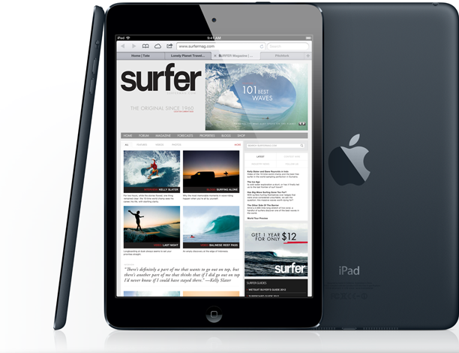
Ipad tips & secrets
Wednesday
4 September
Merenksy 2 library
Training room 1
7:30 – 9:00
Johann van Wyk
RSVP: Una Mgwenya

Slide 4
3rd Life Skills Workshop for Masters and Doctoral researchers in collaboration with Dr Madeleine Nolte Head: Student Support
5 September
Auditorium, Merensky 2 Library
8:00 - 13:00
Marié Theron

Slide 5
Heritage Day exhibition
9-28 September 2013
Merensky 2 Library
By Katrien Malan, Alett Nell, Una Mgwenya & Elsabe Olivier partnering with the National Cultural History Museum.

Slide 6
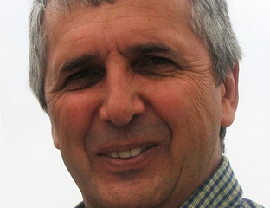
Die dagboek van Louis Tregardt as bron oor Afrikanerkultuur in die Groot Trek-era
Dr Jackie Grobler
17 September
Auditorium, Merensky 2 library
8:30-9:30
RSVP: Una Mgwenya

Slide 7
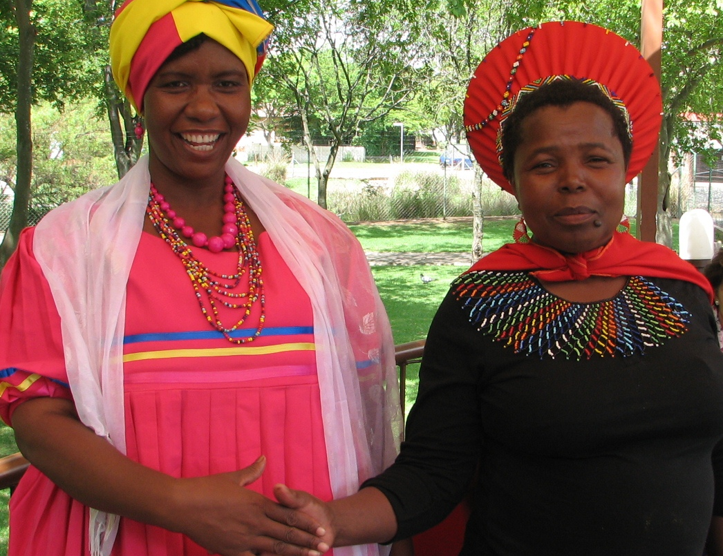
Traditional dress day
Friday
20 September
In celebration of Heritage Day you are invited to come to work in your traditional attire!
Photographs will be taken at 9:30 on level 3.

