Slide 1
A measure of prosumption behaviour in market-exchange activity
Dr. Amaleya Goneos-Malka
Dr. Arien Strasheim
Prof. Anské Grobler
05-12-2012
2012 Australian and New Zealand Marketing Academy Conference

Slide 2
Introduction
Web 2.0 platforms: proliferation, wide scale adoption impacts postmodern society
Escalation in prosumer behaviour (UGC, sharing data)
Prosumption through digitised social media affects how people interact with stakeholders
Embedded marketing is a postmodern marketing concept

Slide 3
Purpose of study
To develop an initial understanding of the determinants of prosumption behaviour with respect to Web 2.0 platforms
To conceptualise and develop a measure of prosumption behaviour with respect to Web 2.0 platforms
To improve understanding of the nature and complexity of the prosumption phenomenon

Slide 4
Definitions
Web 2.0 activities
Web 2.0 activities are orientated around data sharing, UGC, communication, communities and co-production (Fuchs, 2011)
Prosumption
Prosumption: interrelated process of production and consumption (Ritzer et al., 2012)
Embedded marketing constituents
Marketing as an embedded cultural practice, collaborative marketing, diffused marketing, complex marketing (Firat and Dholakia, 2006)

Slide 5
Background : Web 2.0 prosumption
Prosumption receiving attention as a result of changes in consumer behaviour triggered by technology, social and economic influences
Commemorating events and establishing collective memories online (Recuber, 2012);
Promulgating grassroots stories in response to media propaganda (Cheong & Lundry, 2012);
Non-remuneration of prosumer contributions is tantamount to exploitation (Rey, 2012);
Acknowledging bloggers’ efforts through social rather than monetary exchanges (Chia, 2012);
Integration of offline and online acts of prosumption (Woermann, 2012).
Prosumers outnumber marketers and are generating copious volumes of brand related content
Overlapping synergies of prosumption & embedded marketing highlight the importance of these concepts to marketing in postmodern society

Slide 6
Methodology
A new scale (22 items reducing to 16) was developed as a measure of prosumption behaviour in the context of Web 2.0 activities
Exploratory factor analysis and item analysis were used to identify factors
Convenience sample was used with 333 usable questionnaires
The total sample was randomly split into two samples, each with ± 166 students
The first sample was subjected to principal component exploratory factor analysis (EFA) to determine the dimensionality of prosumption behaviour
On the second sample, confirmatory factor analysis (CFA) was used to verify whether the factor structure that came out in the first analysis could be reasonably replicated in the holdout sample

Slide 7
Results
Table 1: EFA factors loadings¹ on prosumption behaviour factors | Critical assertiveness | Resourceful collaboration | Involved consumerism | Authentic representation
Q10 I would like to tell my brands how to improve their products | 0.870
Q9 If brands listen to me they will be able to give me what I expect from them | 0.797
Q11 I would like to feel part of my products’ development process | 0.771
Q13 I think my opinions about products/brands are important | 0.616
Q7 I specifically seek out brands that reflect who I am or who I want to be | 0.547 |  |  | 0.414
Q8 I like to participate in competitions to win things from my favourite brands | 0.528 |  | 0.463
Q19 I value other buyers’ reviews when I am interested in a product/brand |  | 0.826
Q18 I trust the opinions of members in my social network (off or online) |  | 0.820
Q20 I think user comments about products are more authentic than professional articles |  | 0.601 |  | 0.375
Q2 I prefer products and brands that are innovative | 0.372 | 0.496
Q16 When I am DISSATISFIED with brands I express this on blogs, social networks, forums, email, IM |  |  | 0.795
Q15 I chat about brands on blogs, social networks sites, forums, email, IM when I am HAPPY with them |  |  | 0.787
Q12 I tell my friends about my product/brand experiences |  |  | 0.561
Q4 Free-stuff, samples, promotions help me decide which brands to choose |  |  |  | 0.658
Q5 Brands need to have clear value propositions to catch my interest |  |  |  | 0.657
Q6 I prefer to use brands that I see as being authentic |  |  |  | 0.652
Cumulative % of variance explained | 37.8 | 48.6 | 56.6 | 62.8
¹Note that coefficients smaller than 0.35 are not shown

Slide 8
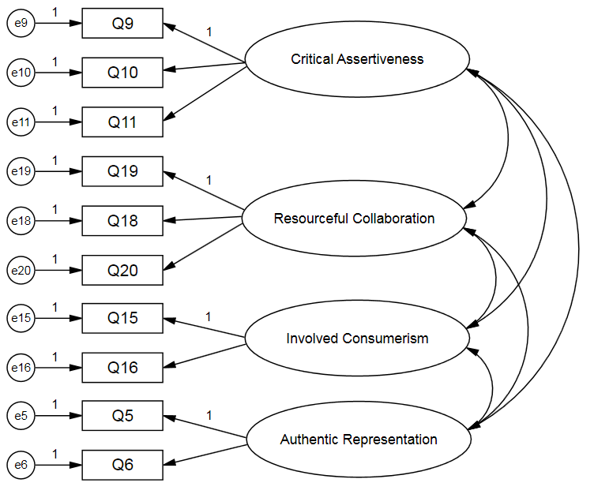
Results CFA analysis

Slide 9
Results and discussion
Table 2: Fit measures of the final CFA model
The conceptual measurement model for prosumption behaviour from this analysis is a ten item four factor model. This model provided an acceptable fit, with fit measures calculated for the first and the second holdout sample, and lastly for the entire sample.
Model | Criteria for good/acceptable fit¹ | Sample 1 (EFA) | Sample 2 (CFA) | Entire sample
Chi-Square |  | 42.7 | 40.2 | 45.7
Df |  | 29 | 29 | 29
Prob>Chi | >0.05 | 0.048 | 0.081 | 0.025
Chi-Square/Df | 3 / 5 | 1.474 | 1.386 | 1.577
IFI | 0.95 / 0.90 | 0.868 | 0.887 | 0.929
TLI | 0.95 / 0.90 | 0.977 | 0.983 | 0.986
RMSEA | 0.05 / 0.08 | 0.072 | 0.085 | 0.073
¹Hu & Bentler (1999)

Slide 10
Results and discussion
Table 3: Cronbach’s alpha and model implied means of latent variables
Critical assertiveness: like to be involved in the development and improvement of products they use
Resourceful collaboration: value experiences of others
Involved consumerism: ‘average’ behaviour of expressing satisfaction or dissatisfaction of brands in digital social media
Authentic representation: strong agreement for seeking authenticity from brands making up consideration set
 | Cronbach’s alpha (Entire sample) | Sample 1 | Sample 2 | Entire sample
Critical Assertiveness | 0.854 | 3.99 | 4.00 | 4.00
Resourceful Collaboration | 0.733 | 3.82 | 3.85 | 3.83
Involved Consumerism | 0.705 | 3.06 | 2.92 | 2.99
Authentic Representation | 0.711 | 4.12 | 4.17 | 4.14
* Correlations between latent variables ranged between 0.45 and 0.65, indicating that they do overlap, but also that they are each distinctive factors

Slide 11
Managerial Implications
The proposed measure of prosumption behaviour is brief and an initial step towards understanding this phenomenon better
Using this scale in a small student sample, confirmed findings from the literature. Respondents exhibit signs of prosumer behaviour and have positive attitude and behaviour towards embedded marketing practices
Respondents expressed the desire to contribute to the development of the brands they use. This insight supports the concept of embedded marketing, suggesting that marketers should initiate opportunities for consumers to participate in brand developments
Marketers should regard consumer generated content as a useful tool to monitor customer experiences and hence enhance the value of future customer experiences

Slide 12
Suggestions for future research
Purification of the initial prosumption measure: qualitative research
Refining the initial prosumption measure, perhaps through the application of C-OAR-SE procedure (Rossiter, 2002)
Analysing prosumption behaviour of Web 2.0 platforms confined to specific contexts, i.e. retail, entertainment, service contexts
Limitations in this study are that a student sample was involved, and therefore only included young consumers in a South African context
Further possible avenues with this work could include other attitudinal measures and outcome variables to study whether prosumption behaviour leads to increased brand loyalty and which of the behaviour types can be utilised by marketers

Slide 13
THANK YOU

