Slide 1

Cost to Clients to Access Financial Services
A Framework and Lessons from South Africa

Slide 2
Outline
A Framework for Analysing and Managing Cost to Clients to Access Financial Services
Conference September 2010
Managing Cost to Clients of Credit: Example of the National Credit Act, S.A.
Managing Cost to Clients of Deposits: Lessons from the SA Banking Industry
[Photos from Alexandra, Most dense township in S.A.]

Slide 3
Range of Financial Services
Transactions
Savings
Credit
Insurance
Range of Clients

Slide 4
Cost a Driver of Up-take
Taking up a service
Cost of the service

Slide 5
Mitigating Cost to Clients
Cost to Client Components
Cost to Client Determinants
Financial
Economic
Regulatory and Compliance
Social and Cultural
Psychological
Enabling Environment
Macro Level
Industry Context
Meso Level
Service Providers
- Micro Level

Slide 6
Components
Cost to Client Components
Financial
Interest, fees, transport, savings
Economic
Opportunity Costs: travelling, queuing, meeting,
Assymetric Info: qualifying criteria
Social and Cultural
Power Arrangements: women; stokvels, moneylenders; chiefs
Regulatory Compliance
KYC, Business Registrations
Psychological
Stress & Fear:
Bank branches
Default consequences

Slide 7
Determinants
Cost to Client Determinants
Industry Context
Meso Level
IT, Sources of Capital, Credit Bureaux
Enabling Environment
Macro Level
Political, Economic, Legislation, Other
Service Providers
Micro Level
Diversity of Providers,
Healthy Level of Competition

Slide 8
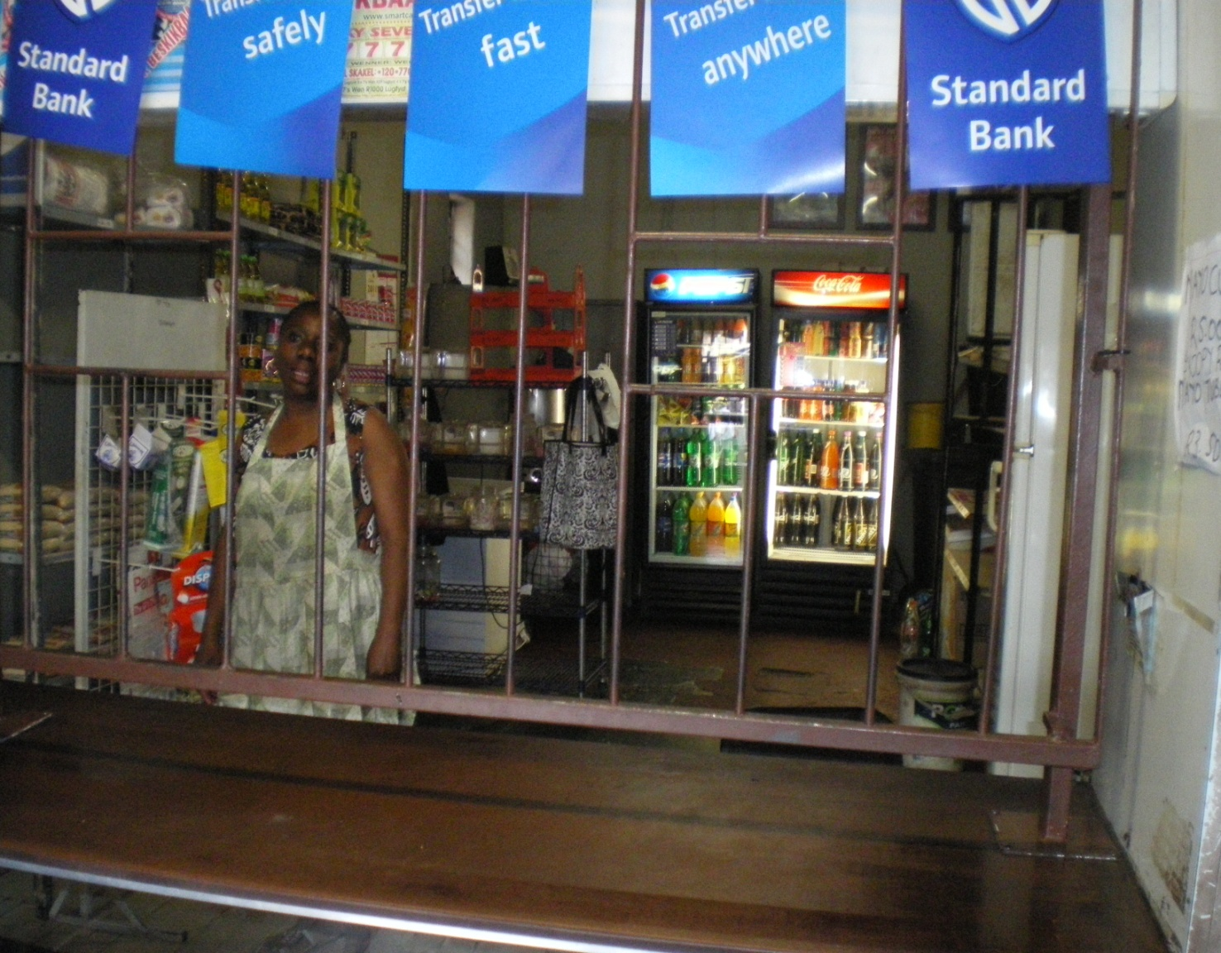

Slide 9
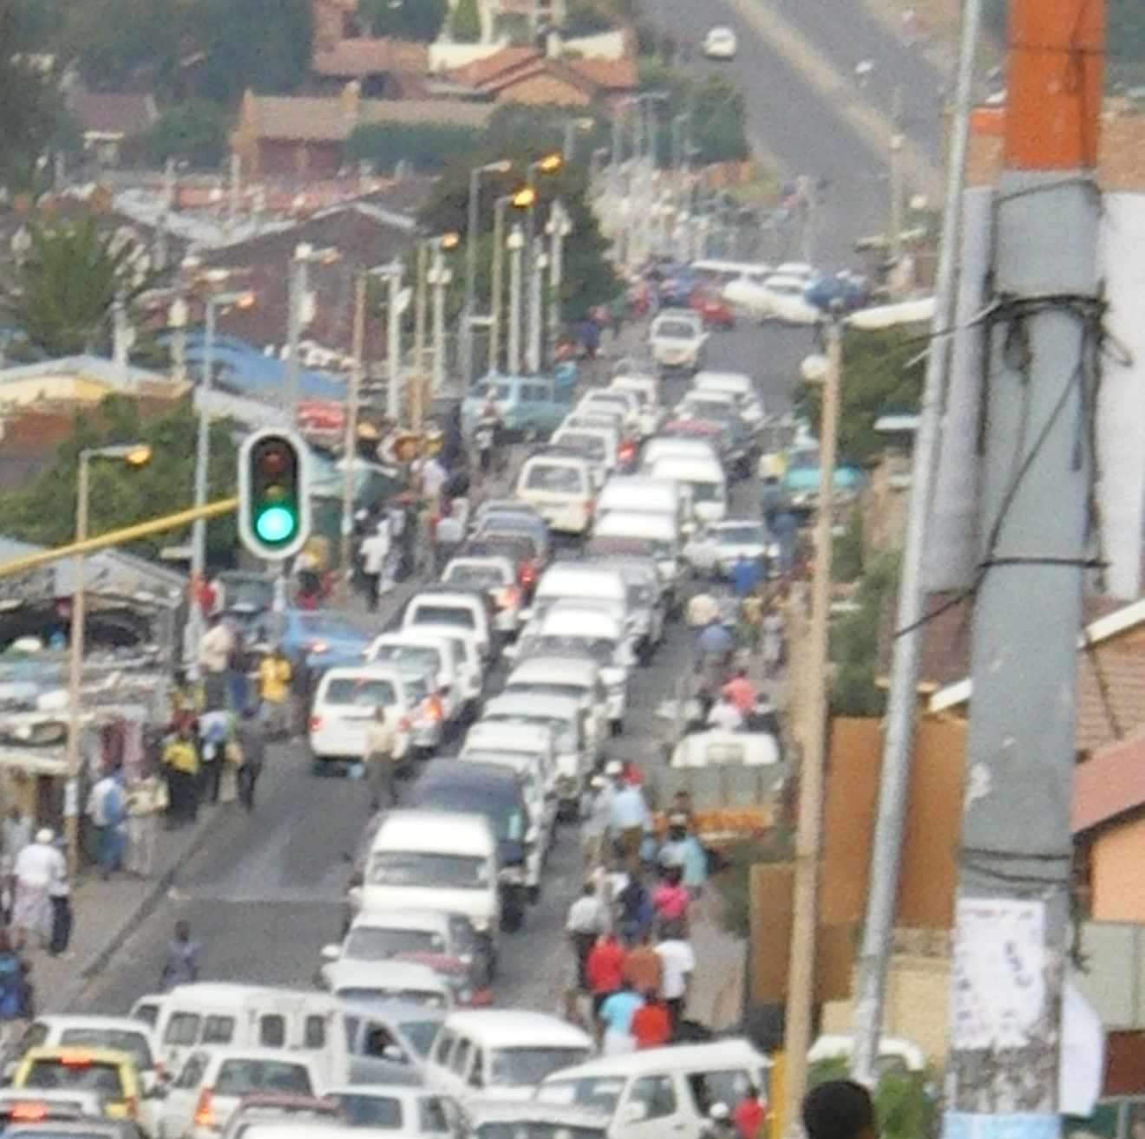

Slide 10
Enabling Environment - Legislation
Legislation - Deposit side
Financial institution legislation and regulations
Basel II & III and KYC
Legislation - Credit side
Consumer protection legislation*
Collateral environment
Credit bureau legislation

Slide 11
The National Credit Act,
No. 34 of 2005
Enacted in 2005; fully effective June 1, 2007
Established the National Credit Regulator
Purpose to:
Enhance social and economic welfare of South Africans
Promote a credit industry which is:
Fair, Transparent, Competitive, Sustainable , Responsible, Efficient, Effective, Accessible
A reaction to undesirable practices
Providing mechanisms for resolving over-indebtedness

Slide 12
The NCA, SA
Application of the Act – General
Institutions
All Credit Providers with 100+ disbursed loans or R500,000+ ($70,000) loan portfolio
Consumers
All natural entities (Consumers)
Juristic entities with turnover or net worth of less than R1 million ($140,000)
Primary Compliance Provisions
Chapter 4: Consumer Credit Policy
Chapter 5: Consumer Credit Agreements
Chapter 6: Collection, Repayment, Surrender, and Debt Enforcement

Slide 13
NCA Provisions Affecting Financial Costs
Maximum Rates and Fees
Category | Interest Rate | Initiation Fee
Unsecured Credit Transactions | (RR x 2.2) + 20% | R150 plus 10% of the amount in excess of R1,000,
Short term Credit Transactions (Up to R 8 000, term up to 6 m) | 5% per month | R150 plus 10% of the amount in excess of R1,000,
Developmental Credit for Small Business | (RR x 2.2) + 20% | R250 plus 10% of the amount in excess of R1,000,
Developmental Credit for low Income Housing | (RR x 2.2) + 20% | R500 plus 10% of the amount in excess of R1,000,

Slide 14
NCA Provisions Affecting Financial Costs
Maximum Rates and Fees
Annualized Percentage Rates for
Small Business Credit
 | 4 months | 9 months | 12 months
R 500 | 290% | 273% | 265%
R 4 000 | 120% | 90% | 82%
R 10 000 | 95% | 69% | 62%

Slide 15
NCA Provisions Affecting Financial Costs
Interest and fee disclosure– declining balance basis;
Interest calculated daily; full rebate of interest with any early settlement or pre-payment of an instalment
No fee or commission may be paid to an employer or trade union for facilitating a credit arrangement
Limits on statement fees
Default interest may not exceed the highest interest rate applicable to the principal debt.

Slide 16
NCA Provisions Affecting Economic Costs
Regulation of Credit Bureau Sector
All entities selling credit information must be registered as a credit bureau
Allowable consumer credit information:
Identity; education and employment history; credit history; financial history

Slide 17
NCA Provisions Affecting Economic Costs
Reckless Lending Provisions
A contract is considered reckless if :
The CP failed to conduct an adequate assessment, or
The CP conducted an assessment and entered into an agreement which would push the consumer into an over-indebted position.
Four items identified for an adequate assessment:
The consumer’s understanding of the risks and costs of the credit agreement
The debt repayment history of the consumer
Existing financial means, prospects, and obligations
Expected level of success of any commercial purpose

Slide 18
NCA Provisions Affecting Psychological Costs
If the reason for a decline is a credit bureau report, the CP must provide the contact particulars of that credit bureau.
Contracts must be written in plain & understandable language
Agents may not visit individuals at their home or place of work unless previously arranged with the consumer.
CP must give consumers 20 days notice before negative information is reported to a credit bureau; consumer has a right to receive a copy of the information.

Slide 19
NCA Provisions Affecting Psychological Costs
Once in default, the CP must notify the consumer and
agree on a plan to bring the payments up to date, or
Propose that the consumer refer the agreement to a debt counsellor or dispute resolution agent.
No legal action may be taken prior to notifying the customer.

Slide 20


Slide 21


Slide 22
Enabling Environment - Other
Government Policy
Willingness to support the sector
Knowledgeable in inclusive banking
“Moralsuasion” with commercial banks *
Apex Organizations
Wholesale capital
Capacity building and other support
DFIs
Fill Gaps left by private sector
Do not crowd out the private sector

Slide 23
SA Financial Sector Charter
Banking Sector led the way with a Financial Sector Charter, 2004 – 2014
Scorecard in Six areas; one was Access to Financial Services for low income market
Primary initiative: introduction of the Mzansi Savings Account
Participants: four big commercial banks and the post bank

Slide 24
SA Mzansi Account
KYC exemptions if transaction levels < R25 000 monthly and < R5 000 daily.
Launched October 2004
6 million accounts opened by 2008 (with adult pop’n of 32 million)
Features: debit card; no monthly fee; same pricing for own and other ATM; low fees for initial transactions
Most popular among FSM 3 to 6

Slide 25
 | 2005 | 2008 | 2009
Banked (Millions) | 14.3 | 20.0 | 19.6
Banked | 46.6% | 62.7% | 59.8%
Previously banked | 12.3% | 7.5% | 8.9%
Never banked | 41.1% | 29.8% | 31.2%
Source: FinScope data

Slide 26
FSM Segment | Banked 2006 | Banked 2009
1 | 1.5% | 1.6%
2 | 5.9% | 11.7%
3 | 35.2% | 44.6%
4 | 83.3% | 84.1%
5 | 96.9% | 98.3%
6 | 100% | 100%
7 | 100% | 100%
8 | 100% | 100%

Slide 27
New Entry Level Bank Accounts Comparison of Fees
Monthly Transaction Assumptions
Mid-Level Microenterprise Owner
Cash deposits of R1000 each - 3
Cash withdrawals of up to R500 each - 3
POS purchases of up to R500 each – 3
Cellphone payment of R500 - 1
Balance enquiries – 3
Statement – 1
Airtime purchases - 2

Slide 28
 | Monthly Fee Rands | Share of R2500 monthly income
ABSA Pre-paid Debit Card | 73.50 | 2.94%
ABSA Flexi-account | 91.45 | 3.66%
FNB Mzansi | 41.50 | 1.66%
FNB Smart | 64.00 | 2.56%
Nedbank Mzansi | 42.60 | 1.70%
Nedbank Transactor plus | 73.15 | 2.93%
Standard Mzansi | 63.15 | 2.53%
Standard e-plan | 87.95 | 3.52%

Slide 29
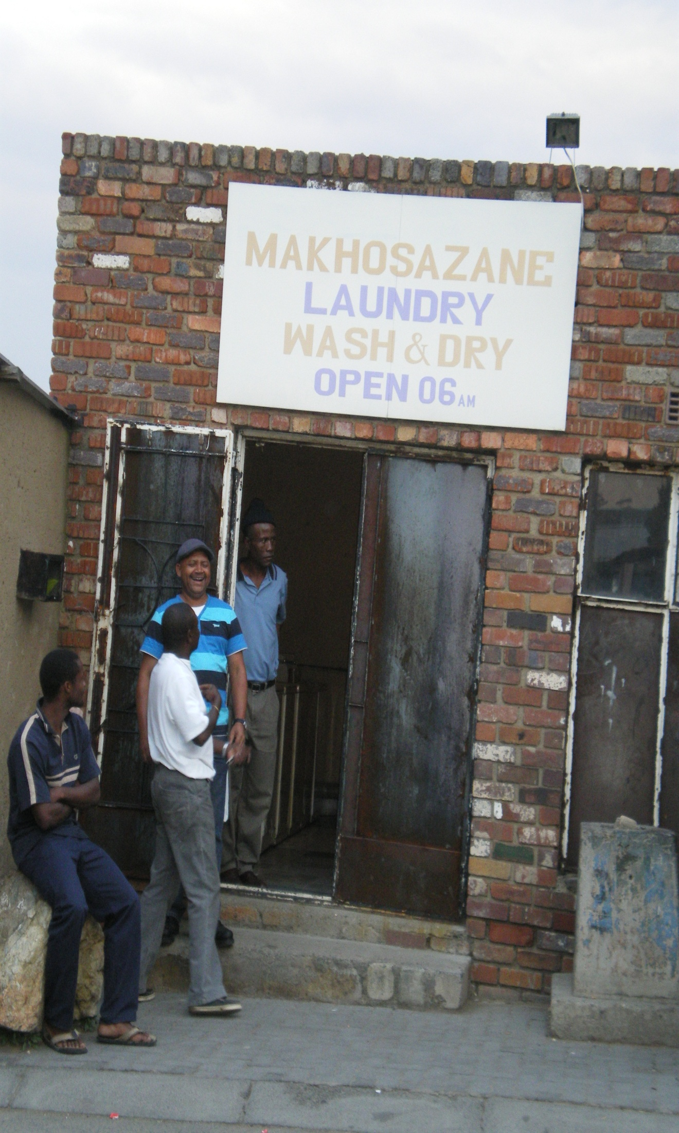

Slide 30
In Conclusion
In assessing cost to clients, there are many components other than rates and fees
It is in the interest of service providers to manage all determinants of cost, even if this requires collaboration with policy makers and competitors
There is an important role for government in establishing an environment which will lower the costs to access financial services
THANK YOU!

