Slide 1

Department of African Languages
Kgoro ya maleme a Bathobaso
2021

Slide 2
Which languages are on offer?
Ndebele: for home language speakers only
Sepedi (Northern Sotho), Tswana and Zulu for:
  Home language speakers; first additional language learners
  Absolute beginners

Slide 3
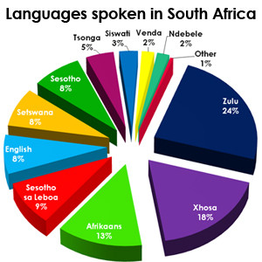
Which language should I take?
Home language distribution by %

Slide 4
To be considered …
Consider the following:
  23% of South Africans speak Zulu as home language, but
  Languages are regionally based:
    Ndebele: Mpumalanga, Gauteng
    Sepedi: Limpopo, Gauteng
    Tswana: Northwest, Gauteng (and Botswana)
    Zulu: KZN, Mpumalanga, Gauteng
  Some African languages are mutually understandable, e.g. Sepedi and Tswana, Zulu and Ndebele

Slide 5
Which language is the easiest to learn?
They are all equally difficult, but fun to learn!

Slide 6
As a beginner learner, what will I be able to do after:
one semester?
  You will have basic communication skills, e.g. greeting, asking and answering simple questions in different tenses, using adjectives, giving instructions
two semesters?
  You will have all of the above PLUS basic reading skills, using more sophisticated grammatical structures in both written and spoken communication

Slide 7
My home language is an African language. Why should I bother?
Having an African language as home language does not mean that you have nothing more to learn about your language!
In-depth study of literature and linguistics

Slide 8
What are the relevant module codes for the first semester?
For beginner learners: SEP 110 (Sepedi / Northern Sotho), ZUL 110 (Zulu), STW 110 (Tswana)
For first language speakers: SEP 111, ZUL 111, STW 111 and NDE 110

Slide 9
For further information
Visit the department in Humanities Building, level 9
Visit our web page: https://www.up.ac.za/african-languages
Send an e-mail to penelope.mdluli@up.ac.za or to Prof Elsabé Taljard elsabe.taljard@up.ac.za

Slide 10
Ke a leboga!
Ngiyabonga!
Thank you!
Baie dankie!

