Slide 1
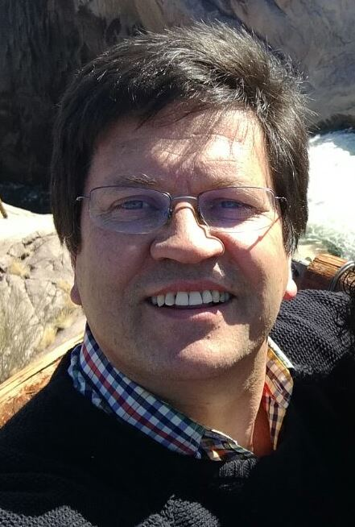
Department of Ancient and Modern languages and cultures Koos Kritzinger

Slide 2
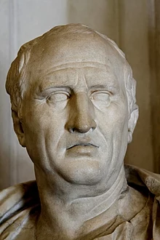
Salvete Amici – Greetings Friends! This is how Marcus Cicero would have greeted and welcomed you.

Slide 3
Latin is a classical language - the language which Cicero, Vergil, Julius Caesar, Horace and Ovid used when they wrote their masterpieces.
VENI
I came
VIDI
I saw
VICI
I conquered

Slide 4
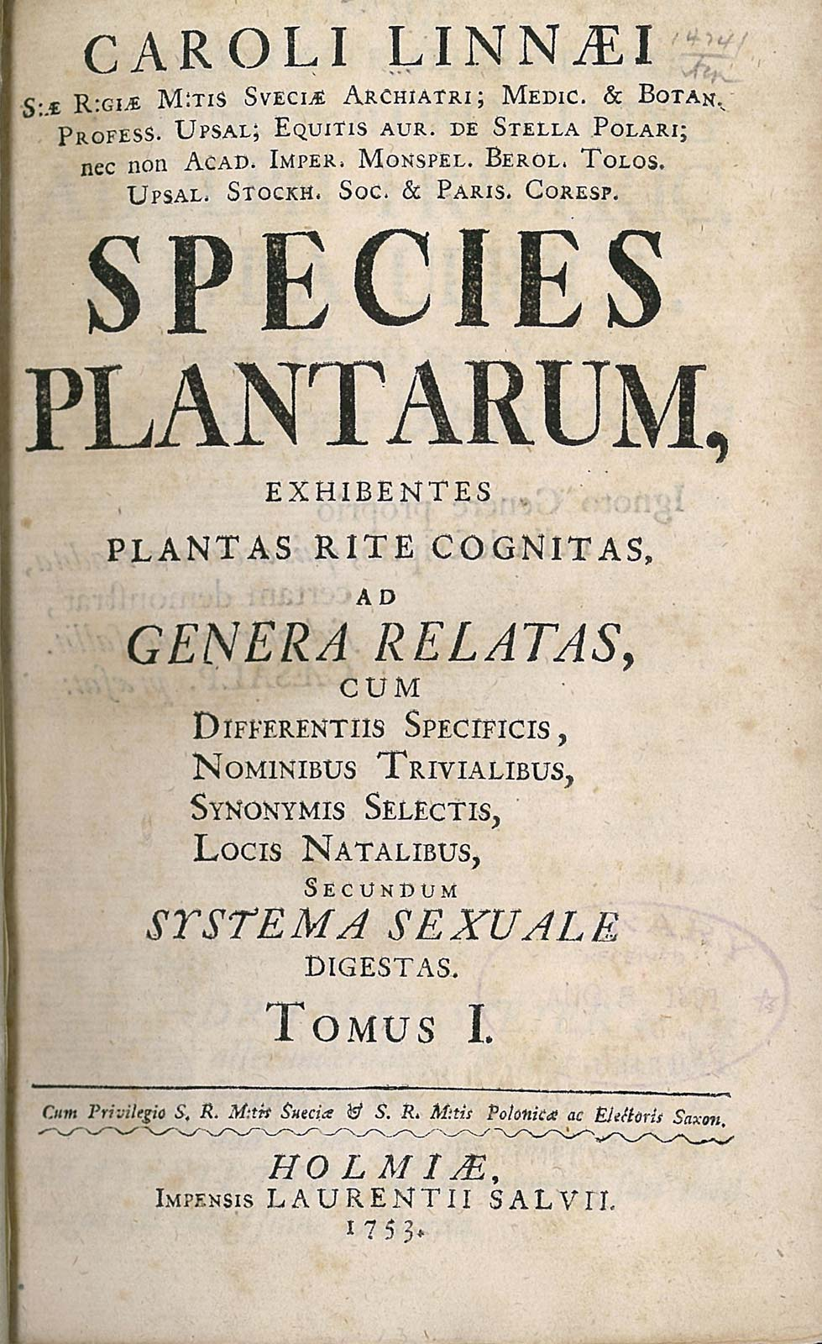
Latin played a very important role in the formation of scientific vocabularies, not only of Law, but also of Medicine, Biology, Theology, et cetera. It was the language of scholarship and it established a scientific language which is still used today.

Slide 5
The words university, faculty, humanities, professor, doctor, lecturer, student, library and campus all derive from Latin
LINGUA
LATINA
VIVIT
The Latin
language is
alive

Slide 6
Words like philosophy and psychology derive from Greek. Others are hybrid forms, having Greek and Latin stems, like sociology, criminology and political science.
PHILOSOPHY
Love of wisdom
PSYCHOLOGY
Study of the soul
SOCIOLOGY
Study of society
CRIMINOLOGY
Study of crimes

Slide 7
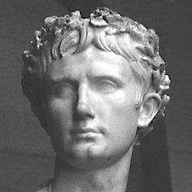
Study of ancient languages and cultures offers inter alia:

Slide 8
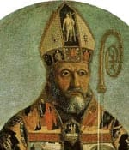
• critical reading and writing skills: indispensable for professionals, language and law practitioners, politicians, preachers and professors;

Slide 9
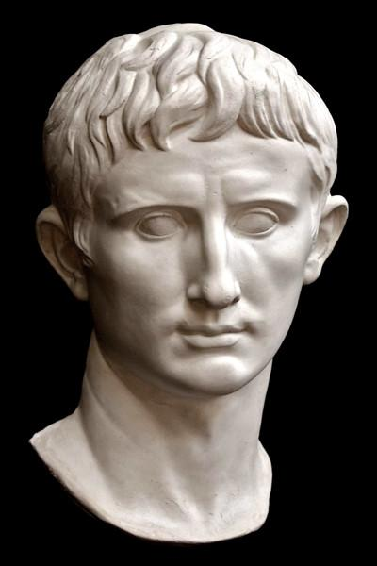
• insight in the grammar and syntax of ancient and modern languages,
which provides an excellent basis for learning other foreign languages; especially French, Spanish, Portuguese and Italian

Slide 10
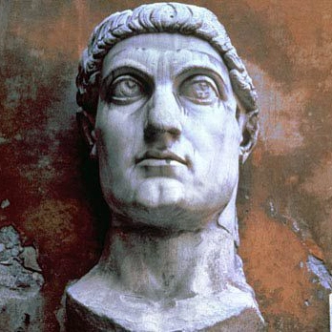
• an introduction to the literature, religion, mythology, art, daily life
and other cultural aspects of the different ancient peoples who lived in the Mediterranean world.

Slide 11
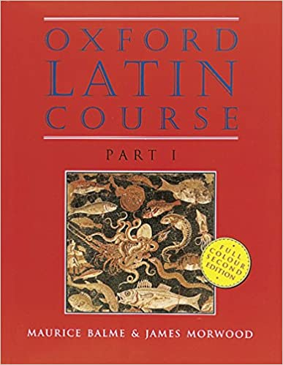
In the first year (LAT 110 and 120) we do the basic Latin grammar.
We use the Oxford Latin Course and we learn Latin by reading Latin.
Socio-historical background, which introduces you to the world of the Ancient Romans

Slide 12
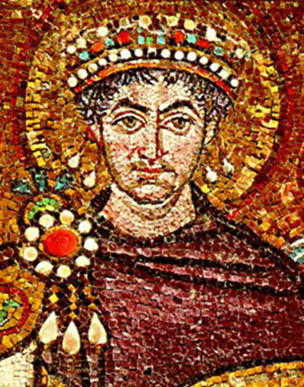
Example of word building:
caedo, caedere caesi caesum
cut, kill (word root: cid-)
Homicide (homo sapiens)
Suicide (sui generis)
Patricide (patrimony)
Matricide (matrix, matriarchy)
Fratricide (fraternity)
Infanticide (infancy)
Cf. also insecticide; fungicide, germicide, tyrannicide.

Slide 13
Latin is for students who want to do something extra to equip themselves better for their professional career.
Small groups ensure that you’ll receive individual attention.

Slide 14
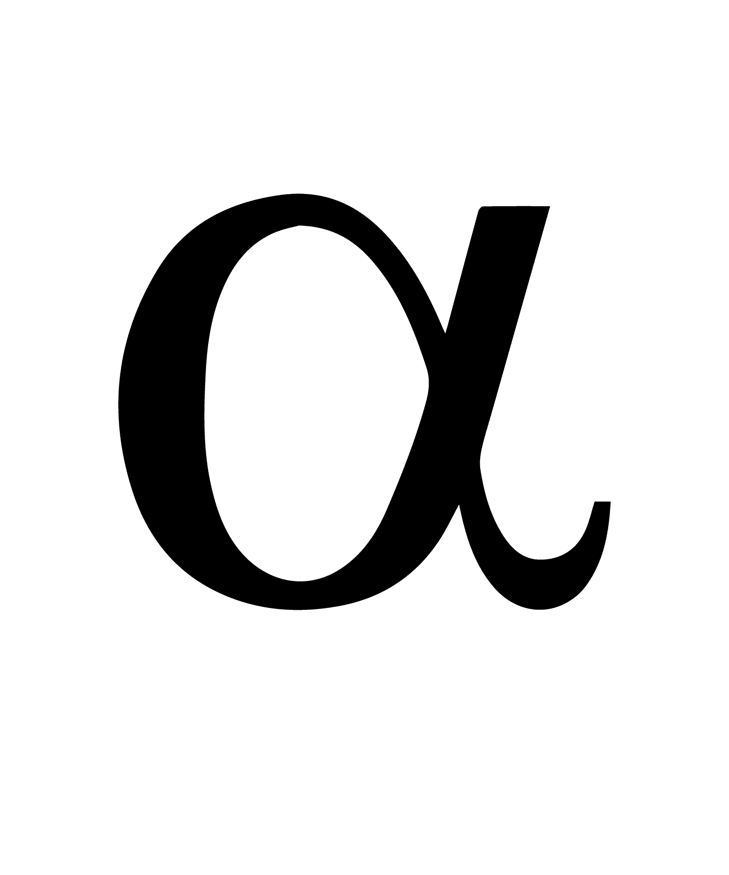
MODULE CODES AKG 110/120 - ANCIENT CULTURE STUDIES HEB 110/120 - HEBREW GRK 110/120 - GREEK LAT 110/120 - LATIN MTL 180 - MEDICAL TERMINOLOGY For more information please contact me at koos.kritzinger@up.ac.za

Slide 15
FINIS THE END GRATIAS MAXIMAS THANK YOU VERY MUCH
F
I
N
I
S

