Slide 1
Tax policies in pursuit of human rights
ESTRELLA DEL VALLE CALZADA
Lecturer and postdoctoral researcher
Public International Law Department – Human Rights Institute
University of Valencia

Slide 2
Fundación Alternativas Link to the report

Slide 3
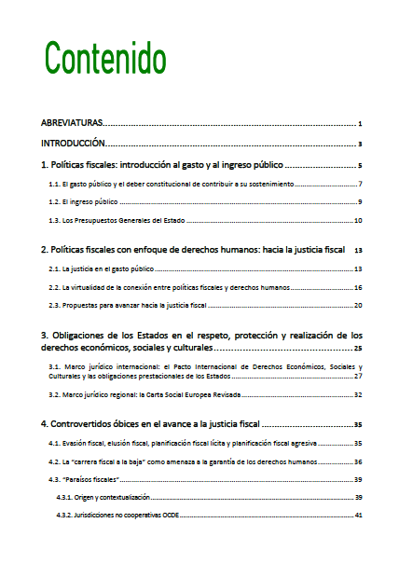
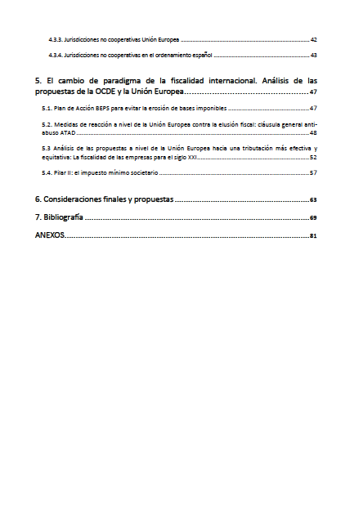

Slide 4
INDEX OF THE REPORT
Fiscal policies: introduction to government expenditure and revenue Fiscal policies with a human rights approach: towards tax justice Obligations of States in respecting, protecting and fulfilling economic, social and cultural rights Controversial obstacles in the advance of tax justice The paradigm shift in international taxation Final considerations and proposals

Slide 5
Main objective….
Establishing the foundations for the necessary connection between tax policies and human rights…
TAX JUSTICE

Slide 6
ANALYSIS OF THE MAIN INSTITUTES OF FISCAL POLICIES
PUBLIC EXPENDITURE
PUBLIC INCOME
INSTRUMENTALITY OF INCOME RELATIVE TO EXPENDITURE

Slide 7
LEGAL FRAMEWORK
To frame the relationship between fiscal policies and human rights in a prevailing legal framework….
National
Spain: Spanish Constitution
South Africa:
Regional
Spain: European Social Charted (Revised)
South Africa: African Charter on Human and Peoples’ Rights + Protocol on the Rights on Women + Protocol on the Rights and Welfare of the Child
International
International Covenant on Economic, Social and Cultural Rights (ICESCR)

Slide 8
Welfare rights: legal enforceability regime...?
It is now uncontested that economic, social and cultural rights are fully effective and legally enforceable.
Existence of a legal obligation of States to adopt sufficient and concrete positive measures towards the progressive realisation of rights.
NEED TO MOBILISE PUBLIC RESOURCES – RELATION BETWEEN PUBLIC EXPENDITURE AND REVENUE = FISCAL POLICIES ORIENTATION

Slide 9
ICESCR. Article 2.1
1. Each State Party to the present Covenant undertakes to take steps, individually and through international assistance and co-operation, especially economic and technical, to the maximum of its available resources, with a view to achieving progressively the full realization of the rights recognized in the present Covenant by all appropriate means, including particularly the adoption of legislative measures.
COMMITTEE ON ECONOMIC, SOCIAL AND CULTURAL RIGHTS (CESCR)
GENERAL COMMENT - No. 3: The nature of States parties obligations (Art. 2, par. 1)
2. (…) Thus while the full realization of the relevant rights may be achieved progressively, steps towards that goal must be taken within a reasonably short time after the Covenant’s entry into force for the States concerned. Such steps should be deliberate, concrete and targeted as clearly as possible towards meeting the obligations recognized in the Covenant.
+ OPTIONAL PROTOCOL TO THE INTERNATIONAL COVENANT ON ECONOMIC, SOCIAL AND CULTURAL RIGHTS (OP-ICESCR) - into force: 2013 (ratifications?)
► ENFORCEMENT MECHANISMS

Slide 10
"Taxation policies are human rights policies” (De Schutter, 2017)
“It cannot be said, however, that current policies in the human rights area have come anywhere near recognizing the fact that tax policy is, in many respects, human rights policy” (Alston, 2015, A/HRC/29/31, par. 53).
“Re-legitimising the Fiscal State through the Realisation of Human Rights” (Waris, 2013)

Slide 11
THE REFLECTION OF THE DOCTRINAL DEBATE IN INSTITUTIONAL PRONOUNCEMENTS
A FEW EXAMPLES…
- Committee on Economic, Social and Cultural Rights. Concluding observations on the sixth periodic report of the United Kingdom of Great Britain and Northern Ireland. E/C.12/GBR/CO/6.
“17. The Committee recommends that the State party:
(a) Conduct a human rights impact assessment, with broad public participation, of the recent changes introduced to its fiscal policy, including an analysis of the distributional consequences and the tax burden of different income sectors and marginalized and disadvantaged groups;
(b) Ensure that its fiscal policy is adequate, progressive and socially equitable and improves tax collection so as to increase resources available for implementing economic, social and cultural rights;
(c) Take strict measures to tackle tax abuse, in particular by corporations and high-net-worth individuals;”.
Inter-American Commission on Human Rights. “Informe sobre pobreza y derechos humanos en las Américas”. OEA/Ser.L/V/II.164 Doc. 147.
502. "Human rights principles provide a framework that underpins the key functions of fiscal policy and taxation." In order to achieve a fiscal policy with a human rights approach, the following principles were considered particularly relevant:
"ensuring minimum essential levels; mobilization of the maximum available resources for the progressive realization of ESCR; progressive realization and non-regressivity of these rights; and the principle of equality and non-discrimination".

Slide 12
THE REFLECTION OF THE DOCTRINAL DEBATE IN INSTITUTIONAL PRONOUNCEMENTS
“Independent Expert on the effects of foreign debt and other related international financial obligations of States on the full enjoyment of all human rights, particularly economic, social and cultural rights”.Current mandate holder: Professor Attiya Waris. Evolution of its nomenclature:
2005-2008: “Independent Expert on the effects of economic reform policies and foreign debt on the full enjoyment of all human rights, particularly economic, social and cultural rights”;
2000-2005: “Independent Expert on the effects of structural adjustment policies and foreign debt on the full enjoyment of all human rights, particularly economic, social and cultural rights”;
1997-2000: “Independent Expert on structural adjustment policies

Slide 13
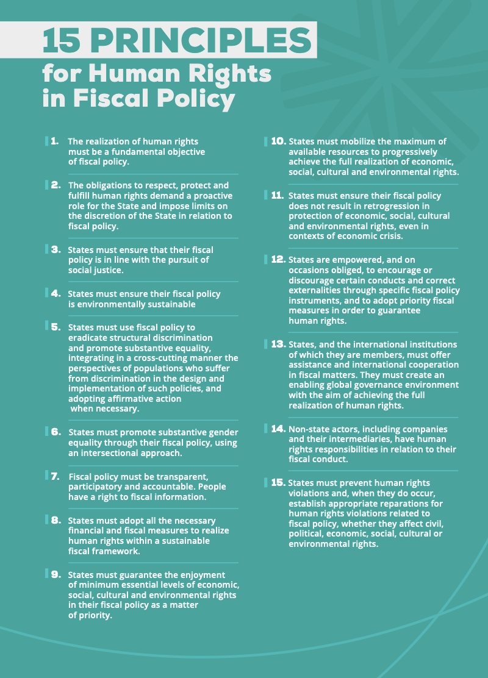
DEVELOPMENTS AND PROPOSALS

Slide 14
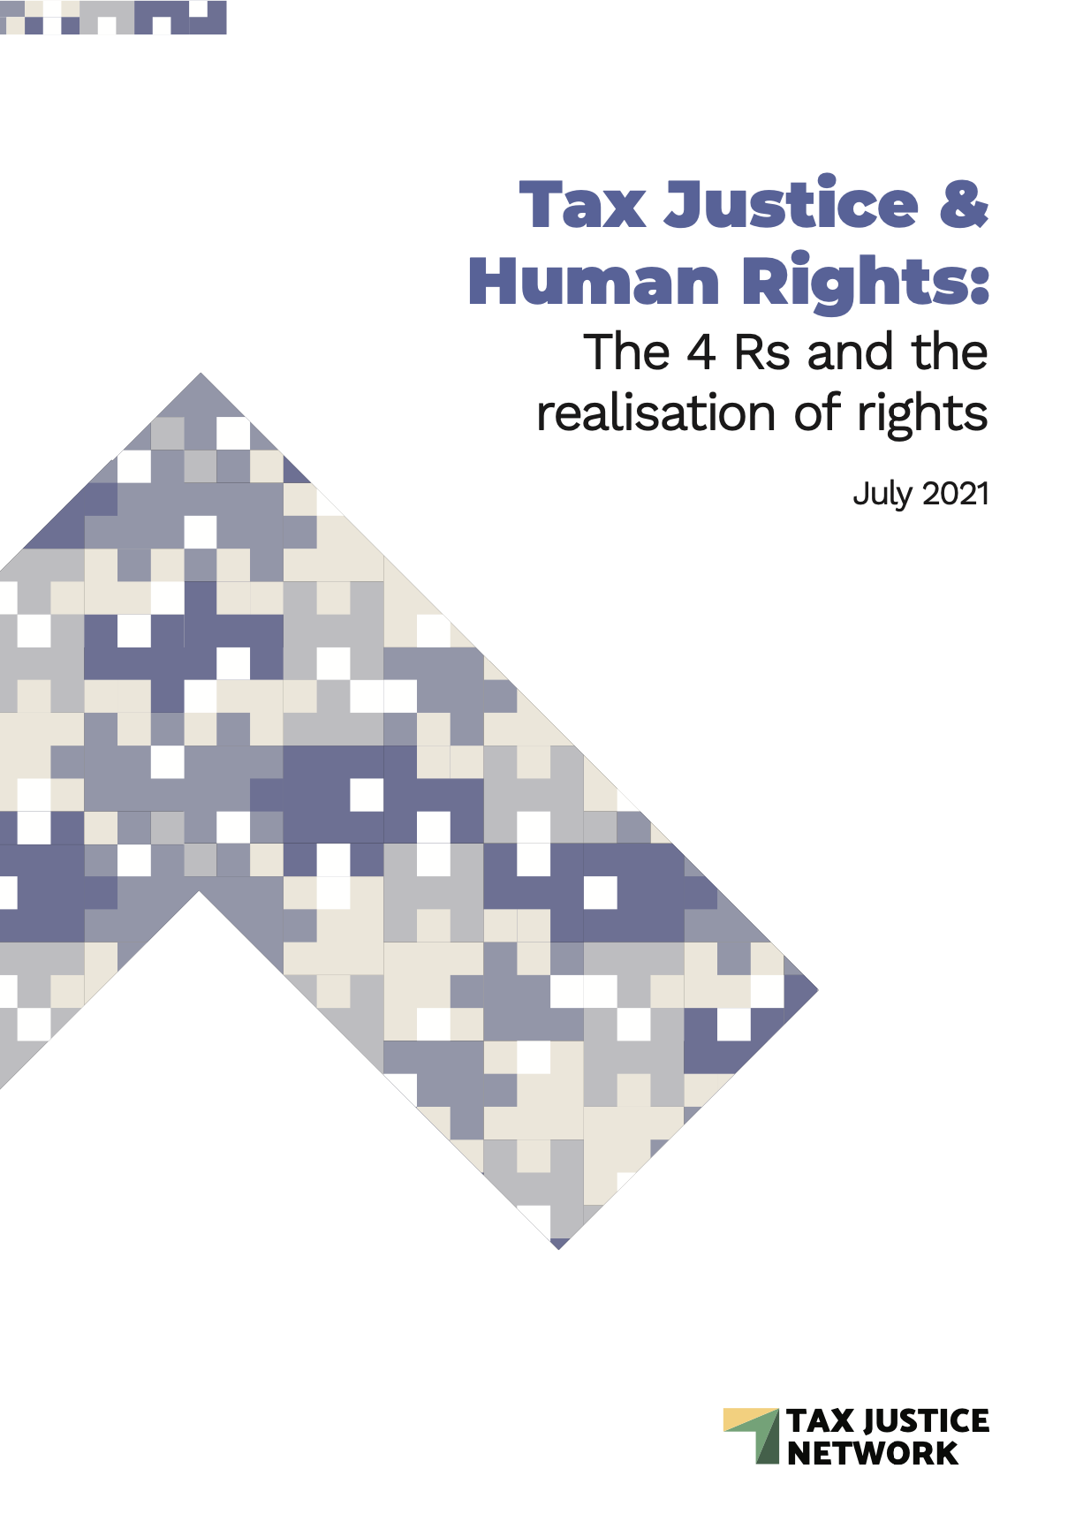
DEVELOPMENTS AND PROPOSALS
REVENUE
REDISTRIBUTION
REPRICING
REPRESENTATION

Slide 15
Considering the challenges of international taxation and the controversial obstacles in moving towards tax justice....
Recovery of a forgotten (but imperative) relationship between fiscal policies and human rights
Relationship within a binding legal framework - tax policies are not solely a discretionary and political decision of States
... Drafting of international guiding principles to guide States in the interpretation of their legal obligations in this area (Special Rapporteurs, Human Rights Council, UN General Assembly).
Following the example of the Guiding Principles on Business and Human Rights or the Guiding Principles on Foreign Debt and Human Rights

Slide 16
Thank you for your kind attention! Estrella del Valle Calzada estrella.valle@uv.es

