Slide 1
Achieving distributive tax justice through nudging

Slide 2
Structure of the presentation
Background
Research problem
Purpose of the study
Methodology
Results
Implications
Research Contribution
Notes:
Before we get into the details, I would like to outline the structure of my presentation. Firstly I will take you through the background of the study, this will be followed by the research problem, I will also outline the purpose of this study, followed by the hypotheses tested and the methodology adopted, I will then present the results of the study, the implications of the findings, lastly the limitations and contribution of this study.

Slide 3
Background
The role of the tax system in achieving distributive justice
equitable distribution of the tax burden
equitable enjoyment of resources
Various factors that can have an influence on perceptions, these factors include providing information to people.
Nudging
Nudging to encourage tax compliance behaviour
Notes:
Taxes are collected by tax revenue authorities from corporate entities and individual taxpayers in accordance with the tax regulations of a country. In most countries a progressive tax system is implemented for individual taxpayers, this is a system in which the tax rate increases as taxable income increases. This is done in order to achieve an equitable distribution of the tax burden. The collected tax revenue is then utilised by government to provide all citizens with public goods and services in order to achieve an equitable enjoyment of resources.
Taxpayers who perceive a tax system as fair and those who perceive that there is justice in the fiscal exchange relationship between government and taxpayers, are more likely to be tax compliant (Farrar et al., 2021; Kim, 2002; Saad, 2011).
In the context of tax compliance, nudge messaging has been increasing utilised by tax authorities and governments in order to influence tax compliance behaviour. There has also been an increase in research conducted on the influence of nudge messages on tax compliance behaviour.

Slide 4
Research problem
Very limited number of these studies have been conducted in developing countries;
No known study has examined how the effectiveness of these nudge messages may be affected by taxpayers’ perception of fairness;
Notes:
Results from studies examining the impact of reciprocity (fiscal exchange), social norm and deterrence nudges on tax compliance are mixed and there are limited studies that examined how the effectiveness of these nudge messages may be affected by taxpayers’ perception of fairness. This study focusses specifically on the effect these nudge messages to improve voluntary tax compliance as step towards distributive justice. The study also investigates whether taxpayers’ perception of fairness has an impact on the effectiveness of such nudges.
The reciprocity and social norm messages affect perceptions around fairness, with the reciprocity messages aimed to influence perceived exchange fairness and the social norm message aimed to influence perceived horizontal fairness.

Slide 5
Research questions
What is the effect of nudge messages on tax compliance behaviour of taxpayers?
Does the effectiveness of the nudge messages differ based on the type of nudge message communicated?
Does the effectiveness of nudge messages differ based on perception of fairness?

Slide 6
Hypotheses
H₁:There is an association between reciprocity nudge messages and tax compliance behaviour
H₂: There is an association between social norm nudge messages and tax compliance behaviour
H₃: There is an association between deterrence nudge messages and tax compliance behaviour

Slide 7
Hypotheses
H₄: Individuals with a high perception of fairness will be more compliant than those with a lower perception of fairness
H₅: Individuals with a high perception of corruption will be less compliant than those with a lower perception of corruption
H₆: Individuals with a positive attitude towards will be more compliant than those with a less positive attitude

Slide 8
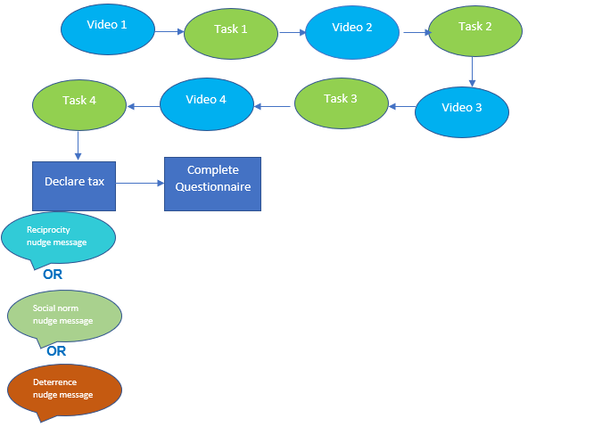
Methodology
Online experiment (206 small business owners)
Experiment: Treatment groups
Notes:
This diagram shows the steps followed by participants in treatment group

Slide 9
Experiment: Messages
“If you decide to declare less than what you have earned, you risk being caught. In this case (only if you are caught) you have to pay tax on the undeclared amount plus a penalty of 75 per cent of the undeclared amount.”
“ Most participants who took part in this experiment correctly declared all their total income.”
“You should further know that the tax amount from your declared total income will be distributed in equal shares among all participants.”

Slide 10
Results

Slide 11
Results
Notes:
Other: Accounting assembly Automotive Beauty Industry Catering Clothing and apparel Communication science Communications Customs Education Entertainment Fashion and style finance FINANCE Finance and accounting Fmcg Food Food and beverage Gift packaging Health Health care Healthcare Hospitality Information technology Information Technology Law Mining Restaurants Science (Research and Development) Supplier of a Variety of Goods and Services Technology

Slide 12
Results
Higher rate of tax compliance in two of the treatment groups compared to control group
Reciprocity message found to be less effective (tax compliance rate 10% lower than control group)
Social norm message had the highest rate of tax compliance (10% higher compared to control group)

Slide 13
Results
Perceptions of fairness, corruption & attitude towards tax
Negative fairness perception
Positive attitude towards tax
High perception of corruption

Slide 14
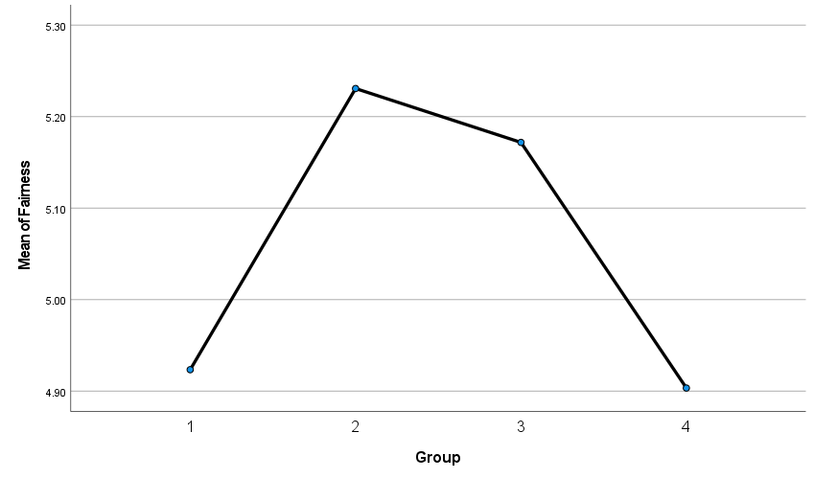
Results
Perceptions of fairness
Notes:
1= control group
2= deterrence
3= social norm
4=reciprocity

Slide 15
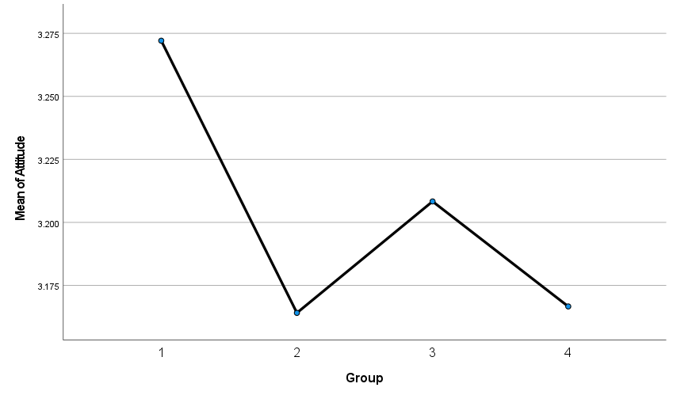
Results
Attitude towards tax
Notes:
1= control group
2= deterrence
3= social norm
4=reciprocity

Slide 16
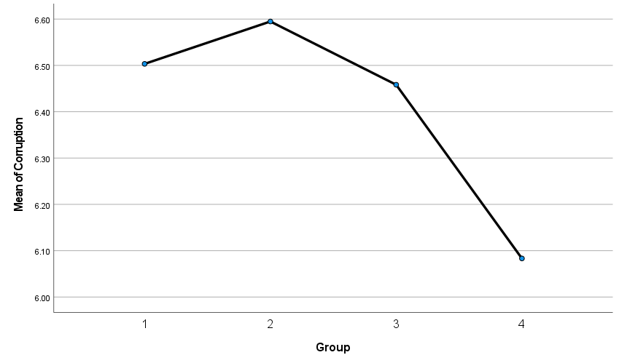
Results
Perception of corruption
Notes:
1= control group
2= deterrence
3= social norm
4=reciprocity

Slide 17
Implications
Nudge messages might have different effect on different taxpayers
Designers of tax nudge messages should pay attention to the target audience

Slide 18
Contribution
Highlights the importance of targeted nudging
Extends knowledge on nudging in developing countries

Slide 19
Thank you!!

