Slide 1
Anculien Schoeman
anculien.schoeman@up.ac.za
2 August 2023
Notes:
Good day
I am Anculien Schoeman, a lecturer and researcher in the Department of Taxation at the University of Pretoria, South Africa.

Slide 2
Supplier acceptance of and engagement in a national tax lottery to enhance domestic revenue mobilisation
Notes:
Today I want to share with you an exciting project I am currently busy with and thus, it is still a work in progress. It is about a Tax lottery system for South Africa to improve tax compliance and tax revenue collection

Slide 3
Overview of Presentation
1
Background & theoretical framework
Research methodology & data analysis
2
Results
3
Conclusion
4
Tax lottery system – 2 Aug 2023

Slide 4
Background
Tax lottery system – 2 Aug 2023
Notes:
A cracked cell phone screen… yes! This is basically the motivation of this whole study.
It happened twice that I had to have my cell phone screen repaired, and encountered large frustration with the fact that I had to go through quite some effort to withdraw cash as they would not accept card payment, and also supposedly had a warrantee on my new battery. Yet, I did not receive a receipt guaranteeing this warrantee.
Furthermore, I could only presume that they are not declaring this sale to the revenue authority, and thus not contributing their fair share to the community.
That makes me wonder if you have ever purchased something and was forced to pay cash, and not been issued with a receipt? Any one?

Slide 5
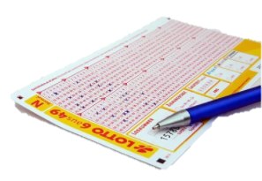
Background
>20 countries implemented a tax lottery system
Receipt please!
Limited empirical studies
Mainly VAT
EU / USA
Increase tax compliance = increased revenue collection
Tax lottery system – 2 Aug 2023
Notes:
There are various ways in which this could be done, such as levying interest and penalties, known as a stick approach.
However, there is also the carrot approach. For example, more than 20 countries implemented a tax lottery system in an attempt to improve tax compliance
The focus of this incentive is not on the supplier or business; rather, its success lies in the acceptance of the consumer: the idea is to incentivise customers to demand receipts for their purchases from suppliers, creating an audit trail – especially for cash sales for which no other audit trail exists – to ensure that suppliers do not underreport sales (Fabbri & Hemels, 2013). The customer then enters their receipt into a tax lottery, where prizes are awarded on a regular basis. Revenue authorities in turn benefit not only from an increase in tax revenue collection, but also save on auditing costs since shoppers now act as the auditors, in part
Not many empirical studies have been done on Tax lottery systems, and certainly none has been done in South Africa, or even in Africa as a continent.

Slide 6
…Results – Objective 1: consumer acceptance
I would be happy to participate in a well-managed tax lottery system:
2 774
76.6%
Tax lottery system – 2 Aug 2023
Notes:
76.6% were somewhat happy or extremely happy to participate in a well-managed tax lottery system

Slide 7
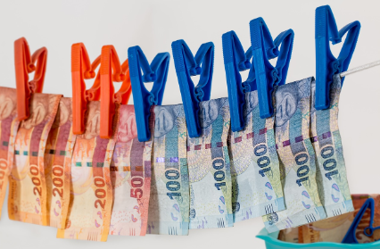
Background
“South Africa is running out of money, and time to address its financial woes” (Jacobs, 2021:1)
Non-compliant tax behaviour
Risk: SME
43% of the Tax Gap
Tax lottery system – 2 Aug 2023
Notes:
The most significant obstacle that governments face when collecting tax revenue is tax non-compliance or tax evasion from taxpayers
Unable to provide essential public goods & services and need to borrow money from other countries, which becomes costly.
Small and medium-sized enterprises (SMEs), especially owner-managed businesses, are more likely to commit non-compliance behaviour than any other group of taxpayers
In particular, “Her Majesty’s Revenue and Customs” report from 2019-2022, suggests that SMEs may be responsible for up to 43% of the tax gap (HM Revenue & Customs, 2022).
SMEs involve understating income, undeclared cash sales, VAT compliance and masquerading personal expenses as business expenses (SARS, 2021). Many of these businesses also do not issue receipts for their sales resulting in no paper trail being available for auditing purposes
Non-compliance by taxpayers is fired on by the corrupt government: taxpayers do not have confidence in the government and thus, not in the revenue authority. Taxpayers are questioning how the tax administration can morally demand that diligent South Africans pay their taxes, considering the perceived corruption within SARS itself.

Slide 8
Research question and objectives
Would small business owners (suppliers) in South Africa accept and engage in a tax lottery system?
To determine the acceptance and engagement of small business owners (suppliers) in South Africa of a tax lottery system
To determine the current tax compliance levels of small business owners (suppliers) in South Africa
To determine the perception of small business owners (suppliers) in South Africa regarding the implementation of a tax lottery system
Tax lottery system – 2 Aug 2023

Slide 9
Contribution
Purpose: To explore the possibility of implementing a national tax lottery system to incentivise tax compliance behaviour by suppliers
1. Theoretical: Adds to the limited empirical studies that have explored tax lottery systems, especially from an African perspective, and a supplier perspective
2. Practical: revenue authority
Would suppliers assist the revenue authority by accepting and engaging in a tax lottery system?
Tax lottery system – 2 Aug 2023

Slide 10
Theoretical framework
Tax compliance
Suppliers:
Understate income earned
Non-registration – cash basis
Expected utility theory
A rational individual is someone who weighs the possibilities of being audited and the related punishment against successfully cheating
Tax lottery system – 2 Aug 2023

Slide 11
Theoretical framework
Corruption
Transparency International Corruption Perceptions Index:
South Africa: 43
State capture cost the country R250 billion during 2015 to 2017
“Corruption leads to lower tax morale and poor trust in government, which in turn leads to larger shadow economies”
Perceptions on tax lotteries
“attempt to squeeze out small vendors on behalf of larger chain stores”
“if the state was not constantly strangling and pressuring people, they would not steal a single tetri” (cent)
Tax lottery system – 2 Aug 2023
Notes:
South Africa has fallen victim to several corruption scandals in recent years as noted in the findings of the former South African Public Protector’s report on State Capture, which implicated several state-owned entities including SARS
Businesses may be more reluctant to pay their hard-earned cash in taxes if they view government to be corrupt and that their taxes are not used for the purpose it is collected for.

Slide 12
Research methodology
Online survey
Small business suppliers in South Africa
Tax lottery system – 2 Aug 2023

Slide 13
Survey instrument
Introduction
Demographic profiles
Registered for tax?
Likert scale
Open-ended – biggest concern
Issuing of receipts
Opinion on a tax lottery system
Tax lottery system – 2 Aug 2023

Slide 14
Data analysis
Descriptive statistics
Relationships: cash basis & support for the system
Tax lottery system – 2 Aug 2023

Slide 15
Results - Demographics
Demographic | N | Percent (%)
Age
18 - 29 | 22 | 43,1%
30 - 39 | 10 | 19,6%
40 - 49 | 11 | 21,6%
≥ 50 | 8 | 15,7%
Gender
Female | 31 | 60,8%
Male | 19 | 37,2%
Other | 1 | 2%
Ethnicity
Black | 5 | 9,8%
Indian | 1 | 2%
White | 43 | 84,2%
Other | 1 | 2%
Prefer not to state | 1 | 2%
51
Tax lottery system – 2 Aug 2023

Slide 16
Results - Demographics
Business Operation by Province | N | %
Gauteng | 30 | 58,8%
Free State | 8 | 15,7%
Other provinces | 4 | 7,8%
Multiple provinces | 8 | 15,7%
Online business only | 1 | 2%
Tax lottery system – 2 Aug 2023

Slide 17
Results - Demographics
Monthly Income | N | %
< R4,167 | 7 | 13,7%
R4,167 – R10,000 | 11 | 21,6%
R10,000 – R83,333 | 19 | 37,3%
> R83,333 | 7 | 13,7%
Prefer not to state | 7 | 13,7%
Time period of Business Operation
Less than 12 months | 15 | 29,4%
Between 1 – 2 years | 15 | 29,4%
Between 3 – 5 years | 7 | 13,7%
More than 5 years | 14 | 27,5%
Tax lottery system – 2 Aug 2023

Slide 18
Results – Objective 1: supplier acceptance
I am supportive of a tax lottery system and would ensure that my business issues valid receipts to my customers/clients in order for them to enter into the tax lottery.
In my opinion, a tax lottery would be unfair towards me and my business
The tax lottery system would be a waste of my time and resources
Tax lottery system – 2 Aug 2023
Notes:
76.6% were somewhat happy or extremely happy to participate in a well-managed tax lottery system

Slide 19
Results – Objective 1: supplier acceptance
 | Supportive (%) | Unfair (%) | Waste of time and resources (%)
Strongly agree | 33.3 | 21.6 | 17.6
Agree | 17.6 | 13.7 | 15.7
Neither agree nor disagree | 17.6 | 27.5 | 29.4
Disagree | 11.8 | 21.6 | 23.5
Strongly disagree | 19.6 | 15.7 | 13.7
76.6%
50.9%
Tax lottery system – 2 Aug 2023
Notes:
76.6% were somewhat happy or extremely happy to participate in a well-managed tax lottery system

Slide 20
Results – Objective 1: supplier support
Support in administering a tax lottery system
 | Issue receipt, customer submits (%) | Submit on app on behalf of customer (%)
Highly likely | 33.3 | 19.6
Somewhat likely | 23.5 | 21.6
Neither likely nor unlikely | 19.6 | 15.7
Somewhat unlikely | 11.8 | 19.6
Highly unlikely | 11.8 | 23.5
56.8%
41.2%
Tax lottery system – 2 Aug 2023

Slide 21
Results – Objective 1: supplier support
Ability of a supplier to issue a receipt
Yes, I always issue receipts | 55.1%
Yes, but only upon request of the customer/client | 20.4%
No, currently my business/trade does not make use of receipts | 24.5%
Tax lottery system – 2 Aug 2023

Slide 22
Results – Objective 1: supplier support
Willingness of a supplier to issue a receipt
 | I am willing to supply receipts to my customers/ clients on a regular basis (%) | I have the necessary resources at my disposal to provide a customer/client with a receipt (%) | If a customer/ client requests a receipt for my services or goods, I can provide it to them immediately upon request (%) | I can only issue receipts to my customers/clients if I can charge them an extra cost (%)
Strongly agree | 74.5 | 56.9 | 66.7 | 3.9
Agree | 9.8 | 23.5 | 13.7 | 7.8
Neither agree nor disagree | 3.9 | 5.9 | 3.9 | 7.8
Disagree | 7.8 | 7.8 | 3.9 | 41.2
Strongly disagree | 3.9 | 5.9 | 11.8 | 39.2
Tax lottery system – 2 Aug 2023

Slide 23
Results – Objective 2: Current tax compliance
Registration Status | Participants (n) | Participants (%)
Registered Participants | 28 | 54,9%
- Only Income Tax | 13 | 46,4%
- Only VAT | 3 | 10,7%
- Income Tax & VAT | 11 | 39,3%
- Income Tax, VAT, Other | 1 | 3,6%
Unregistered | 20 | 39,2%
Unsure of registration status | 3 | 5,9%
VAT: n = 3
IT: n = 4
Tax lottery system – 2 Aug 2023

Slide 24
Results – Objective 3: perceptions
Trends identified on suppliers’ concerns on the implementation of a tax lottery
Tax lottery system – 2 Aug 2023
Notes:
53%: No concerns

Slide 25
Results – Objective 3: perceptions
Trends identified on suppliers’ concerns on the implementation of a tax lottery
prizes will only be given to politically connected individuals
this lottery would not function without collusion or corruption
Tax lottery system – 2 Aug 2023
Notes:
53%: No concerns

Slide 26
Results – Objective 3: perceptions
Trends identified on suppliers’ concerns on the implementation of a tax lottery
Corruption is “threatening the livelihood of everyone by crippling service delivery, undermining economic growth and eroding the legitimacy and the functioning of the state” (Manyaka & Nkuna, 2014:1573).
Tax lottery system – 2 Aug 2023

Slide 27
Conclusion
51% of respondents would support the tax lottery system
34% - 35% of the respondents feel it would be unfair and a waste of their time and resources
56.8% are likely to issue a receipt to customers to submit to the lottery themselves
41.2% would be willing to submit the receipts directly to SARS
Currently, 55% always issue a receipt
Around 80% are willing and able to issue receipts regularly
There are possible instances of non-compliance among the current sample
Corruption is the biggest concern of suppliers
Tax lottery system – 2 Aug 2023

Slide 28
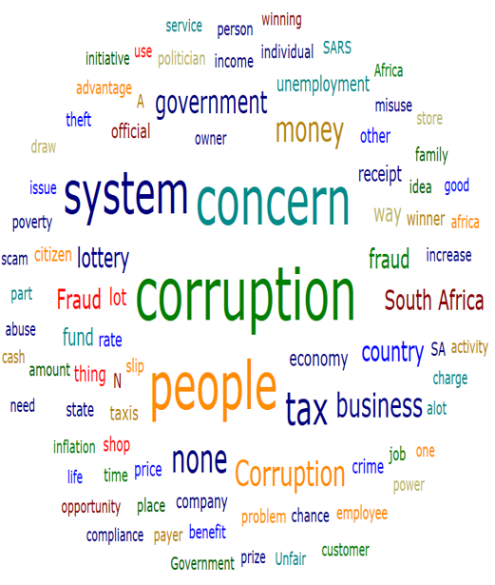
Future research
Consumer qualitative responses
Implementation strategy
Tax lottery system – 2 Aug 2023

Slide 29
?
Tax lottery system – 2 Aug 2023

