Slide 1
CONTROVERSIAL OBSTACLES TO PROGRESS TOWARDS TAX JUSTICE
International Conference in Taxation 2023
2-3 August 2023 – University of Pretoria
Benjamín Sevilla Bernabéu Lecturer and postdoctoral researcher
University of Valencia

Slide 2
INDEX
Definition of tax avoidance, tax evasion and tax planning
Tax havens and the race to the bottom
Links between tax justice and human rights
Pilar II: the minimum of global taxation and how these harms developing countries
Conclusions/Reflections

Slide 3
1. TAX AVOIDANCE, TAX EVASION AND TAX PLANNING
ILLICIT
ILLEGAL
LEGAL
Tax evasion
Tax avoidance
Tax planning
TAX AVOIDANCE
Tax avoidance means any reduction in the tax burden initially due, including abusive actions
ABUSE

Slide 4
2. TAX HAVENS AND THE RACE TO THE BOTTOM
What is a tax haven? A tax haven is a territory characterized by low or no taxation, the absence or small number of agreements to avoid double taxation and the lack of an effective exchange of tax information with other States
There are several criteria to identify a tax haven:
Incorporation of companies at reduced cost (both time and economic); with minimal or no requirements as evidence of activity or compliance with applicable regulations, and with irrelevant share capital, not specifying a physical location.
Strict application of bank secrecy.
Absence of criminal figures in their codes against tax or registrable crimes.
Dual currency exchange system, for residents and non-residents; The latter are allowed to carry out any operation in foreign currency with little or no control.

Slide 5
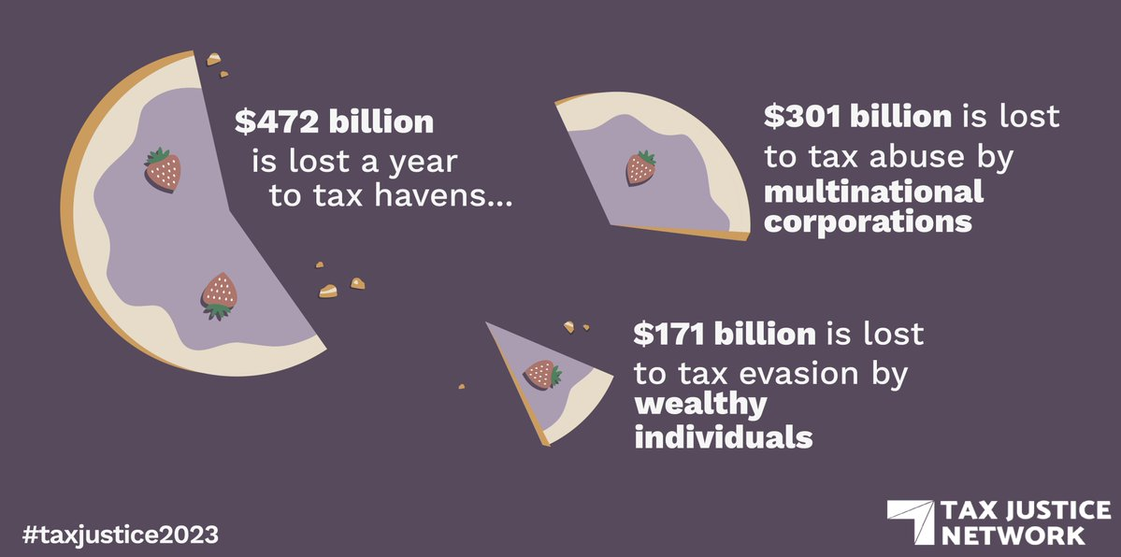
"Countries are on track to lose about 5 trillion dollars in taxes in the next 10 years because multinational companies and wealthy individuals use tax havens to pay less taxes, warns the Network for Tax Justice"

Slide 6
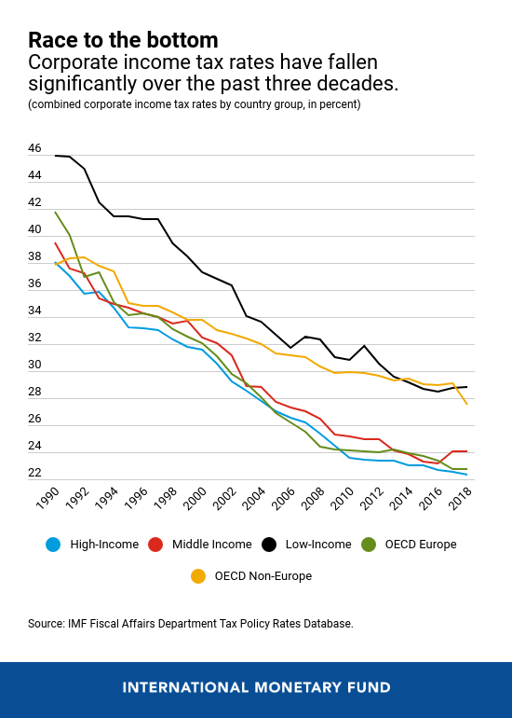
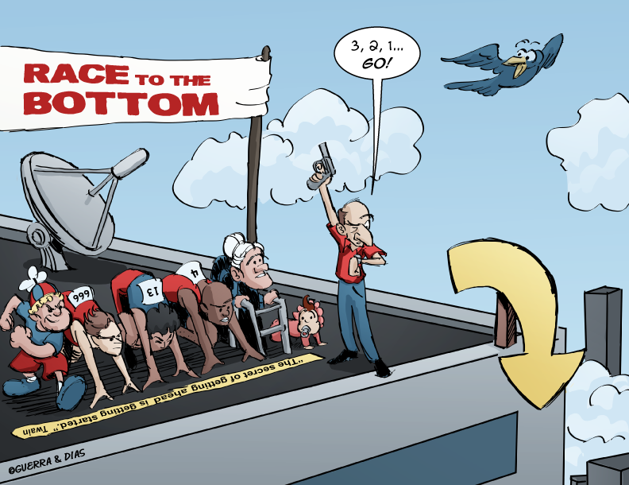
The average tax rate in the eighties and in the EU countries was almost 50%. In 2000 the EU-28 countries had an average corporate tax rate of 32%, and in 2018 it was only 23%. In ten years, Spain has seen the tax rate fall from 35% to 25%. In the case of the EU, Ireland stands out, which with a corporate tax of only 12.5% has become the base camp of all technology multinationals that want to operate in Europe.

Slide 7
3. LINKS BETWEEN TAX JUSTICE AND HUMAN RIGHTS
REVENUE
International human rights law establishes the obligation of States to maximize national resources progressively and through international cooperation, while understanding and assessing the impact of policy-making on individuals.
REDISTRIBUTION
Dorothy Brown: “If you have more, you should pay more”
REPRICING
The tax system is a mechanism to reassess the social costs and collateral "damages" of private interests. A well-functioning progressive tax system can make a significant contribution to sustainable development
REPRESENTATION
Redistribution is crucial in the fight against growing inequalities
The protection of human rights depends on a high level of accountability and integrity. Taxation is indispensable to ensure that the State truly represents the needs, rights and aspirations of all citizens

Slide 8
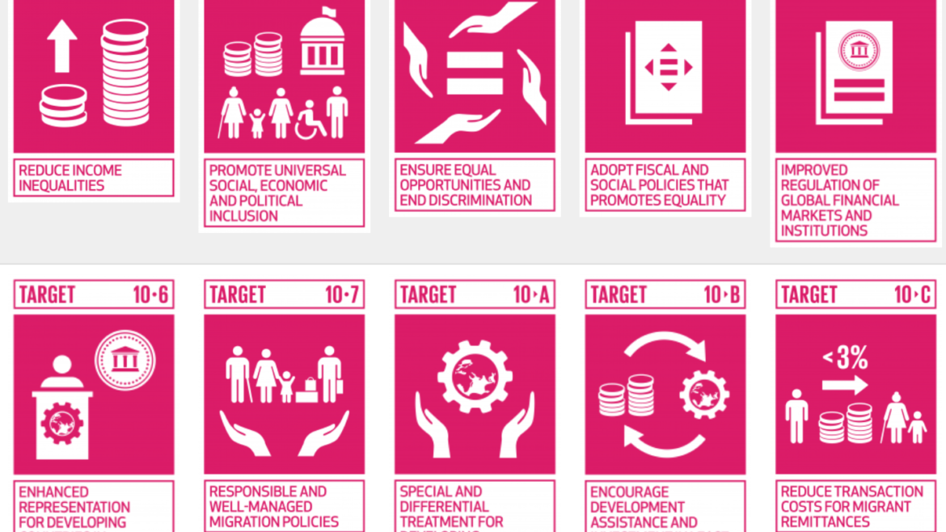
INEQUALITY AND TAXATION
Fairer tax model
The fiscal model be increasingly progressive and not more regressive
End tax havens or non-cooperative jurisdictions
Promote data transparency and facilitate the exchange of information

Slide 9
4. PILLAR II: THE GLOBAL AGREEMENT FOR MINIMUM CORPORATE TAXATION. HOW THIS IS DETRIMENTAL TO DEVELOPING COUNTRIES
The objective of Pillar II is to ensure that multinational companies are subject to an effective minimum level of taxation on all their profits each year. Pillar II would apply to all multinational groups exceeding a threshold of €750 million of combined financial income. This means that all large multinational companies would be covered by minimum effective taxation measures.
However, the question we must ask ourselves is, which countries will benefit most from the proposal? Will it put an end to harmful tax competition between states?

Slide 10
5. CONCLUSIONS/REFLECTIONS
The definitive solution is to harmonize corporate taxation.
This idyllic scenario would mean that many of the richest states would cede their sovereignty in a supranational entity that would control the harmonization of the tax, distributing the cake in a more equitable way among the States.
“Tax avoidance or tax evasion is not just a matter of euros or dollars; it is a question of human rights. These are people who are denied services to help them out of poverty because of tax avoidance or evasion”.
Winnie Byanyima. Executive Director of Oxfam International

Slide 11
THANK YOU FOR YOUR KIND ATTENTION!
Benjamín Sevilla Bernabéu
benjamin.sevilla@uv.es

