Slide 1
Do we have the tools for achieving distributive tax justice?
International Conference on Taxation
“Distributive Tax Justice in the Global Economy”
Department of Taxation, University of Pretoria
August 2023
James Alm
jalm@tulane.edu

Slide 2
The scale of income and wealth inequality has grown significantly over the last several decades.
Can tax policy – and other government policies – serve as a tool to promote distributive justice?
Here I focus on a wide range of specific tax reforms that are both feasible and that can lead to a fairer tax system…
By increasing the taxes paid by the rich,
By reducing tax evasion by the rich, and
By decreasing the tax burdens by gender, race, and ethnicity.
I start by focusing on tax policies in the United States, and I move at the end toward tax policies around the world.
My basic themes are that tax changes must be achievable rather than aspirational but that even within this somewhat limiting framework much can be done.
Specifically…

Slide 3
…for the policies that I suggest…
These policies all work through existing taxes.
These policies are all administratively feasible.
None of these policies raises statutory marginal tax rates.
These policies are broadly consistent with the standard “Broad Base, Low Rate” approach to tax reform – even though I have been critical of this approach – see Alm (2018).
Variants of these policies apply world-wide.
And…
These policies do not preclude other tax reforms that can help achieve distributive tax justice.

Slide 4
Presentation
A brief note on trends in the data
A general menu of suggested reforms
A specific menu of my own feasible reforms
What about taxes on businesses or wealth or…?
Conclusions

Slide 5
A brief note on trends in the data

Slide 6
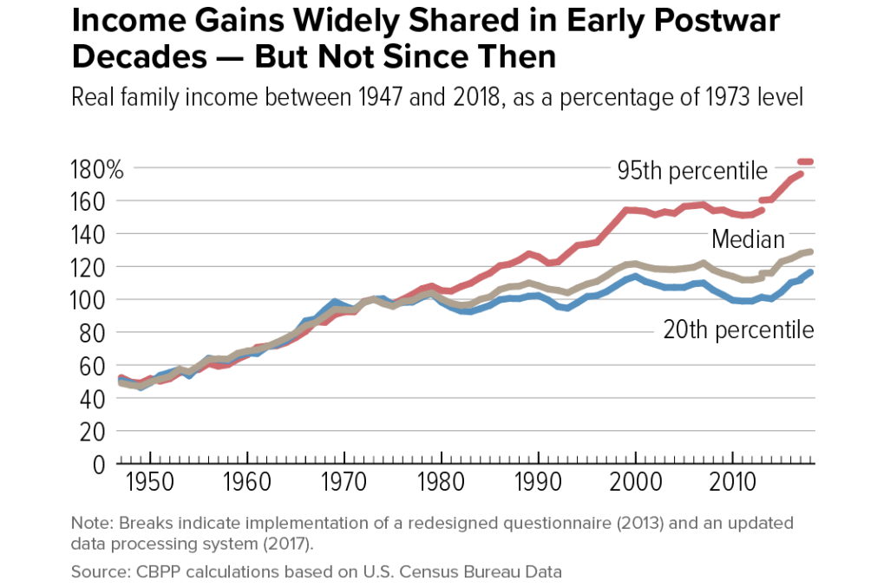

Slide 7
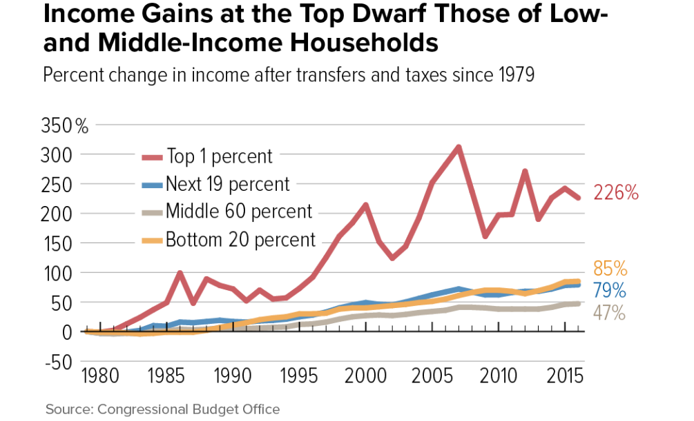

Slide 8
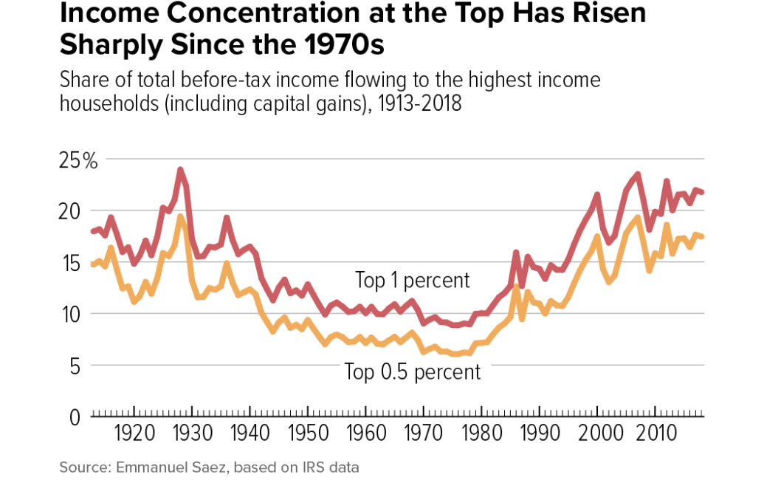

Slide 9
A general menu of suggested (U.S.) reforms
For the individual income tax
Raise marginal tax rates, especially on the rich
Cap tax deductions for the rich
End pass-through deduction
Eliminate carried interest tax preference
Close individual tax shelters
Expand the EITC
Raise marginal tax rates on (realized) capital gains
Impose minimum tax on the rich (e.g., Buffett rule)
Tax capital gains as they accrue
For the corporate/business income tax
Raise corporate income tax rate
Close corporate tax shelters
Eliminate corporate tax preferences (e.g., accelerated cost recovery)
Tax corporate income where consumers are located (BEPS 2.0 Pillar One)
Enact global minimum corporate income tax (BEPS 2.0 Pillar Two)
For a wealth tax
Enact annual wealth tax (Piketty/Saez/Zucman/Warren/Sanders)
Enact one-time billionaire wealth tax (Saez/Zucman)
Reform estate and gift tax
Expand local property taxes
For other taxes
Enact financial transactions tax
Enact personal consumption tax

Slide 10
A specific menu of my own feasible reforms
Here are some feasible policies that are at the top of my list – and keep in mind again that my policies are probably more relevant for the U.S. and other developed countries but are, I hope still, still applicable outside these countries:
Making taxes more just by taxing now-untaxed income:
Tax capital gains at death by eliminating stepped-up basis
Making taxes more just by making people pay legally due taxes:
Increase enforcement, especially on the rich
Making taxes more just by reducing disparate tax treatment by race, ethnicity, and gender:
Move to the individual as the taxable unit in the individual income tax

Slide 11
Tax capital gains at death by eliminating stepped-up basis

Slide 12
Increase enforcement, especially on the very rich

Slide 13
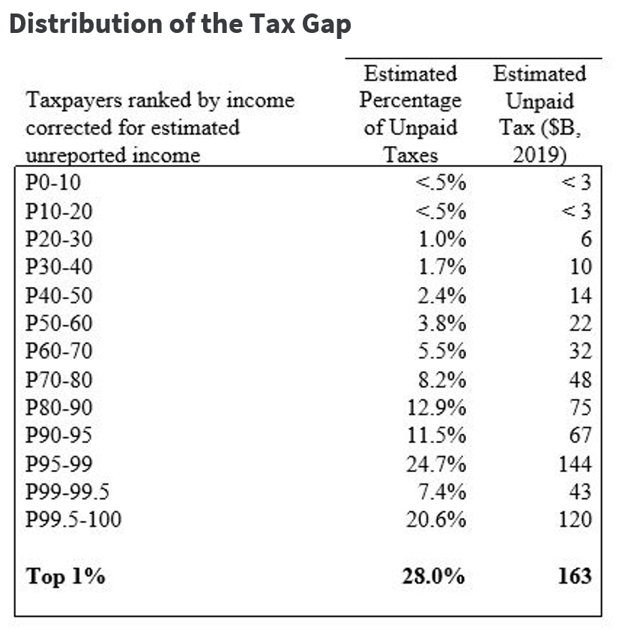

Slide 14
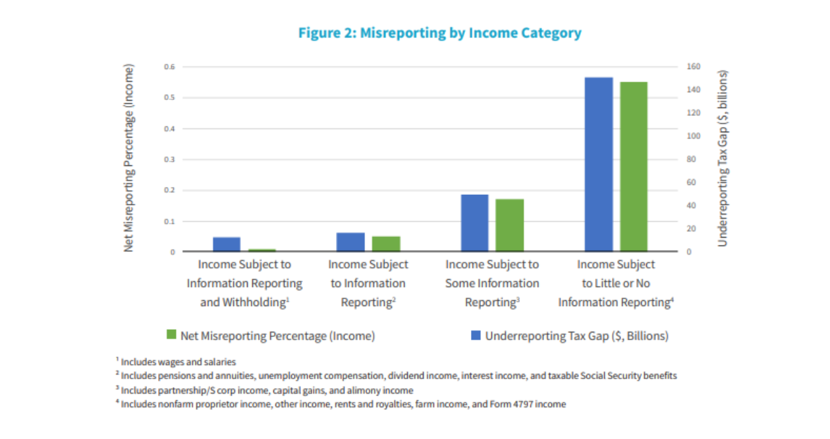

Slide 15
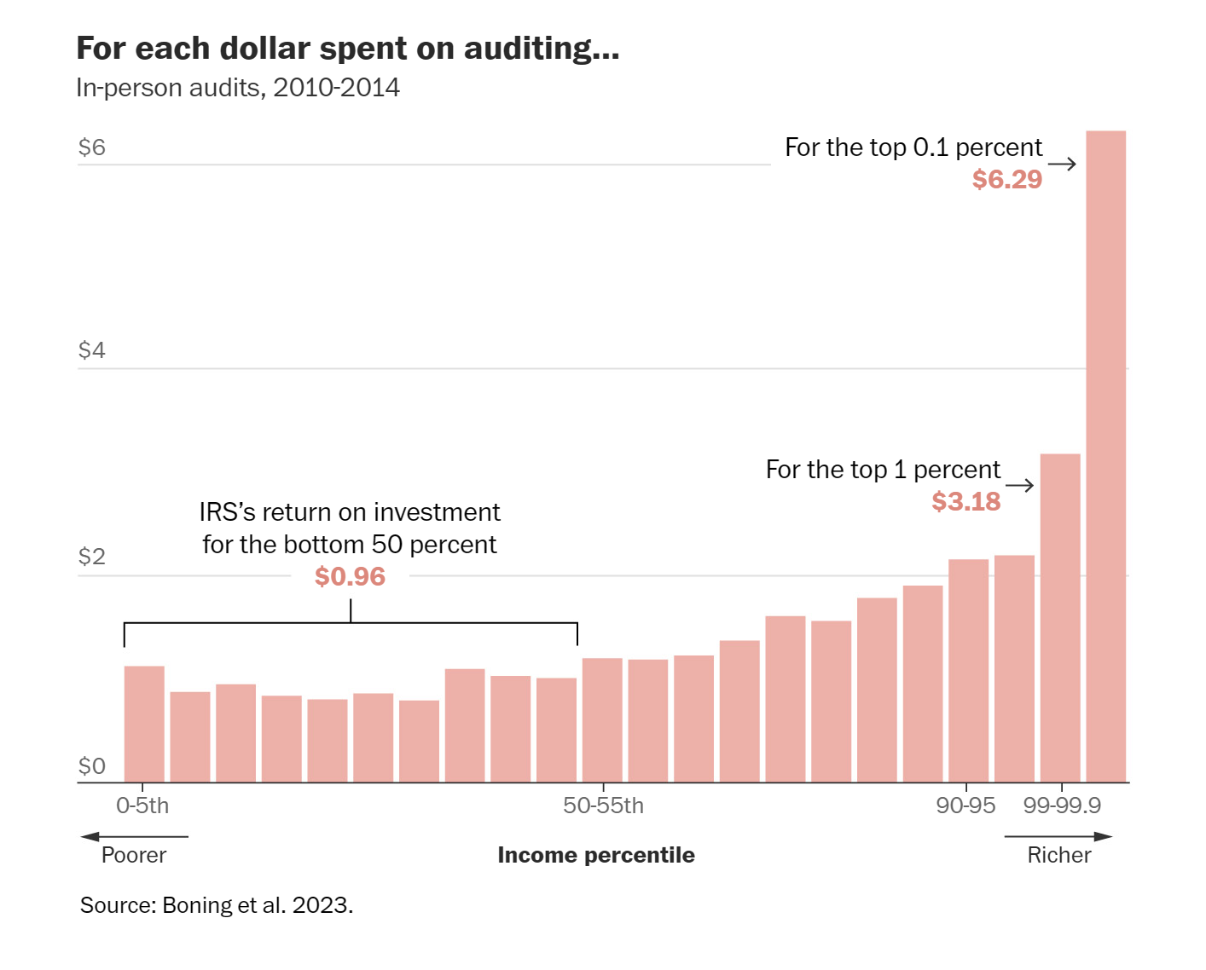

Slide 16
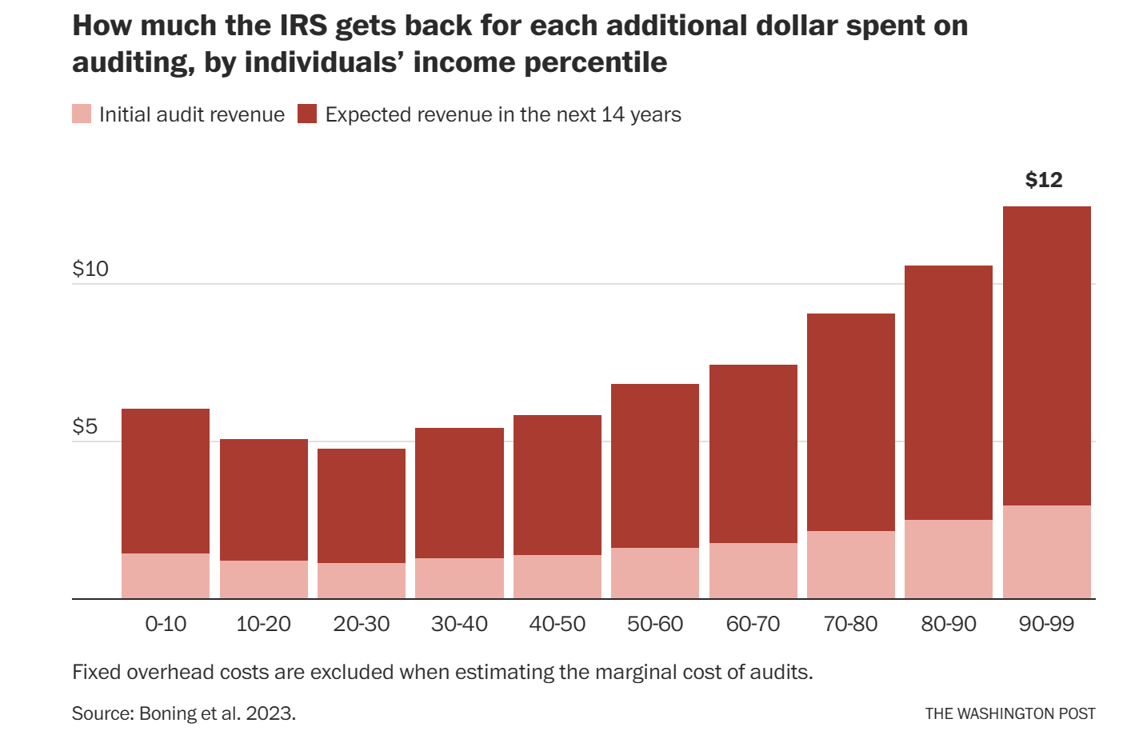

Slide 17
Move to the individual as the taxable unit in the individual income tax

Slide 18
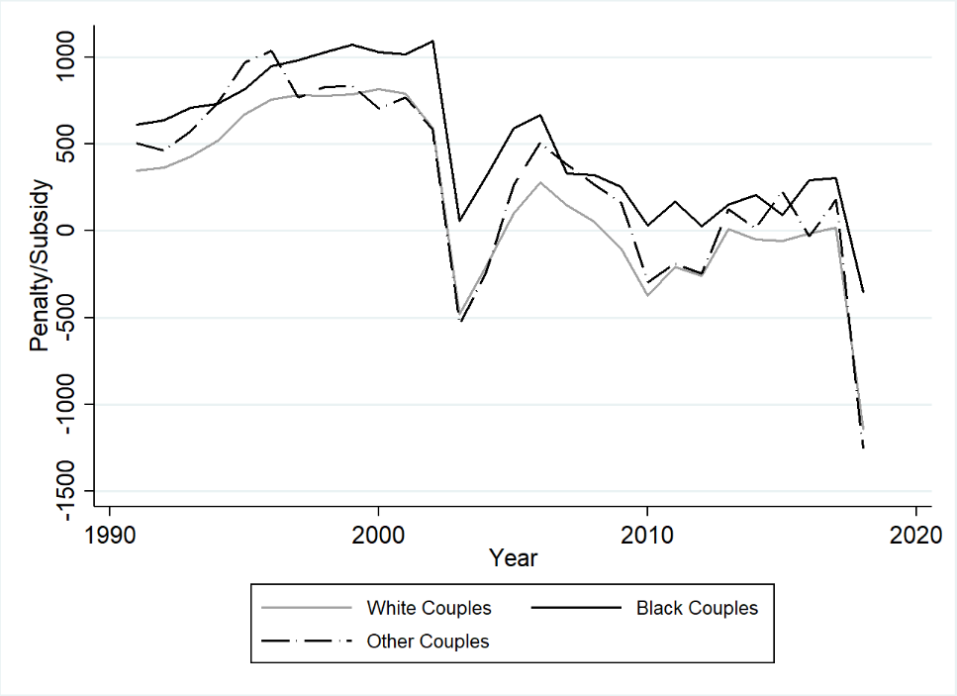
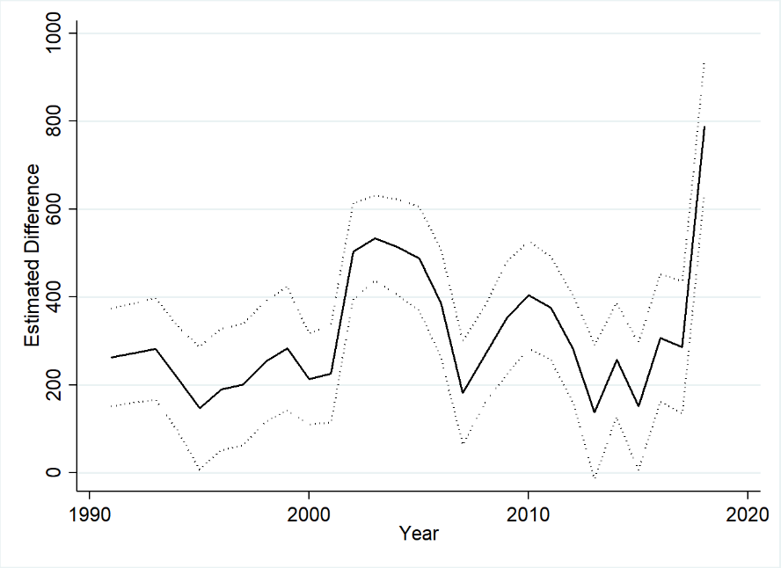
Average Marriage Penalty/Bonus by Race
(A) Average Marriage Penalty/Bonus
(B) Difference Between Black and White Couples

Slide 19
What about taxes on business or wealth or …?
Increasing taxes on businesses?
Imposing a wealth tax, a la Piketty, Saez, and Zucman (or Sanders or Warren)?
Increasing marginal tax rates, especially the top rate?
Increasing marginal tax rates on (realized) capital gains?
Reforming the estate tax (especially by lowering the exemption level)?
…

Slide 20
Conclusions
Improving distributive justice via tax and other policies is possible, but it requires the political will to do so.
Still, I believe that some options are more effective than others, especially those that:
Do not require entirely new tax administration machinery
Do not rest on unrealistic assumptions regarding behavioral responses
Recognize that redistribution occurs via multiple avenues, including some avenues that do not require changes in marginal tax rates (e.g., enforcement) and that address disparate tax treatments by race, ethnicity, and gender.
And note again several things about my own policy menu:
These policies all work through existing taxes.
These policies are all administratively feasible.
None of these policies raises statutory marginal tax rates.
These policies are broadly consistent with the standard “Broad Base, Low Rate” approach to tax reform.
Variants of these policies apply world-wide, especially those policies that:
Find some way to tax the capital gains of the rich
Ensure that everyone – especially the rich – pays their legally due taxes
Attempt to eliminate disparate race/ethnicity/gender impacts due to the ways in which tax codes interact with economic decisions.

Slide 21
More broadly, it is important to consider the ways in which all taxes combined (and not simply individual taxes taken separately) affect the tax liabilities of individuals, especially the very rich.
And it is also important to remember that it is often on the expenditure side of the government budget that the most effective distributional policies exist.
A challenge is that quantifying the distributional effects of government expenditure policies – including government infrastructure programs – is very difficult.
And it is the incidence of this entire fiscal system – taxes and expenditures – that is of most importance for a just fiscal system.
For a promising methodology for performing expenditure incidence analysis, see Alm and Khan (2023).

Slide 22
The challenges are several:
Coming up with policy recommendations that are feasible and effective
Finding ways to implement these policies via the political process.
I am optimistic that this conference will help point the way along both dimensions.

