Slide 1
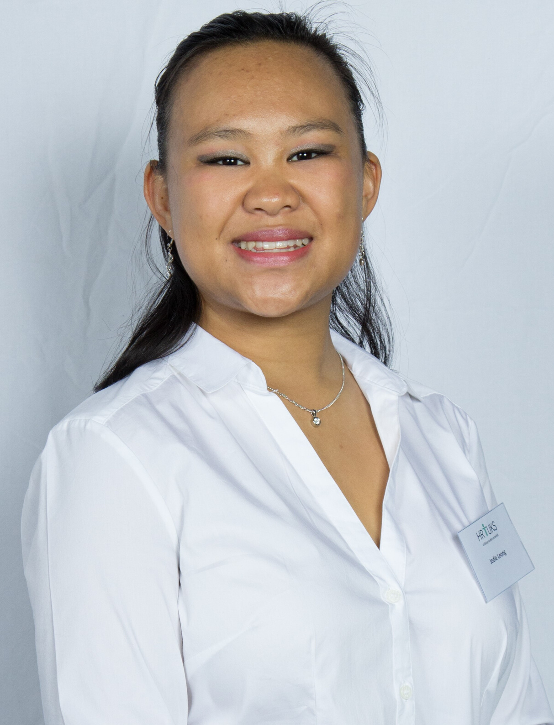
AHI EMPLOYERS ORGANISATION UNDERGRADUATE PRIZE & LEXIS NEXIS BOOK VOUCHER:
Jody Leong
Best achievement during the three-year study period for the degree BCom in Human Resource Management
Motto:
"We are bound only by the limits of our imaginations."

Slide 2
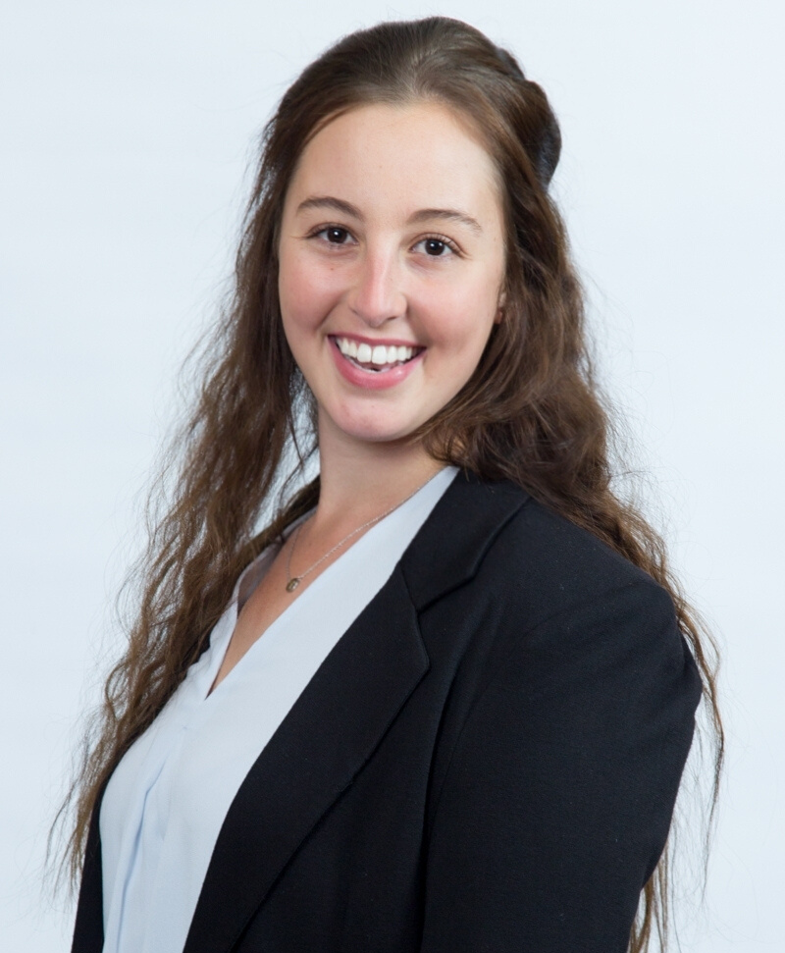
INSTITUTE FOR PEOPLE MANAGEMENT POSTGRADUATE PRIZE FOR HUMAN RESOURCE MANAGEMENT
Taylor Montgomery
Best achievement for the degree BCom Honours in Human Resource Management
Motto:
"So wear your strongest posture now and see your hardest times as more than just the times you fell, but a range of mountains you learned to climb."

Slide 3
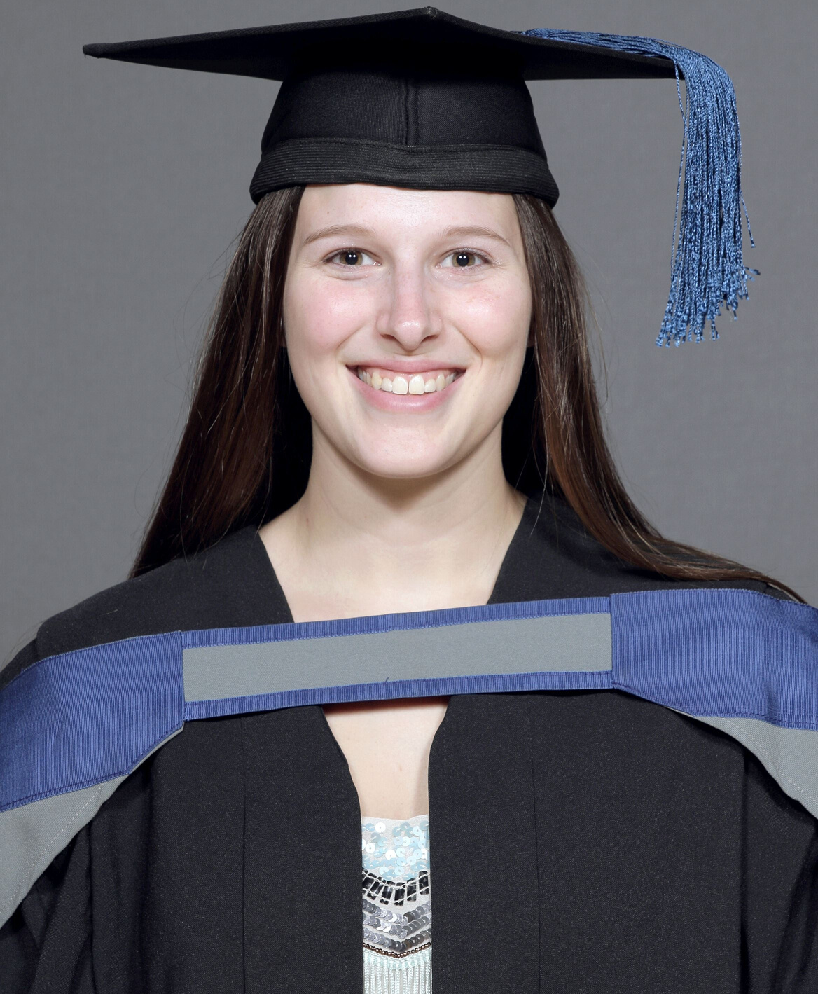
HUMAN CAPITAL BUSINESS SOLUTION POSTGRADUATE PRIZE FOR INDUSTRIAL PSYCHOLOGY:
Amalia Magnin
Best achievement for the degree BCom Honours in Industrial Psychology
Motto:
"A satisfied life is better than a successful life because our success is measured by others, but our satisfaction is measured by our mind, soul and heart." - Unknown

Slide 4
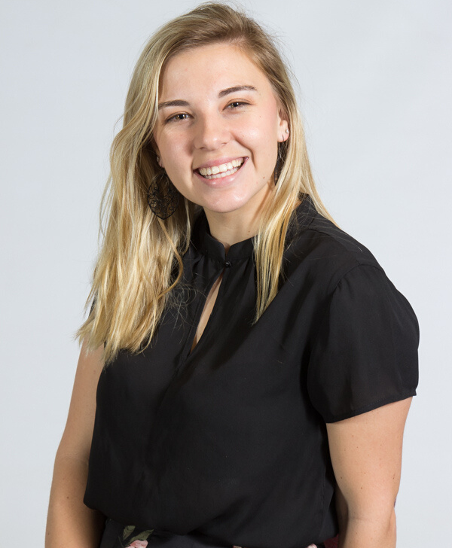
INSTITUTE FOR PEOPLE MANAGEMENT RESEARCH PRIZE FOR THE DEGREE BCOM HONOURS IN INDUSTRIAL PSYCHOLOGY AND HUMAN RESOURCE MANAGEMENT
Suné van Huyssteen
Best academic achievement in research subjects for the degree BCom Honours in Industrial Psychology
Motto:
"Always do your best. What you plant now, you will harvest later" Og Mandimo

Slide 5
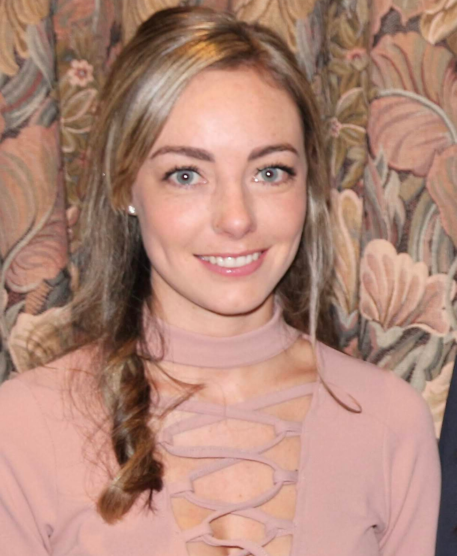
SABPP - COUNCIL CERTIFICATE
Tiffany Webster
Best overall achievement for the degree MCom Industrial and Organisational Psychology
Motto:
“The only person you should try to be better than, is the person you were yesterday” – Anonymous

Slide 6
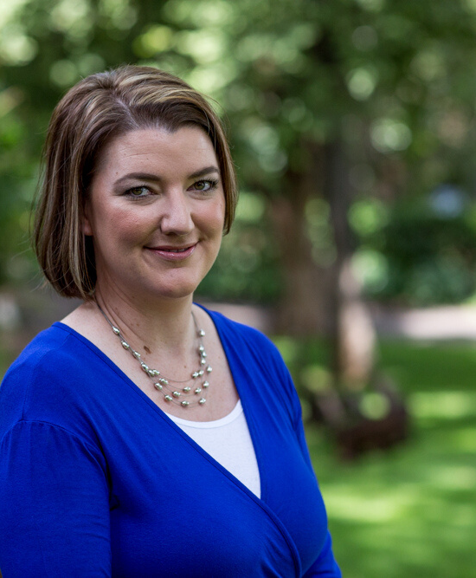
HUMAN RESOURCE MANAGEMENT DEPARTMENT PRIZE
Kim Dowdeswell
Best PhD student in the PhD Learning Programme
Motto:
"Success isn’t about how much money you make; it’s about the difference you make in people’s lives." - Michelle Obama

Slide 7
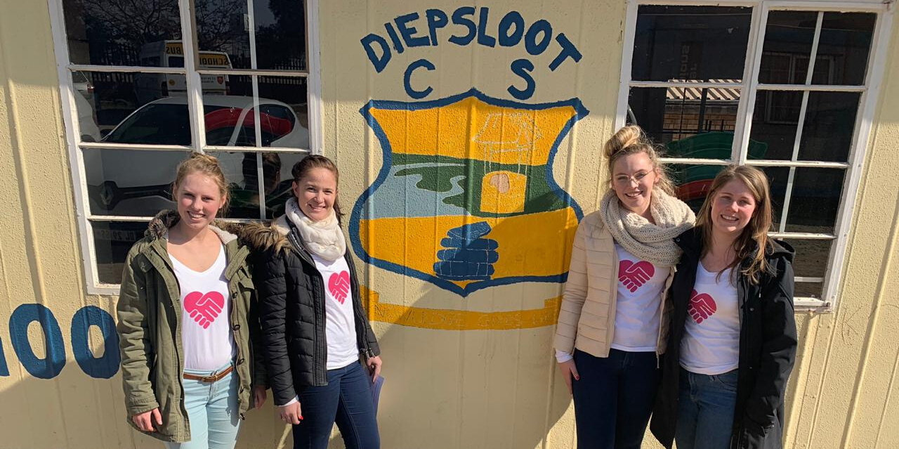
BEST COMMUNITY PROJECT FOR THE DEGREE BCOM HONOURS IN INDUSTRIAL PSYCHOLOGY
Group Members:
- Cemonn Wegerele (at the far left)
- Hesti Groenewald (at the left)
- Teagan Routledge (at the right)
- Bianca van Heerden (at the far right)
Read for Africa Project:
"Our group went to the Read for Africa holiday programme at Diepsloot for 3 days in the June holiday to help the children with their English reading, writing and pronunciation. At first, the idea of working with kids and helping them with their reading, writing and pronunciation seemed a bit daunting. However, in a matter of a day, it became clear that our skills did help these kids. Throughout this experience, the most valuable lesson learned was how happy these children were regardless of their circumstances. They came in each and everyday with the biggest smiles on their faces, something we all can learn from and apply it to our daily lives. Also, once again it occurred to us that time is invaluable, it incredible to see what impact the 3 days had on these children. All we gave were our time and patience and that cost us nothing. Lastly, we learned to give without any expectations back. With that said we urge you to visit the Read for Africa Diepsloot holiday programme this June holiday. We all feel that we’ve learned so much more than we ever expected and why shouldn’t you."

