Slide 1
MODULE 10: Measuring Waist Circumference
Sanja Nel (M.Diet, RD(SA))
Friede Wenhold (PhD, RD(SA))
Louise van den Berg (PhD, RD(SA))

Slide 2
This presentation is intended for use with the training manual
Hands-on Anthropometry: A South African Handbook for Large-Scale Nutrition Studies
Module 10: Measuring Waist Circumference
Available online at https://www.up.ac.za/centre-for-maternal-fetal-newborn-and-child-healthcare/article/3043272/anthropometry-body-composition-and-growth-assessment
Licensed under Creative Commons Attribution-ShareAlike 4.0 (CC BY-SA) International License. May be freely used and distributed with appropriate credit. Reasonable alterations are allowed; altered materials must be distributed under the same CC BY-SA licence

Slide 3
Learning outcomes
By the end of this session, you will be able to
Measure waist circumference in all participants age 18 years and up, following standardised procedures
Capture measurement data using the the Anthropometry Data Capture Form or electronic app

Slide 4
Identifying the correct site for measuring waist circumference

Slide 5
Importance of measuring in the right place
The abdomen is curved
The circumference is not the same everywhere.
We need to measure each participant in the exact same spot to be able to combine measurement data from different participants.
Reference standards for what is “normal” are based on measurements taken at this site.
99,4 cm
98,1 cm

Slide 6
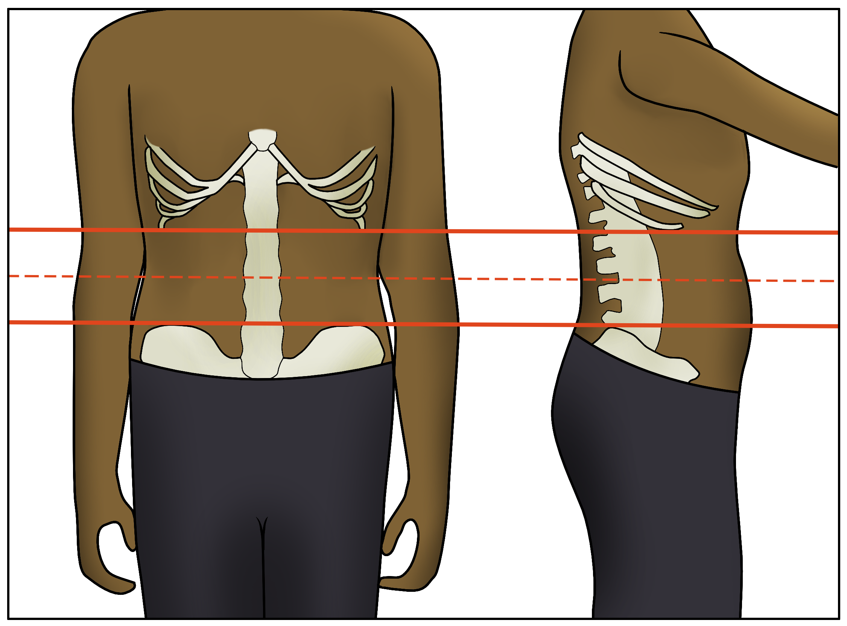
Find the measurement site
Ask the person to stand comfortably
Upper reference point: Feel for the lowest edge of the last rib.
Lower reference point: Feel for the highest edge of the hip bone (iliac crest.
Use a tape measure to find the halfway point between the two reference points.
Mark with the cosmetic pencil.
Notes:
• Ask the person to stand comfortably, with their weight evenly distributed on both feet and their stomach muscles relaxed.
• Find the lowest edge of the lowest rib, and mark it with the cosmetic pencil.
• Find the highest point of the hip bone (iliac crest).
• Place your measuring tape with the zero end on the upper point, and measure the distance between the points. Divide the distance by two: this is the midpoint where the measurement should be taken.
(To make this easier, the electronic data collection application should have a built-in function to calculate the midpoint.)

Slide 7
Waist circumference measurement site
Lowest edge of the last rib
Midpoint
Highest point of the hip bone (iliac crest)
Notes:
This slide shows the correct measurement site for waist circumference.

Slide 8
Practical tips
Ask the participant to show you where their hip bone and lowest rib are
They usually know exactly where it is
Participants may prefer to have their waist circumference measured by an anthropometrist of the same sex
Accommodate this preference if possible by letting the assistant take the measurement (if they are the appropriate sex)
It is recommended that both the anthropometrist and the assistant practice taking waist circumference measurements

Slide 9
Measuring waist circumference in adolescents and adults
From 13 years old onwards

Slide 10
An important exclusion
We do not measure waist circumference in a woman who:
Is currently pregnant, or
Gave birth or had a miscarriage in the last 6 months
In these cases, the waist circumference reflects the state of pregnancy, not the person’s fat stores.

Slide 11
Summary of the procedure
Waist circumference is measured in
Secondary school learners ages 13-18
Adults age 18 years and up
The person should be standing, but relaxed, during the measurement
Use a spring-wound measuring tape.
If a spring-wound tape is not available, a regular tape measure can also be used.
Notes:
Waist circumference is measured in secondary school children (13 years and older), adults and the elderly, using a spring-wound measuring tape.
It is important that the person should relax their abdominal muscles during the measurment, in order to get an accurate waist circumference measurement.

Slide 12
Prepare for the measurement
Ask the person if they are currently pregnant or gave birth in the last 6 months
Mark the appropriate box (Y/N) on the form or app
If yes – do not measure waist circumference
Ask the person to uncover the waist
Lift shirt
May need to lower their trousers slightly – you need to be able to feel the upper edge of the hip bone
Ask the person to stand comfortably
The anthropometrist stands on one side of them and the assistant on the other
Not in front and behind → uncomfortable
Notes:
1. Before starting, ask a woman if she is currently pregnant or if she was recently pregnant. Waist circumference is NOT measured in women who are pregnant or who have given birth or had a miscarriage in the past six months.
• On the Anthropometry Data Capture Form or the electronic app, mark the relevant boxes (Y=yes, N=no) labelled “pregnant” and “<6 months postpartum” (this means less than 6 months after having delivered).
• If you mark “Y” for either, do not do this measurement.
2. Ask the person to uncover their waist. This may require raising their shirt and possibly lowering their trousers slightly. If the person is wearing a dress, suggest that they change into a separate shirt and trousers/skirt to allow you to access their waist.
3. The anthropometrist and the assistant position themselves to opposite sides of the participant. Standing directly in front of or behind the participant may make him or her feel uncomfortable.
• For a right-handed anthropometrist, it is easiest to work on the right side of the participant.

Slide 13
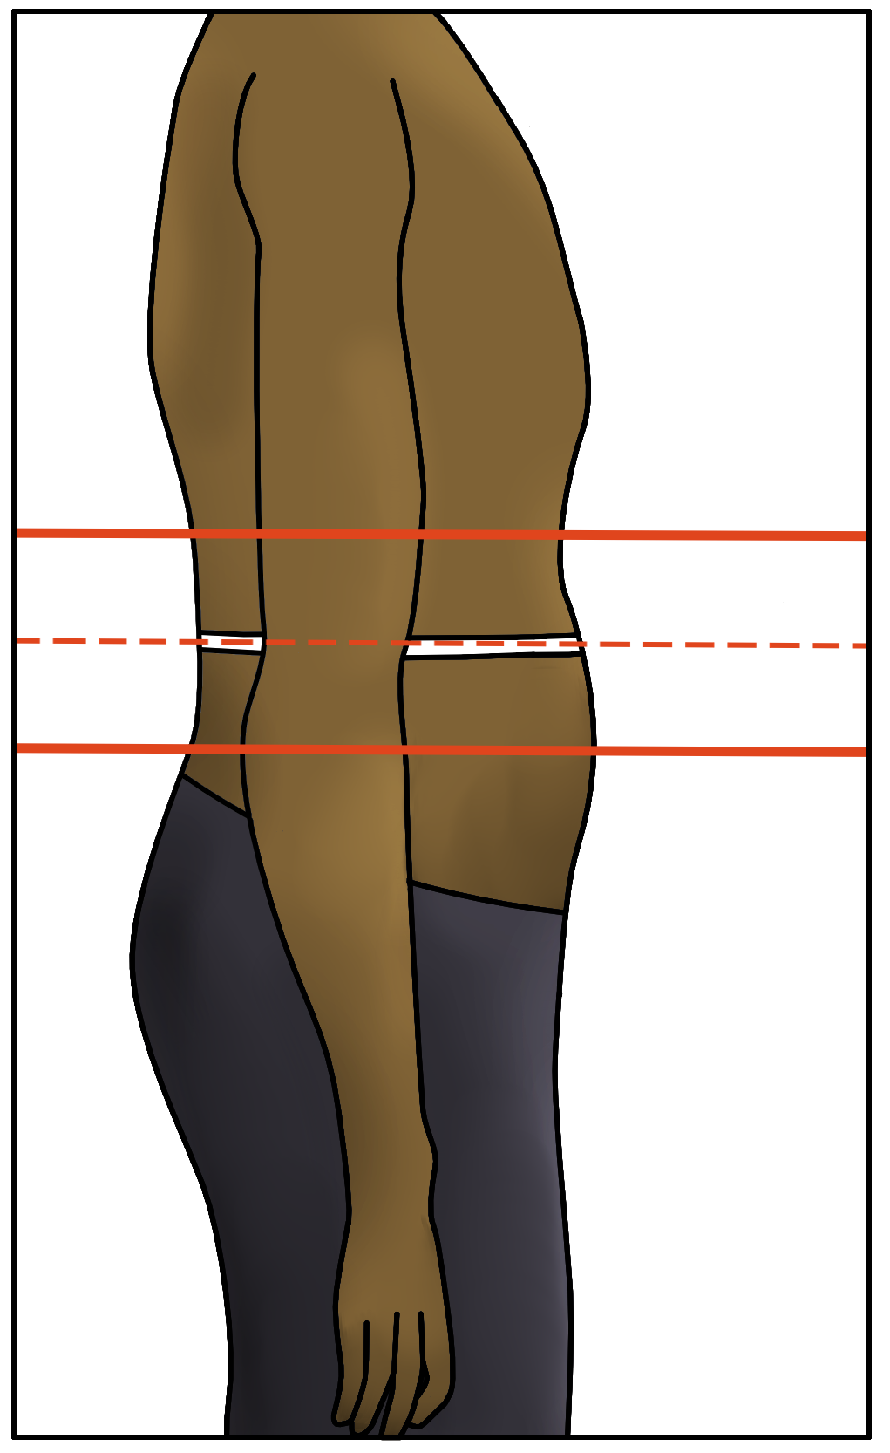
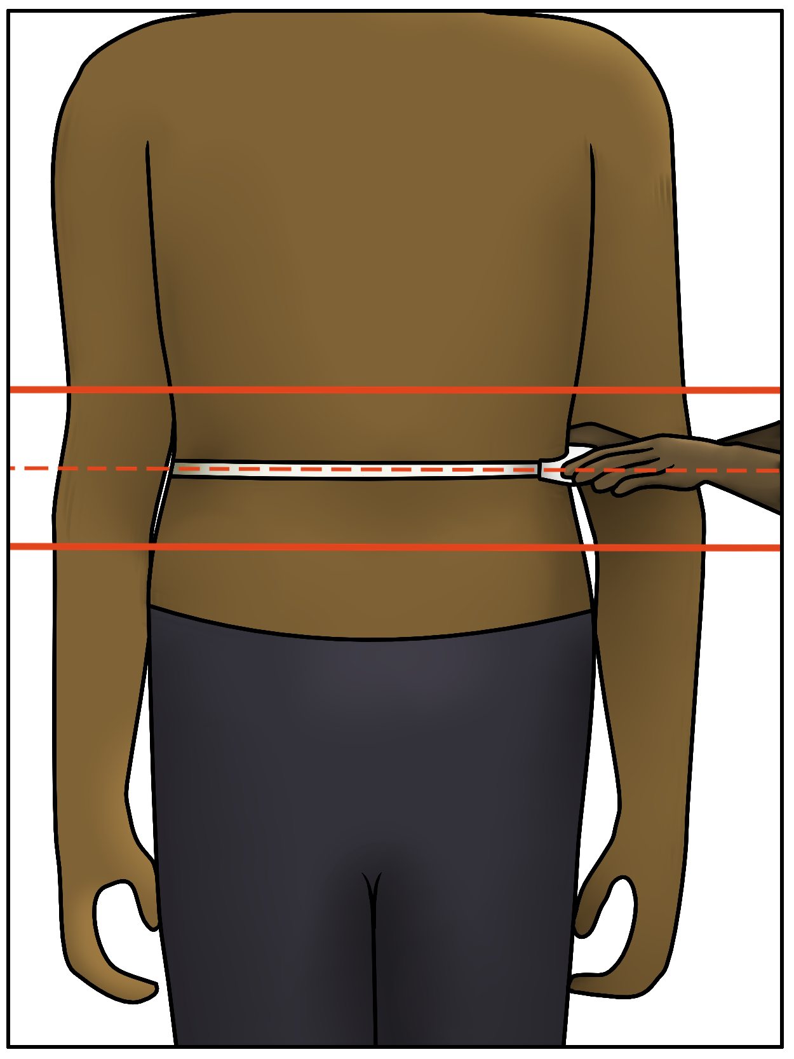
Take the measurement
Locate and mark the measurement site
Place the measuring tape around the waist at the level you marked
Make sure the measuring tape is horizontal and parallel to the floor all the way around the waist, not curving up or down in the front or back.
Slide the pin on the end of the tape into the plastic casing
Press the button to pull the tape snug against the skin
Check that it isn’t too tight or too loose
Notes:
4. The anthropometrist locates the midpoint of the waist at one side:
• Find the lowest edge of the lowest rib, and mark it with the cosmetic pencil.
• Find the highest point of the hip bone (iliac crest).
• Place your measuring tape with the zero end on the upper point, and measure the distance between the points. Divide the distance by two: this is the midpoint where the measurement should be taken.
• Mark the midpoint with the cosmetic pencil.
5. Place the measuring tape around the person’s waist at the level of the mark you made.
• The anthropometrist holds the casing of the measuring tape in the one hand (right hand for right-handed anthropometrist) and uses their left hand to pass the end of the tape measure to the assistant around the participant’s back. The assistant then takes the tape measure around the participant and uses their left hand to pass the end of the tape measure to the anthropometrist around the participant’s front.
• Ensure that the measuring tape is horizontal and parallel to the floor all the way around the waist, not curving up or down in the front or back.
• The measuring tape should fit snugly; neither compressing the tissue nor hanging loosely.
• The assistant should help to hold the measuring tape in position.

Slide 14
Record and repeat the measurement
Read the measurement at the edge of the plastic casing
Record the measurement
Anthropometrist calls out the measurement
Assistant records it on the form / app next to “1”
Repeat the measurement
Record on the form/app next to “2”
Thank the person
Check that the measurement is recorded clearly and legibly
Notes:
6. Read the measurement at the edge of the plastic casing.
7. Record the waist circumference on the Anthropometry Data Capture Form or the electronic app in the space next to “1”.
• The anthropometrist calls out the value, and the assistant writes it down.
• Record calf circumference in centimetres, to one decimal place; for example 103.2 cm.
8. Remove the measuring tape and repeat the measurement.
• Record the second waist circumference measurement on the Anthropometry Data Capture Form or the electronic app in the space next to “2”.
9. Thank the person, and allow them to readjust their clothing.
10. Check that the measurements are recorded clearly and legibly. The anthropometrist and the assistant should both check the form.

Slide 15
Thank you
Questions and Discussion

