Slide 1
Join the session:
Detecting the High-Risk Fetus
in the Low-Risk Mother
and Its Implications
21 APRIL 2021
7:30 - 9:00 PM (South African Standard Time & CEST)
Attend the virtual #GHTechX21 conference on global health, 21-24 April 2021. Registration is free and open to all: https://bit.ly/GHTechXregister

Slide 2
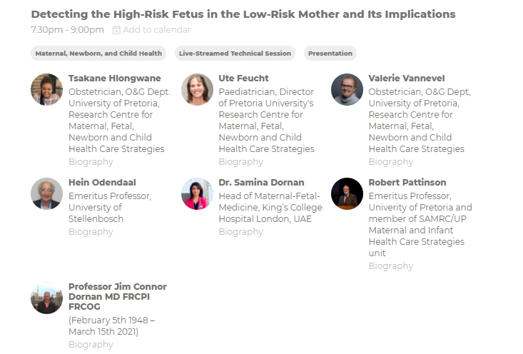
Join the session:
21 APRIL 2021
7:30 - 9:00 PM (South African Standard Time & CEST)
Attend the virtual #GHTechX21 conference on global health, 21-24 April 2021. Registration is free and open to all: https://bit.ly/GHTechXregister

