Slide 1


The role of non-linear functional response on predator’s body size evolution
Savannah Nuwagaba
Cang Hui
Ulf Dieckman
Åke Brännström

Slide 2

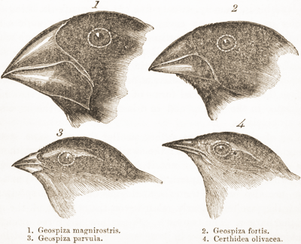

Slide 3
Evolutionary dynamics
Ecological dynamics
Trait/strategy dynamics
Population
dynamics
Adaptive dynamics

Slide 4
Assumptions
Clonal inheritance
Mutations are rare (Resident population at equilibrium)
Mutant at low density
Small mutational steps
Example
Fitness
(initial per capita growth rate of the rare mutant)
If
> 0
x’ > x succeeds
< 0
x’ < x succeeds
fitness
= 0
Interesting
Canonical equation of adaptive dynamics
Trait

Slide 5
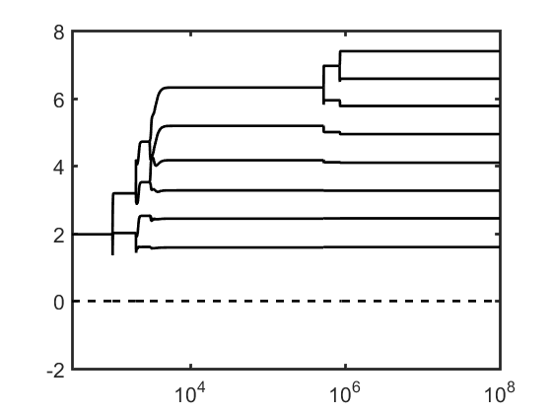
Body size
fitness
Trait
Trait
Time

Slide 7


Model I
Mortality
Predation gain
Competition
Growth rate
Competition
Predation loss

Slide 8
Mutant introduction
Invasion fitness
Mutant dynamics
< 0 > 0 = 0

Slide 9
Changes in body size and density with respect to handling time

Slide 10
Role of body size evolution on population densities
Predator density
Prey density
Time
Time

Slide 11
Bifurcation analysis (Using matcont software)

Slide 15
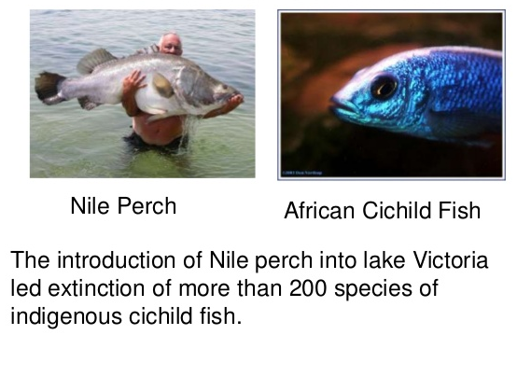
Brief background
Propagule pressure
Body size
Handling time

Slide 16
Invasion scenarios
Handling time 1
Handling time 2
Handling time 3
Handling time 4
Propagule pressure 1
Propagule pressure 2
Propagule pressure 3
Propagule pressure 4
Small body size
Same body size
Bigger body size
Before first branching
After several branching

Slide 17
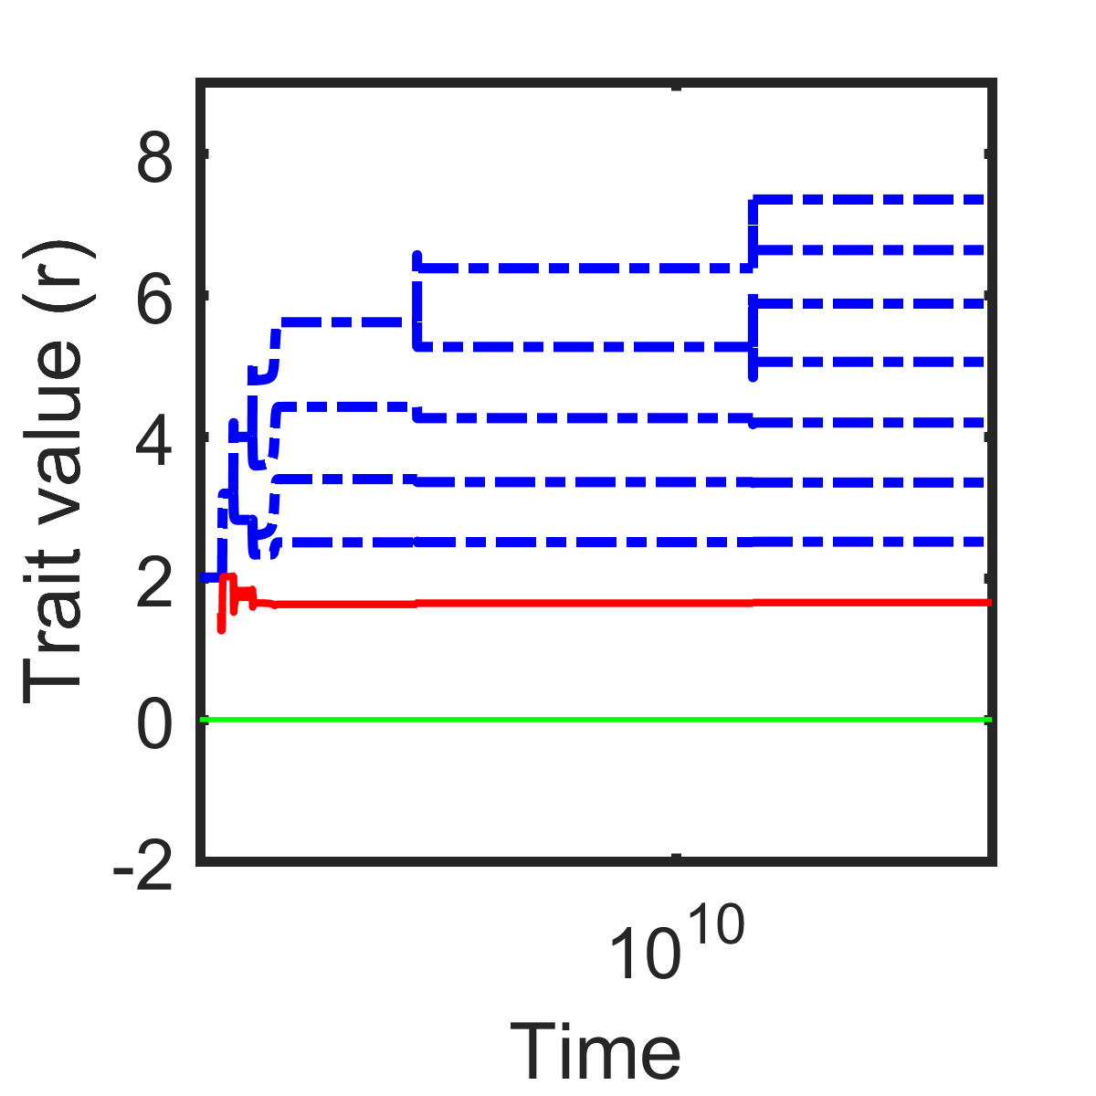
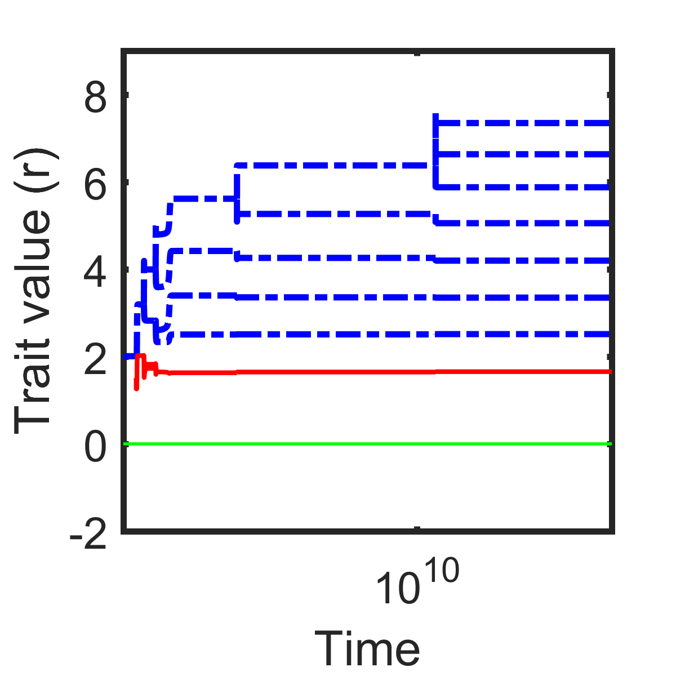
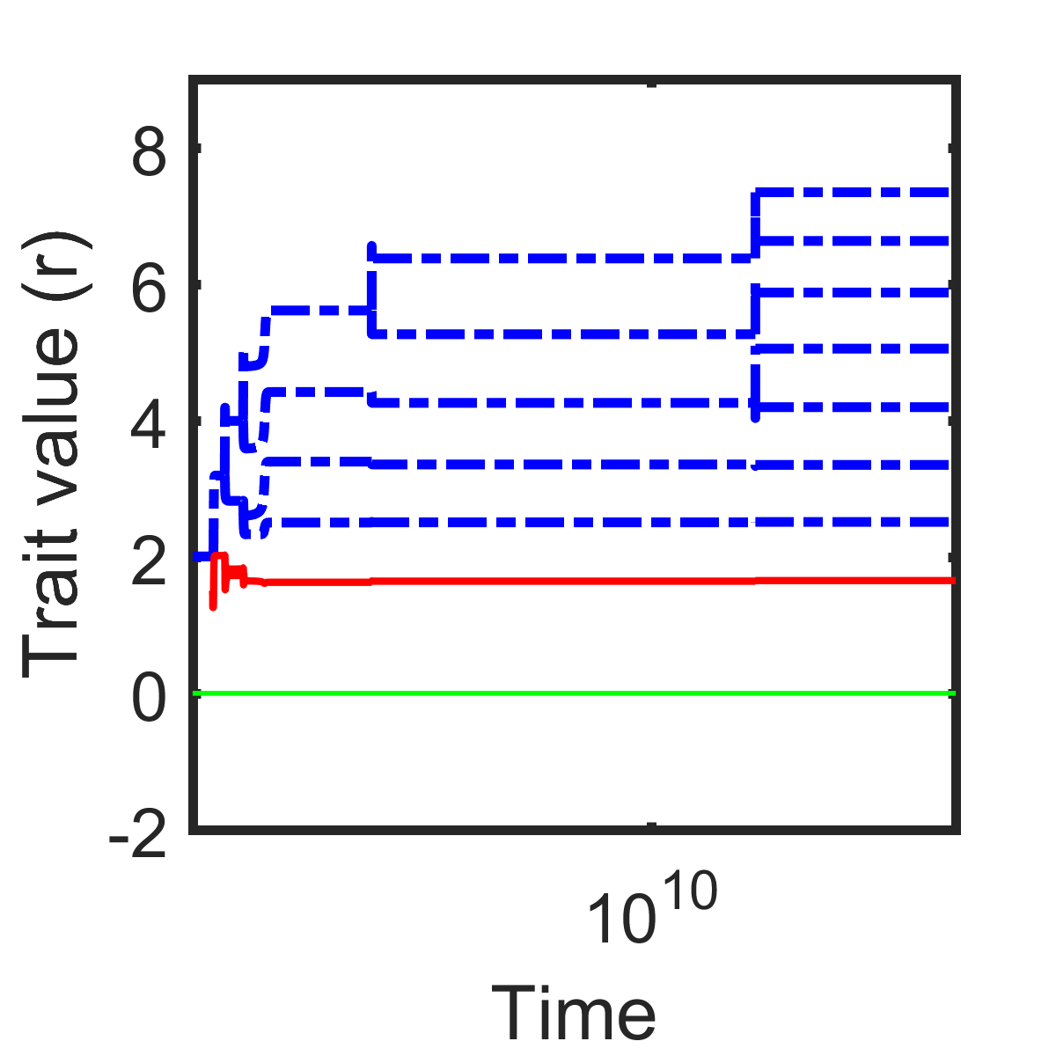
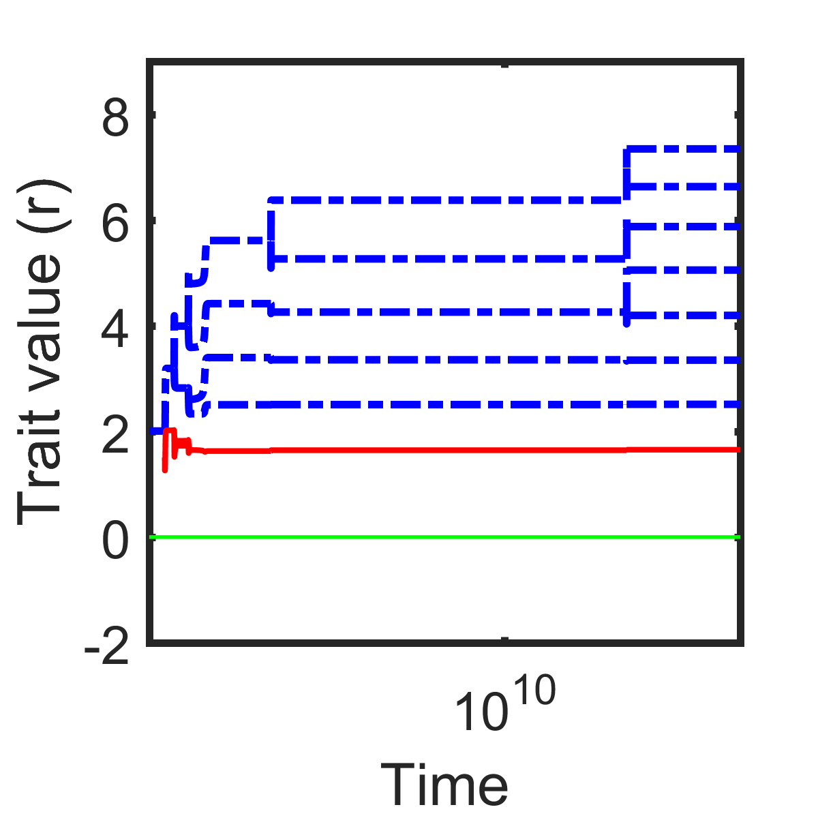

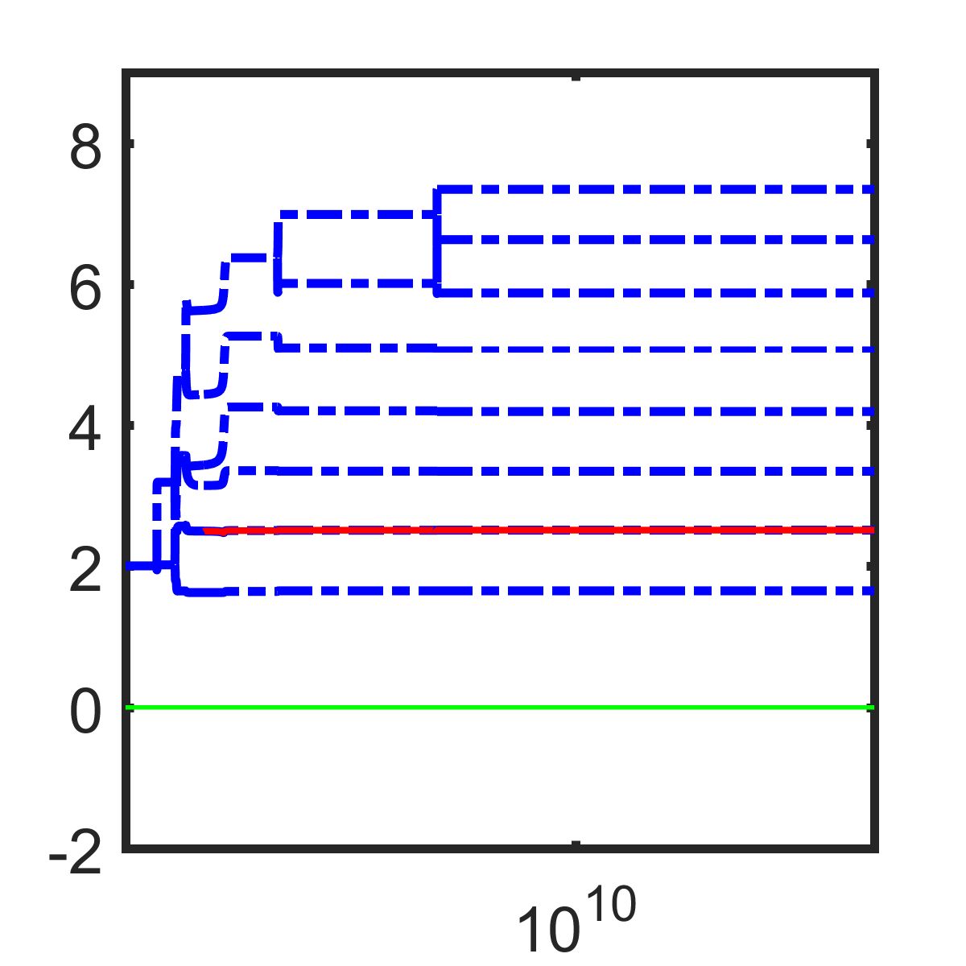
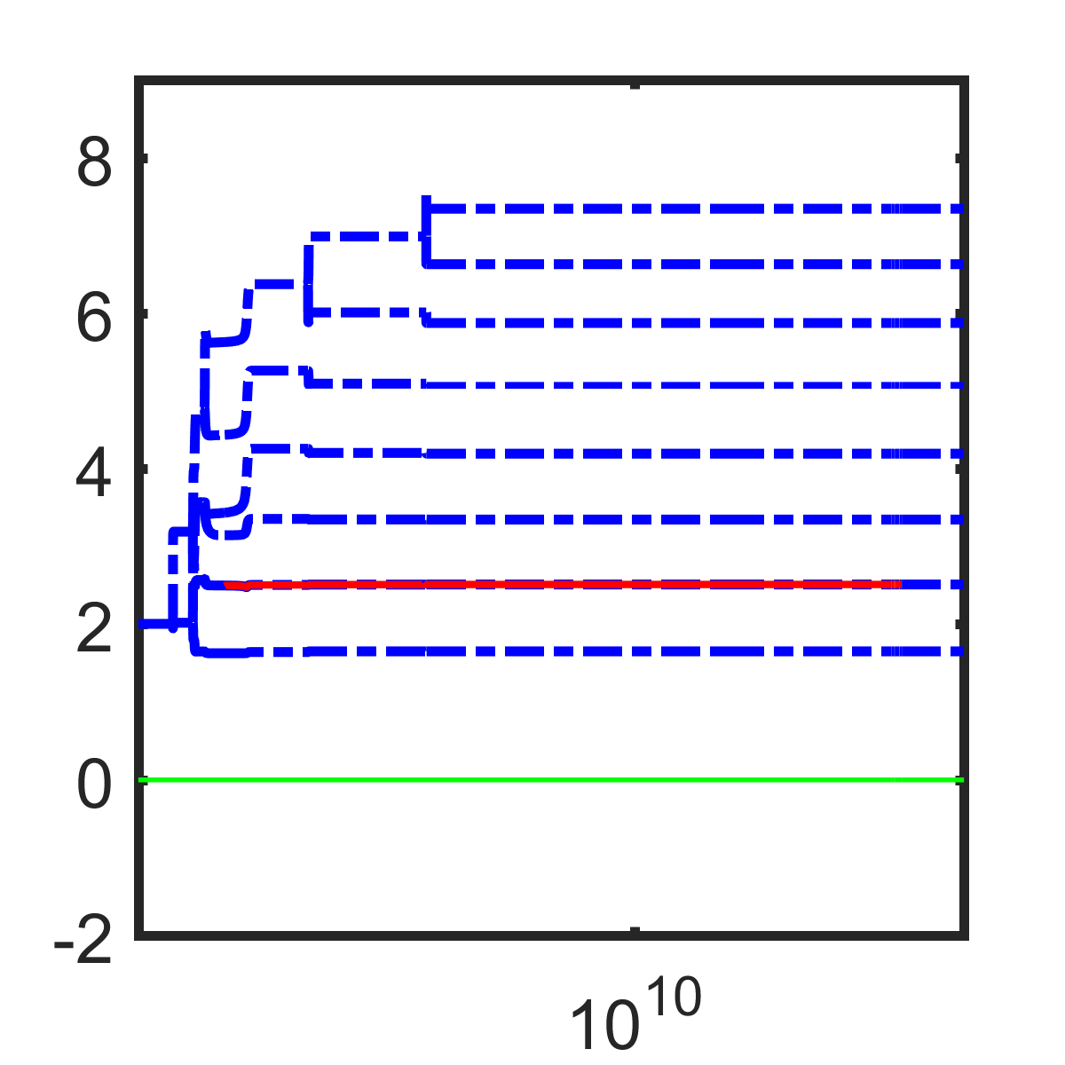
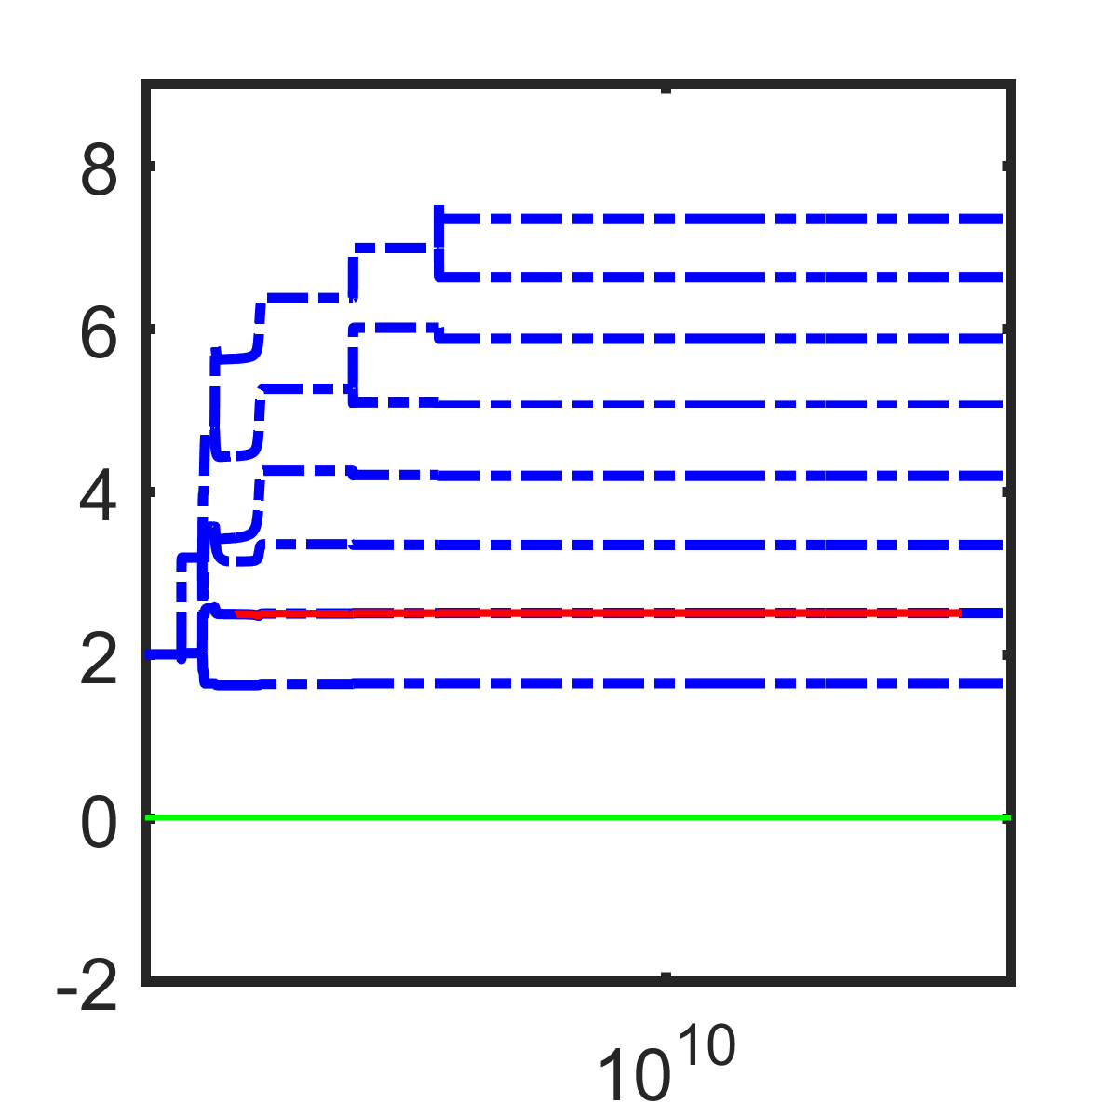
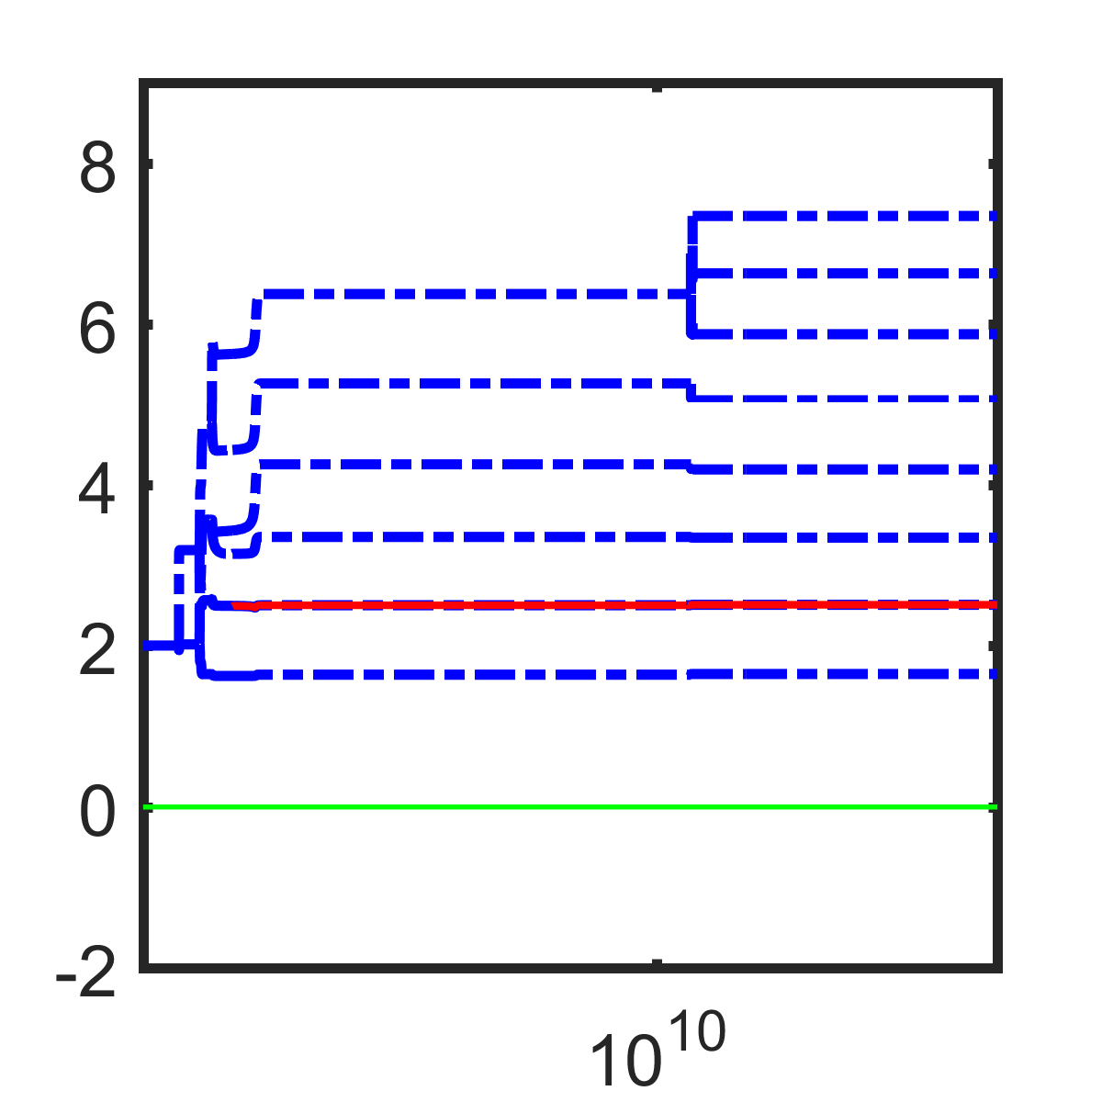
Results
Smaller body size
(a)
(b)
(c)
(d)
Relative body size
Relative body size

Slide 18
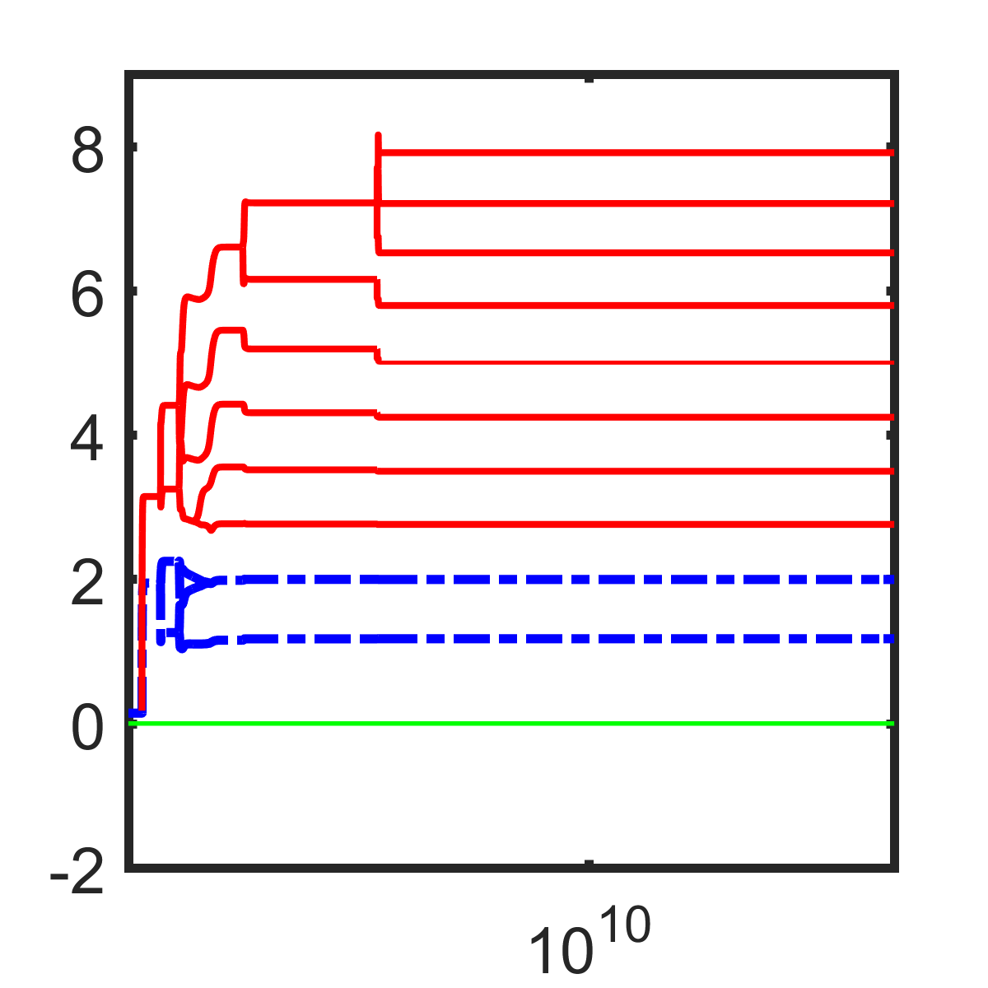
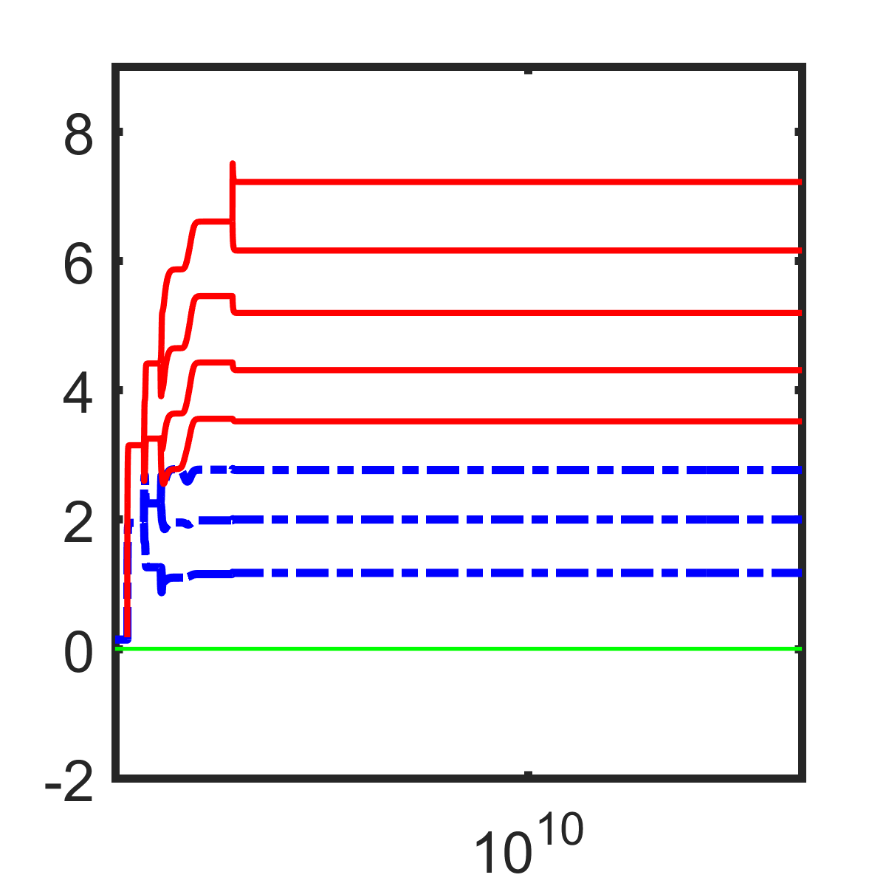
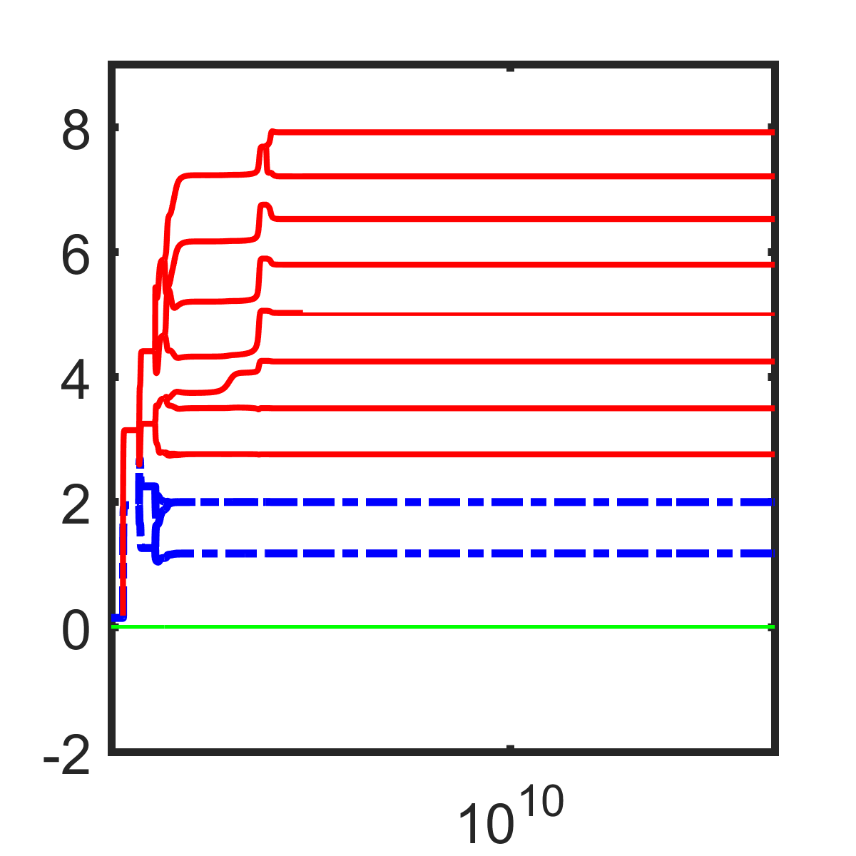
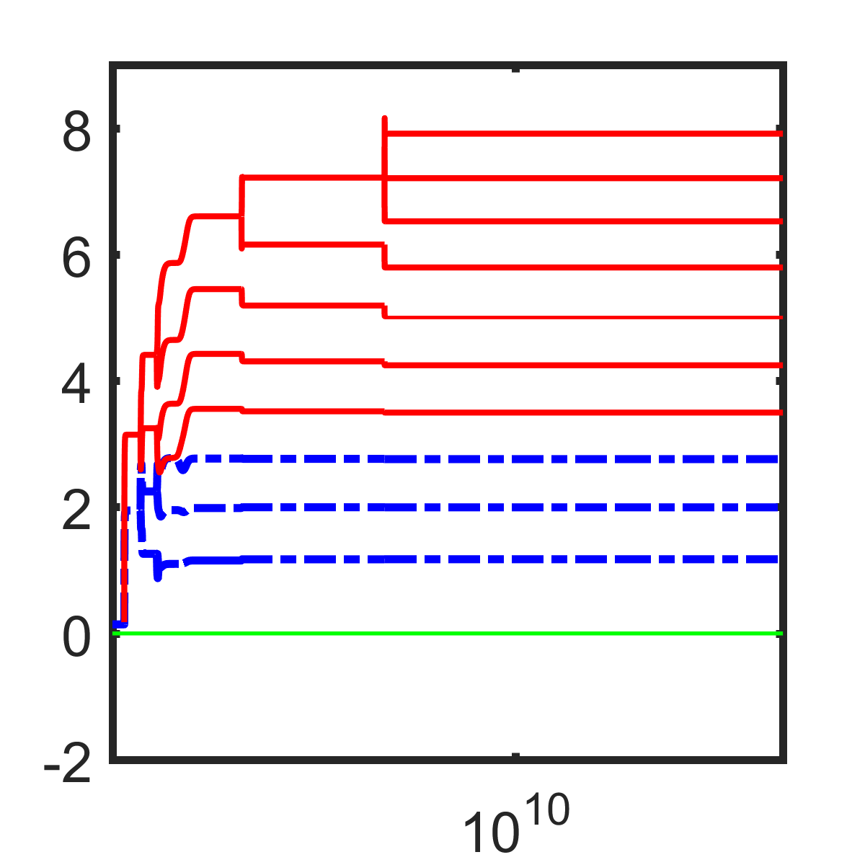
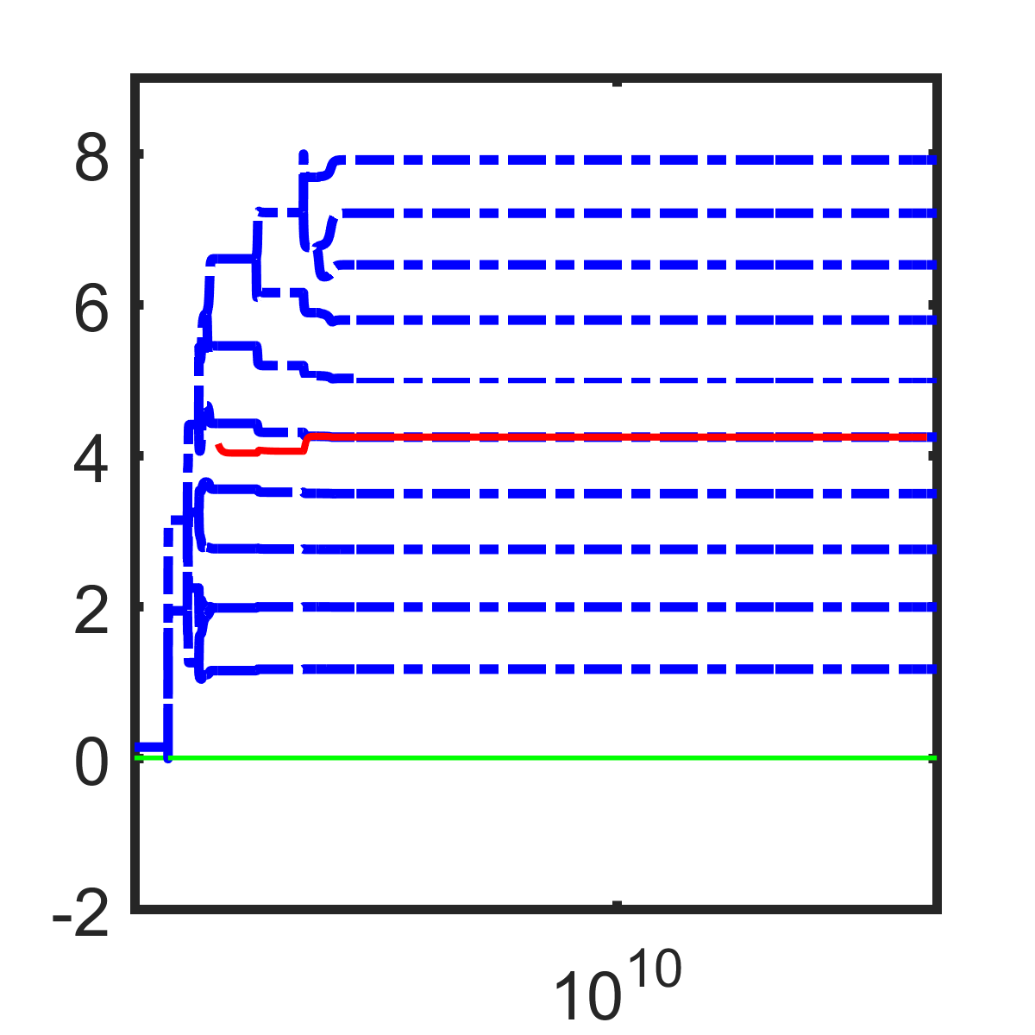
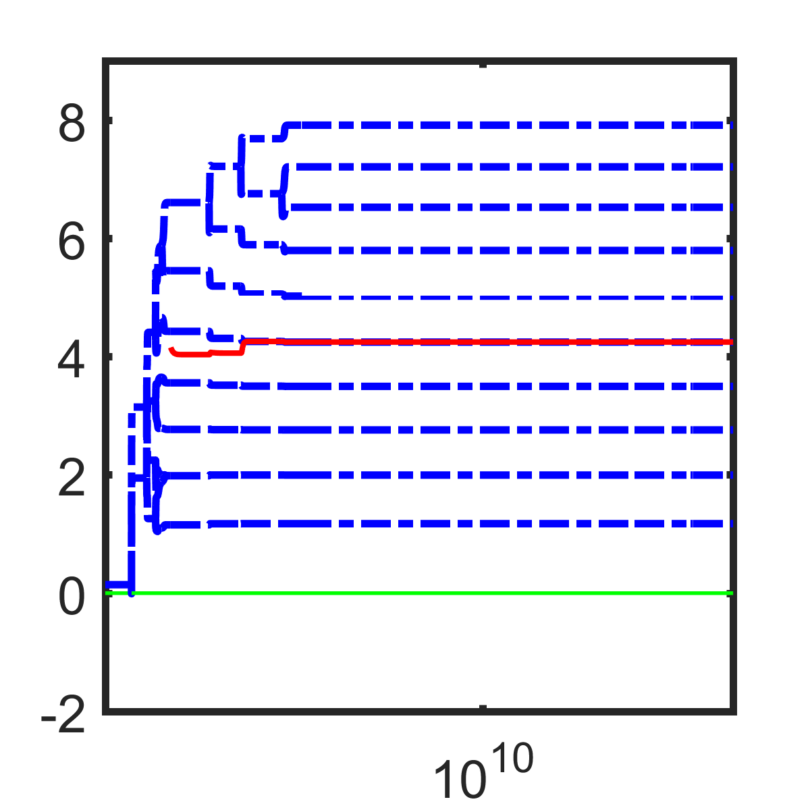
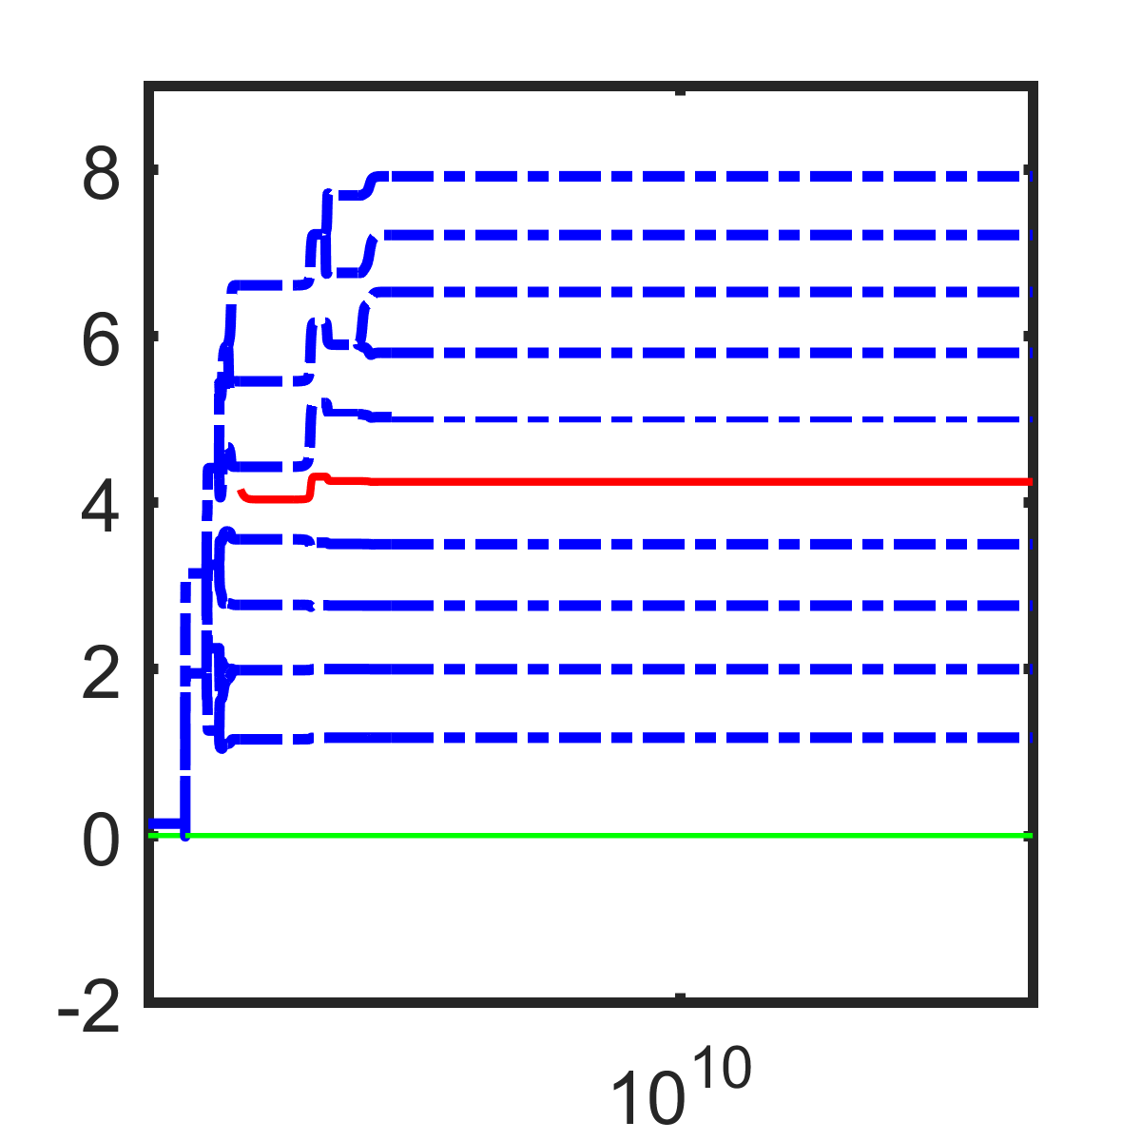
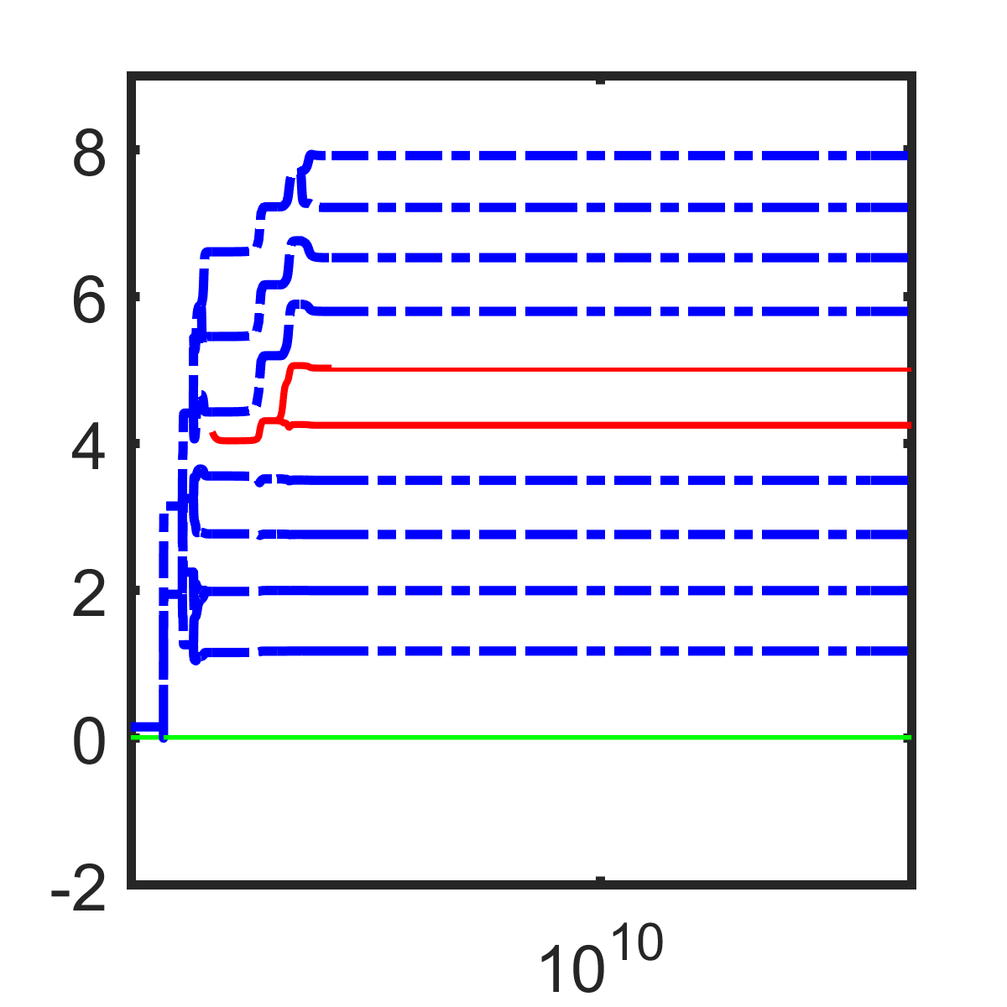
Larger body size
Relative body size
Relative body size

Slide 19
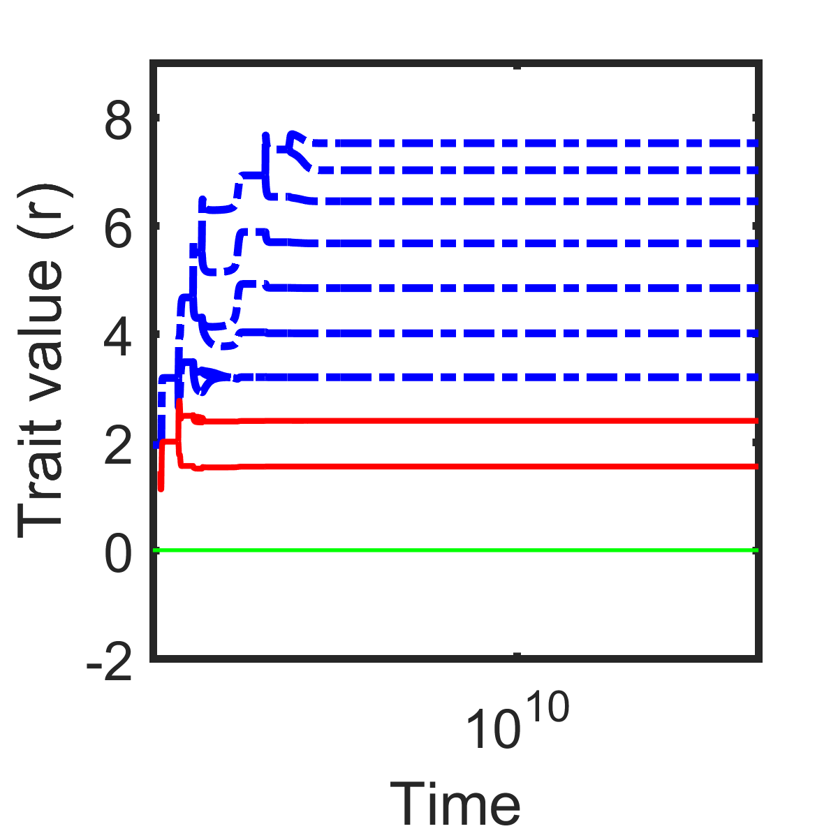
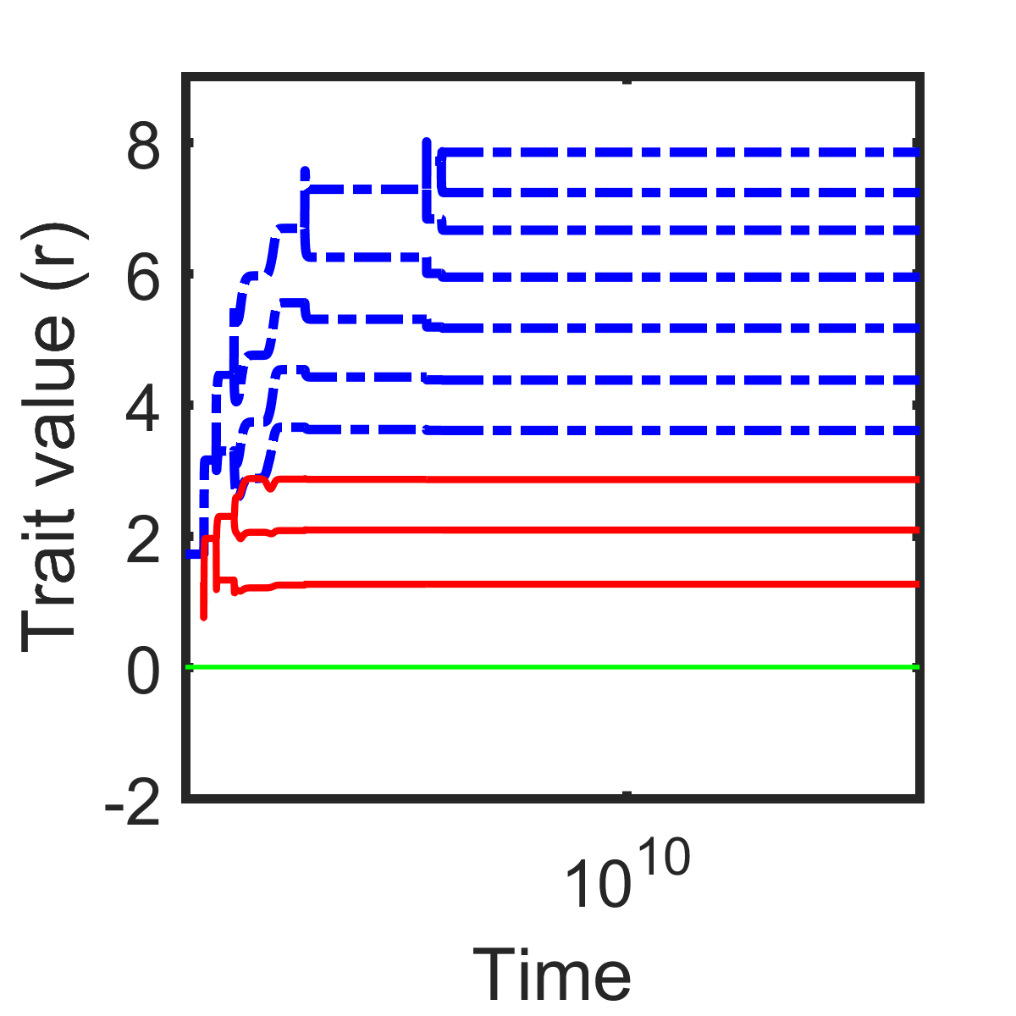
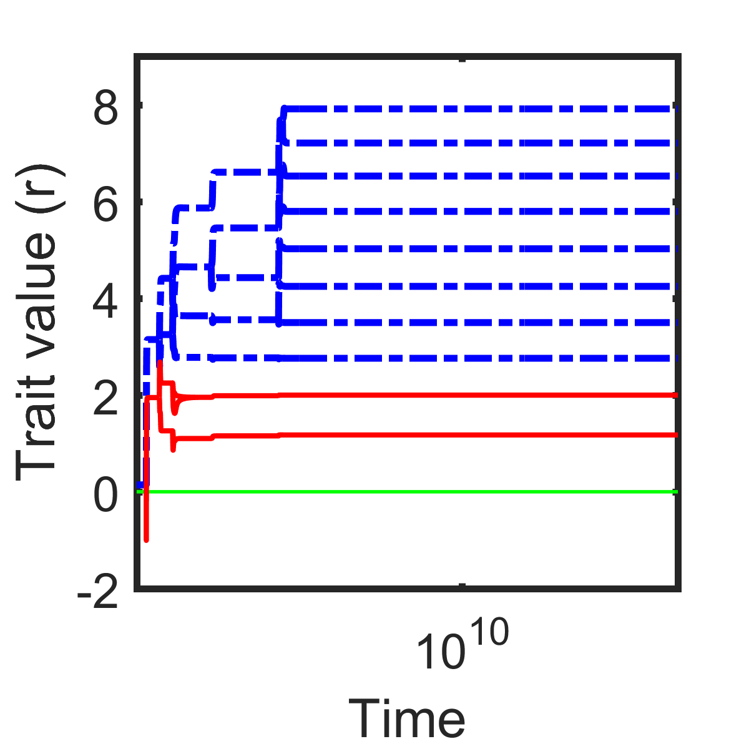
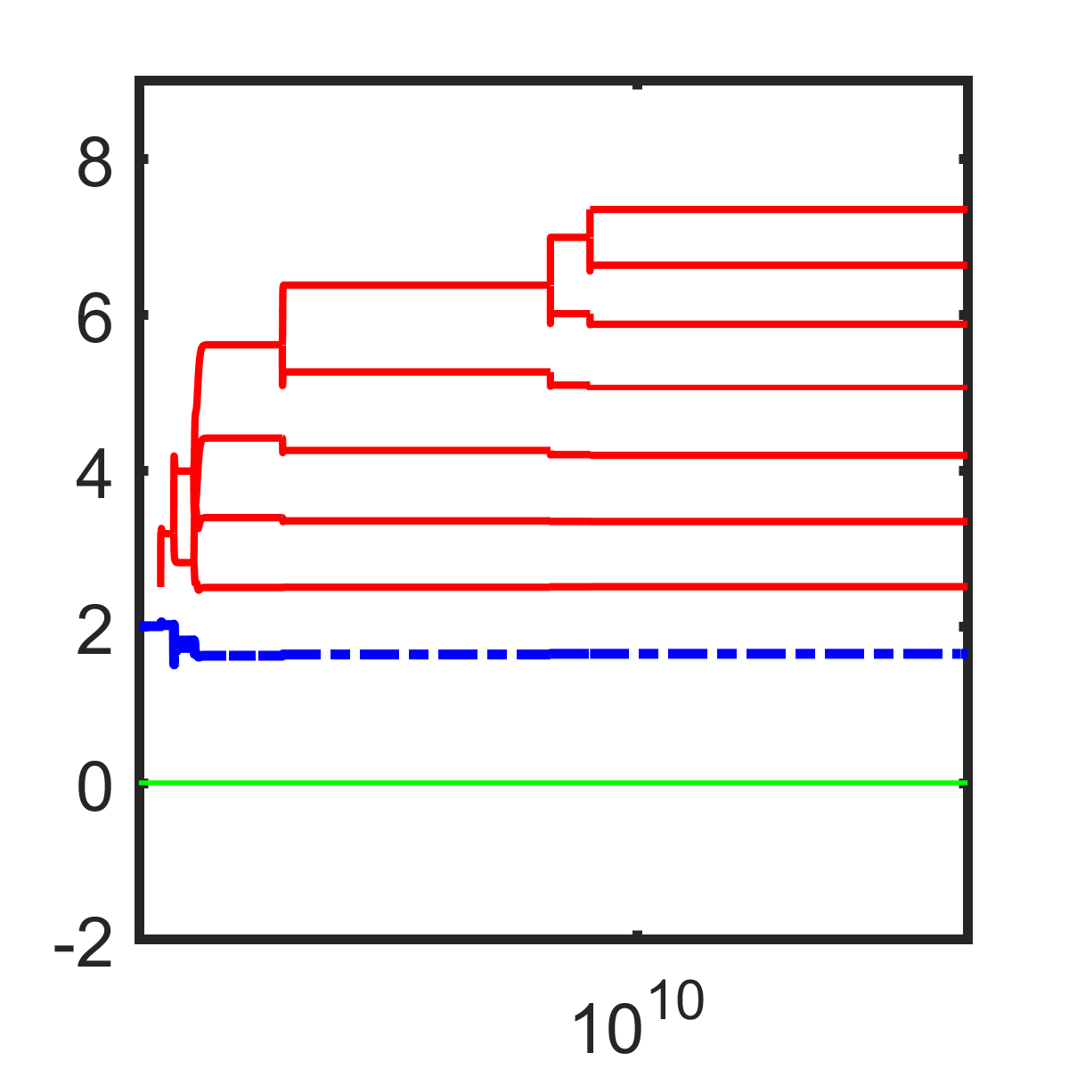
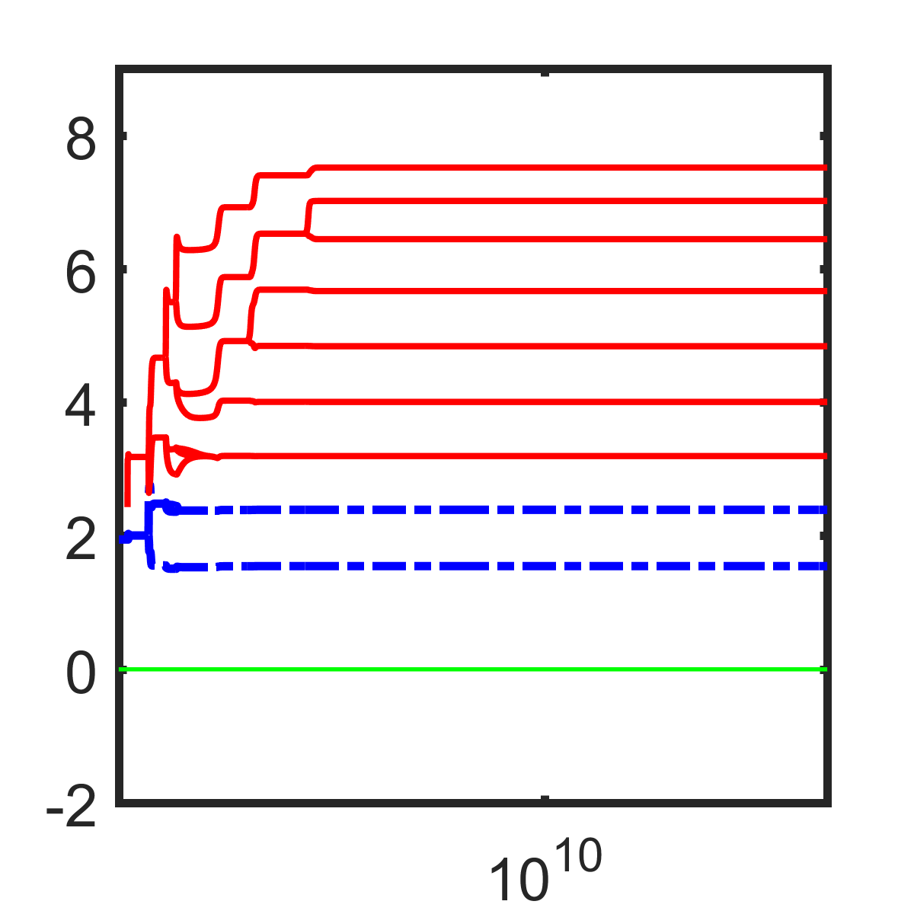
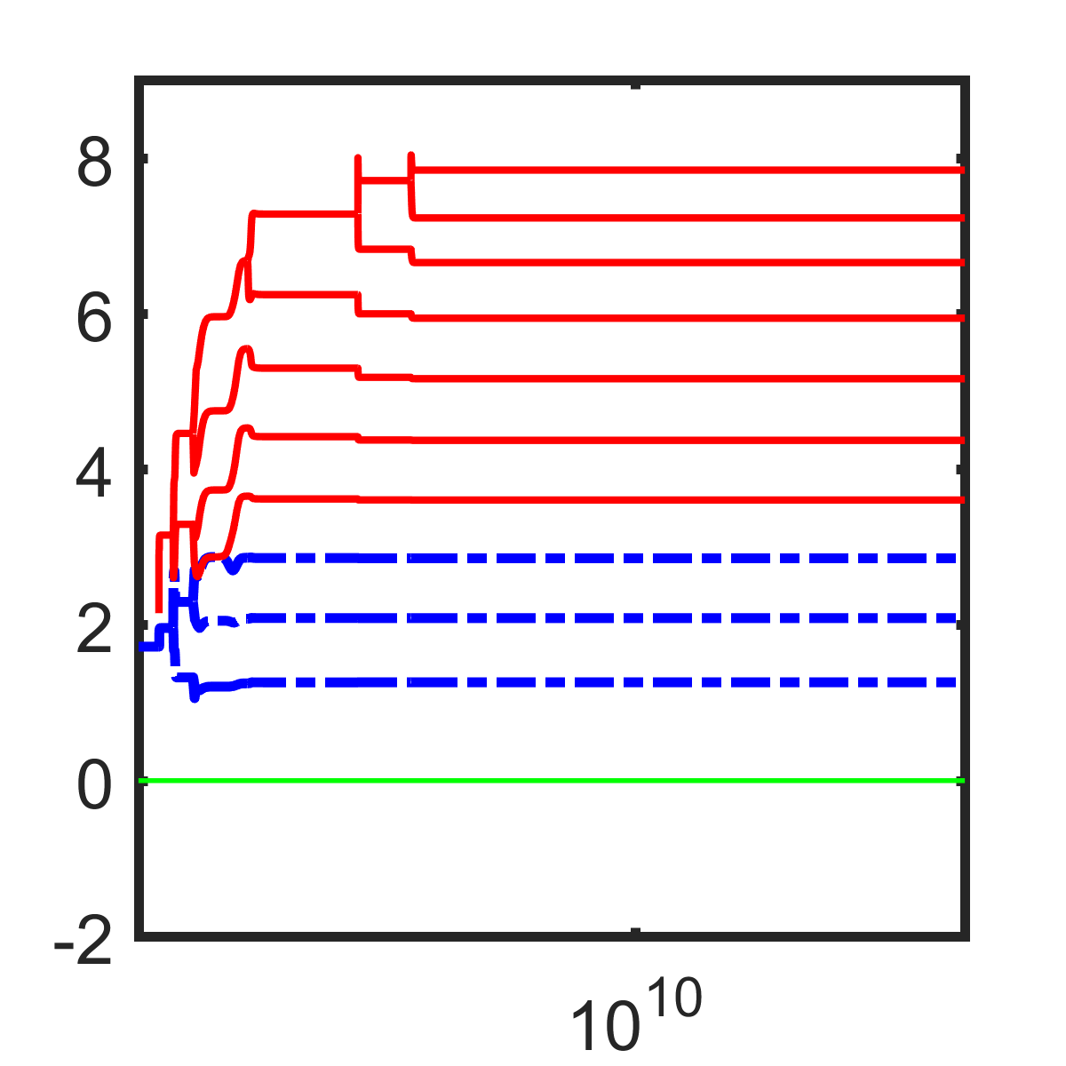
Different handling times
Relative body size

Slide 20
Conclusions
Interplay between ecological and evolutionary dynamics
Non-linear functional response explains existence of evolutionary regime shifts
Food web development and structure
Invasion
Large body size
Propagule pressure (irrelevant if no niche)
Diversity-invasibility hypothesis

Slide 21





Acknowledgements

