Slide 1
Scalar and vector 2D, 3D and 4D Dissipative optical light bullets, Rogue waves in paraxial and nonparaxial optical solitons
DFG-AIMS Workshop on « Evolutionary Processes on Networks » in Kigali, Rwanda
From 20 to 24 March 2018
T. C. Kofane
Department of Physics, Faculty of Science, University of Yaounde I,
P.O Box 812, Yaounde, Cameroon
And
African Centre of Excellence in Information and Communication Technologies, University of Yaounde I, P.O Box 812, Yaounde, Cameroon
This work in collaboration mostly with Martin Djoko and Estelle Temgoua

Slide 2
Introduction
Solitons occur in many scientic fields and have a long history.
The discovery of Optical Solitons dates back to 1971.
Zhakarov and Sabat solved in 1971 the nonlinear Schrödinger (NLS) equation with the inverse scattering method.
Hasegawa and Tappert realized in 1973 that the same NLS equation governs pulse propagation inside optical bers.
They predicted the formation of both bright and dark solitons.
Bright solitons were first observed in 1980 by Mollenauer et al.
By 1987, dark solitons could be formed in laboratory experiments.
Many other types of solitons are possible.
Examples include spatial, vortex, dissipative, necklace-ring, rhombic and grating solitons.

Slide 3
Optical fiber types and their constructions
Basics
Geometry, refractive index profile, in a typical rays in a multimode step-index, multimode graded-index, and a single-mode step-index
Maxwell’s equations
Helmholtz equation
Solution of the wave
equation
Tranverse Electric (TE) /
Transverse Magnetic (TM)
modes
Hybrid modes
Linearly polarized (LP)
modes

Slide 4
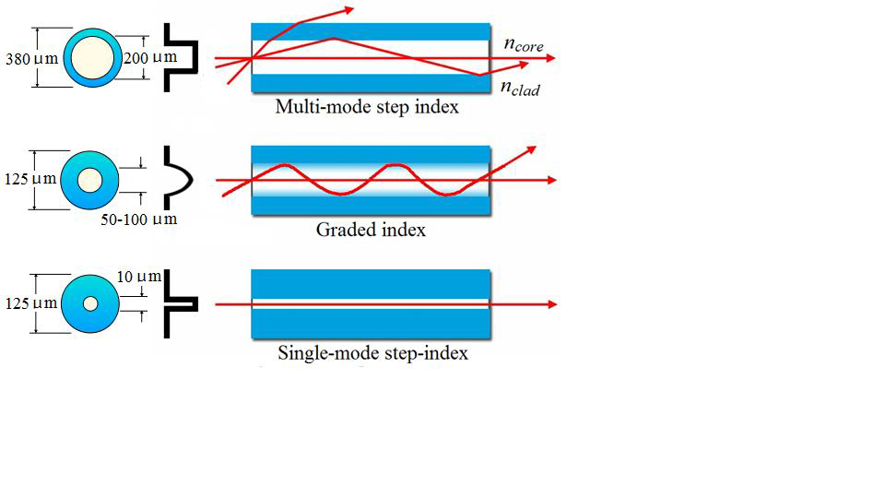
Optical fiber types and their constructions
Fiber Propagation Modes

Slide 5
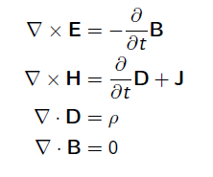
Optical fiber types and their constructions
Light Wave Propagation Model
Maxwell’s equations
Light wave propagation in optical fiber follows by Maxwell’s equations for Electromagnetic Wave
Constitutive relations
E & H are Electric and Magnetic Fields
D & B are their relative flux densities

Slide 6
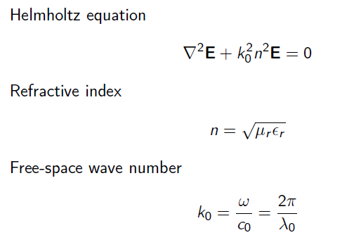
Optical fiber types and their constructions
Light Wave Equation
Using Maxwell’s Equations and Cylindrical symmetry of optical fiber along Z axis, we obtain

Slide 7
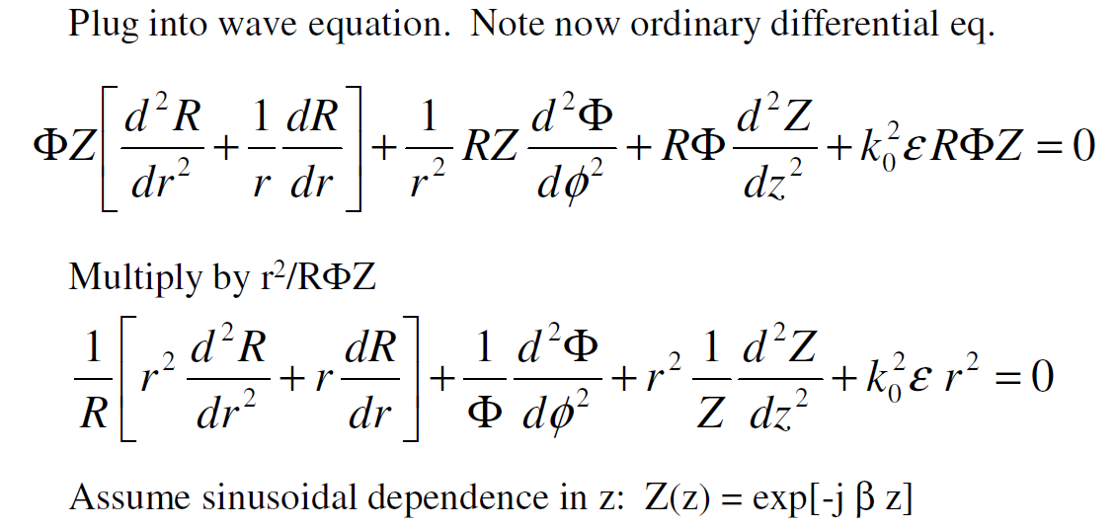
Optical fiber types and their constructions
Light Wave Equation
Using method of separation of variables and rewriting the equation
Resulting in 3 equations:

Slide 8
Optical fiber types and their constructions
Light Wave Equation
Resulting in 3 equations:

Slide 9
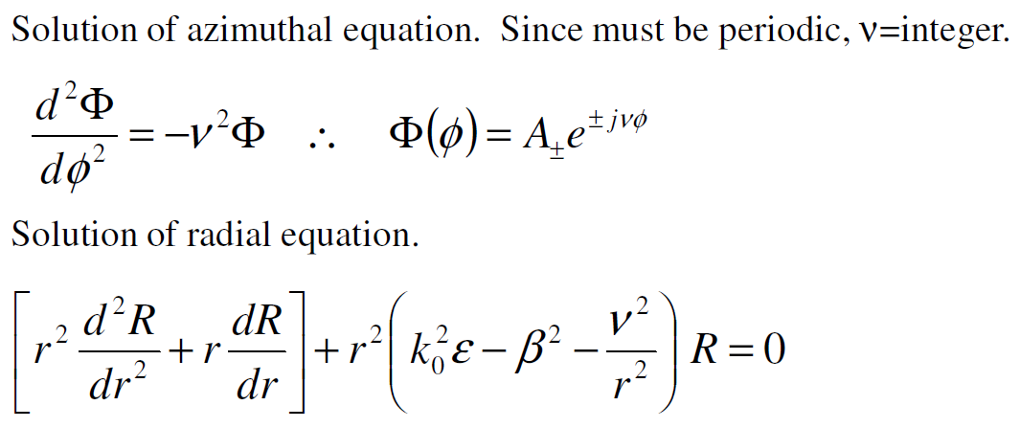
Optical fiber types and their constructions
Light Wave Equation

Slide 10
Optical fiber types and their constructions
Light Wave Equation
The last equations seems to be complex but it is in fact Bessel function of the form

Slide 11
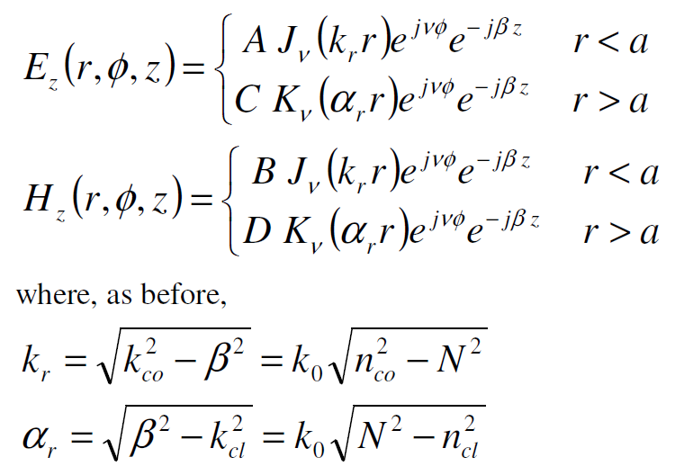
Optical fiber types and their constructions
Forms of Fields
Excluding functions that approach in the core, or in the cladding, we obtain the bounded solutions:
(core)
(cladding)
(core)
(cladding)

Slide 12
Optical fiber types and their constructions
Forms of Fields
Where is the Bessel function of the first kind and order
and is the modified Bessel function of the second kind and order r . The function J oscillates like the sine or cosine function but with a decaying amplitude . The function decays exponentially at large z. Two examples of the radial distribution of and are displayed in the following figures.

Slide 13
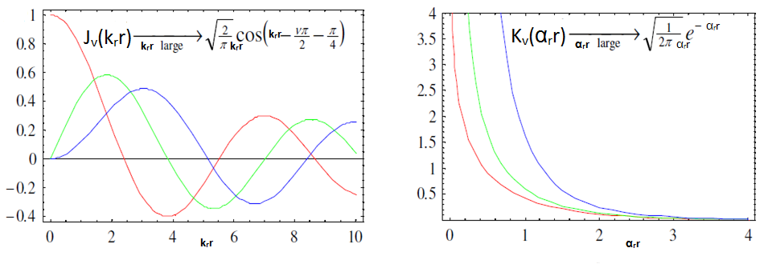
Optical fiber types and their constructions
Forms of Fields

Slide 14
What is an Optical Soliton?
Nonlinear effects arrest pulse broadening resulting from group
velocity dispersion for a specific shape and peak power of input pulses.
The pulse then maintains its input shape and width: It propagates
as an optical bright soliton.
In the case of silica optical fibers, solitons form only if the pulse experiences anomalous dispersion.
Dark solitons form in the normal-dispersion region and appear as
an intensity dip whose shape and size do not change.
Spatial bright and dark Solitons can be formed using Continuous
Wave beams.
Nonlinear effects control diffraction-induced beam spreading in the
case of spatial solitons.

Slide 15
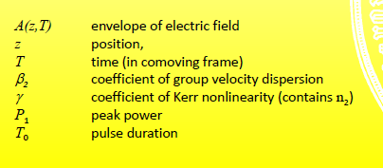
Temporal Bright Solitons

Slide 16
Temporal Bright Solitons

Slide 17
Stability of Optical Solitons

Slide 18
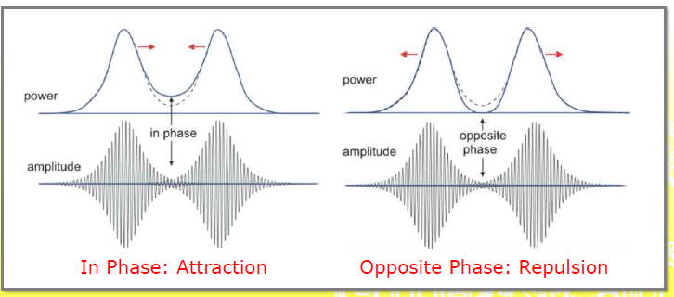
Propagation of light pulses in fiber is dominated by the Nonlinear Schrödinger Equation (NLSE)
Three facts about solitons
Interaction between two solitons

Slide 19
Propagation of light pulses in fiber is dominated by the Nonlinear Schrödinger Equation (NLSE)
Corrections for non-idealized situations
In reality, several corrections may apply: some effects are not captured in the NLSE but may be described by additional terms.

Slide 20
Propagation of light pulses in fiber is dominated by the Nonlinear Schrödinger Equation (NLSE)
Raman scattering and Losses

Slide 21
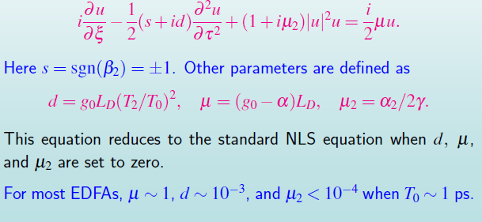
Soliton Formation Amplifiers
New kinds of solitons form inside an optical fiber
These are known as autosolitons or dissipative solitons
Pulse propagation in optical fiber amplifiers is governed by a generalized NLS equation, also known as the complex Ginzburg-Landau equation:

Slide 22
Autosolitons in Optical Fiber Amplifiers

Slide 23
Properties of Autosolitons

Slide 24
Properties of Autosolitons

Slide 25
Properties of Autosolitons

Slide 26
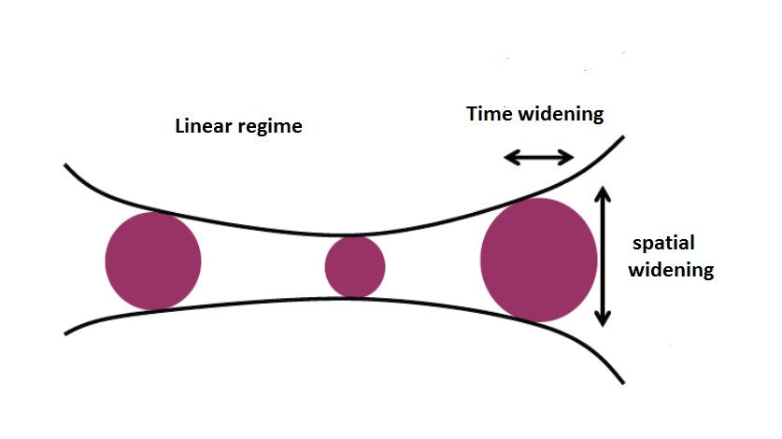
Example of spatiotemporal soliton
Linear Regime
The effects of dispersion and diffraction are visible here, because of the absence of nonlinearities. Therefore, the pulse’s shape is not maintained during propagation.

Slide 27
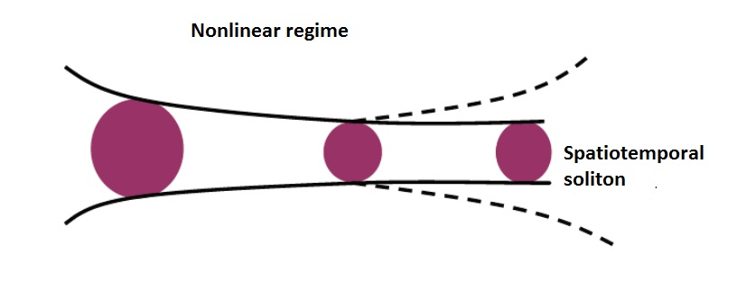
Example of spatiotemporal soliton in nonlinear regime
Nonlinear Regime
Due to the compensation between nonlinearities and dispersion/diffraction, the pulse’s shape is maintained during the propagation

Slide 28
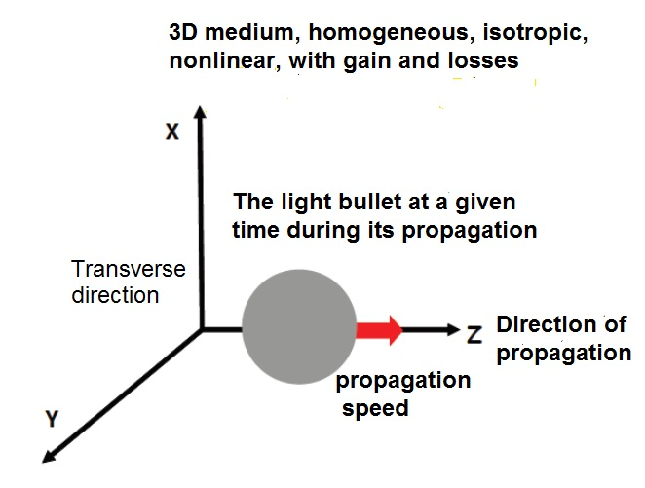
Example of spatiotemporal soliton in 3D medium
Here, there is a visible compensation between nonlinearities and dispersion/diffraction, gains and losses.

Slide 29
Derivation of the higher-order (3 + 1)-dimensional CQS-CGL equation
Optical solitons have promising potential to become principal information carriers in telecommunication due to their robustness and capability of propagating long distance without attenuation and changing their shapes.
As we know, the waveguides used in the picosecond optical pulse propagation in nonlinear optical communication systems are usually of Kerr type and consequently the dynamics of light pulses are described by nonlinear Schrödinger (NLS) family of equations with cubic nonlinear terms .
However, the validity of the NLS equation as a reliable model is dependent on the assumption that the spatial width of the soliton is much larger than the carrier wavelength. This is equivalent to the condition that the width of the soliton frequency spectrum is much less than the carrier frequency.
The high frequency of the optical carrier makes possible a high bit rate, and to increase the bit rate further, it is desirable to use shorter femtosecond pulses and in order to model the propagation of a femtosecond (<100fs) optical pulse in an optical fiber, higher-order 4D-dimentional cubic quintic septic complex Ginzburg-Landau
equation (including optical fiber loss) is required.

Slide 30
Derivation of the higher-order (3 + 1)-dimensional CQS-CGL equation
It is well known that, the cubic (Kerr effect) nonlinearity is related to the value of third-order susceptibility . Moreover, in a recent experiment, it has been established that the optical susceptibility of CdSxSe1−x-doped glass processes a considerable level of fifth-order susceptibility. In semiconductor doubled optical fibers, the doping silica fibers with two appropriate semiconductor particles may lead to an increased value of third-order susceptibility and a decreased value of the fifth-order susceptibility. However, when the saturation is very strong, a self-focusing seventh-order susceptibility is also needed. Quite recently, an experiment has been reported in material such as chalcogenide glass which exhibits not only third-order nonlinearities but even seventh-order nonlinearities. In other words, chalcogenide glass can be classified as a cubic-quintic-septic nonlinear material.

Slide 31
Derivation of the higher-order (3 + 1)-dimensional CQS-CGL equation
To enlarge the information capacity, it is necessary to transmit dissipative solitons at a high bit rate (≈ 1 − 10 fs) of ultrashort pulses, which can be seen in many applicative contexts such as high repetition pulse sources based on fiber as well as on doped fiber technology. Thus, several new effects such as higher-order dispersion term up to six, self-steepening (Kerr dispersion), self-frequency shift (SFS) arising from stimulated Raman scattering and cubic, quintic, septic nonlinearities of dispersive and dissipative types greatly influence the propagation properties of optical pulses.
In this case, the governing equation that we will derive in the paraxial wave approximation, to describe light bullets and which is based on the above cited effects, is called the higher-order (3 + 1)D cubic-quintic-septic complex Ginzburg–Landau (CQS-CGL) equation.

Slide 32
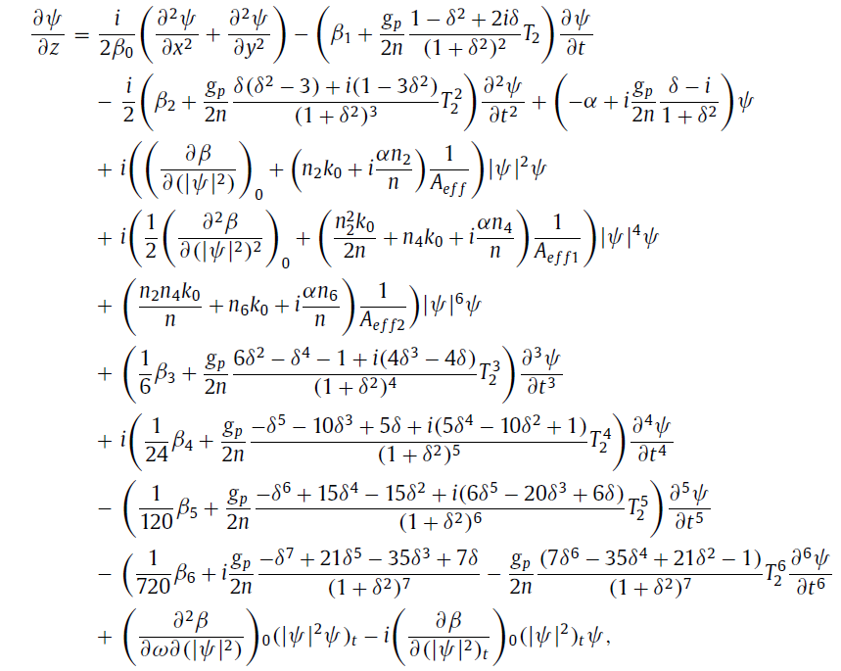
Derivation of the higher-order (3 + 1)-dimensional CQS-CGL equation

Slide 33
Derivation of the higher-order (3 + 1)-dimensional CQS-CGL equation
The starting point to derive the above equation is the following wave equation
The linear and the nonlinear part of the induced polarization are related to the electric field E

Slide 34
Derivation of the higher-order (3 + 1)-dimensional CQS-CGL equation
In the slowly varying envelope approximation, it useful to separate the rapidly varying part of the electric field writing as:
In order to obtained the wave equation for the slowly varying envelope E(r, t), it is convenient to work in the Fourier domain. Substituating the above equation in the wave equation, the Fourier transform defined as:

Slide 35
Derivation of the higher-order (3 + 1)-dimensional CQS-CGL equation
Is found to satisfied the Helmohtz equation
Complex dielectric constant
Refractive index of the fiber
We have

Slide 36
Derivation of the higher-order (3 + 1)-dimensional CQS-CGL equation
Then
The atomic response which can be included through the susceptibility of two-level system is given as

Slide 37
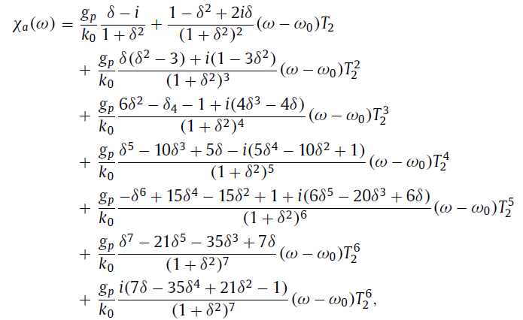
Derivation of the higher-order (3 + 1)-dimensional CQS-CGL equation

Slide 38
Derivation of the higher-order (3 + 1)-dimensional CQS-CGL equation
The Helmohtz equation can be solved by using the method of separation of variables. If we assume the solution of the form
Where is the slowly varying function of Z and the center wave number and
the modal distribution of the fundamental fiber mode. Combining those equation in the above wave equation, we obtain
we have approximated

Slide 39
Derivation of the higher-order (3 + 1)-dimensional CQS-CGL equation
Inserting this equation to the previous one, we obtain

Slide 40
Derivation of the higher-order (3 + 1)-dimensional CQS-CGL equation
Inserting this equation to the previous one, we obtain the following equation:

Slide 41
Derivation of the higher-order (3 + 1)-dimensional CQS-CGL equation

Slide 42
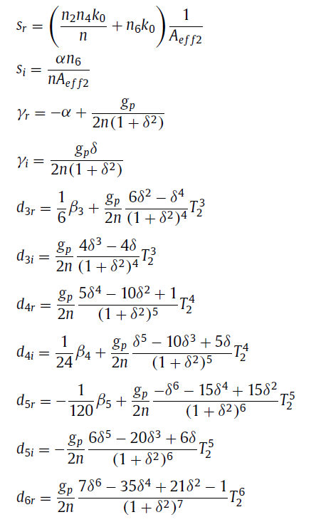
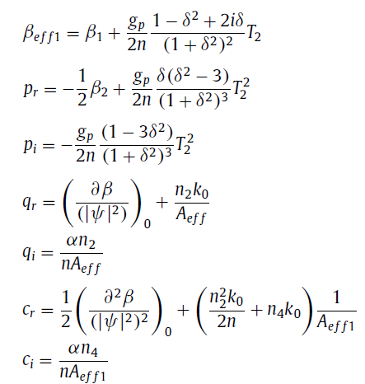
Derivation of the higher-order (3 + 1)-dimensional CQS-CGL equation
Where

Slide 43
Derivation of the higher-order (3 + 1)-dimensional CQS-CGL equation
and
We obtain the higher-order (3+1) CQS-CGL equation which models the propagation of ultrashort optical soliton in an doped optical fiber

Slide 44
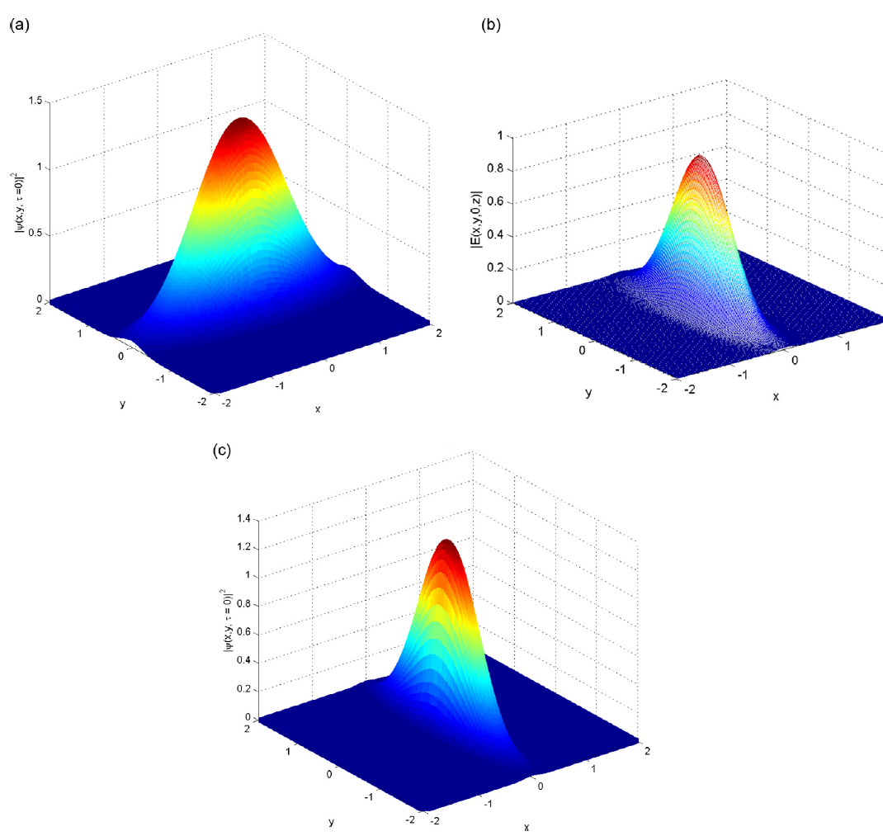
Stable solutions from the higher-order (3 + 1)-dimensional CQS-CGL equation obtained with the most popular Gaussian pulse shape
Bell-shaped dissipative light bullets in propagation regime of (a) anomalous dispersion , (b) zero dispersion, (c) normal dispersion . The Gaussian pulse shape is given below:

Slide 45
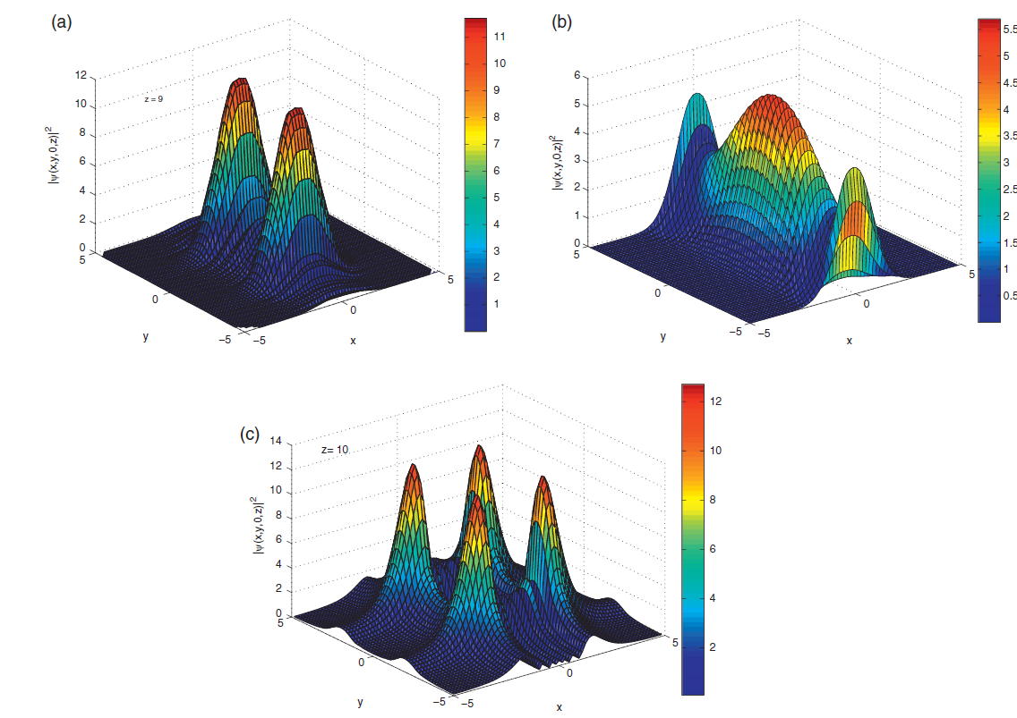
Stable solutions from the higher-order (3 + 1)-dimensional CQS-CGL equation obtained with the most popular Gaussian pulse shape
Spatial transverse profiles of the dissipative light bullets illustrating the formation of pulsating optical bullet complexes: (a) Double bullet complexes, (b) Triple bullet complexes and (c) Quadruple bullet complexes obtained from numerical simulation of the model equation

Slide 46
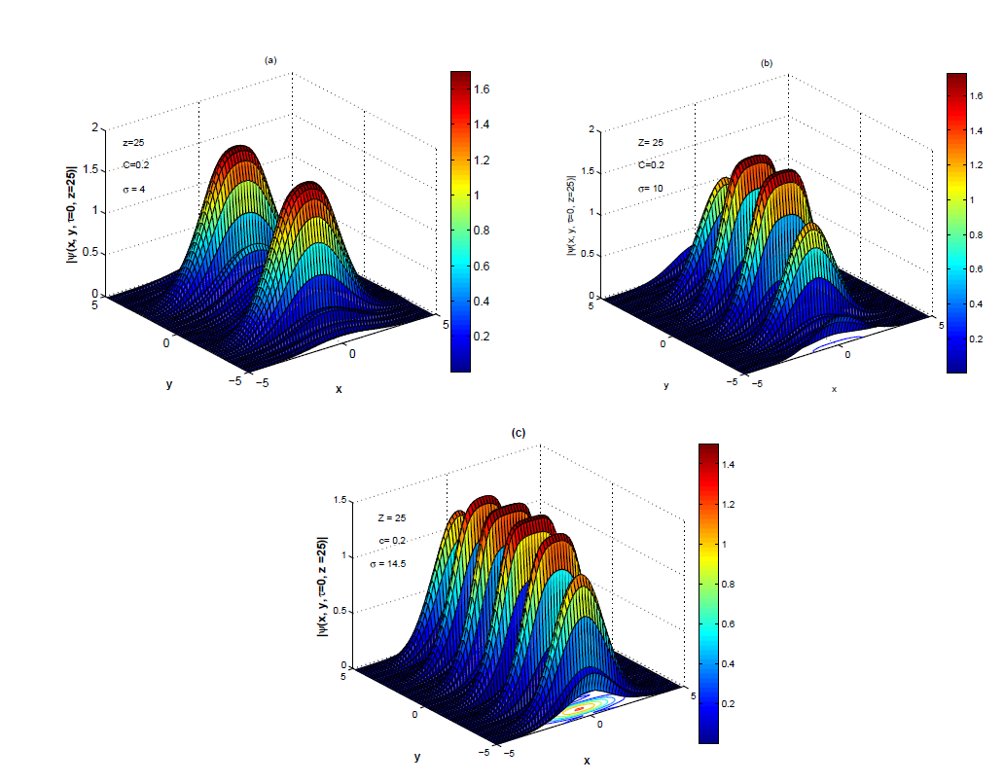
Stable solutions from the higher-order (3 + 1)-dimensional CQS-CGL equation obtained with the most popular Gaussian pulse shape
Other types of spatial profile of light bullets (a): double bullet complexes (b): quadruple bullet complexes (c): sixfold bullet complexes obtained from full numerical simulation of the model equation

Slide 47
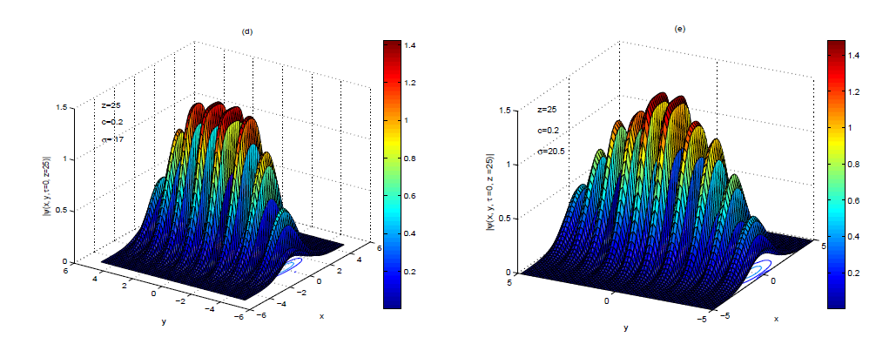
Stable solutions from the higher-order (3 + 1)-dimensional CQS-CGL equation obtained with the most popular Gaussian pulse shape
Other types of spatial profile of light bullets (d): eightfold bullet complexes (e): tenfold bullet complexes obtained from full numerical simulation of the model equation

Slide 48
Stable solutions from the higher-order (3 + 1)-dimensional CQS-CGL equation obtained with the most popular Gaussian pulse shape
The stability is studied numerically by introducing focusing and chirping as well as 5%, complex-valued random noise both in x and in y leading to the following initial condition

Slide 49
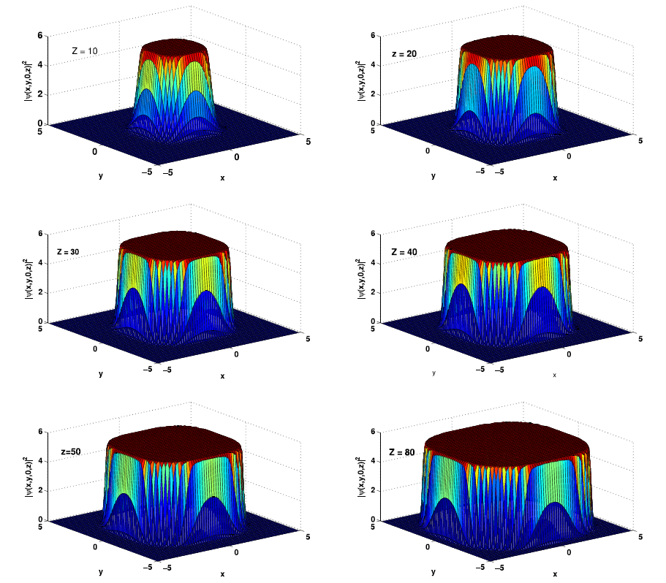
Stable solutions from the higher-order (3 + 1)-dimensional CQS-CGL equation obtained with the Generalized-Gaussian pulse shape
3D stable spatiotemporal soliton profiles of the dissipative light bullet obtained from direct numerical simulation of the model equation
The Generalized-Gaussian pulse shape

Slide 50
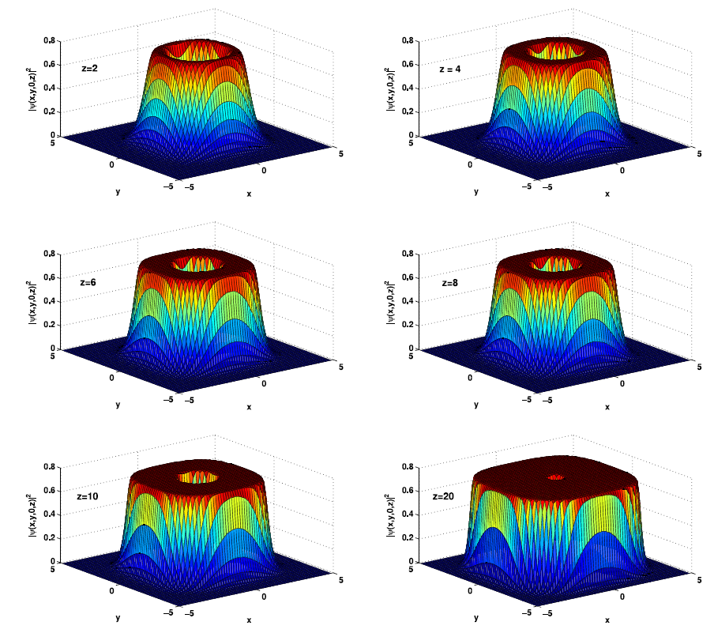
Stable solutions from the higher-order (3 + 1)-dimensional CQS-CGL equation obtained with the Generalized-Gaussian pulse shape
3D stable vortex soliton profiles of the dissipative light bullet obtained from direct numerical simulation of the model equation

Slide 51
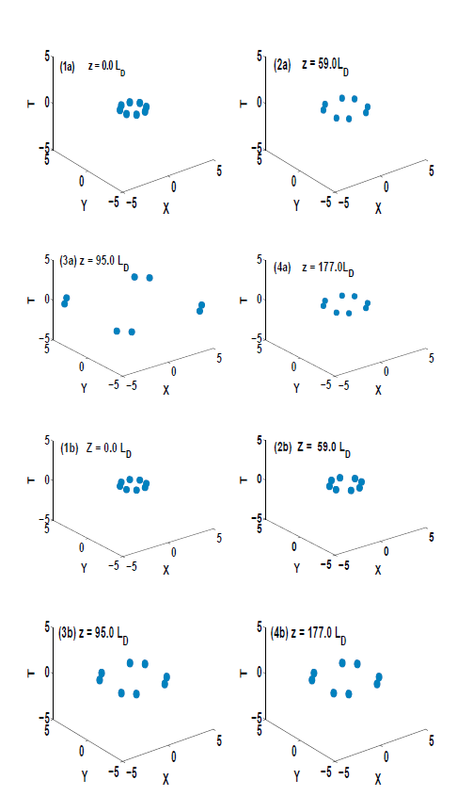
Stable solutions from the higher-order (3 + 1)-dimensional CQS-CGL equation obtained from direct numerical simulation of the model equation
Evolutions of the spatiotemporal necklace-ring solitons carrying (a) m = 0, and (b) m = 8 angular momentum vs the distance z in the presence of noise.

Slide 52
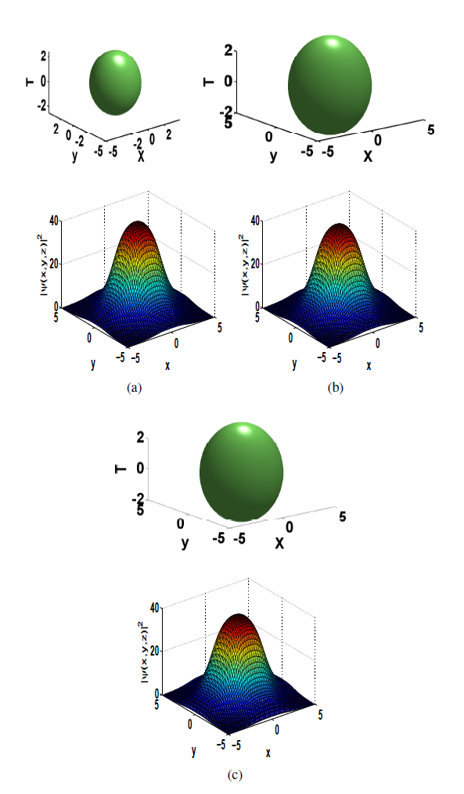
Stable solutions from the higher-order (3 + 1)-dimensional CQS-CGL equation obtained from direct numerical simulation of the model equation
Isosurface plots and the intensity distributions of light bullets

Slide 53
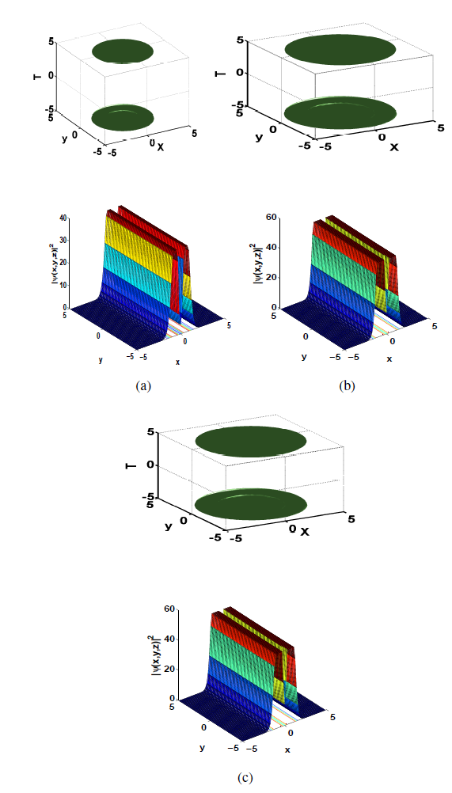
Stable solutions from the higher-order (3 + 1)-dimensional CQS-CGL equation obtained from direct numerical simulation of the model equation
Isosurface plots and the intensity distribution of light bullets in x-y plane, showing the evolution of two typical stable rhombic vortex solitons

Slide 54
Stable solutions from the higher-order (3 + 1)-dimensional CQS-CGL equation obtained from direct numerical simulation of the model equation
The stability is studied numerically by introducing focusing and chirping as well as 5%, complex-valued random noise both in x and in y leading to the following initial condition

Slide 55
Conclusion
We have presented some overview results of exciting research in the field of nonlinear singular optics that study the propagation of optical vortices and optical beams carrying an angular momentum in nonlinear media.
Understanding and controlling the properties of optical vortices could lead to applications in the near future, ranging from optical communications and data storage to the trapping, control, and manipulation of particles and cold atoms. Indeed, optical vortices provide an efficient way to control light by creating reconfigurable waveguides in bulk media. The study of phase singularities in optical parametric processes not only suggests novel directions of fundamental research in optics, but also provides links to other branches of physics.
For example, the recent discovery of a rich variety of exotic topological defects in unconventional superfluids (such as ³He-A) and superconductors points to the likelihood that deep analogies exist between vortices in complex superfluids and singularities in light waves.

Slide 56
REFERENCES
[1] G. A. Swartzlander and C. T. Law, Phys. Rev. Lett. 69, 2503 (1992).
[2] M. Soljacic, S. Sears and M. Segev, Phys. Rev. Lett. 81, 4851 (1998).
[3] M. Soljacic and M. Segev, Phys. Rev. Lett. 86, 420 (2001).
[4] A. S. Desyatnikov and Y. S. Kivshar, Phys. Rev. Lett. 88, 053901 (2002)
[5] L. F. Mollenauer , R. H. Stolen , and J. P. Gordon, Phys. Rev. Lett. 45 , 1095 (1980).
[6] H. Nakatsuka, D. Grischkowsky, and A. C. Balant, Phys. Rev. Lett. 47, 910 (1981).
[7] D. Mihalache, D. Mazilu, L-C. Crasovan, I. Towers, B. A. Malomed, A. V. Buryak, L. Torner,
and F. Lederer, Phys. Rev. Lett. 88, 073902 (2002).
[8] N. K. Efremidis, K. Hizanidis, B. A. Malomed, and P. D. Trapani, Phys. Rev. Lett. 98, 113901
(2007).
[9] D. Mihalache, D. Mazilu, F. Lederer, Y. V. Kartashov, L-C. Crasovan, L. Torner, and B. A. Malomed, Phys. Rev. Lett. 97, 073904 (2006).
[10] V. Skarka, N. B. Aleksic, H. Leblond, B. A. Malomed, D. Mihalache, Phys. Rev. Lett. 105, 213901 (2010).
[10] Martin Djoko and T. C. Kofane, Commun. Nonlinear Sci. Numer. Simulat. 48, 179 (2017)
[11] Martin Djoko and T. C. Kofane, Opt. Commun. 416, 198-201 (2018)

Slide 57
Thank you very much for your kind attention

