Slide 1
Life after Metformin!
Prof Paul Rheeder
Department Internal Medicine
University of Pretoria

Slide 2
Disclosures
Lilly Global Health Partnership funding the TIP programme at UP
Some of the slides from Lilly
Novo funded academic consortium with WITS and SMU

Slide 3
Case study
56 year old Mr N with T2DM x 2 years
On Metformin 850mg tds, Glimepiride 4 mg mane.
BMI 33
BP 146/88 mm Hg on Enalapril 10mg bd
LDL 3.2 mmol/l on Simvastatin 40 mg nocte
HbA1c 8.4%
What next? What other information do I need?

Slide 4
Glucose Goals
Hba1c evaluates glucose control over last 3 months
Target is below 7% for most patients
Latest 2021 Adult Guidelines say below 8%
In practice aim for 7% but between 7 and 8% reinforce compliance, check doses etc.
Above 8% intensify treatment

Slide 5

B1: Blood Glucose :EDL 2018
Notes:
Standard treatment guidelines 2014. Primary health care level

Slide 6
Setting Targets and Managing Hyperglycaemia
Patient/Disease Features
More Stringent ← HbA1c 7% → Less Stringent
Risks potentially associated with
hypoglycaemia and other drug adverse effects
Low
High
Disease duration
Newly diagnosed
Long standing
Life expectancy
Long
Short
Relevant comorbidities
Absent
Few/mild
Severe
Established vascular complications
Absent
Few/mild
Severe
Patient attitude and expected treatment efforts
Highly motivated, excellent self-care capabilities
Less motivated, poor self-care capabilities
Resources and support system
Readily available
Limited
Notes:
Key Points:
Numerous aspects must be considered when setting glycaemic targets
The American Diabetes Association proposes optimal targets, but each target must be individualised to the needs of each person with diabetes and his or her disease factors
When possible, such decisions should be made with the person with diabetes, reﬂecting his or her preferences, needs, and values
An insulin-treated person with diabetes with impaired awareness of hypoglycaemia or an episode of clinically signiﬁcant hypoglycaemia should be advised to raise their glycaemic targets to strictly avoid hypoglycaemia for at least several weeks to partially reverse impaired awareness of hypoglycaemia and reduce risk of future episodes
Reference:
American Diabetes Association. Standards of medical care in diabetes – 2018. Diabetes Care. 2018; 41(suppl 1):S1-S157.

Slide 7
Treatment Pathways
In The Past / Public sector
Stepwise
Metformin then add Sulphonylurea
Then add Insulin

Slide 8
A Stepwise Approach – Treat to Failure
OAM
monotherapy
uptitration
OAM +
multiple daily
insulin injections
Diet and
exercise
OAM
monotherapy
OAM
combination
OAM +
basal insulin
10
Complications²
9
Mean
HbA1c (%)¹
8
7
6
Duration of Diabetes
Notes:
Note to Speaker:
Optional slide
Copyright Disclosure: Figure has been recreated for Eli Lilly and Company with data from Del Prato S, et al. Int J Clin Pract. 2005;59:1345-1355.
Key Points:
With the traditional stepwise approach for diabetes treatment, insulin is initiated at a late stage of disease progression
The traditional approach has a number of drawbacks:
Unacceptable delays in achieving and maintaining glycaemic goals
Delays in transitioning from monotherapy to combination therapy
References:
Del Prato S, Felton AM, Munro N, et al. Improving glucose management: ten steps to get more patients with type 2 diabetes to glycaemic goal: Recommendations from the Global Partnership for Effective Diabetes Management. Int J Clin Pract. 2005;59(11):1345-1355.
Stratton IM, Adler AI, Neil HA, et al. Association of glycaemia with macrovascular and microvascular complications of type 2 diabetes (UKPDS 35): prospective observational study. BMJ. 2000;321(7258):405-412.

Slide 9
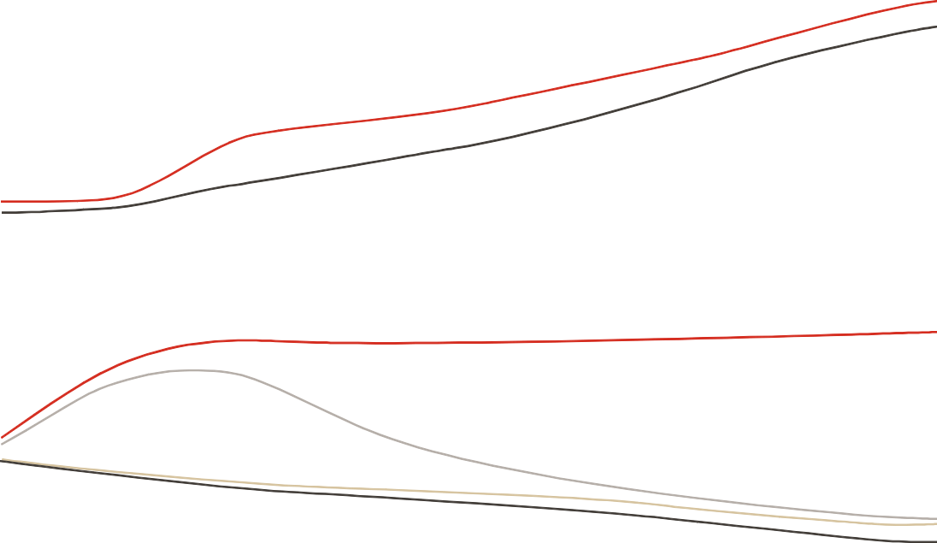
T2D Is a Progressive Disease^{1,2}
350
Prediabetes
metabolic syndrome
Diabetes
diagnosis
300
250
Glucose (mg/dL)
200
Postmeal glucose
150
50% reduction
100
Fasting glucose
50
-15
-10
-5
0
5
10
15
20
25
30
in β-cell function
at the time of diagnosis of T2D²
250
Insulin resistance
200
150
Insulin level
Decline in
β-cell function
is progressive²
Relative Function
Incretin effect
100
50
β-cell function
0
Onset of
diabetes
-15
-10
-5
0
5
10
15
20
25
30
Years
Notes:
Note to Speaker:
Click once to reveal the right side of the graph
Key Points:
T2D results from the combination of resistance to insulin action, inadequate insulin secretion, and excessive or inappropriate glucagon secretion³
It is a progressive disease in which ß-cell function continually declines after diagnosis⁴
Many patients eventually need insulin because of advanced insufficiency in insulin secretion⁵
Treatment requires gradual intensification to compensate for increasing loss of insulin production⁵
Additional Information:
β-cell failure is progressive. By the time diabetes is clinically diagnosed, β-cell function may be reduced by as much as 50% of normal¹
Thereafter, β-cell function continues to decline; there is an additional approximate 20% decrease in β-cell function 6 years after diagnosis¹
Recent data suggest that onset of T2D may be 4-6 years before a clinical diagnosis is reached—a much shorter period of time than previous estimates (>10 years per UK Prospective Diabetes Study [UKPDS] data)⁶
References:
Kendall DM, Cuddihy RM, Bernenstal RM. Clinical application of incretin-based therapy: therapeutic potential, patient selection and clinical use. Am J Med. 2009;122(suppl 6):S37-S50.
DeWitt DE, Hirsh IB. Outpatient insulin therapy in type 1 and type 2 diabetes. JAMA. 2003;289(17):2254-2264.
Khardori R. Type 2 diabetes mellitus. 2017. http://emedicine.medscape.com/article/117853-overview. Accessed 1 November 2017.
UK prospective diabetes study 16. Overview of 6 years' therapy of type II diabetes: a progressive disease. UK Prospective Diabetes Study Group. Diabetes. 1995;44(11):1249-1258.
Christiansen JS, Liebl A, Davidson JA, Ligthelm RJ, Halimi S. Mid- and high-ratio premix insulin analogues: potential treatment options for patients with type 2 diabetes in need of greater postprandial blood glucose control. Diabetes Obes Metab. 2010;12(2):105-114.
Porta M, Curletto G, Cipullo D, et al. Estimating the delay between onset and diagnosis of type 2 diabetes from the time course of retinopathy prevalence. Diabetes Care. 2014;37(6):1668-1674.

Slide 10

Tight Glycaemic Control Can Reduce Complicationsª
Epidemiological Extrapolation Showing Benefit of a 1% Reduction in Mean HbA1c
HbA1c
1%
37%
12%
Microvascular disease^{b}
43%
14%
Stroke^{c}
Amputation
or death due to peripheral vascular
disease^{b}
21%
Acute myocardial infarction^{b}
T2D-related deaths^{b}
Notes:
Copyright Disclosure: Figure created for Eli Lilly and Company based on data from Stratton 2000. Individual images are original Lilly images or adapted from images available in the public domain (https://commons.wikimedia.org/wiki/File:Surface_projections_of_the_organs_of_the_trunk.png#/media/File:Man_shadow_with_organs.png).
Key Point:
One of the major defining principles of the current treatment paradigm is the idea that for each 1% reduction in HbA1c, there is an associated reduction in the risk of diabetes-related complications, as evidenced in the UKPDS trial
Reference:
Stratton IM, Adler AI, Neil HA, et al. Association of glycaemia with macrovascular and microvascular complications of type 2 diabetes (UKPDS 35): prospective observational study. BMJ. 2000;321(7258):405-412.

Slide 11
Treatment Pathways
Latest strategy
Driven by latest research that shows benefit of new treatments

Slide 12
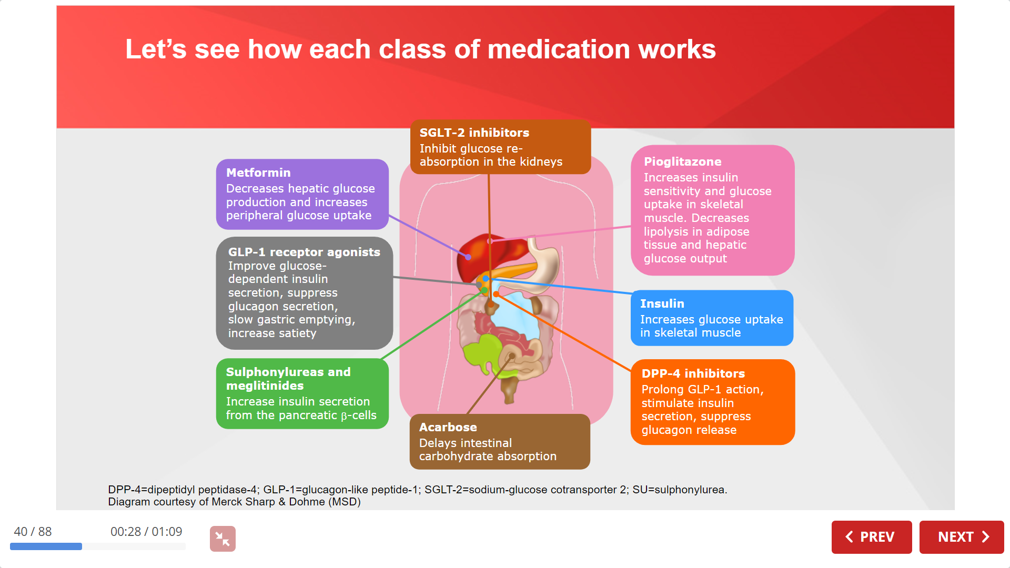
Overview of treatment options

Slide 13
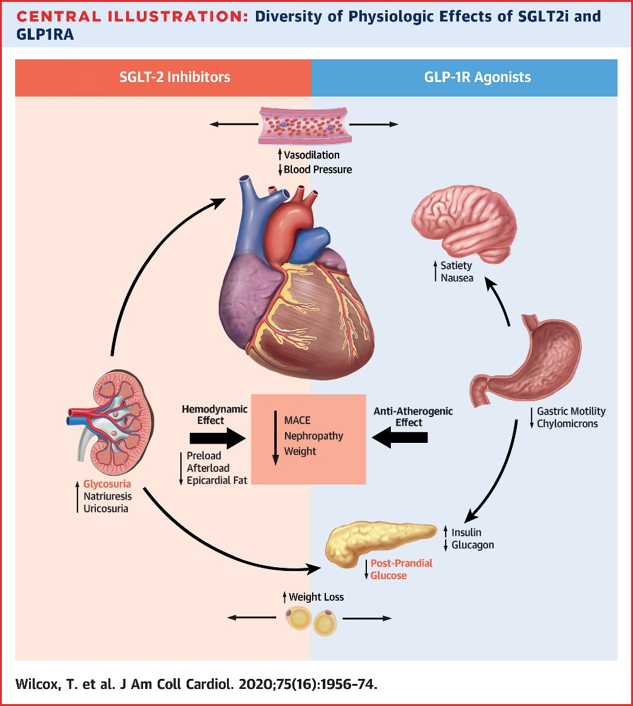
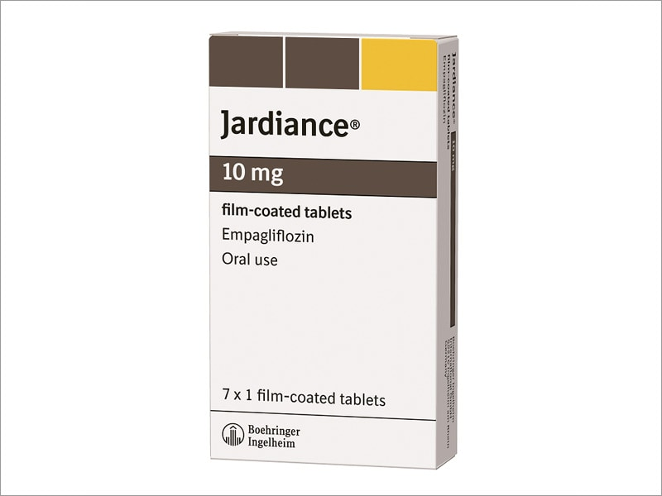


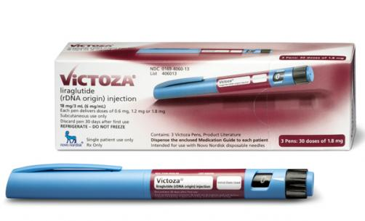
The latest additions

Slide 14
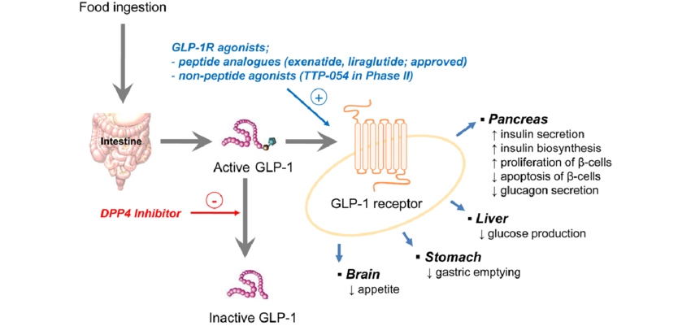
GLP1 and DDP4 inhibitors

Slide 15
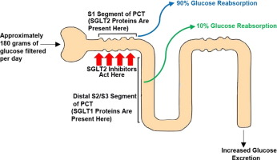
SGLT2 inhibitors
https://doi.org/10.1016/j.ejps.2016.08.025

Slide 16
How Do the Recent Major Randomized Controlled Trials Inform Best Use of the Novel Glucose-Lowering Agents?
Kidney Blood Press Res 2020;45:823–836

Slide 20
Outline of Recommendations by ADA for
Antihyperglycaemic Therapy in T2D
HEART or KIDNEY
RISKS
First-Line Therapy Is Metformin and Comprehensive Lifestyle If HbA1c above target, proceed as below
 | With Established |  |  |  | Without Established ASCVD, HF, CKD
 | ASCVD |  | HF, CKD |  | Minimise Hypoglycaemia |  |  |  | Minimise Weight Gain or Promote Weight Loss |  |  | Attention to Cost^{a,b}
Preference | GLP-1 RA^{c} |  | SGLT2i^{c,d,e,f} |  | DPP-4i |  | GLP-1 RA |  |  | GLP-1 RA^{g} |  |  | SU^{h}
 | SGLT2i^{c,e,f} |  | GLP-1 RA^{c} |  | SGLT2i^{f} |  | TZD |  |  | SGLT2i^{f} |  |  | TZD
 | If HbA1c above target, consider intensification
 |  | SGLT2i^{c,e,f} |  |  |  | SGLT2i^{f} |  |  |  | SGLT2i^{f}
 |  | GLP-1 RA^{c} |  |  |  | GLP-1 RA |  |  |  | GLP-1 RA^{g}
 |  | DPP-4i^{i} |  |  |  | DPP-4i^{i}
 |  | Basal insulin
 |  | TZD^{j,k} |  |  |  | TZD |  |  |  |  |  |  | TZD
 |  | SU^{h} |  |  |  |  |  |  |  |  |  |  | SU^{h}
 | If HbA1c above target, consider intensification
 |  |  |  |  |  | SU^{h} |  |  |  | DPP-4i^{i} |  |  | Basal insulin
 |  |  |  |  |  | Basal insulin |  |  |  | SU^{h} |  |  | DPP-4i
 |  |  |  |  |  |  |  |  |  | TZD^{j} |  |  | SGLT2i
 |  |  |  |  |  |  |  |  |  | Basal insulin
OR
OR
OR
OR
Reassess and monitor
every 3-6 months
Reassess and monitor
every 3-6 months
ªIf no specific comorbidities. ^{b}Consider country- and region-specific cost of drugs. ^{c}With proven CVD benefit, meaning it has label indication of reducing CVD events. ^{d}SGLT2i is preferred if HF or CKD predominates. If SGLT2i not tolerated or contraindicated or if eGFR less that adequate, add GLP-1 RA. ^{e}If eGFR adequate. ^{f}SGLTi vary by region and individual agent with regard to indicated level of eGFR for initiation and continued use. ^{g}With good efficacy for weight loss. ^{h}Choose later generation SU with lower risk of hypoglycaemia. ^{i}If not on GLP-1 RA. ^{j}Low dose may be better tolerated though less well studied for CVD events. ^{k}Avoid TZD in the setting of HF.
ADA = American Diabetes Association; ASCVD = atherosclerotic cardiovascular disease; CKD = chronic kidney disease; DPP-4i = dipeptidyl peptidase-4 inhibitor; EASD = European Association for the Study of Diabetes; GLP-1 RA = glucagon-like peptide-1 receptor agonist; HF = heart failure; SGLT2i = sodium-glucose cotransporter 2 inhibitor; SU = sulphonylurea; TZD = thiazolidinedione.
ADA. Diabetes Care. 2019:42(suppl 1):S1-S183.
Notes:
Key Points:
The American Diabetes Association (ADA) recommends an HbA1c target of <7% for nonpregnant adults
Each target must be individualised to the needs of each patient and his or her disease factors. More or less stringent glycaemic goals may be appropriate for individual patients
For patients with recent-onset T2D or HbA1c <7%, comprehensive lifestyle plus metformin therapy (monotherapy) is recommended
Treatment intensification is recommended if HbA1c target is not achieved after approximately 3-6 months
Metformin should be continued as background therapy and used in combination with other agents in patients who do not reach their glycaemic targets on monotherapy
Early consideration of weight, hypoglycaemic risk, treatment cost, and other patient-related factors that may influence treatment selection is recommended
For patients with established atherosclerotic cardiovascular disease (ASCVD), either GLP-1 RA with proven cardiovascular disease (CVD) benefit or SGLT2i with proven CVD benefit, if eGFR adequate, is preferred as the first therapy to consider after metformin if HbA1c is above target
For patients with established heart failure (HF) or chronic kidney disease (CKD), SGLT2i with evidence of reducing HF and/or CKD progression in CVOTs if eGFR adequate is preferred as the first therapy to consider after metformin if HbA1c is above target
If SGLT2i is not tolerated or contraindicated or if eGFR less than adequate, add GLP-1 RA with proven CVD benefit
For patients without established ASCVD, HF, or CKD:
If there is a compelling need to minimise hypoglycaemia, then DPP-4i, GLP-1 RA, SGLT2i, or TZD should be considered as the first therapy after metformin if HbA1c is above target
If there is a compelling need to minimise weight gain or promote weight loss, then either GLP-1 RA with good efficacy for weight loss or SGLT2i is preferred as the first therapy to consider after metformin if HbA1c is above target
If cost is a major issue, and there are no specific comorbidities (ie, no established CVD, low risk of hypoglycaemia, low priority to avoid weight gain or no weight-related comorbidities), then SU or TZD may be considered as the first therapy after metformin if HbA1c is above target
However, country- and region-specific cost of drugs should be considered as in some countries, TZDs are relatively more expensive and DPP-4i relatively less expensive
Further treatment intensification is recommended if HbA1c target is not achieved after approximately 3-6 months, paying attention to patient preference or specific comorbidities as necessary
Reference:
American Diabetes Association. Standards of medical care in diabetes—2019. Diabetes Care. 2019;42(suppl 1):S1-S183.

Slide 21
Antihyperglycemic Agents and Renal Function
2018 Diabetes Canada CPG – Chapter 13. Pharmacologic Glycemic Management of Type 2 Diabetes
CKD Stage
5
4
3b
3a
1 or 2
eGFR (mL/min/1.73 m²):
<15
15–29
30–44
45-59
≥ 60
Alpha-glucosidase Inhibitors
Acarbose
30
Biguanides
Metformin
30
500-1000 mg daily
45
Alogliptin
6.25 mg daily
30
12.5 mg daily
60
Linagliptin
15
DPP-4 Inhibitors
15
2.5 mg daily
50
Saxagliptin
30
Sitagliptin
25 mg daily
50 mg daily
50
Dulaglutide
15
GLP-1 Receptor Agonists
Exenatide
30
50
Exenatide QW
30
50
Liraglutide
15
Lixisenatide
30
Gliclazide
30
60
Glimepiride
30
60
Insulin Secretagogues
60
Glyburide
Repaglinide
60
25
45
60
Canagliflozin*
45
100 mg daily
SGLT2 Inhibitors
Dapagliflozin
60
Empagliflozin
30
45
Pioglitazone
60
Thiazolidinediones
Rosiglitazone
Fluid retention
60
Insulins
30
Use alternative agent
Dose adjustment required
Caution
Do not initiate
Dose adjustment not required
* May be used for cardiorenal benefits in those with clinical CVD, A1C above target and eGFR >30 mL/min/1.73m²

Slide 22
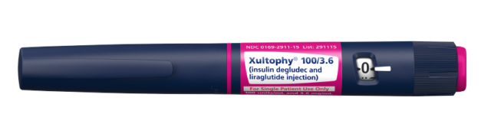
Whats next?
Weekly exenatide SC
Weekly semaglutide SC
Oral semaglutide !
Combination therapy

Slide 23
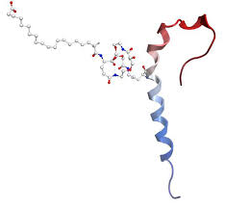
TIRZEPATIDE
GIP+GLP1

Slide 24
Case study
56 year old Mr N with T2DM x 2 years
On Metformin 850mg tds, Glimepiride 4 mg mane.
BMI 33
BP 146/88 mm Hg on Enalapril
LDL 3.2 mmol/l on Simvastatin 40 mg nocte
No CVD disease

Slide 25
Lab results
LDL 3.2 mmol/l on Simvastatin 40 mg nocte
HbA1c 8.4%
Serum Creatinine 87 umol/l eGFR 70
UACR 4.6
Repeated and 5.2
Implications for BP, Lipid AND glucose Rx

Slide 29
Drug-Specific and Patient Factors to Consider When Selecting
Antihyperglycaemic Treatment in Adults With T2D
Antihyper glycaemic Treatment |  | Efficacy | Hypoglycaemia | Weight Change | Cost | Oral/ SQ
Metformin |  | High | No | Neutral (potential for modest loss) | Low | Oral
SGLT-2i |  | Intermediate | No | Loss | High | Oral
GLP-1 RA |  | High | No | Loss | High | SQ
DPP-4i |  | Intermediate | No | Neutral | High | Oral
TZD |  | High | No | Gain | Low | Oral
SU (second generation) |  | High | Yes | Gain | Low | Oral
Insulin | Human insulin | Highest | Yes | Gain | Low | SQ
 |  |  |  |  | High | SQ
 | Analogue
For agent-specific dosing recommendations, please refer to the manufacturers’ prescribing information.
ADA = American Diabetes Association; DPP-4i = dipeptidyl peptidase type 4 inhibitor; GLP-1 RA = glucagon-like peptide 1 receptor agonist; SGLT2i = sodium-glucose cotransporter-2 inhibitor; SQ = subcutaneous; SU = sulphonylurea; T2D = type 2 diabetes; TZD = thiazolidinedione.
ADA. Diabetes Care. 2019:42(suppl 1):S1-S183.
Notes:
Reference:
American Diabetes Association. Standards of medical care in diabetes—2019. Diabetes Care. 2019;42(suppl 1):S1-S183.

Slide 30
Drug-Specific and Patient Factors to Consider When Selecting
Antihyperglycaemic Treatment in Adults With T2D
Antihyperglycaemic Treatment |  | CV Effects
 |  | ASCVD | CHF
Metformin |  | Potential benefit | Neutral
SGLT-2i |  | Benefit: empagliflozinª, canagliflozin | Benefit: empagliflozinª, canagliflozin, dapagliflozin
GLP-1 RA |  | Neutral: lixisenatide Benefit: liraglutideª > semaglutide > exenatide ER | Neutral
DPP-4i |  | Neutral | Potential risk: saxagliptin, alogliptin
TZD |  | Potential benefit: pioglitazone | Increased risk
SU (second generation) |  | Neutral | Neutral
Insulin | Human insulin | Neutral | Neutral
 | Analogue
For agent-specific dosing recommendations, please refer to the manufacturers’ prescribing information.
ªFDA approved for CVD benefit.
ADA = American Diabetes Association; ASCVD = atherosclerotic cardiovascular disease; CHF = congestive heart failure; CV = cardiovascular; CVD = cardiovascular disease; DPP-4i = dipeptidyl peptidase type 4 inhibitor; ER = extended release; GLP-1 RA = glucagon-like peptide 1 receptor agonist; SGLT2i = sodium-glucose cotransporter-2 inhibitor; SU = sulphonylurea; T2D = type 2 diabetes; TZD = thiazolidinedione.
ADA. Diabetes Care. 2019:42(suppl 1):S1-S183.
Notes:
Note to Speaker:
Sections 9, 10, and 11 of ADA Standards of medical care in diabetes—2019¹ have been revised² based on findings from The Dapagliflozin Effect on Cardiovascular Events-Thrombosis in Myocardial Infarction 58 (DECLARE-TIMI 58) Trial, in which dapagliflozin treatment showed a reduction of hospitalization for heart failure and a reduction in progression of chronic kidney disease (CKD)
References:
American Diabetes Association. Standards of medical care in diabetes—2019. Diabetes Care. 2019;42(suppl 1):S1-S183.
American Diabetes Association. Living Standards of Medical Care in Diabetes. Diabetes Care website. http://care.diabetesjournals.org/living-standards. Accessed 28 March 2019.

Slide 31
Drug-Specific and Patient Factors to Consider When Selecting
Antihyperglycaemic Treatment in Adults With T2D
Antihyper glycaemic Treatment |  | Renal Effects
 |  | CKD Progression | Dosing/Use Considerationsª
Metformin |  | Neutral | Contraindicated with eGFR <30
SGLT-2i |  | Benefit: canagliflozin, dapagliflozin, empagliflozin | Renal dose adjustment required (canagliflozin, dapagliflozin, empagliflozin, ertugliflozin)
GLP-1 RA |  | Benefit: liraglutide | Renal dose adjustment required (exenatide, lixisenatide) Caution when initiating or increasing dose because of potential risk of acute kidney injury
DPP-4i |  | Neutral | Renal dose adjustment required (sitagliptin, saxagliptin, alogliptin); can be used with renal impairment No dose adjustment required for linagliptin
TZD |  | Neutral | No dose adjustment required Generally not recommended in renal impairment because of potential for fluid retention
SU (second generation) |  | Neutral | Glyburide: not recommended Glipizide and glimerpiride: initiate conservatively to avoid hypoglycaemia
Insulin | Human insulin | Neutral | Lower insulin doses required with decrease in eGFR; titrate per clinical response
 | Analogue
ªFor agent-specific dosing recommendations, please refer to the manufacturers’ prescribing information.
ADA = American Diabetes Association; CKD = chronic kidney disease; DPP-4i = dipeptidyl peptidase type 4 inhibitor; eGFR = estimated glomerular filtration rate; GLP-1 RA = glucagon-like peptide 1 receptor agonist; SGLT2i = sodium-glucose cotransporter-2 inhibitor; SU = sulphonylurea; T2D = type 2 diabetes; TZD = thiazolidinedione.
ADA. Diabetes Care. 2019:42(suppl 1):S1-S183.
Notes:
Note to Speaker:
Sections 9, 10, and 11 of ADA Standards of medical care in diabetes—2019¹ have been revised² based on findings from The Dapagliflozin Effect on Cardiovascular Events-Thrombosis in Myocardial Infarction 58 (DECLARE-TIMI 58) Trial, in which dapagliflozin treatment showed a reduction of hospitalization for heart failure and a reduction in progression of chronic kidney disease (CKD)
References:
American Diabetes Association. Standards of medical care in diabetes—2019. Diabetes Care. 2019;42(suppl 1):S1-S183.
American Diabetes Association. Living Standards of Medical Care in Diabetes. Diabetes Care website. http://care.diabetesjournals.org/living-standards. Accessed 28 March 2019.

Slide 32
Drug-Specific and Patient Factors to Consider When Selecting
Antihyperglycaemic Treatment in Adults With T2D
Antihyper glycaemic Treatment |  | Additional Considerations
Metformin |  | GI side effects common (eg, diarrhoea, nausea) | Potential for B12 deficiency
SGLT-2i |  | FDA Boxed Warning: risk of amputation (canagliflozin) Risk of bone fracture (canagliflozin) DKA risk (all agents, rare in T2D) GU infection | Risk of volume depletion, hypotension Increased LDL-C Risk of Fournier gangrene
GLP-1 RA |  | FDA Black Box: risk of thyroid C-cell tumor (liraglutide, albiglutide, dulaglutide, exenatide extended release) | GI side effects common (eg, nausea, vomiting, diarrhoea) ISR Acute pancreatitis risk
DPP-4i |  | Potential risk of acute pancreatitis | Joint pain
TZD |  | FDA Black Box: CHF (pioglitazone, rosiglitazone) Fluid retention (oedema, heart failure) Benefit in NASH | Risk of bone fracture Bladder cancer (pioglitazone) Increased LDL-C (rosiglitazone)
SU (second generation) |  | FDA Special Warning on increased risk of CV mortality per studies of an older SU (tolbutamide)
Insulin | Human insulin | ISR Higher hypoglycaemia risk with human insulin (NPH or premixed formulation) vs analogue
 | Analogue
ADA = American Diabetes Association; CHF = congestive heart failure; CV = cardiovascular; DPP-4i = dipeptidyl peptidase type 4 inhibitor; DKA = diabetic ketoacidosis; DKD = diabetic kidney disease; FDA = US Food and Drug Administration; GI = gastrointestinal; GLP-1 RA = glucagon-like peptide 1 receptor agonist; GU = genitourinary; ISR = injection-site reaction; LDL-C = low-density‒lipoprotein cholesterol; NASH = nonalcoholic steatohepatitis; NPH = neutral protamine Hagedorn; SGLT2i = sodium-glucose cotransporter-2 inhibitor; SU = sulphonylurea; T2D = type 2 diabetes; TZD = thiazolidinedione.
ADA. Diabetes Care. 2019:42(suppl 1):S1-S183.
Notes:
Reference:
American Diabetes Association. Standards of medical care in diabetes—2019. Diabetes Care. 2019;42(suppl 1):S1-S183.

Slide 33
Understanding insulins: AACE

Slide 37
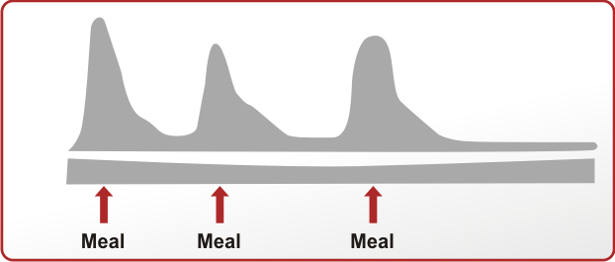
2018 Diabetes Canada CPG – Chapter 13. Pharmacologic Glycemic Management of Type 2 Diabetes
Serum Insulin Level
Time
Human Basal
Human Bolus
Analogue Basal
Analogue Bolus
guidelines.diabetes.ca | 1-800-BANTING (226-8464) | diabetes.ca
Notes:
Insulin treatment for type 2 diabetes includes
Human or intermediate-acting insulin basal insulin
Long-acting analogue basal insulin
Both of which may be given once or twice daily for basal glycemic control
Human or short-acting bolus insulin
Rapid-acting analogue bolus insulin
Both of which are given at mealtimes for prandial glycemic control
37

Slide 38
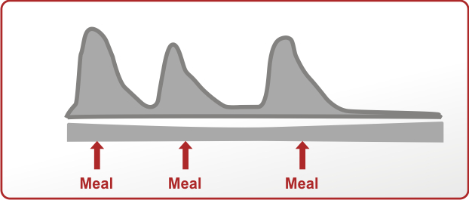
2018 Diabetes Canada CPG – Chapter 13. Pharmacologic Glycemic Management of Type 2 Diabetes
Serum Insulin Level
Human Premixed
Analogue Premixed
guidelines.diabetes.ca | 1-800-BANTING (226-8464) | diabetes.ca
Notes:
Premixed insulin is also available containing mixtures of human basal and bolus insulin
Or
Analogue basal and bolus insulin
38

Slide 39
Recommendation for Intensifying to Injectable Therapy in Adults With T2D
ADA
To Avoid Clinical Inertia, Reassess and Modify Treatment Regularly (3-6 months)
 | If HbA1c above target despite dual/triple therapy: Consider initial injectable combination
 | Consider GLP-1 RA in most before insulinª Consider insulin as first injectable if: HbA1c very high >97 mmol/mol (11%) Symptoms or evidence of catabolism T1D is possible GLP-1 RA not appropriate or insulin preferred
 | If above HbA1c target
 | Add basal insulin For patient on GLP-1 RA and basal insulin: Consider fixed-ratio combination of GLP-1 RA and insulin Note maximum dose of insulin in fixed-ratio combinations
 | If above HbA1c target despite adequately titrated basal insulin or once basal dose >0.7-1.0 IU/kg or FPG at target
INTENSIFICATION
ªConsider choice of GLP-1 RA, as well as patient preference, HbA1c lowering, weight-lowering effect, and frequency of injection. If CVD present, consider GLP-1 RA with proven CVD benefit.
ADA = American Diabetes Association; CVD = cardiovascular disease; FPG = fasting plasma glucose; FRC = fixed-ratio combination; GLP-1 RA = glucagon-like peptide-1 receptor agonist; HbA1c = glycated haemoglobin; T1D = type 1 diabetes; T2D = type 2 diabetes.
ADA. Diabetes Care. 2019:42(suppl 1):S1-S183.
Notes:
Note to Speaker:
This slide and the next slide must be used and/or moved between presentations together.
Key Points:
If HbA1c above target despite dual/triple therapy: Consider initial injectable combination (ie, GLP-1 RA + basal insulin or prandial/basal insulin) if HbA1c >86 mmol/mol (10%) and/or >23 mmol/mol (2%) above target
Consider GLP-1 RA in most before insulin (Consider choice of GLP-1 RA, as well as patient preference, HbA1c lowering, weight-lowering effect, and frequency of injection. If CVD present, consider GLP-1 RA with proven CVD benefit.)
Initiation for GLP-1 RA: Initiate starting dose (varies across class)
Titration for GLP-1 RA: Gradual titration to maintenance dose (varies across class)
Consider insulin as first injectable if: HbA1c very high >97 mmol/mol (11%), symptoms or evidence of catabolism (weight loss, polyuria, polydipsia) which suggest insulin deficiency, T1D is possible
If above HbA1c target, add basal insulin
Initiation for basal: Start 10 IU/day or 0.1-0.2 IU/kg/day
Titration for basal: Patient self-titration is more effective; Set FPG target that correlates to HbA1c target; Choose evidence-based titration algorithm to reach FPG target without hypoglycaemia
For hypoglycaemia, determine case; if no clear reason, decrease dose by 10%-20%
For patients on GLP-1 RA and basal insulin, consider FRC of GLP-1 RA and insulin, note maximum dose of insulin in FRCs
If above HbA1c target despite adequately titrated basal insulin or once basal dose >0.7-1.0 IU/kg or FPG at target
(Continued on next slide)
Reference:
American Diabetes Association. Standards of medical care in diabetes—2019. Diabetes Care. 2019;42(suppl 1):S1-S183.

Slide 40

Recommendation for Intensifying to Injectable Therapy in Adults With T2D
ADA (cont.)
 | If above HbA1c target despite adequately titrated basal insulin or once basal dose >0.7-1.0 IU/kg or FPG at target
 | Add prandial insulin Usually 1 dose with largest meal or meal with greatest PPG excursion Consider BID or TID premixed insulin regimen Caution higher risk of hypoglycaemia and/or weight gain
 | If above HbA1c target
 | Add additional injections of prandial insulin stepwise
 | If above HbA1c target
 | Proceed to full basal-bolus regimen (ie, basal and prandial insulin with each meal) | If HbA1c does not improve, review ongoing need for basal-bolus regimen. Consider additional DSMES
INTENSIFICATION
ADA = American Diabetes Association; BID = twice daily; DSMES = diabetes self-management education and support; FPG = fasting plasma glucose; HbA1c = glycated hemoglobin; PPG = postprandial glucose; TID = 3 times daily.
ADA. Diabetes Care. 2019:42(suppl 1):S1-S183.
Notes:
Note to Speaker:
This slide and the previous slide must be used and/or moved between presentations together.
Key Points:
If above HbA1c target despite adequately titrated basal insulin or once basal dose >0.7-1.0 IU/kg or FPG at target, add prandial insulin
Usually 1 dose with largest meal or meal with greatest PPG excursion
Initiation for Prandial: 4 IU/day or 10% of basal dose
If HbA1c <64 mmol/mol (8%), consider lowering total dose by 4 IU/day or 10% of basal dose
Titration for Prandial: Increase dose by 1-2 IU or 10%-15% twice weekly
For hypoglycaemia, determine cause, if no clear cause, decrease corresponding dose by 10%-20%
If HbA1c above target, consider BID or TID premixed insulin regimen
Caution higher risk of hypoglycaemia and/or weight gain
Initiation: In insulin-naïve patients 10-12 IU or 0.3 IU/kg; if on existing insulin regimen, usually unit to unit at same total insulin dose but may require adjustment per individual need
Titration: Individual dose adjustment depends on type of biphasic insulin; more complex if on TID regimen
If above HbA1c target, add additional injections of prandial insulin in a stepwise manner
Initiation of Stepwise Prandial: stepwise addition of prandial insulin every 3 months if HbA1c > target is associated with lower hypoglycaemia risk and increases patient satisfaction vs immediate introduction of full basal-bolus regimen
If above HbA1c target, proceed to full basal-bolus regimen (ie, basal and prandial insulin with each meal)
If HbA1c does not improve, review ongoing need for basal-bolus regimen. Consider additional DSMES
Reference:
American Diabetes Association. Standards of medical care in diabetes—2019. Diabetes Care. 2019;42(suppl 1):S1-S183.

Slide 41
Case study
66 year old Mr N with T2DM x 12 years
On Metformin 850mg tds, Empagliflozin 10mg/d
BMI 35
BP 146/88 mm Hg on Enalapril,HcTZ, Amlodipine
LDL 1.2 mmol/l on Atorvastatin 80 mg nocte
Had an MI 2 years ago.

Slide 42
Case study
UACR 8
eGFR 45
HbA1c 9.2%
What next?.

Slide 43
Summary ADA guideline
Combination Oral agents dependent on clinical status
Use GLP1 first (no----very costly)
Use Nocte NPH (protophane) or dly Analogue eg Lantus, titrate
Then Add short acting before largest meal
Or BD NPH if was on Nocte
Then more pre preprandial doses
Or Premixed eg Actraphane or Novomix
OR Basal bolus

Slide 44
Summary Public Sector
Add Nocte NPH 10 units, titrate
then
Use premixed Actraphane BD
(this would comply with EDL and APC, one could however still consider adding a short acting insulin before the largest meal eg 4 Units Actrapid)

