Slide 1
Obstructive sleep apnea – the worst comorbidity to have with cardiac disease
Dr Alison Bentley
Private practice – Morningside and Emmarentia, Johannesburg
A Bentley Inc
South African Society for Sleep and Health

Slide 2
Outline
Introduction
Identifying patients with obstructive sleep apnea
Pathophysiology of OSA
Consequences of OSA
  Cardiovascular
  Metabolic
  Other
Treating apnea

Slide 3
Introduction
Despite you never hearing about it at med school – obstructive sleep apnea is an important problem
Common -
Benjafield 2019 Lancet
No formal teaching – very few formal sleep clinics in academic medicine
Sleep is one of few multidisciplinary fields
New Society for Sleep and Health – focus on education

Slide 4
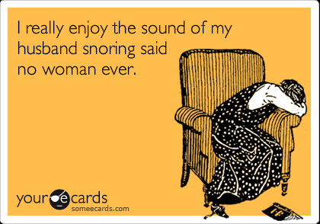
Obstructive sleep apnea
Heavy snoring
Gasps and pauses
Restlessness
Excessive daytime sleepiness
Headaches
Nocturnal polyuria
Hypertension
Gastro-oesophageal reflux
Impotence and lack of libido

Slide 5
Other patients
Women
  Sleepiness different and lower scores in ESS (?ESS validated in women as of 2016)
  Present with different symptoms such as insomnia, restless legs, depression, nightmares, palpitations, and hallucinations
  40% of women with an AHI > 15/h did not report any of the classic OSA symptoms (Valipour 2007)
  Women are more symptomatic at lower AHI – perhaps more minor episodes (increased RDI versus AHI)
Children
  Children with Down’s syndrome – OSA 45-76%

Slide 6
WHO ARE THE MOST LIKELY PATIENTS TO HAVE OBSTRUCTIVE SLEEP APNEA?
Co-morbid disorders
Very high prevalence in all cardiovascular and metabolic disorders
Atrial fibrillation – 40-60%
  Significantly reduces success of ablation
Metabolic disorders
  Type 2 diabetes – 50-60%
Resistant hypertension – 80%
Hypertension – 40%
Any other cardiovascular disorder – 30-60%
Strokes and TIAs – age, male sex, HT and AF

Slide 7
OSA – STOP-BANG questionnaire
Four questions – all yes / no:
Snoring: Do you snore loudly (louder than talking or loud enough to be heard through closed doors?
Tired: Do you often feel tired, fatigued or sleepy during daytime?
Observed: has anyone observed you stop breathing during your sleep?
Blood Pressure: Do you have or are you being treated for high blood pressure?

Slide 8
Examination
Add to history – stop-bang
BMI – independent predictor of OSA (>30kg,m⁻²),
Age (>50 years),
Neck circumference (>43 cm men and >41 cm women) and
Gender - male
5 or more positive in men and 4 or more positive in women high predictor (>80%) of positive finding for OSA

Slide 9
Epworth sleepiness scale
How likely are you to doze off or fall asleep in the following situations after you’ve had your usual nights sleep: (circle one number for each)
Would never doze Slight chance Moderate chance High chance
a. Sitting and reading 0 1 2 3
b. Watching television 0 1 2 3
c. Sitting inactive in a public place 0 1 2 3
d. Passenger in a car for an hour 0 1 2 3
without a break
e. Lying down to rest in the afternoon 0 1 2 3
f. Sitting and talking to someone 0 1 2 3
g. Sitting quietly after lunch with no alcohol 0 1 2 3
h. In a car, while stopped for a few 0 1 2 3
Minutes in the traffic
>10/24 is pathological sleepiness

Slide 10
Obstructive sleep apnea – phenotypes
Only 60% of patients with OSA have excessive daytime sleepiness which is linked to cardiovascular risk (Kapur 2008)
Older patients have less sleepiness and present with enuresis, cognitive dysfunction and mood impairments (Goonaratne 2014)
Male symptom phenotypes (Iceland): excessive daytime sleepiness 42%, disturbed sleep/insomnia 33% and minimally symptomatic 25% (Ye 2014)
Two types of patients (Gagnadoux 2016)
  1) middle aged, obese women with marked insomnia, depression, and comorbidities
  2) older, obese men with typical nocturnal and diurnal OSA symptoms, depression, and a marked comorbidity burden

Slide 11
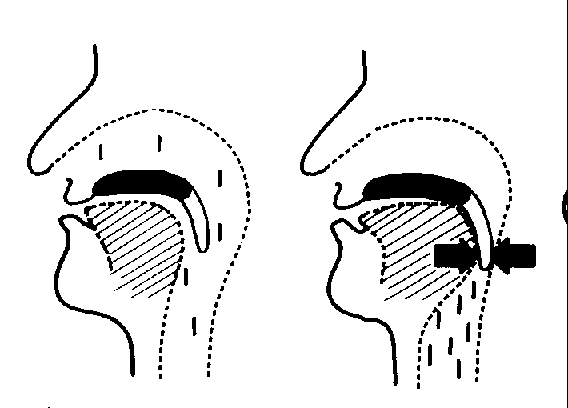
Normal breathing during sleep
Air Flow
Outward movement of ribcage and contraction of diaphragm create negative pressure

Slide 12
Causes of snoring and apnea
A perfect storm involving one or more of the following structures:
Snoring:
Partial obstruction, turbulent airflow and vibration of soft tissues
Apnea:
Total / critically increased obstruction
Nose
Palate
Tongue
Deposit of adipose tissue

Slide 13
Arousal from apnea during sleep
Sleep onset
Collapse of pharynx
Restart breathing
Arousal from sleep

Slide 14
Components of an obstructive apnea
2 main causes of consequences
J AM COLL CARD VOL . 6 9 , NO. 7 , 2 0 1 7

Slide 15
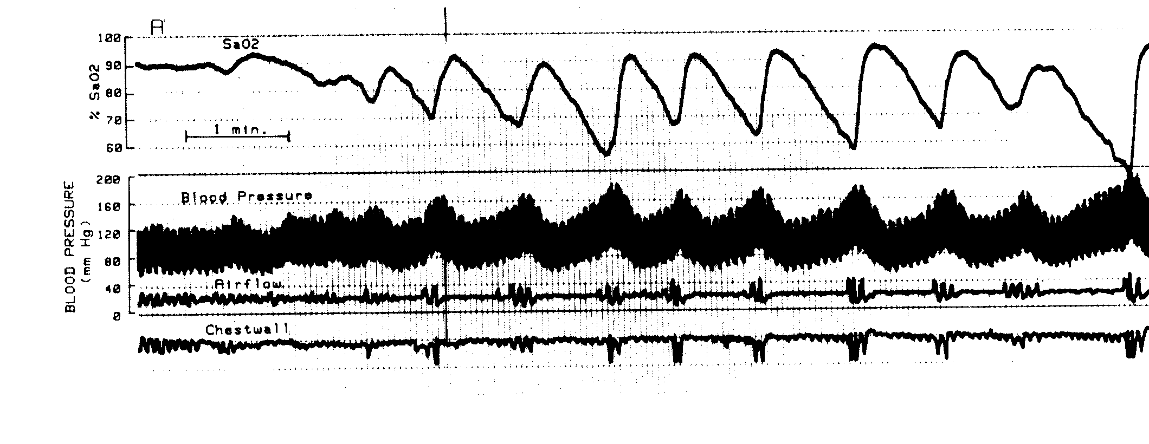
Consequences of osa – blood pressure

Slide 16
What does this mean in the long term?
Sustained daytime hypertension after 3 weeks of experimental OSA in animal models
Sustained high sympathetic tone during the day
Lack of nocturnal dipping of blood pressure during sleep
  Linked to increased risk of cardiovascular disease
Intermittent hypertension – blood pressure high in early am and lower in pm
Mechanism of hypertension is unexpected – is not based on renin-angiotensin – more sympathetic system

Slide 17
Consequences - Arhythmias
Combination of:
  hypoxia,
  sympathovagal imbalance (particularly increased sympathetic tone
  mechanical effects of negative intrathoracic pressure on the ventricular free walls
  systemic inflammation
Patients with OSA 4 times more likely to have atrial fibrillation Mehra et al AJRCCM 2006
The use of CPAP was associated with 44% decreased risk for AF recurrence (P<0.001) after cardiac ablation
Qureshi et al Am J Cardiol 2015

Slide 18
Severe apnea

Slide 19
Cardiovascular effects of OSA
Treat with
CPAP
OSA
Intermittent hypoxia
Sleep fragmentation
Oxidative stress
Sympathetic activation
Perturbation of HPA axis
Inflammation and adipokine pathways
Sleepiness
Reverse CVS effects
}
Endothelial dysfunction
Cardiovascular disease
Hypertension
Dyslipidaemia

Slide 20

American Heart Association scientific statement
Circulation 2021

Slide 21
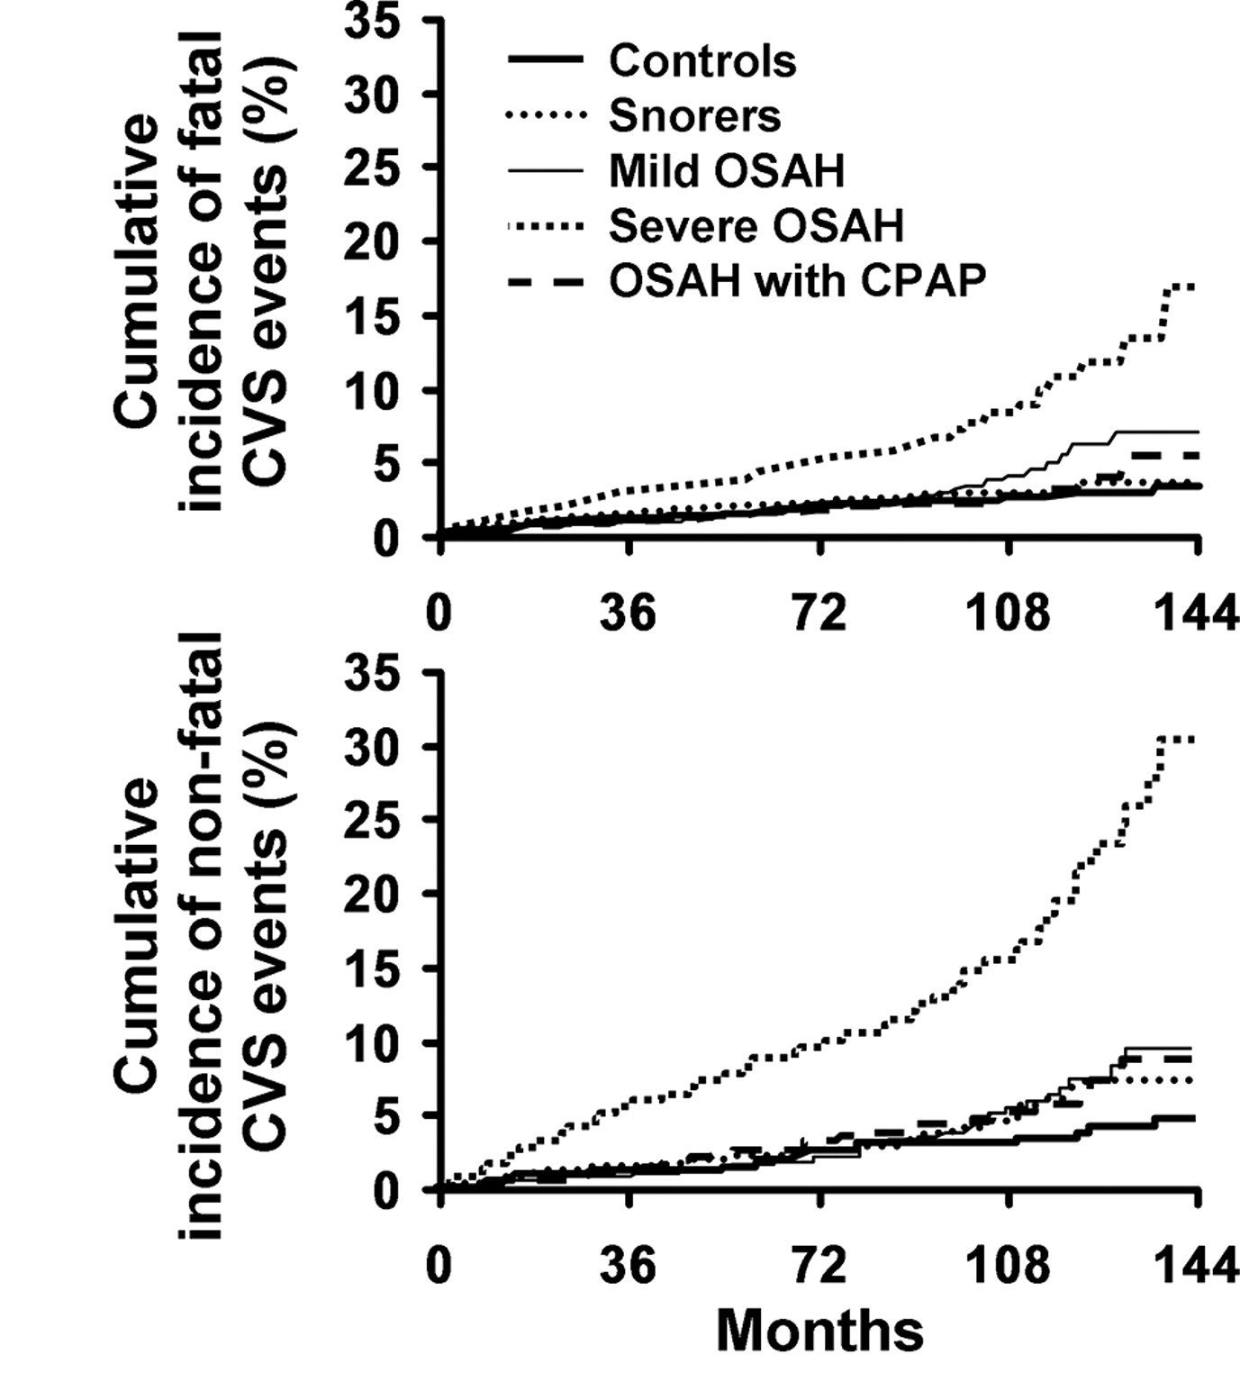
Long term effects
Severe OSA treated with CPAP
Marin JM, Carrizo S, Vicente E, Agusti AGN: Long term cardiovascular outcomes in men with obstructive sleep Lancet 2005;365:1046–1053.

Slide 22
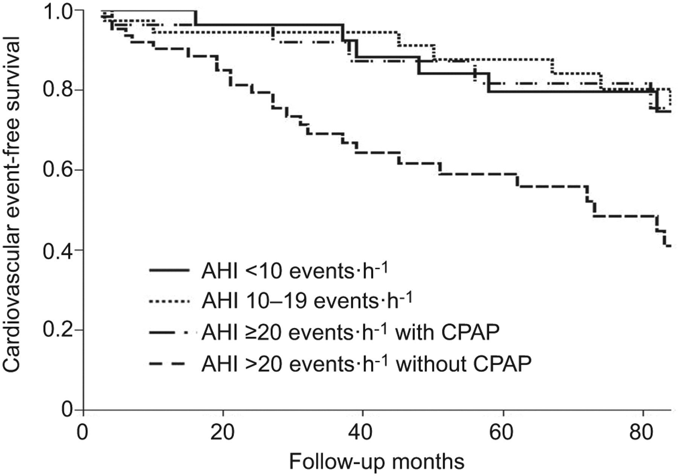
Treatment effects of OSA
Moderate to severe OSA treated with CPAP
Eur Respir 2012 39:906

Slide 23
Metabolic disorders and osa- Are they the same disorder?
Prevalence of OSA – 68%
Drager et al 2009
Prevalence of MetS – 45-80%
Eur Resp Rev 2008
Metabolic syndrome
Central obesity
Impaired fasting glucose
Dyslipidaemia
Hypertension
Obstructive sleep apnea
Central obesity
Hypertension
Dyslipidaemia
Impaired fasting glucose

Slide 24
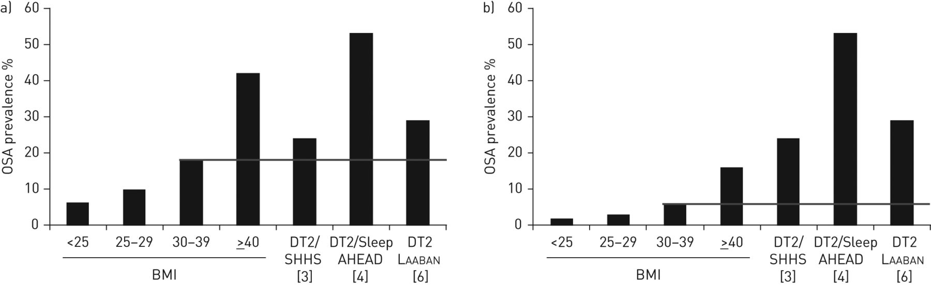
relationship between OSA and diabetes
Males
Females
Prevalence of obstructive sleep apnoea (OSA) (apnoea/hypopnoea index ≥15 events·h−1) in a) males aged 50–69 years and b) females aged 50–69 years with type 2 diabetes compared with estimated prevalence (—) in a general population of the same age range and body mass index (BMI). DT2: type 2 diabetes; SHHS: Sleep Heart Health Study.

Slide 25
Other consequences
Depression: In patient with comorbid OSA: Depressive episodes are worse and more likely to be treatment resistant
OSA patients are likely to have low testosterone and lowered libido
Polycythemia: Men with severe OSA and low nocturnal oxygen saturation
Ophthalmology: Floppy eyelid syndrome and red eyes (1997)
Liver disease :OSA established factor in non-alcoholic fatty liver disease
End stage kidney disease: estimated 50-60% have OSA

Slide 26
Snoring or mild apnea - Approach
Patients with SDB usually have multiple pathologies:
  Those of a “global” pathology, i.e. obesity (higher BMI) or other contributing systemic diseases, and
  Those with a “local” anatomical pathology (big tonsils and/or adenoids).
My experience: almost all patients have a component of both.
For this reason, the attending doctor must include a comprehensive treatment approach for most patients.
  Weight
  Nasal / palate obstruction - ENT
  Tongue / jaw – positional / oral appliance
Should be repeat study to confirm
adequate therapy
If severe or very severe go for CPAP first rather than add too many smaller procedures together

Slide 27
Effects of CPAP.
Nasal CPAP (compared to no treatment) causes a significant reduction in:
disease severity, sleepiness, blood pressure, and motor vehicle accidents, and improvement in sleep-related quality of life in adults with OSA.
The initiation of PAP in the home demonstrated equivalent effects on patient outcomes when compared to an in-laboratory titration approach.
The use of auto-adjusting or bilevel PAP did not result in clinically significant differences in patient outcomes compared with standard continuous PAP.
Problems – difficulty in doing RCTs, few studies on women, differing severities of OSA in studies, few studies specifically on patients with disorders e.g. depression.
Patil S, Ayappa I, Caples S, Kimoff J Patel S and Harrod C. Treatment of Adult Obstructive Sleep Apnea With Positive Airway Pressure: An American Academy of Sleep Medicine Systematic Review, Meta-Analysis, and GRADE Assessment. J Clin Sleep Med. 2019;15(2):301–334

Slide 28
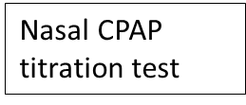
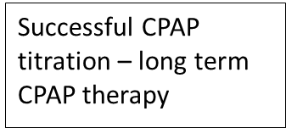
Process of putting patient on CPAP
Positive diagnosis of moderate to severe OSA
AHI over 15 per hour usually
Try out the mask and the machine. One or multiple nights
Does not usually need repeat sleep study unless severe desaturations
Compliance defined as:
More than 4 hours on CPAP per night
AHI less than 10

Slide 29
Conclusion
OSA is more common than you think
Why is it the worst co-morbidity? Unless you ask you won’t know
  it happens at night when you don’t seen them and
  the patients doesn’t even know it is happening (Hint: the bedpartner does!)
Questions about sleep should be standard in assessment of all patients with diabetes and / or cardiovascular disease
  Sleep quantity and daytime function
  STOP-BANG or Berlin questionnaire
Consequences of obstructive sleep apnea are much more than daytime fatigue and sleepiness

Slide 30
On behalf of South African society for sleep and health: Short course on obstructive sleep apnea
1. Obstructive sleep apnea basics – symptoms, pathophysiology, consequences, co-morbidities
2. Measuring respiration and sleep – airflow, oxygen saturation, the language of sleep disordered breathing. Basic sleep stages, Epworth Sleepiness Scale
3. Diagnosing obstructive sleep apnea – proposed guidelines, Step 1 find likely patient. Step 2 send for correct test. Step 3 interpret the test. Step 4 manage the patient
4. Managing snoring and mild/moderate OSA – evidence for weight loss, ENT options, oral appliances and other gadgets
5. Treating moderate to severe OSA – CPAP machines. CPAP titration, key measures, central and complex apneas. Bilevel and ASV devices
6. Other sleep disorders – insomnia, Restless legs syndrome, narcolepsy. What if the apnea test is negative but they still have symptoms?
Next course starts 18 October 2021 Monday evenings 19:30 to 20:30 on Zoom send an email to sasleepsoc@gmail.com for registration form. R600 and 6 CPD points

