Slide 1
The role of nutrition and lifestyle in the prevention and management of Cardiometabolic Syndrome
Vanessa Kotzé RD(SA)
Part time lecturer, Dpt Human Nutrition, UP
Private practice, Groenkloof Life Hospital, Pretoria

Slide 2
The deadly quartet
Syndrome X
Insulin resistance syndrome
hypertriglyceridemic
waist

Slide 3
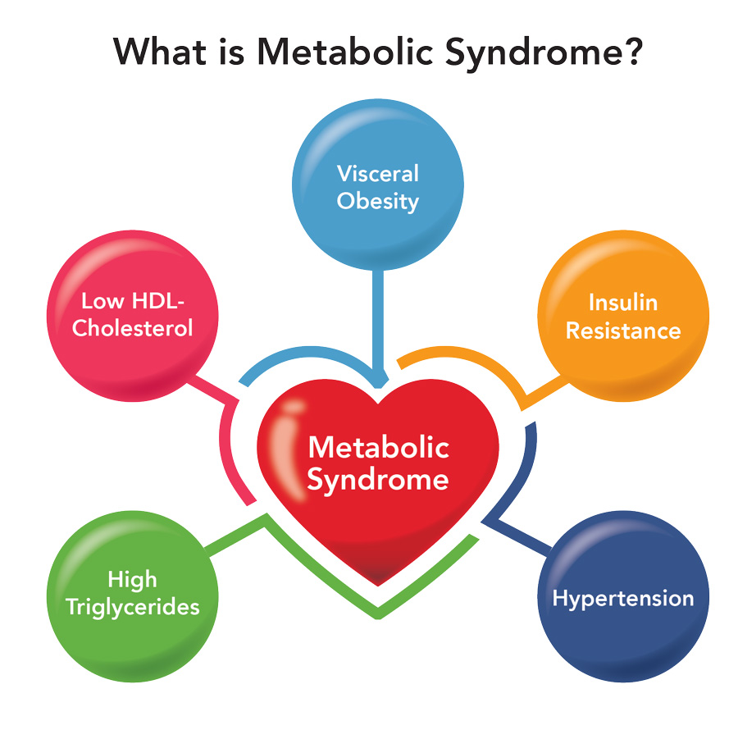
Cardiometabolic syndrome
Cluster of metabolic abnormalities that include
hypertension,
central obesity,
insulin resistance, and
atherogenic dyslipidemia
Strongly associated with an increased risk for developing diabetes and atherosclerotic and nonatherosclerotic cardiovascular disease (CVD)

Slide 4
METABOLIC SYNDROME
No universally accepted pathogenic mechanism
No universally accepted diagnostic criteria
Still debate if MS represents specific syndrome or is a surrogate of combined risk factors that put an individual at particular risk
Increased prevalence in childhood and young adulthood

Slide 5
Diagnosing cardiometabolic syndrome

Slide 6
Pathogenesis
Notes:
Abnormal fat distribution - Leptin, adiponectin, liver fat content
Atherogenic dyslipidemia – Apo B (or non-HDL-c), small LDL particles
Insulin resistance – Fasting insulin/proinsulinlevels, HOMA-IR, insulin resistence, elevated free fatty acids
Vascular dysregulation – Measurement of endothelial dysfunction, microalbuminuria
Proinflammatory state – Elevated high sensitivity c-reactive protein, elevated inflammatory cytokines, decrease in adiponectin levels
Prothrombotic state – Fibrinolytic factors, clotting factors
Hormonal factors – Pituitary adrenal axis

Slide 7
Is it relevant in 2021?
Now even more so…
Impact of confinement during lockdown

Slide 8
Exercise restrictions
Closed gyms
Restrictions on walking distance
lack of space and infrastructure of homes for
physical exercise
lack of technical knowledge on appropriate training routines

Slide 9
Effects on diet
Limited access to shops
Poor quality of food due to poor income
Overeating

Slide 10
Effects on acute inactivity and dietary changes
Parameters assessed:
Blood parameters
Inflammatory parameters
Lipid profile
Body composition
Cardiorespiratory ﬁtness (CRF)

Slide 11
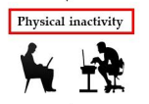
Metabolic effects of acute inactivity in healthy adults
With ↑ in PA
Normal function return
Several studies
less than 2 h of regular exercise/week
walked < 3500 steps / day
BUT same dietary patterns
Parameters
Blood parameters: ↑ AUC for plasma insulin during an OGTT, ↑ C-peptide, increased insulin resistance and diminished insulin sensitivity
Inflammatory parameters: None
Lipid profile: ↑ TG
Body composition: 7% ↑ intra-abdominal FM, ↓ FFM
Cardiorespiratory ﬁtness (CRF): Maximal aerobic capacity (VO2max) ↓

Slide 12
Metabolic effects of acute inactivity in overweight adults
With ↑ in PA
Normal function return
Dixon et al & Bowden studies
overweight vs normal weight
Men & women
< 4000 steps/day
Central obesity
BUT same dietary patterns
Blood parameters: ↑ AUC for plasma insulin during an OGTT, ↑ C-peptide, increased insulin resistance and diminished insulin sensitivity, ↑ ALT
Inflammatory parameters: None
Lipid profile: ↑ TG, total-chol, LDL
Body composition: ↑ intra-abdominal & total FM, ↓ FFM
Cardiorespiratory ﬁtness (CRF): Maximal aerobic capacity (VO2max) ↓
Notes:
Results suggested that high levels of CRF in the overweight and obese population signiﬁcantly reduced or eliminated the elevated risk of CVD and all-cause
mortality.
This indicates that CRF changes the relationship between body fat and its prognosis.

Slide 13
Metabolic effects of acute sedentary lifestyle in elderly
Prevalence of sarcopenia high
loss of skeletal muscle mass and strength
Repercussions on health
Aging associated with abdominal obesity
Important contributor to:
insulin resistance and metabolic syndrome,
a higher level of proinﬂamatory cytokines
drastic ↓ in PA could have worse consequences in elderly by
accelerating the ageing process and
the appearance of age-related diseases

Slide 14
Metabolic effects of acute sedentary lifestyle in elderly
With ↑ in PA
Glc homeostasis & inflammatory markers did not return to normal
Healthy older adults
Usual > 3500 steps --- ↓ 76%
BUT same dietary patterns
Blood parameters: ↑ AUC for plasma insulin during an OGTT, ↑ C-peptide, increased insulin resistance and diminished insulin sensitivity, ↑ ALT
Inflammatory parameters: ↑ TNF, CRP & IL-6
Lipid profile: ↑ TG, total-chol, LDL
Body composition: ↑ intra-abdominal, ↓ skeletal leg muscle & protein synthsesis
Cardiorespiratory ﬁtness (CRF): Maximal aerobic capacity (VO2max) ↓

Slide 15
Metabolic effects of acute sedentary lifestyle and overfeeding
With ↑ in PA & ↓ eating
Body weight & adipocity did not return to normal
< 4000 steps/day
> 50% increase in energy intake
Blood parameters: ↑ AUC for plasma insulin during an OGTT, ↑ C-peptide, increased insulin resistance and diminished insulin sensitivity
Inflammatory parameters: -
Lipid profile: -
Body composition: ↑ total FM, android, gynoid and visceral fat
Cardiorespiratory ﬁtness (CRF): Maximal aerobic capacity (VO2max) ↓
Notes:
Previous studies: only decrease in PA
Now dec PA & inc in eating
Sedentary activities
not only reduce energy expenditure, but
they also promote increased food intake

Slide 16
So what about reversing the acute effect?

Slide 17
What effect will dietary modifications have?

Slide 18
What effect will dietary modifications have?
Few RCT have examined the effects of calorie restriction on health
Study 1
three-month period of calorie restriction
cycles of a ﬁve-day fasting-mimicking diet
Results
↓ BMI, trunk, and total body fat
↓ blood pressure, TG, total and LDL, CRP, and insulin-like growth factor 1

Slide 19
What effect will dietary modifications have?
Study 2
2yrs
↓ 15% energy
average weight loss of 8.7 kg (70% was body fat)
Study 3
6 weeks
↓ 40% energy
3/7 days of severe restriction (600–800 Kcal)
4/7 Normal intake
Considerable weight loss including reduced fat mass (mostly android)
BUT also on LBM

Slide 20
What does the guidelines recommend?
Perex-Martinez 2017

Slide 21
Physical Activity to Mitigate the Metabolic Impacts of Conﬁnement
improved waist circumference, fasting blood glucose, HDL-cholesterol, triglycerides, diastolic blood pressure, and VO2 peak
no changes
What type of training is appropriate for an individual with metabolic syndrome?

Slide 22
Physical Activity to Mitigate the Metabolic Impacts of Conﬁnement
Q: how many steps per day are recommended?
More steps per day (8000 vs. 4000 steps per day) is associated with lower all-cause mortality
No signiﬁcant association between step intensity and mortality
Notes:
No signiﬁcant association between step intensity and mortality after adjusting for the total number of steps per day

Slide 23
What does the guidelines recommend?
Perex-Martinez 2017

Slide 24
Is it as simple as the energy balance

Slide 25
The role of microbiota

Slide 26
Trimethylamine N-oxide (TMAO)
Notes:
Trimethylamine N-oxide (TMAO) is a molecule generated from choline, betaine, and carnitine via gut microbial metabolism. The plasma level of TMAO is determined by several factors including diet, gut microbial flora, drug administration and liver flavin monooxygenase activity

Slide 27
What about the diet patterns?

Slide 28
Mediterranean diet
Nutritional districution | Improvements in MetS
Protein: 15 – 18% TE | CVD: ↓ incidence & outcomes HPT: ↓ SBP & DBP Dyslipidaemia: improvement T2DM: ↓ incidence
CHO: 35 – 45% TE
Fat: 35 – 45% TE Mainly MUFA

Slide 29
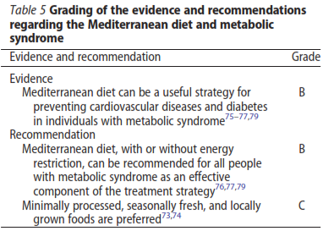
What does the guideline say?

Slide 30
What does the guidelines recommend?

Slide 31
Nutritional distribution | Improvements in MetS
Protein: 18% TE | CVD: ↓ incidence & outcomes HPT: ↓ SBP & DBP Cardiometabolic profile: improvement T2DM: ↓ incidence Anthrop: ↓ BMI & WC
CHO: 55% TE
Fat: 27% TE - SFA 6%

Slide 32
Plant based diets
Nutritional distribution | Improvements in MetS
Protein: restrict animal derived food | CVD: ↓ mortality HPT: ↓ SBP & DBP T2DM: ↓ incidence Anthrop: ↓ BMI
CHO: wholegrains
Fat: rich in UFA

Slide 33
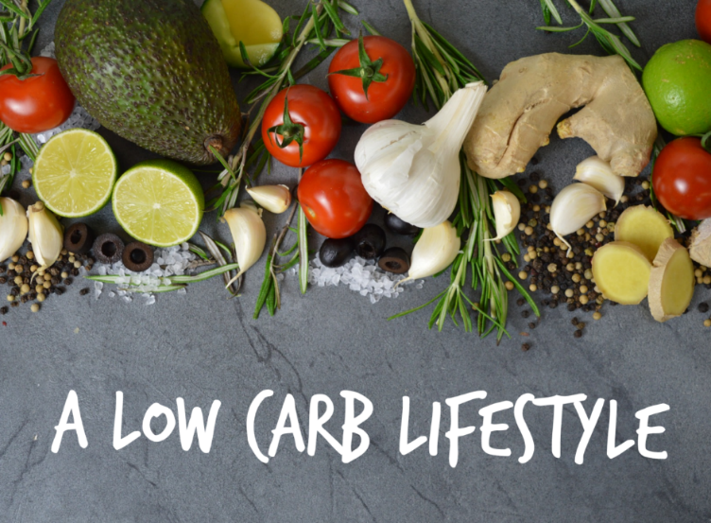
Low CHO & very low CHO
Nutritional distribution | Improvements in MetS
Protein: 20 - 30% TE | HPT: ↓ DBP Cardiometabolic profile: ↓ LDL & TG, ↑ HDL T2DM: ↓ HbA1c, insulin resistance Anthrop: ↓ weight & maintenance
CHO: < 50% TE (in ketogenic: <10% TE)
Fat: 30 - 70% TE

Slide 34
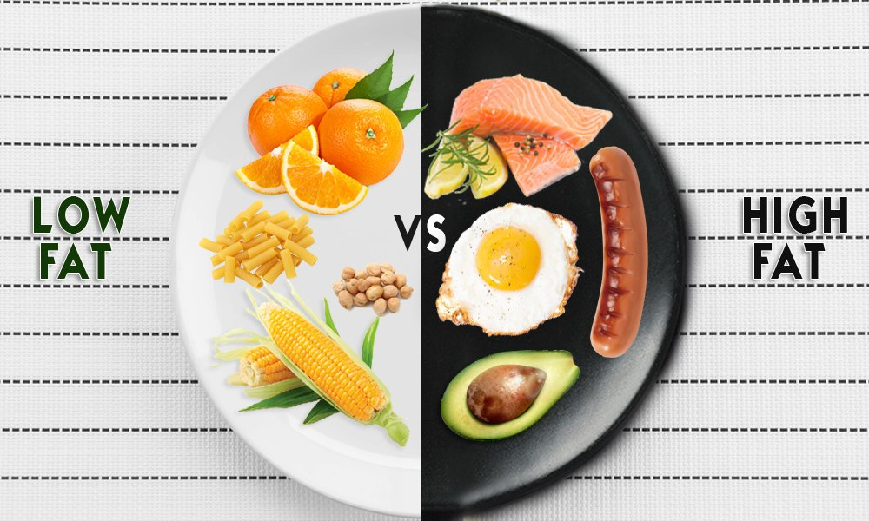
Low fat diet
Nutritional distribution | Improvements in MetS
Protein: 15 - 17% TE | ↓ all-cause mortaility HPT: ↓ SBP & DBP Cardiometabolic profile: short term improvement Anthrop: ↓ weight – short term
CHO: 50 - 60% TE
Fat: <30% TE - SFA < 10% TE

Slide 35
High protein diet
Nutritional distribution | Improvements in MetS
Protein: 20 - 30% TE (1.34 – 1.5g/kg/d) | Cardiometabolic profile: ↓ TG
CHO: 40 - 50% TE
Fat: 20 - 40% TE

Slide 36
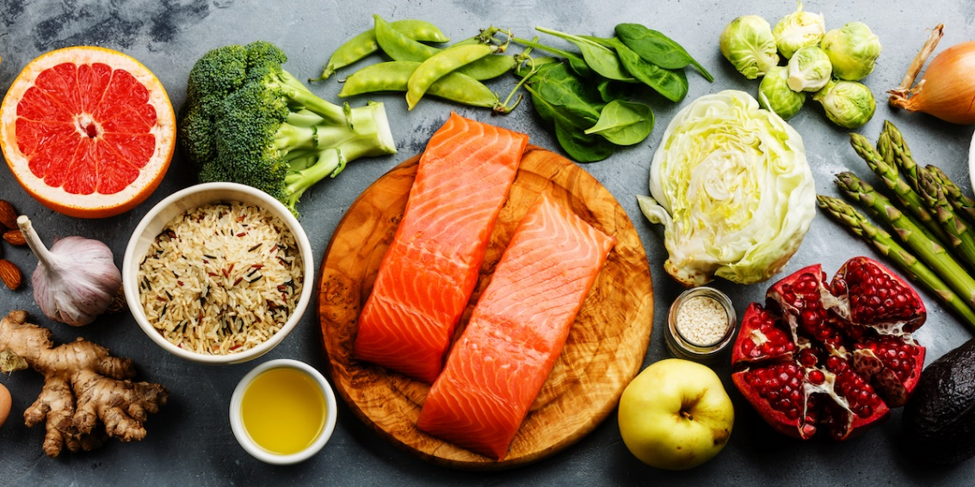
Nordic diet
Nutritional distribution | Improvements in MetS
Protein: Low meat | HPT: ↓ SBP & DBP Cardiometabolic profile: ↑ HDL
CHO: High in whole grain products
Low in processed food

Slide 37
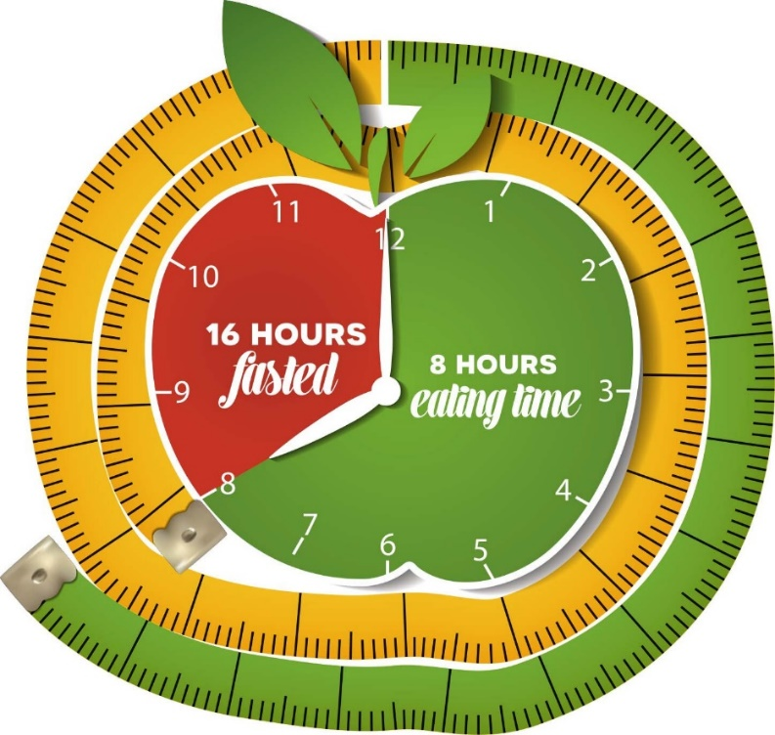
Intermittent fasting
Nutritional distribution | Improvements in MetS
Fasting for extended periods | CVD: ↓ risk HPT: ↓ SBP & DBP Cardiometabolic profile: improvement T2DM: ↓ risk, insulin resistance Anthrop: ↓ weight loss

Slide 38
What does the guidelines recommend regarding diets?

Slide 39
Do not forget about SAFBDG

Slide 40
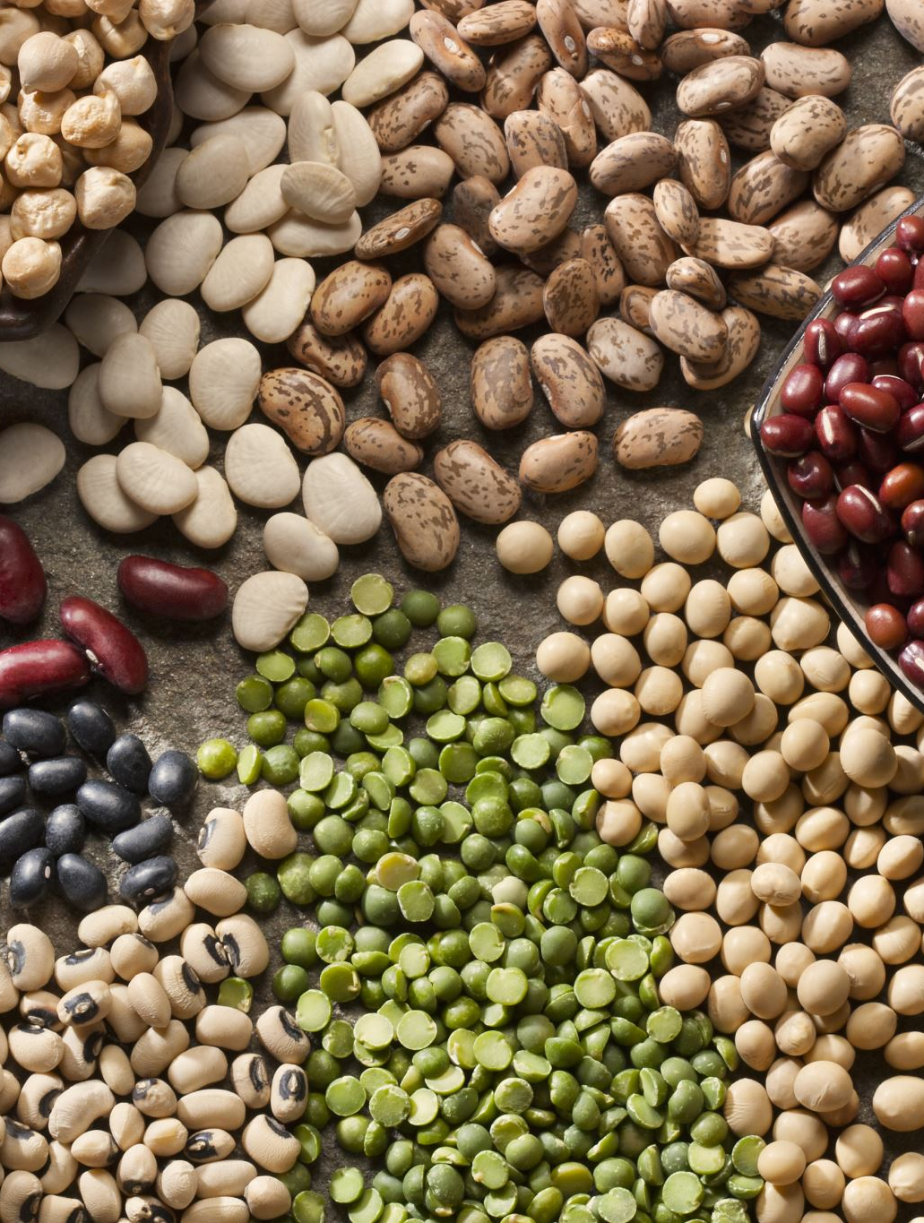
Specific food sources?

Slide 41
What does the guidelines recommend for LEGUMES?

Slide 42
What does the guidelines recommend for GRAINS?

Slide 43
What does the guidelines recommend?

Slide 44
What does the guidelines recommend?

Slide 45
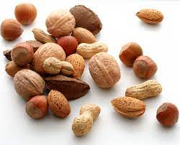
What does the guidelines recommend?

Slide 46
What does the guideline recommend?

Slide 47
What does the guidelines recommend?

Slide 48
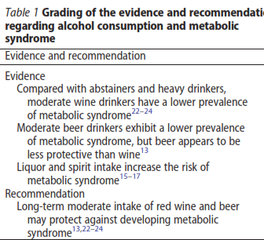
What does the guidelines recommend?

Slide 49
Do not forget about SAFBDG – there is a place for it

Slide 50
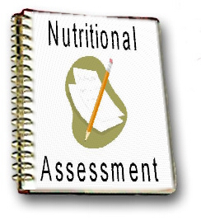
How do you decide which diet?

Slide 51
What about neutraceuticals?

Slide 52
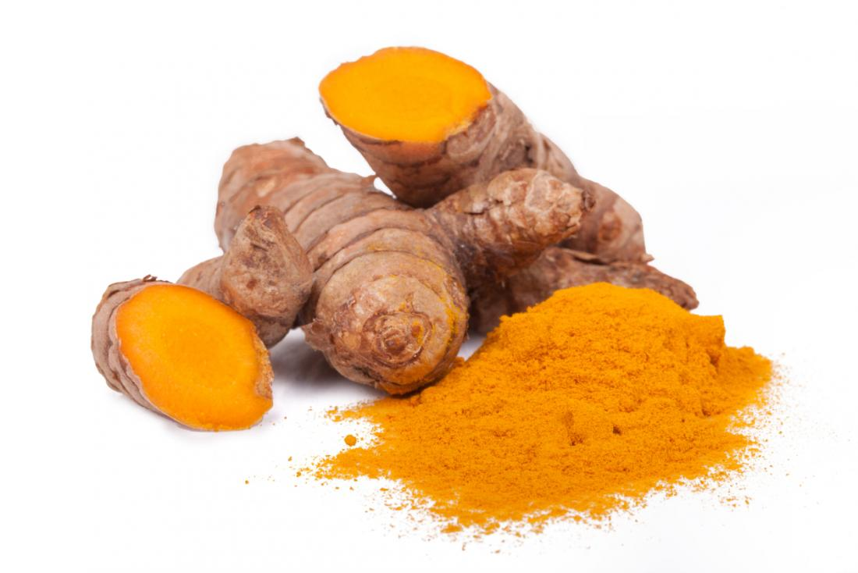
Tumeric

Slide 53
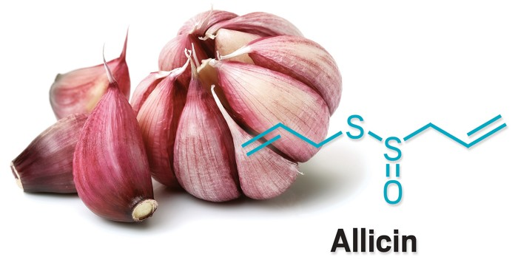
Garlic
Notes:
Thiol group fights inflammation

Slide 54
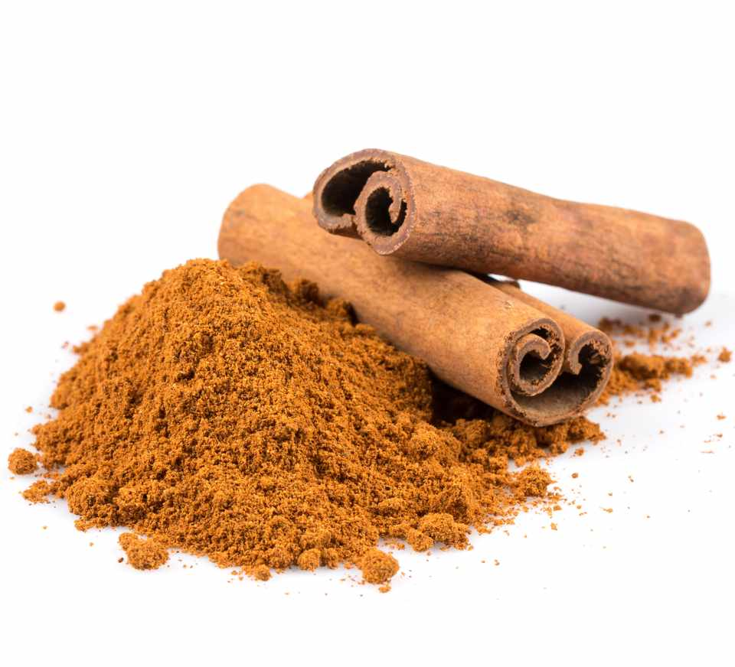
Cinnamon

Slide 55
Neutraceuticals

Slide 56
Neutraceuticals
Notes:
Sulphorane = phytochemical
Sulforaphane = Antioxidant transcription factor

Slide 57
Take note
Small and few studies

Slide 58
Associated conditions

Slide 59
Non-alcoholic fatty liver disease (NAFLD)

Slide 60
Proposed lifestyle modification guidelines for NAFLD

Slide 61
Polycystic ovary syndrome (PCOS)

Slide 62
Lifestyle modifications
Enhance insulin sensitivity
CHO
Restrict refined CHO and total energy
High fibre foods
Low (40%) vs high CHO (60%)
Protein
Whey protein
Small, frequent meals
High energy intake @ breakfast rather than at dinner
Vit D & chromium & magnesium

Slide 63
Nutritional correlates in PCOS
Magnesium deficiency
Copper excess
Chrome deficiency
Vit D deficiency
N-6/n-3 ratio
Notes:
Magnesium
Copper
↑ copper levels (PCOS, IR)
Induce oxidative stress
ROS species, dec glutathion levels
Chrome
Chrome picolinate
Trivalent chromium (Cr³⁺) (Trivalent chromium = present in normal diet)
Complex with picolinic acid = enhance gut absoprtion
Cleaved from picolinic acid = transferrin & later chromodulin transport
Binds to insulin receptor
Chrome deficiency = glucose intolerance
Vit D deficiency
Pathogenesis of IR + metS
Impaired glc clearance and insulin secretion
Mechanisms unclear
Supplementation: improve hormonal status & IR
N-6/n-3 ratio
↑ PUFA = improve endocrine and metabolic characteristics
EPA & DHA supplementation

Slide 64
Closing notes
Need to address the cause of the problem
Remember the steps to get from the start point to your goal in treatment
Neutraceuticals have the possibility to be beneficial but should not be your starting point

Slide 65
References
Martinez-Ferran M, de la Guía-Galipienso F, Sanchis-Gomar F, Pareja-Galeano H. Metabolic Impacts of Confinement during the COVID-19 Pandemic Due to Modified Diet and Physical Activity Habits. Nutrients. 2020;12(6):1549
Rochlani Y, Pothineni NV, Kovelamudi S, Mehta JL. Metabolic syndrome: pathophysiology, management, and modulation by natural compounds. Ther Adv Cardiovasc Dis. 2017 Aug;11(8):215-225

Slide 66
References
Pérez-Martínez P, Mikhailidis DP, Athyros VG, Bullo M, Couture P, Covas MI, et al. Lifestyle recommendations for the prevention and management of metabolic syndrome: an international panel recommendation. Nutr Rev. 2017 May 1;75(5):307-326.

