Slide 1
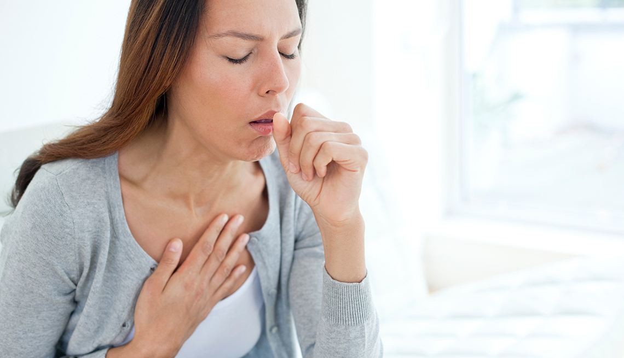
THE COUGHING PATIENT
Prof Frank Peters
Dept Family Medicine
University of Pretoria

Slide 2
Common GP diseases
Bronchitis
Pneumonia
Community Acquired Pneumonia
DS TB
DR TB

Slide 3
Bronchitis
Definition
Acute bronchitis is caused by inflammation of the bronchi 80-90% caused by a viral infection
Symptoms
Coughing with clear, yellow or green sputum
Fatigue
Wheezing
Runny, stuffy nose occurring before chest congestion begins
Shortness of breath, usually following a coughing jag
Discomfort in the centre of the chest due to cough
Mild fever

Slide 4
Pneumonia
Definition
An inflammation of the lungs, pneumonia has many of the same symptoms as bronchitis
Symptoms
Persistent fever (often high)
Cough, often with yellow or green mucus
Chills, which sometimes cause shaking
Shortness of breath
Sharp chest pain
Confusion (which occurs primarily in older people)

Slide 5
COMMUNITY AQCUIRED PNEUMONIA

Slide 6
Case presentation
A 65 year old man presents to the casualty department (ER) with a 5-day history of productive cough, pleuritic chest pain, shortness of breath, fever and night sweats
He has also noticed weight loss
He was diagnosed as having COPD five years ago, but stopped smoking shortly thereafter and he has hypertension and hypercholesterolemia

Slide 7
Clinical examination
Physical findings include a blood pressure of 148/86 mmHg, an oral temperature of 38.5ºC, a pulse rate of 110 beats/minute and a respiratory rate of 32 breaths/minute
Examination of the chest reveals the presence of dullness to percussion with bronchial breathing and crackles in the right upper lobe

Slide 8
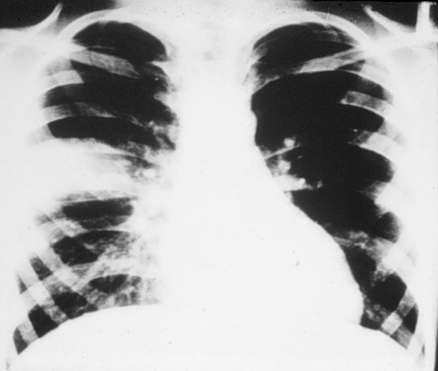

Slide 9
Question
What is the most likely cause of pneumonia?
Streptococcus pneumoniae
Haemophilus influenzae
Respiratory viruses
Mycobacterium tuberculosis
Legionella pneumophila
Other agent

Slide 10
X-RAY
LOBAR PNEUMONIA
MULTI LOBAR

Slide 11
Case presentation
A 66 year old woman presents to the casualty department (ER) with a 5-day history of productive cough, pleuritic chest pain, shortness of breath, fever and night sweats
She was diagnosed as having COPD five years ago, but stopped smoking shortly thereafter and she is on oral medication for Type II Diabetes Mellitus

Slide 12
Clinical examination
Physical findings include a blood pressure of 96/58 mmHg, an oral temperature of 38.5ºC, a pulse rate of 121 beats/minute and a respiratory rate of 32 breaths/minute
Examination of the chest reveals the presence of dullness to percussion with bronchial breathing and crackles in the right upper lobe

Slide 13
WHEN TO ADMIT

Slide 14
Where should the patient be treated?
Send the patient home
Admit the patient to hospital
Admit the patient to a high-care unit
Admit the patient to ICU
Let the patient decide

Slide 15
WHERE ARE YOU PRACTICE
HOME
ADMIT
Young Adult
No Co-morbidity
Rx Augmentin
The CURB-65 score includes. >2+ admit
Age ≥ 65 years
Cyanosis/Confused
Raised urea > 7 mmol/L
Rapid respiratory rate ≥ 30 beats per minute
BP Systolic <90 Diastolic>60

Slide 16
Aetiology of CAP in HIV-infected and Non-infected Subjects
S. pneumoniae 88 (34.5%)
S. aureus 19 (7.5%)
H. influenzae 12 (4.7%)
P. aeruginosa 6 (2.4%)
E. coli 5 (2.0%)
GN bacilli
26 (10.4%)
K. pneumoniae 4 (1.6%)
S. marcesens 4 (1.6%)
Other 4 (1.6%)
Bacillus species 3 (1.2%)
Other 11 (4.4%)
M. tuberculosis 101 (39.6%)
N=257
Consecutive patients with CAP
hospitalised in KZN, South Africa
Nyamande K et al. Int J Tuberc Lung Dis 2007; 11: 1308-1313

Slide 17
Rx CAP
Augmentin IVI
Azithromycin or Macrolide
Special investigations
1. Sputum GXP
2. Sputum Microscopic AFB
3. Sputum Culture
4. FBC CRP

Slide 18
HOW TO READ A X-RAY

