Slide 1
Emergency Medicine
Dr Vidya Lalloo
Department of family medicine
Division of emergency medicine
University of Pretoria

Slide 2
What is a medical emergency?
http://waelalsagban.blogspot.co.za/2016/04/emergency-medicine-by-ttc-medical.html

Slide 3
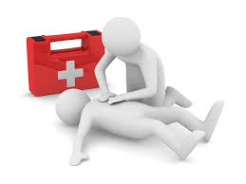
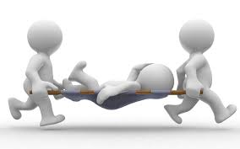
pulseless
With a pulse who are very sick
https://www.gograph.com/stock-illustration/3d-white-people-first-aid.html

Slide 4
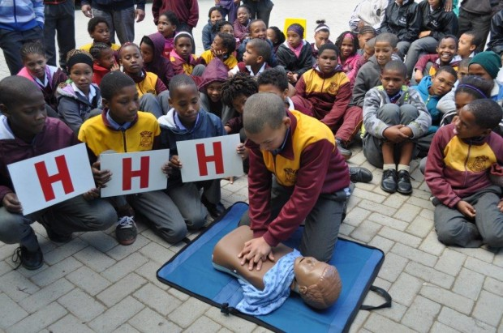
Pulseless patients…
What’s the plan of action?
http://www.nsri.org.za/2014/09/skole-se-deure-staan-oop-vir-waterwise/
Notes:
First comes HHH- Hazards (PPE), hello, help (BRING AED and call ambulance)
Then start CPR with CAB. (compressions, airway, breathing)
Who knows the rate of compressions to breaths in adults? 30:2
Children (single rescuer 30:2; 2 rescuers 15:2)

Slide 5
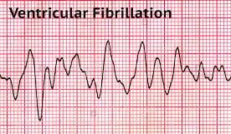
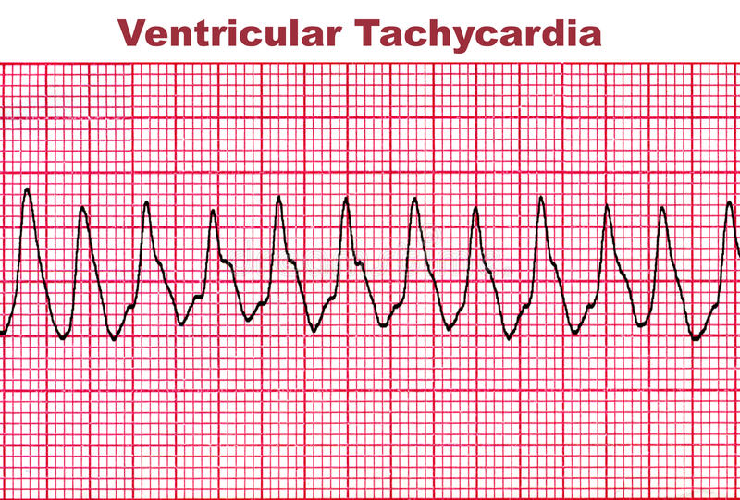
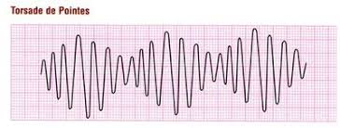
ACLS algorithm
https://www.alamy.com
https://www.dreamstime.com
https://eccguidelines.heart.org/index.php/circulation/cpr-ecc-guidelines-2/part-7-adult-advanced-cardiovascular-life-support/
https://step2.medbullets.com
Notes:
And we go down the algorithm
If you have an AED- automated external defibrillator, then it tells you whether to shock or not, and if not, you need to know the basic rhythms which are shockable- which are? –VF, pulseless VT, torsade
If you look closely, you’ll see adrenaline in there as well, and we give adrenaline every second cycle, or every 4 mins but if you forget the adrenaline, it’s not the end of the world… in fact the evidence for adrenaline in CPR is quite weak...

Slide 6
What saves lives in CPR?
Notes:
What do you think is the most important thing that saves lives during CPR?

Slide 7
What saves lives in CPR?
Good quality chest compressions
Allow chest recoil
Minimise interruptions
http://www.keepcalmandposters.com/poster/2483906_keep_calm_and_push_hard_push_fast
Notes:
How can we tell if the compressions are good enough? We can use ETCO2 monitoring and if the reading is above 15mmHg, you are generating a good perfusion. If not available, how hard is hard? (third of the depth of the chest) How fast? 100-120 compressions per minute. CPR metronome

Slide 8
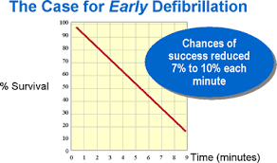
What saves lives in CPR?
Good quality chest compressions
2. Early defibrillation
http://www.emedgroup.com/learn_defibrillation.htm
Allow chest recoil
Minimise interruptions
Notes:
Every minute that goes by without defibrillation in a shockable rhythm, the chances of survival decrease by 10%

Slide 9
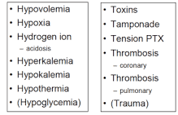
What saves lives in CPR?
Good quality chest compressions
3. Reverse the cause
2. Early defibrillation
http://www.emedgroup.com/learn_defibrillation.htm
http://rebelem.com/a-new-pulseless-electrical-activity-algorithm/
Allow chest recoil
Minimise interruptions

Slide 10
https://clipart.guru/clipart/3032-thumbs-up-emoji-clipart.html

Slide 11
The very sick patient with a pulse…
https://www.gograph.com/stock-illustration/3d-white-people-first-aid.html

Slide 12
Scenarios
Cough and/or difficulty breathing
Chest pain
Hemiparesis

Slide 13
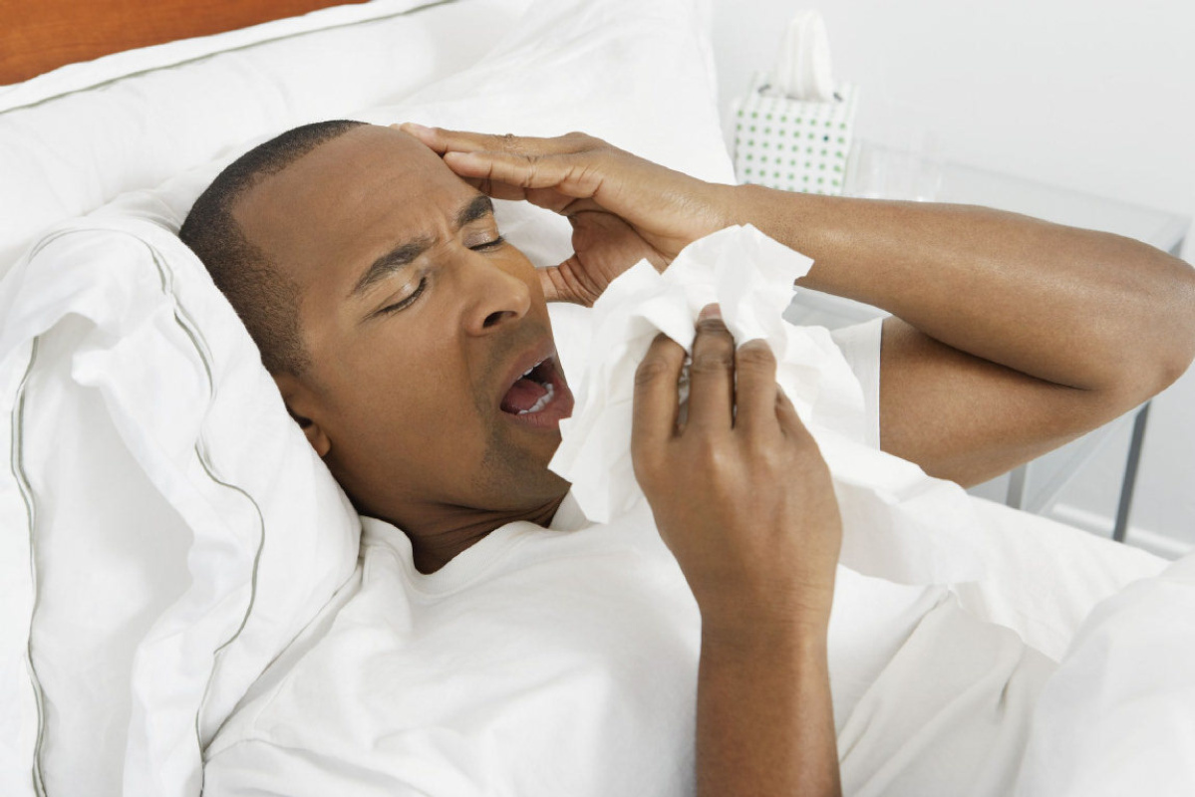
Scenario 1
42 year male
MC: green productive cough, fever, weakness for 2 weeks
Known smoker and HT on Rx, no allergies
He is awake and talking, but very short of breath
What is your first step?
https://www.thestar.com/life/2015/09/06/sleep-longer-to-stay-healthier-study-finds.html
Notes:
You start the same way as you did with CPR- with HHH

Slide 14
HHH
Hazards: gloves for you, mask on him
Hello: he is awake and greets you, although he is a bit short of breath
Help: you make plans to call the ambulance

Slide 15
Primary survey (ABCDE)
Airway:
patent, maintainable, failed
Breathing:
RACES
Rate (respiratory rate)
Auscultation
Colour? (pink/blue)
Effort? (work of breathing)
Saturation (pulse oximeter)
Notes:
Ask him to speak- listen for hoarseness, stridor, gurgling, any added sounds- based on that, decide if it’s patent, maintainable or failed

Slide 16
Circulation:
RACES
Rate (heart rate)
AVPU
Colour (pale/grey)
End organ perfusion (ie capillary refill time)
Systolic BP

Slide 17
Disability:
3 Ps
Pupils
Posture
avPu
Exposure:
RST
Rashes
Swellings
Temperature, Turn the patient

Slide 18
Back to our patient…
Airway: Speaking therefore intact,
Coughing up ≥ 1 tablespoon of fresh blood
Action: None
Breathing:
R: RR= 30
A: course crackles bilaterally
C: cyanosed
E: intercostal recessions, nasal flaring
S: sats 80%
Action??
He needs resus, call ambulance, OXYGEN!!
Notes:
O2 administration for a very sick patient like this one, choose highest % mask available. Eg non-rebreather with one valve removed (80%), partial rebreather (60%),, venturi (28-45%)
Nasal prongs alone would not be adequate unless in combination with partial or non-rebreather

Slide 19
Circulation:
R: HR= 130
A: Alert
C: cyanosed
E: cap refill >3 sec
S: BP 70/40
Action??
2 large bore IV lines with crystalloids
Take bloods, glucose, cultures, ABG

Slide 20
Disability:
PEARL
Posture: lying in bed
Avpu: alert
Action? No
Exposure
No rash
No swellings
Temp= 39,5
Action??
Remove blankets/ jerseys
Panado/perfalgen for comfort

Slide 21
What’s your overall assessment of this patient?
Multi-lobar, community acquired pneumonia, possibly in septic shock
Specific management for septic shock
Antibiotics, O2, IV fluids, inotropes, source control
What if the main symptom was a wheezing patient with difficulty breathing?
<50 yrs, no pedal oedema, consider asthma
Severe: adrenaline 0,3-0.5 mg sc, nebs, steroid, MgSO4
Unilateral wheeze in a child, foreign body > refer
>50 yrs, consider ADHF
Check BP, furosemide, NIV
Notes:
Other things to consider: Wheeze and difficult breathing, no leg swelling, if 1st episode of wheeze, patient < 50 years suspect asthma and treat according to guideline.
Difficult breathing worse on lying flat especially with leg swelling or 1st episode of wheeze in patient ≥ 50 years, heart failure likely and treat according to guideline for CCF.

Slide 23
Scenario 2 Chest pain
63 yr female complains of chest pain
It is central and spreads to the left arm
Associated with nausea and dizziness
Worse with exertion
She is a known diabetic and HT on treatment
Smoker: 30 pack years
No previous heart attacks

Slide 24
Go through the system
HHH- no problems there, speaking to you
Airway: Awake and talking

Slide 25
Breathing
RACES:
Rate: 16/min
Auscultation: Clear air entry bilat
Colour: normal
Effort: normal
Sats: 93% room air
Action??
No need for O2 as long as sats > 90%
Notes:
In fact, the recent AHA update in 2015 states that for chest pain specifically, the sats only needs to be above 90%, not 94%

Slide 26
Circulation
RACES:
Rate: HR 70/min
AVPU: alert
Colour: normal
End-organ perfusion: cap refill 2sec
Sys BP: 140/85
Action??
12-lead ECG!!- within 5-10 mins, and continuous cardiac monitoring
IV line (for in case she decompensates), bloods (cardiac enzymes), glucose

Slide 27
Disability
3Ps
Pupils: PEARL
Posture: Normal
avPu: Alert
Action??
None

Slide 28
Exposure
RST:
Rashes: none
Swellings: none
Temperature: 36.8
Action??
None

Slide 29
Summary of the case
Patients with chest pain may have no abnormalities on vitals or examination but you still have to take them seriously!
Call an ambulance! Do not let them drive!
Chest pain or anginal equivalents necessitates good monitoring and an URGENT ECG
If there are signs of STEMI on the ECG, the patient needs urgent reperfusion (thrombolytics or PCI)
Anti-ischemic medical Rx includes
Dual antiplatelet cover: Asprin, Clopidogrel
Anticoagulant: Clexane
High dose statin (plaque stabilizing): Simvastatin 80mg po stat
Nitrate (unless right sided MI on ECG, or low BP): Angised
Morphine 3-5 mg ivi boluses if required for pain (watch the BP)
Refer to cardiology
Notes:
Asprin 150mg to chew, Clopidogrel 300mg po stat
Clexane 30mg iv stat then 20 mins later,1mg/kg sc bd
Angised 1 SL prn x3 as long as BP is not low

Slide 31
Scenario 3 Hemiparesis
You are in church one Sunday morning when a 70yr female suddenly collapses
You see the commotion and rush over
She reports that her right arm and leg feels weak and you notice that her speech is slurred.
Being the competent medical practitioner that you now are, you go through your H’s and primary survey

Slide 32
HHH
Hazards: None
Hello: awake with slurred speech
Help: Go call for the EMS to take her to the nearest hospital

Slide 33
Airway
Speech is slurred but there are no secretions in her airway
Action?
none

Slide 34
Breathing
RACES:
Rate: 14/min
Auscultation: Clear, equal air entry bilaterally
Colour: pink
Effort: normal
Sats: 96%
Action?
none

Slide 35
Circulation
RACES:
Rate: 76/min
AVPU: alert
Colour: pink
End-organ perfusion: 3 secs
Sys BP: 130/80
Action?
none

Slide 36
Disability
3Ps
Pupils: PEARL
Posture: right arm and leg weak but she can still stand and walk with a limp
avPu: alert, following commands

Slide 37
Exposure
RST:
Rashes: none
Swellings: none
Temperature: 36.8
Action??
none

Slide 38
What do you make of this case?
One sided weakness and slurred speech sounds suspiciously like a stroke
Notes:
How did you know? You subconsciously did the Cincinnati stroke scale in your head

Slide 39
FAST mnemonic

Slide 43
Specific goals for stroke patients
Identify a possible stroke patient
Note the time last seen normal (only qualify for lytics if < 4,5 hrs)
Support ABCs if necessary, check glucose
Order a stat non-contrasted CT brain
Bleed >> refer neurosurgery
No bleed/ normal scan >> consider fibrinolytics after considering risks and discussing with patient or family and neurologist
Admit to a stroke unit ideally
Notes:
Lytics controversial
NNT
NNH

Slide 44
RECAP: Approach to a medical emergency
Pulseless: HHH, CAB (good quality, early defib, reverse cause)
Pulse: HHH, ABCDE
Airway: patent, maintainable, failed
Breathing: Rate, Auscultation, Colour, Effort, Sats
Circulation: Rate, Avpu, colour, End-organ cap refill, sBP
Disability: Pupils, posture, avPu
Exposure: Rashes, Swelling, Temp, turn pt

Slide 45
Questions??

