Slide 1
SKIN CANCER

Slide 3
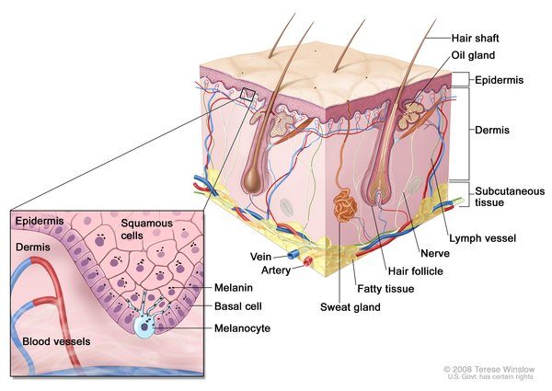

Slide 4
INTRODUCTION
Skin cancer accounts for 30% of all cancer in RSA
Americans have a 1 in 3 lifetime risk of skin cancer
40% of white pt. by age 65 will have some form of skin cancer
60% of melanomas are detected by patients themselves
Skin cancer is divided into 2 main types: NMSC vs MELANOMA SC

Slide 5
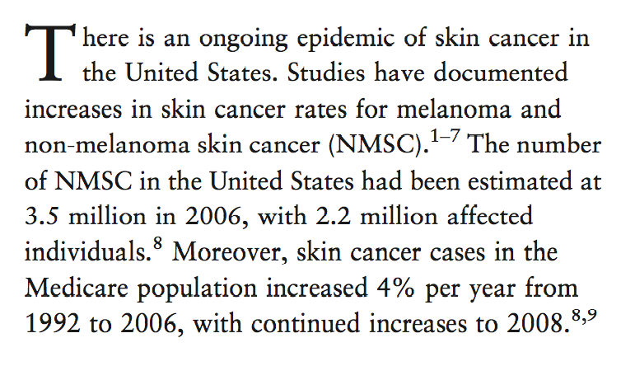

Slide 6
NON-MELANOMA SKIN CANCER
Non melanoma skin cancer (NMSC) is the most common and most rapidly increasing cancer in the world
America 3.5 million cases per year increasing by 4% per year

Slide 7
CLINICAL TYPES
Basal-cell skin carcinoma
Squamous-cell carcinoma
Melanoma
Others: dermatofibrosarcoma protuberans, Merkel cell carcinoma, Kaposi's sarcoma, sebaceous carcinomas, microcystic adnexal carcinoma, Paget's disease of the breast

Slide 8
RISK FACTORS
Smoking
HPV infections
Genetic syndromes e.g. congenital melanocytic nevi syndrome, GORLINS
Chronic non-healing wounds e.g. Marjolin's ulcers
Ionizing radiation such as X-rays, environmental carcinogens, artificial UV radiation (e.g. tanning beds)
Immunosuppressive medication e.g. (Cyclosporin A, a calcineurin inhibitor, azathioprine)

Slide 9
UV RADIATION
UV RADIATION
Ultraviolet light consists of UVA, UVB and UVC
UVC does not reach through the earth’s atmosphere
The narrower UVB rays cause the browning reaction that we call ‘tanning’ > redness of skin, painful burning, skin damage and skin spots > skin cancer.

Slide 10
UV RADIATION
Additional skin cancers per million from UV exposure
Latitude of RSA 13 degrees north to 22 degrees south
UV index higher (>10) at higher altitudes - UVR levels rise by about 4 to 5 percent for every 1000 feet of altitude

Slide 11
UV RADIATION
UVA rays penetrate deeper into the skin: structural damage> causing ageing> risk of skin cancer.
UVB rays are normally only active when you are in actual sunlight. They are filtered by glass and clothing.
UVA rays can pass through glass, shade, water and loose clothing.

Slide 13
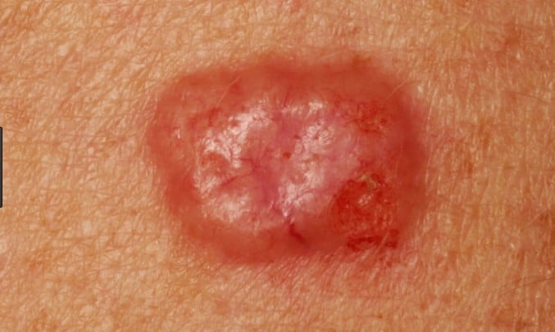

Slide 16
APPROACH

Slide 17
BASAL CELL CARCINOMA

Slide 18
GROWTH TYPES
Normal
Aggressive

Slide 19
NORMAL GROWTH TYPES
Superficial
Nodulocystic differentiation variants
VS

Slide 20
AGGRESSIVE GROWTH
Micronodular
Infiltrative
Morphoeic
Metatypical (Basosquamous)

Slide 21
ANATOMICAL AREA
Face
Rest of the body

Slide 22
SKIN TYPE

Slide 23
VITAL FUNCTIONAL AREAS
Eyelids
Ears
Lips
Nose

Slide 24
BASAL CELL CARCINOMA
Sometimes what is seen at the surface is only the tip of the iceberg
Doubles in size every two years

Slide 25
Latest statistics 2004
New
National Cancer Registry
from 2010
2004 Numbers
Underreported
NMSC
Caucasian males
BCC 36%
SCC 14%
250/100 000
NMSC
Cape Coloureds
BCC 18%
SCC 8.7%
84/100 000
NMSC
Caucasian females
BCC 31%
SCC 11.7%
140/100 000
Melanoma
69/100 000

Slide 26
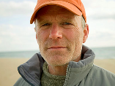
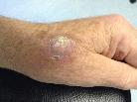
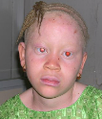
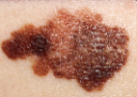
Sunny climate
Caucasian population
UV
Northern European
Descent
Cape
Coloureds
Epidemic of
NMSC
Melanoma
Fair skin
VS
Tirosinase + albinism
African descent approx 11000

Slide 27
GENETIC PREDISPOSITION

Slide 28
Treatment options

Slide 29
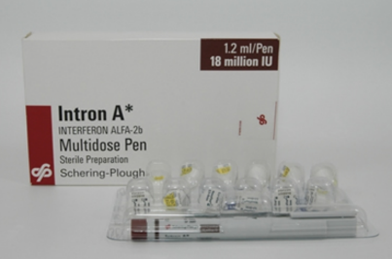
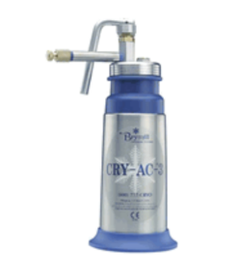
NON SURGICAL THERAPIES

Slide 30
RADIOTHERAPY

Slide 31
SURGICAL TREATMENT OPTIONS
“Blind”
Excision
Mohs micrographic
excisional surgery
Excision with margin control via
selected vertical frozen sections
performed by pathologist
present in theatre

Slide 32
SKIN LESION
Clinically certain BCC
Uncertain as to
diagnosis
type of BCC
depth
Plan treatment
Diagnostic procedure
Certainty

Slide 33
Diagnostic options
Curettage
Dermoscopy/
Siascopy
Tangential excision
Ellipse incision
Punch biopsy

Slide 34
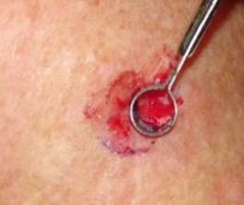
TREATMENT
Can I treat with curettage?

Slide 35
Why not?
Too large for curettage/ non-surgical options

Slide 36
Why not?
Less ideal areas for curettage
bridge/tip of nose
upper lip
eyelids

Slide 37
Why not?
Recurrence (non-surgical options not ideal)

Slide 38
Yes
With cautery
2 stages
curette
cautery 1mm
curette again
cautery 1mm
92% cure rate
Without cautery
Better scar
Lower cure

Slide 39
Curettage without cautery
Perform adjuvant therapy
Metvix PDT e.g. nostril
Aldara cream e.g. ear
Intron A e.g. nose/
cheek in young patient
Observe
Anterior chest
Medial canthus eye

Slide 40
Why not?
Small
Superficial and vital area
Scared of scarring
face
chest
lower legs

Slide 41
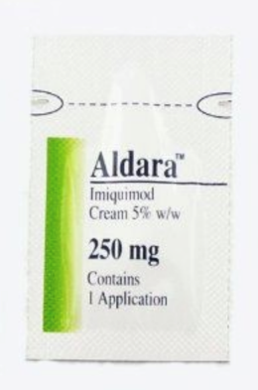
5 days a week for 6 weeks
good for
ears
body
lips
>90% cure

Slide 42
2 sessions
one week apart
good for face/ nose/ lower legs
80-85% cure

Slide 43
3x/week for 3 weeks
1.5 mu / cm2
1-2 lesions at a time max
Good for nose/ cheek
Small lesions
Cure rate >90%

Slide 44
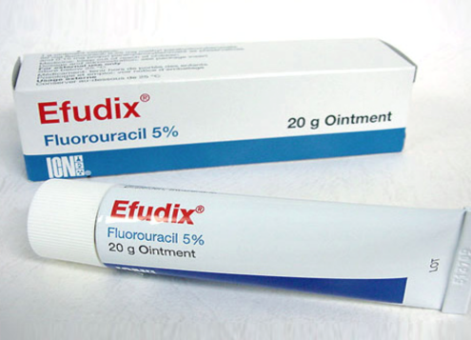
Do NOT use for BCC
Low cure rate
Can recur as
aggressive growth pattern

Slide 45
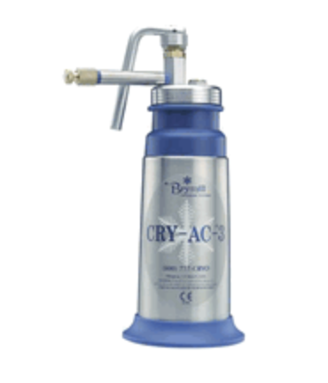
Genetic cases
Multiple early BCC’s
Superficial
2 freeze-thaw cycles

Slide 46
Why not?
Aggressive growth patterns

Slide 47
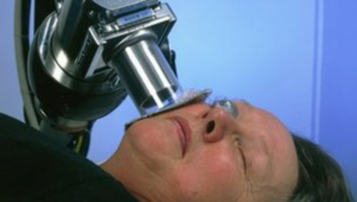
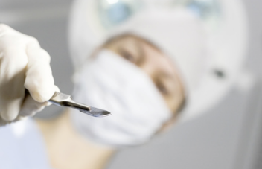
What’s my options?

Slide 48
Radiotherapy
Old/ frail patients
Good option in selected patients
The better the surgical options available, the less attractive radiotherapy is as a treatment option for NMSC

Slide 49
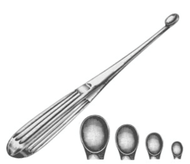
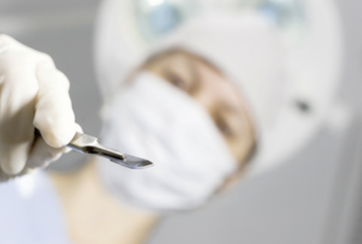
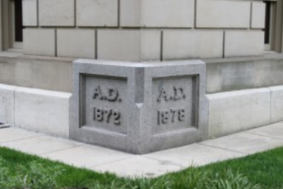

Slide 50
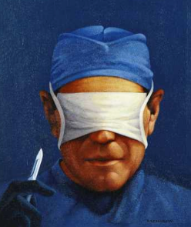
Wide “blind” excision of skin cancer
Good consulting room or theatre option on uncomplicated cases
Feedback on completeness only after repair is done
Pathology evaluation random only, can miss tumour

Slide 51
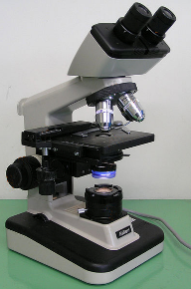
Excision with margin control by selected vertical frozen sections performed by pathologist present in theatre
Best surgical treatment option in a non-Mohs environment
Still only random sampling, miss incomplete excision in 8-10% of cases
Expensive in pathologist and theatre time

Slide 52
Why is vertical pathology sampling less accurate?

Slide 53
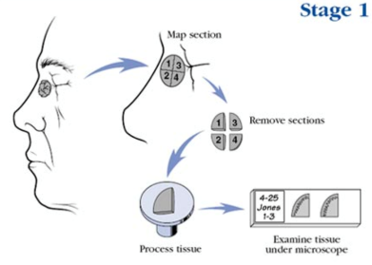
Mohs Micrographic Surgery
Offers the highest cure rate (98-99%)
Evaluates the entire surgical margin microscopically

Slide 54
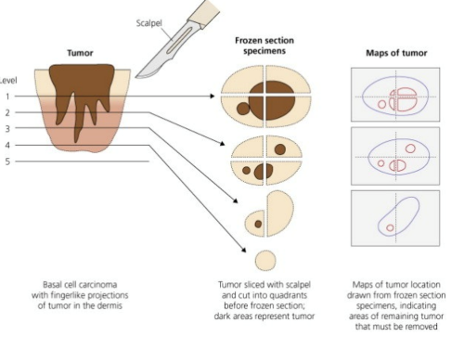
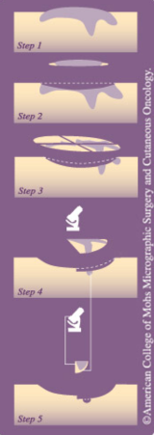
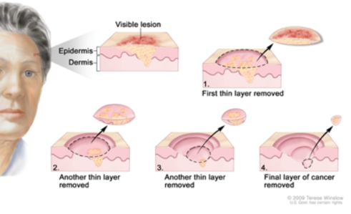

Slide 55
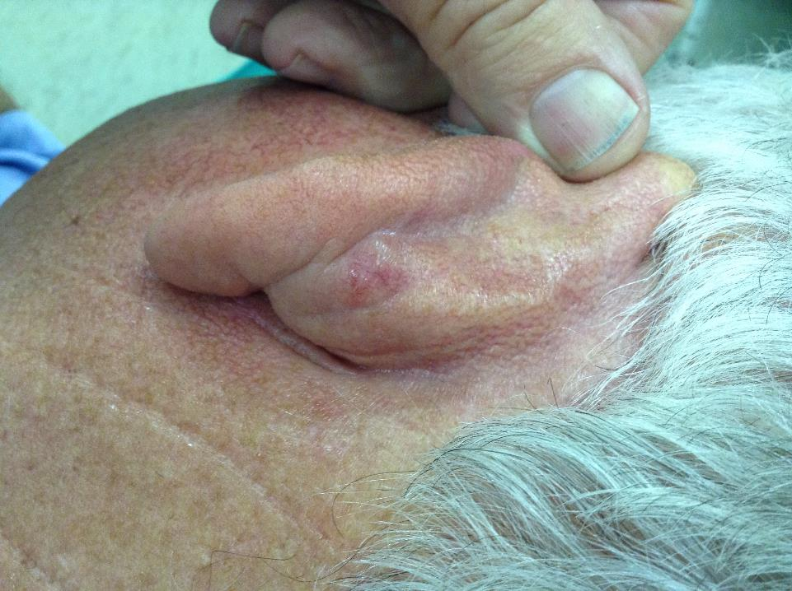

Slide 56
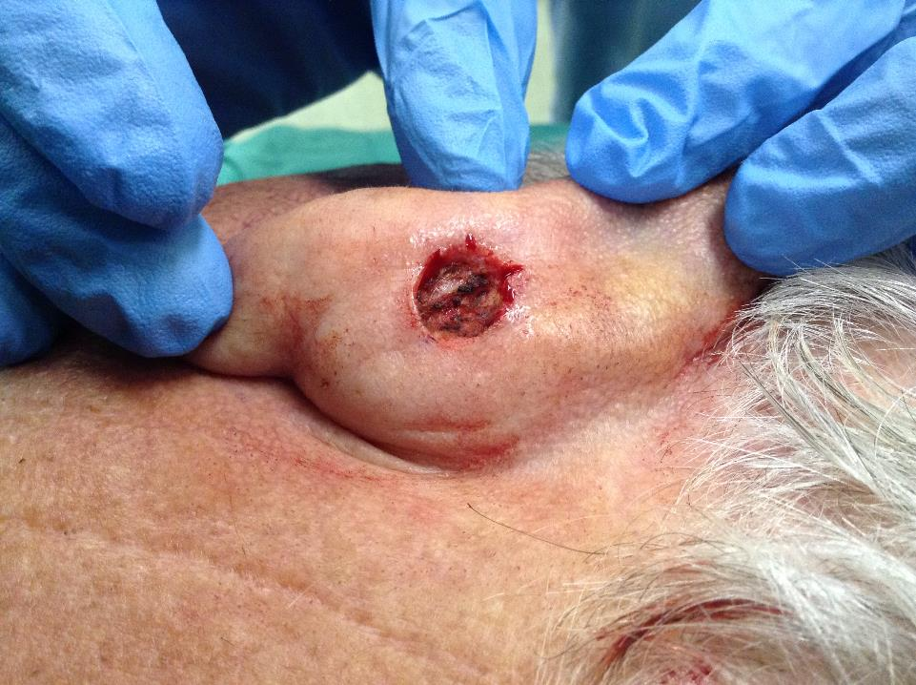

Slide 57
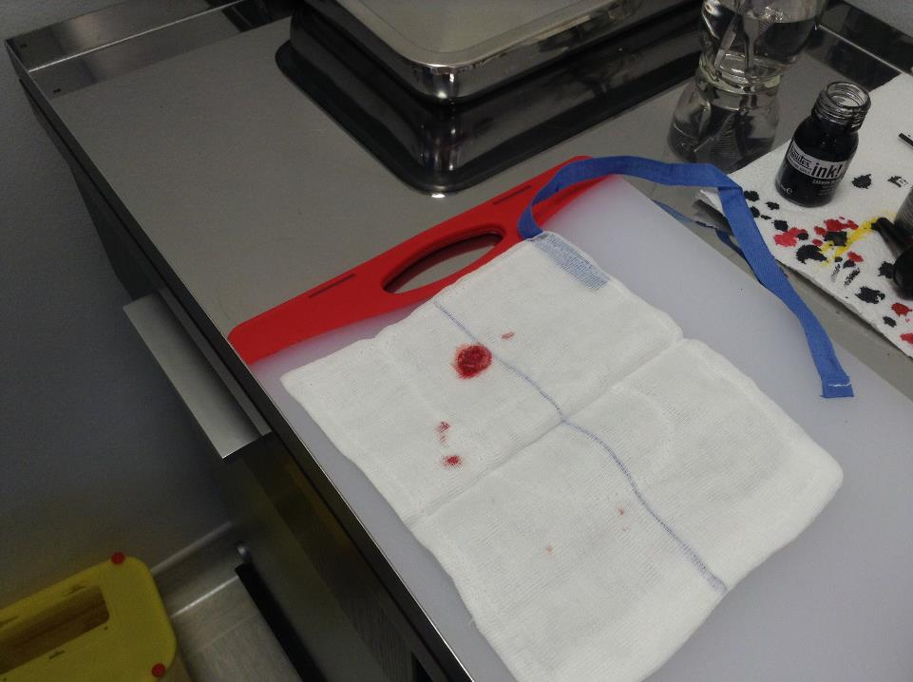

Slide 58
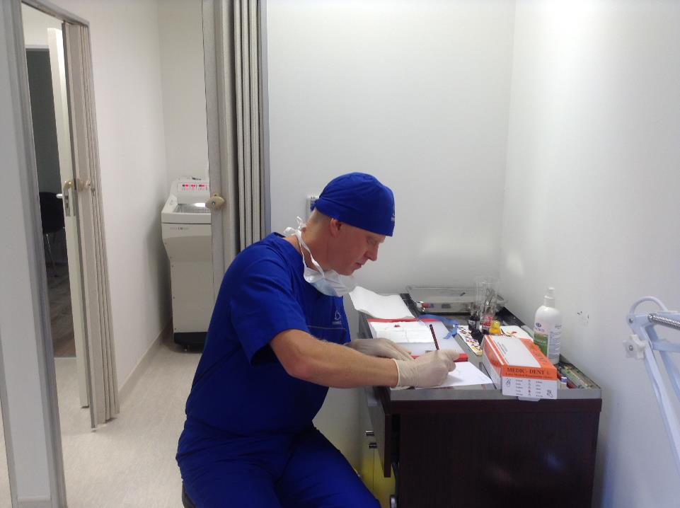

Slide 59
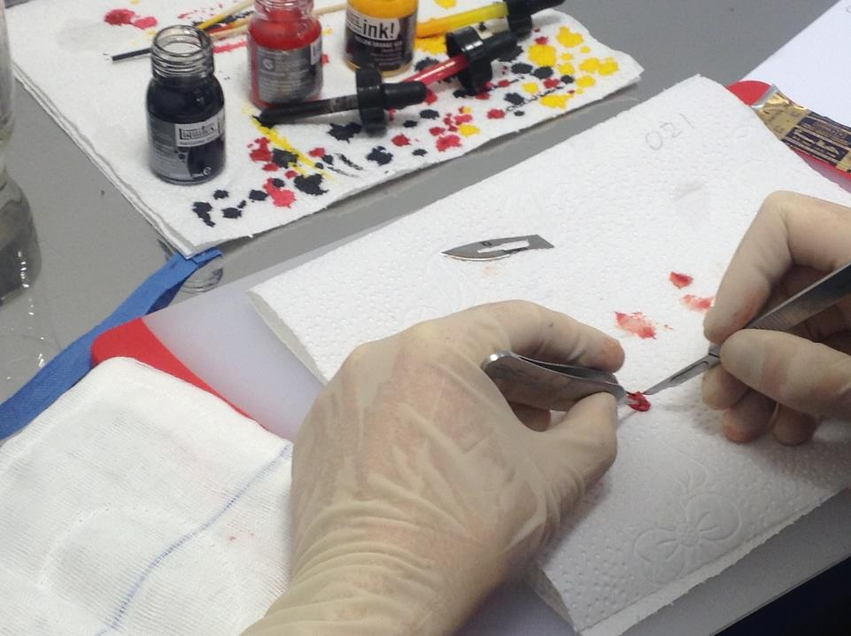

Slide 60
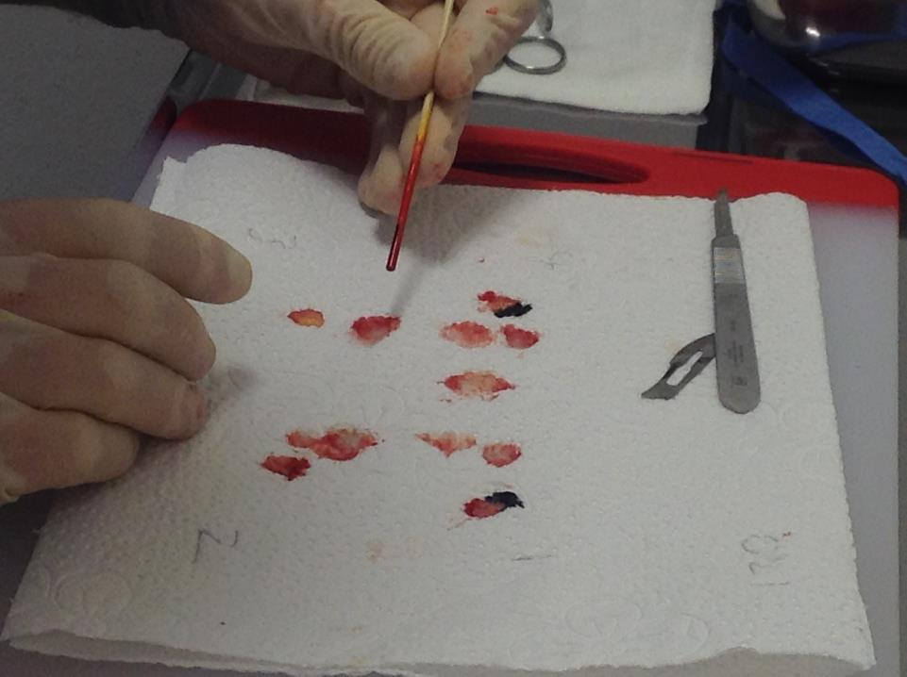

Slide 61
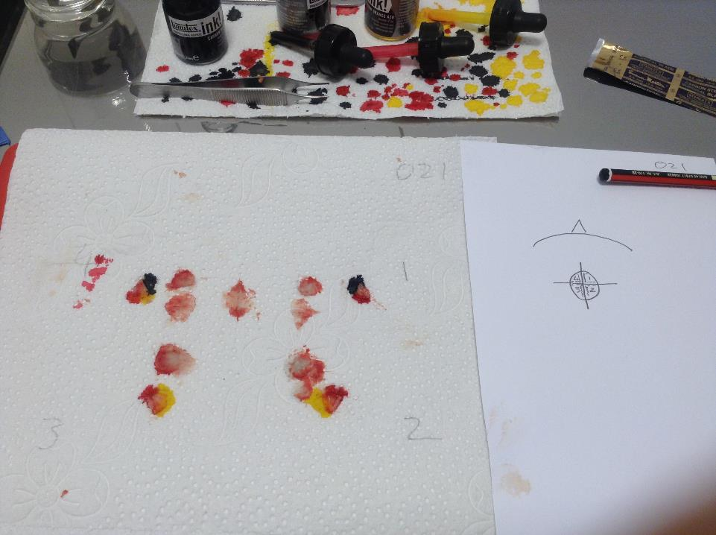

Slide 62
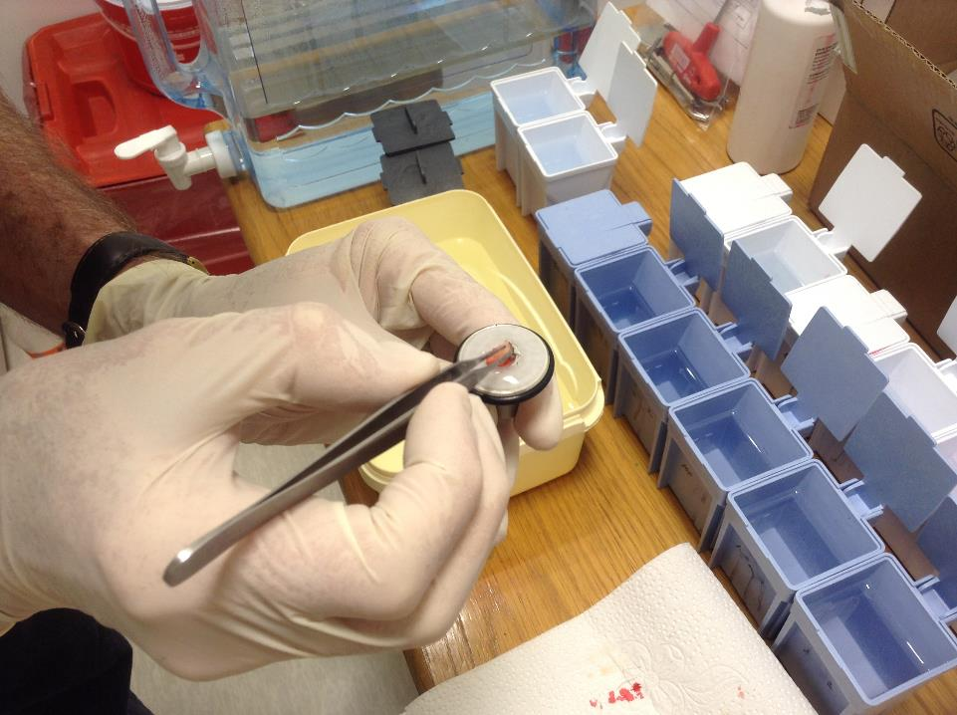

Slide 63
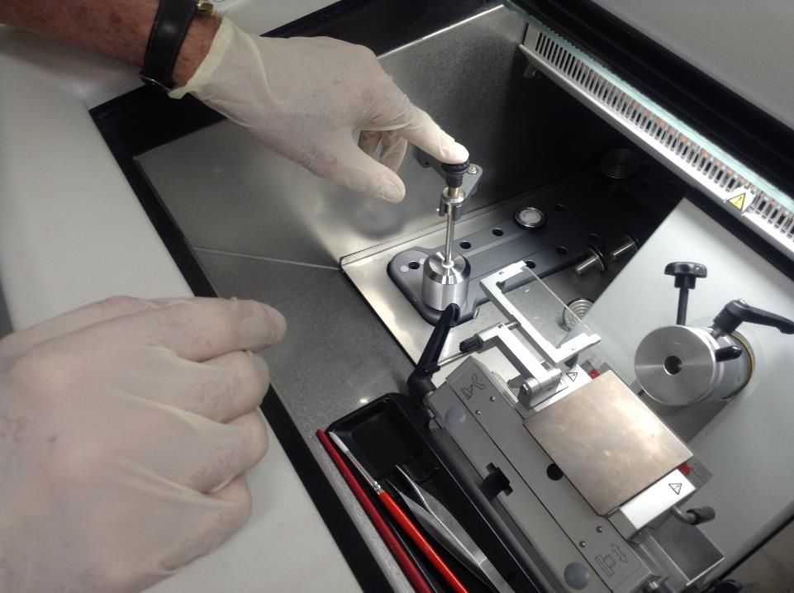

Slide 64
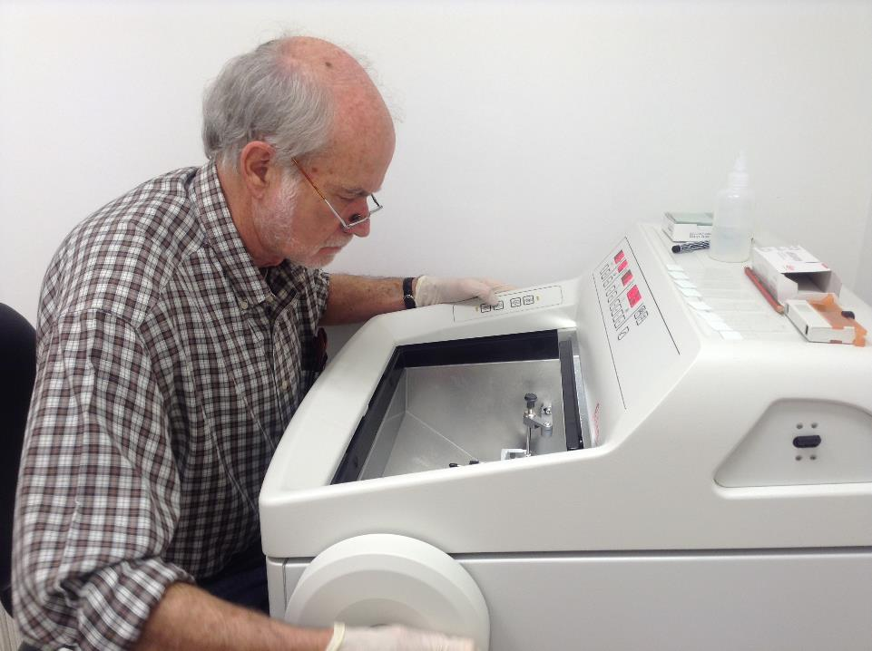

Slide 65
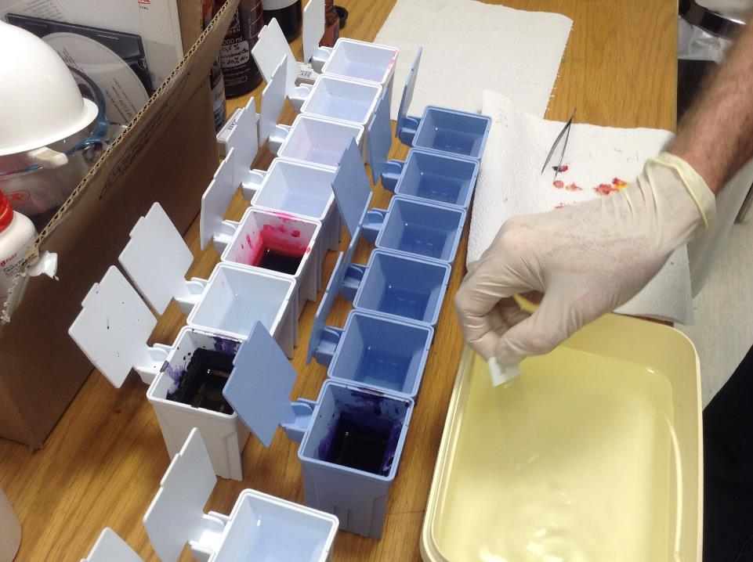

Slide 66
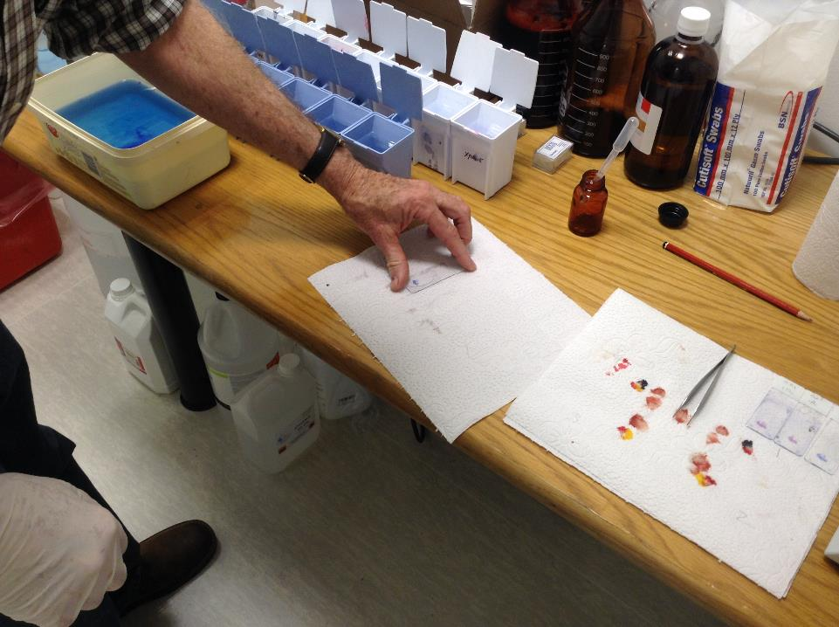

Slide 67
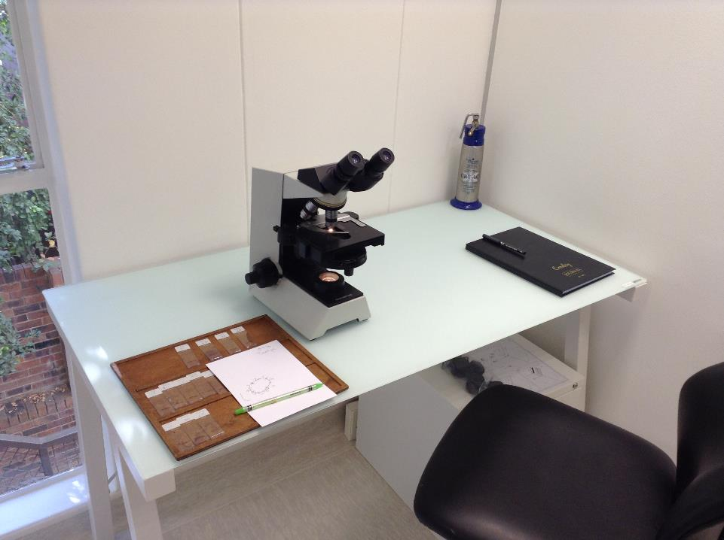

Slide 68
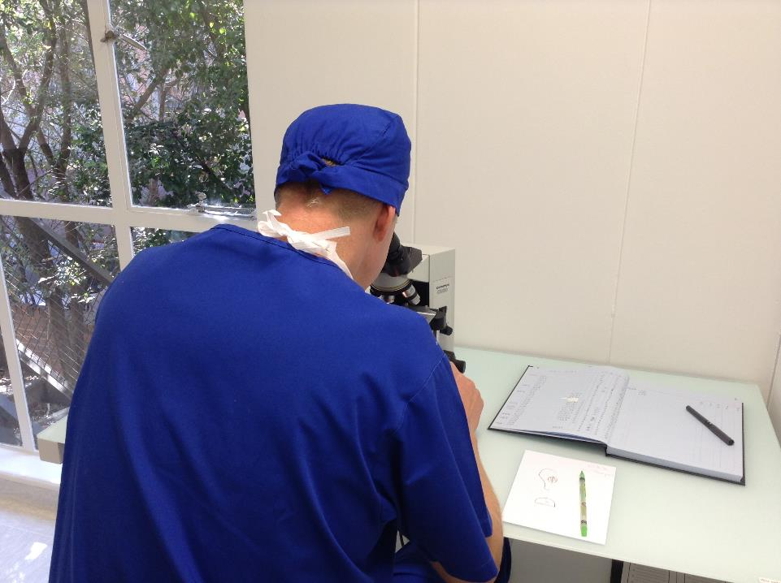

Slide 69
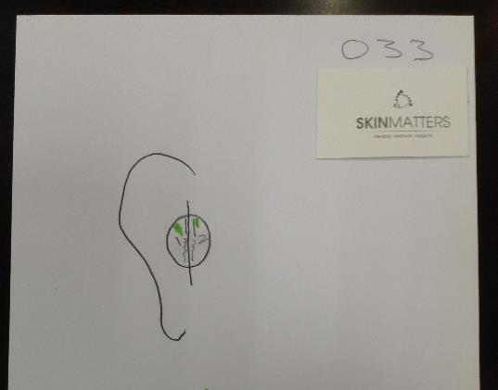

Slide 70
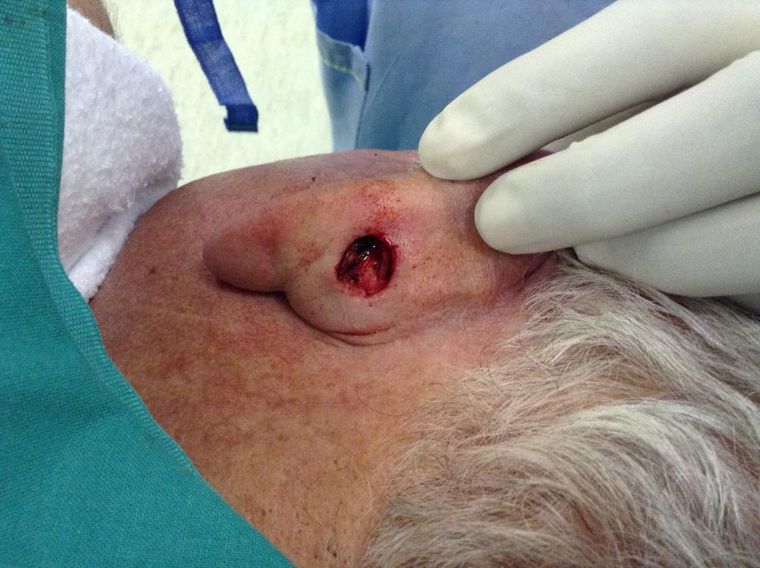

Slide 71
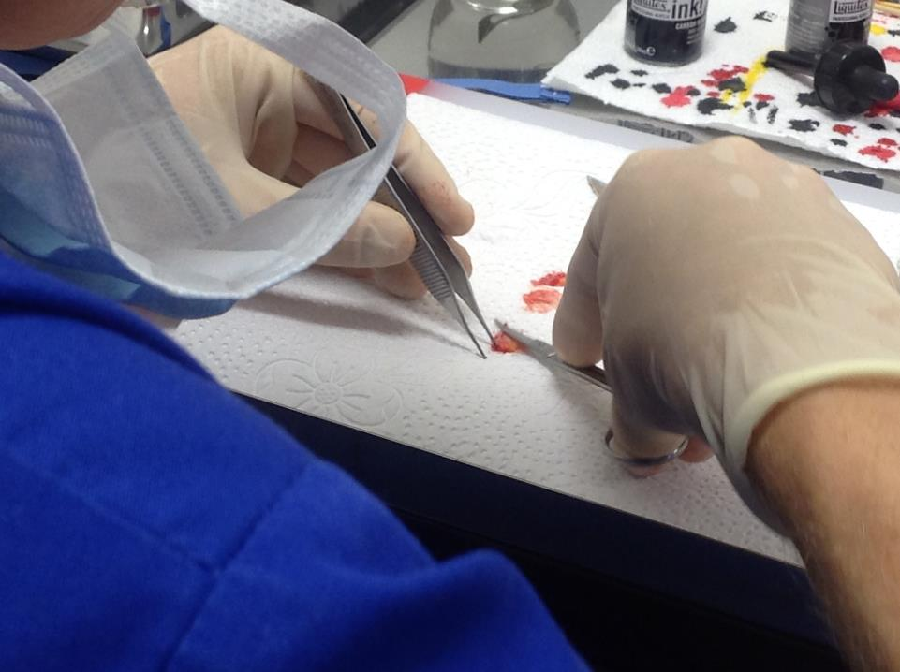

Slide 72
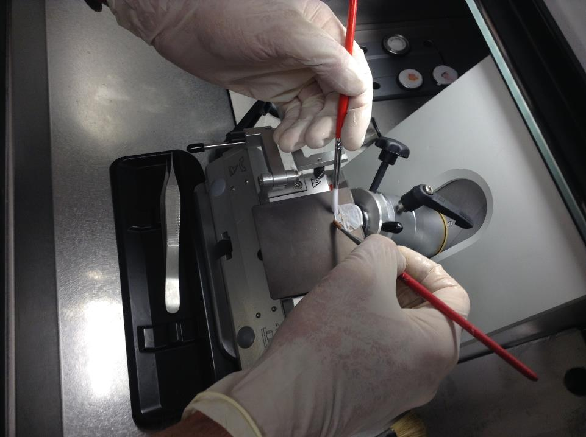

Slide 73
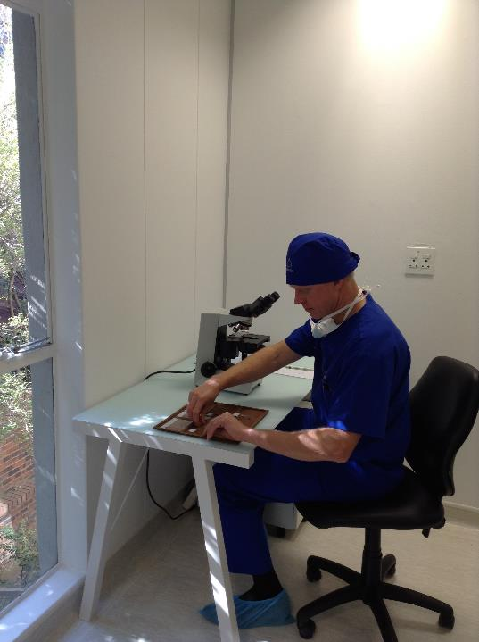

Slide 74
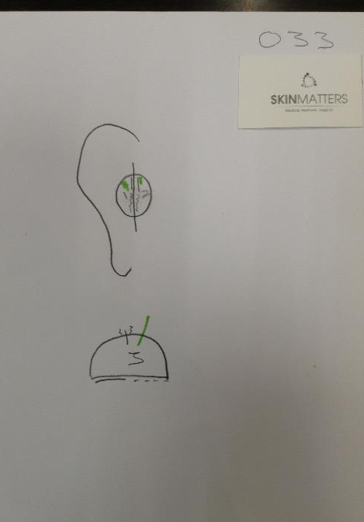

Slide 75
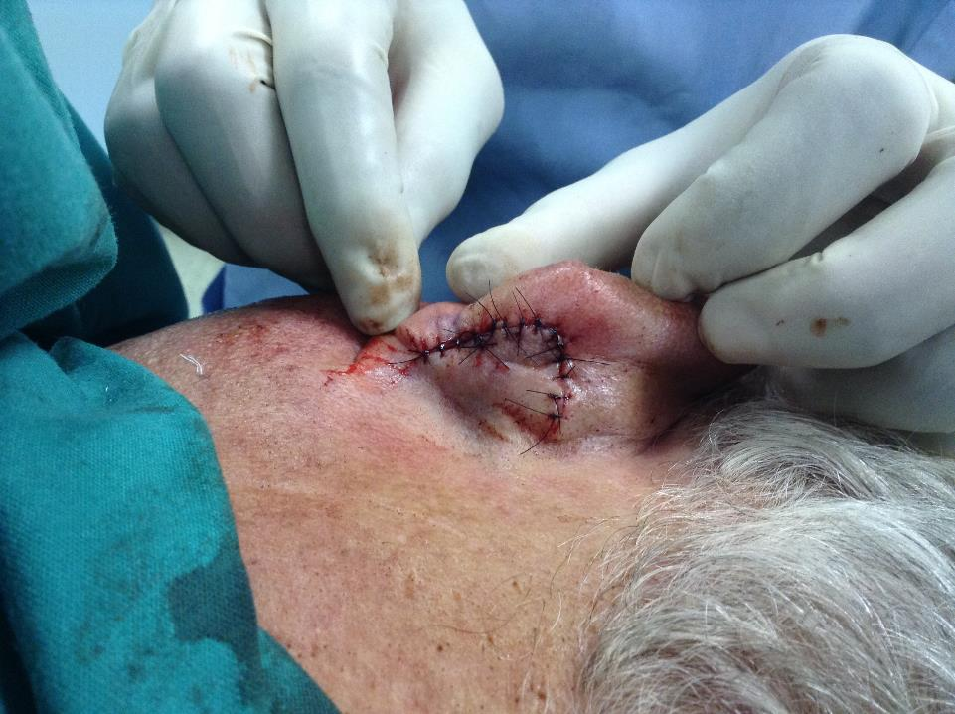

Slide 76
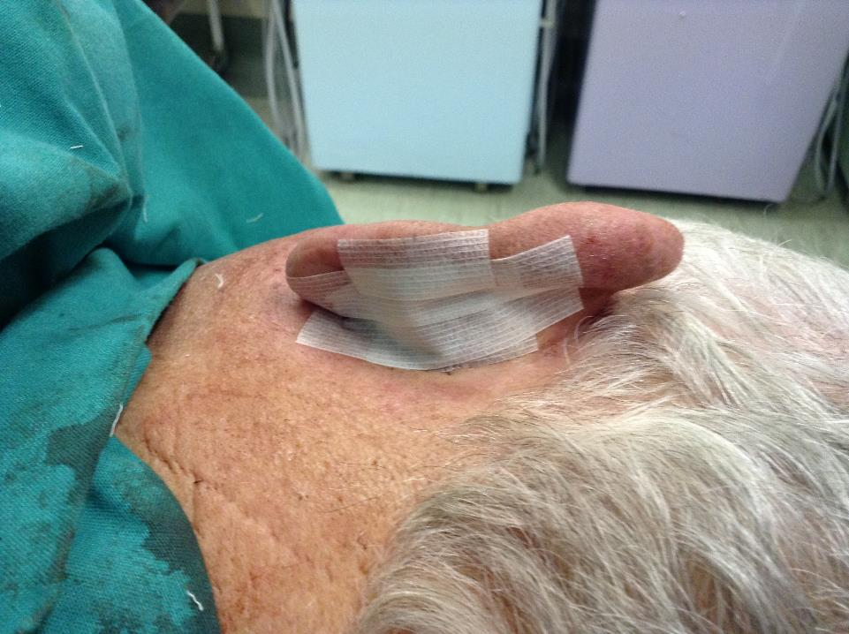

Slide 77
Synergy between specialties
Mohs Micrographic Surgery is an excisional technique, it must always be followed by some form of closure or decision
An ideal unit therefore includes a Mohs Surgeon as well as a Specialist Reconstructive Surgeon working together

Slide 78
SUMMARY
Diagnosis?

Slide 79
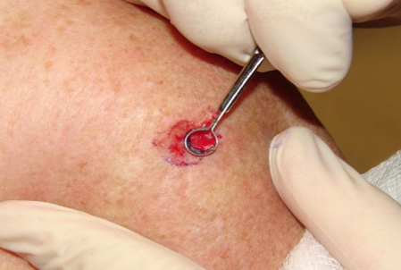
Summarize
TREATMENT
Curettage and cautery if possible

Slide 80
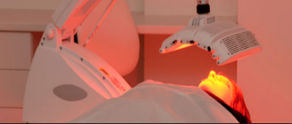
SUMMARY
TREATMENT
If small/
superficial/
adjuvant to curettage without cautery:

Slide 81
Summarize
Treatment
Large
Critical functional area
Aggressive growth pattern
Recurrence
Incompletely excised

Slide 82
Uncomplicated growth
pattern and area

Slide 83
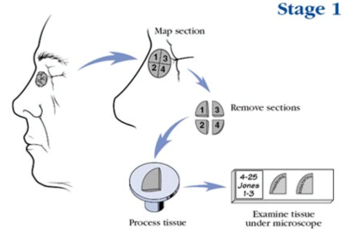
Complicated
functional area
aggressive growth pattern
recurrence
incomplete
ill-defined
large

Slide 84
