Slide 1
Comprehensive Diabetes Care
Continued(3)

Slide 2
Complication screening

Slide 3
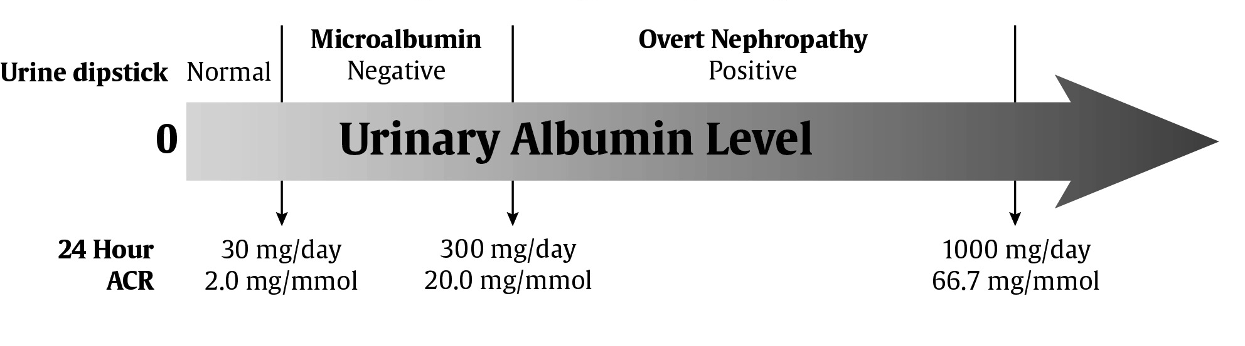
Stages of Diabetic Nephropathy
Note: change in definition of microalbuminuria
ACR ≥2.0 mg/mmol
guidelines.diabetes.ca
Notes:
Avoid term nephropathy
Avoid terms “microalbuminuria” and “macroalbuminuria”
Single cutpoints of 24-Hour and ACR for men and women – gender –specific cutpoints were abandoned (KDIGO)

Slide 4
CKD in Diabetes
Nephropathy assessment
ACR ≥2.0 mg/mmol
and / or
eGFR <60 mL/min
SEMDSA=Canadian Guidelines
guidelines.diabetes.ca

Slide 5
Nephropathy assessment
SEMDSA: Need 2 tests to exclude Chronic kidney disease (CKD)
-serum creatinine (lab will convert to eGFR- need age, sex, race for formula)
-urine albumin:creatinine ratio (ACR)
If ACR = normal range AND eGFR > 60ml/min-screen annually
If ACR abnormal OR eGFR <= 60ml/min – repeat ACR x2 and serum creatinine x1 in next 3 months: REFER if ACR abnormal in 2/3 tests OR eGFR remains <= 60ml/min
guidelines.diabetes.ca
Notes:
SEMDSA 2012

Slide 6
Nephropathy(continued)
DOH Screening for Diabetic nephropathy
Check annually for proteinuria using dipstix.
A diagnosis of nephropathy can be made on either a positive dipstix
OR
if dipstix negative, send urine to laboratory for albumin:creatinine ratio. If ratio > 3 mg/mmol, diagnose nephropathy.
DOH 2014: if patient already on ACE-inhibitor; no need to send urine to exclude micro-albuminuria
Measure serum creatinine annually, and estimate GFR.
guidelines.diabetes.ca
Notes:
DOH 2014 Standard treatment guidelines and essential medicine list differs from SEMDSA guidelines who recommends screening for microalbuminuria twice a year

Slide 7
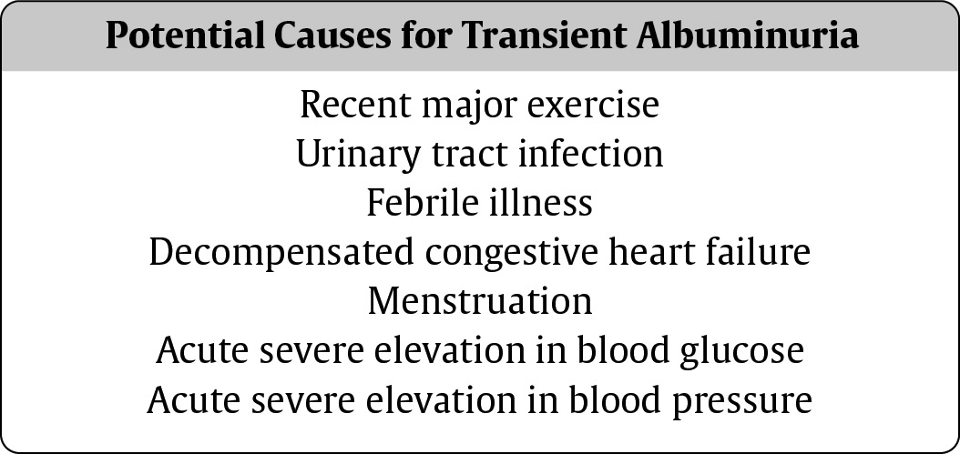
Beware of Transient Albuminuria

Slide 8
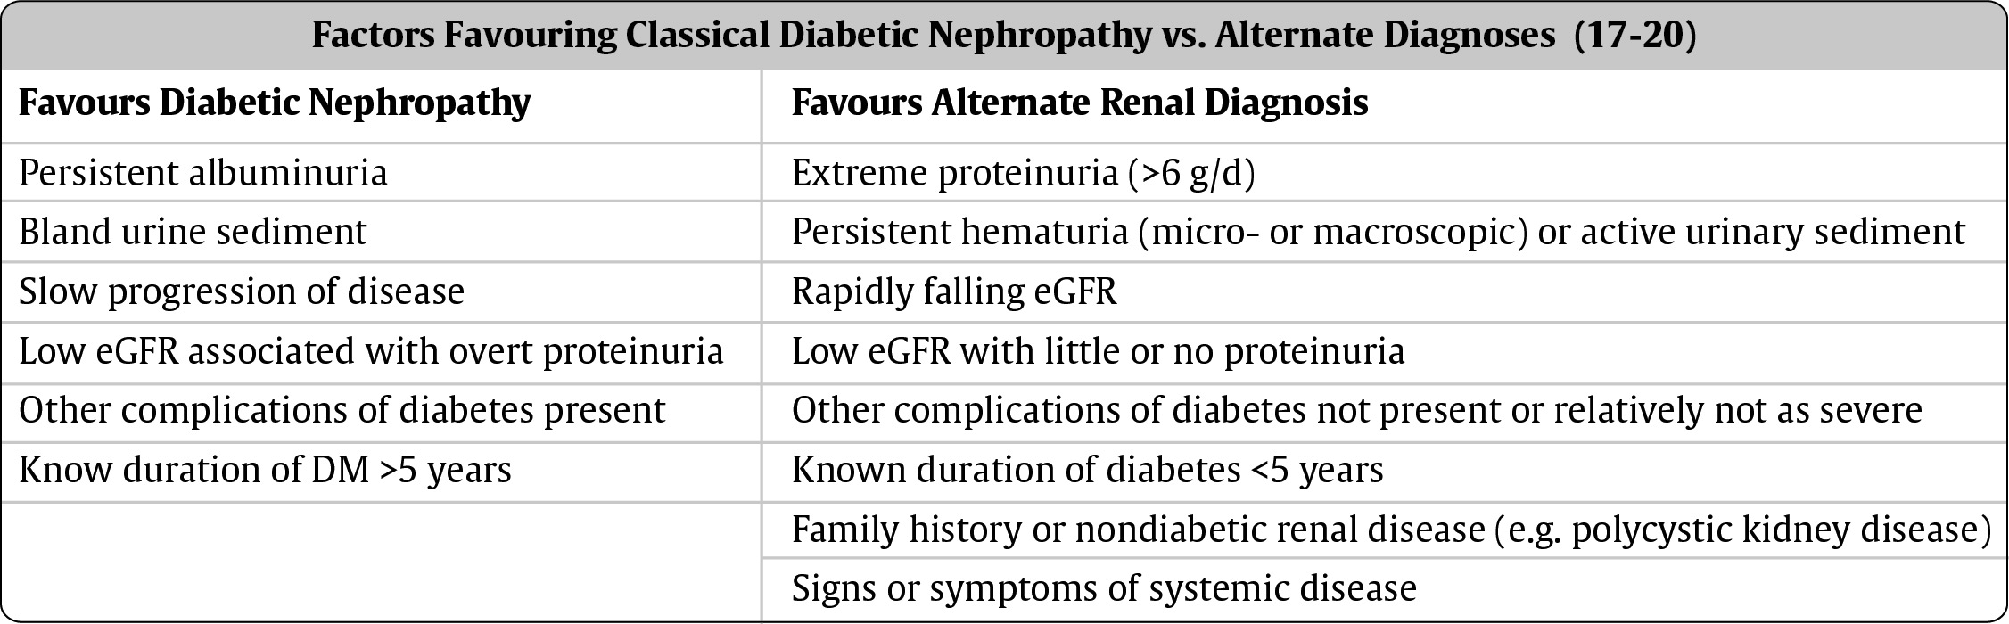
When to Consider Other Causes of CKD

Slide 9
Prevention of Diabetic Nephropathy
Optimal glycemic control in type 1 and type 2 diabetes has been shown to reduce the development and progression of nephropathy
guidelines.diabetes.ca

Slide 10
Reducing Progression of Diabetic Nephropathy
Optimal glycemic control
Optimal blood pressure control (better than 140/90)
ACE-inhibitor (ACEi) or Angiotensin Receptor Blocker (ARB)
guidelines.diabetes.ca

Slide 11
When to Refer…..
Chronic, progressive loss of kidney function
ACR persistently >60 mg/mmol
eGFR <30 mL/min
Unable to remain on renal-protective therapies due to adverse effects such as hyperkalemia or a >30% increase in serum Cr within 3 months of starting ACEi or ARB
Unable to achieve target BP
guidelines.diabetes.ca
guidelines.diabetes.ca | 1-800-BANTING (226-8464) | diabetes.ca
Copyright © 2013 Canadian Diabetes Association

Slide 12
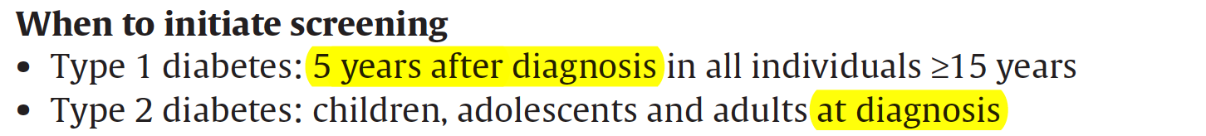
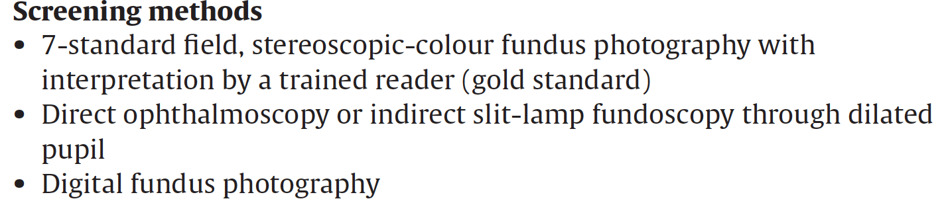
Screening for Retinopathy
2018 Diabetes Canada CPG – Chapter 30. Retinopathy

Slide 13
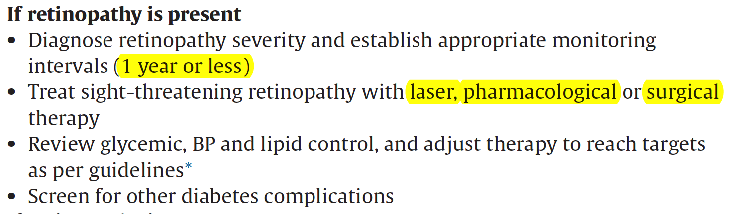
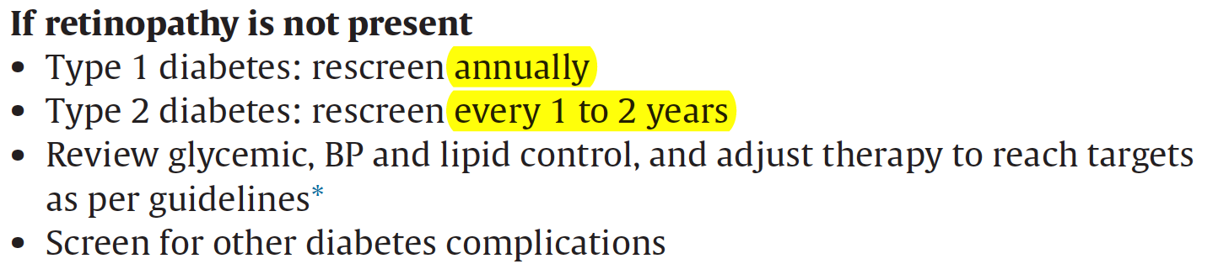
Retinopathy (cont’d)
2018 Diabetes Canada CPG – Chapter 30. Retinopathy

Slide 15
Re-examination and referral

Slide 16
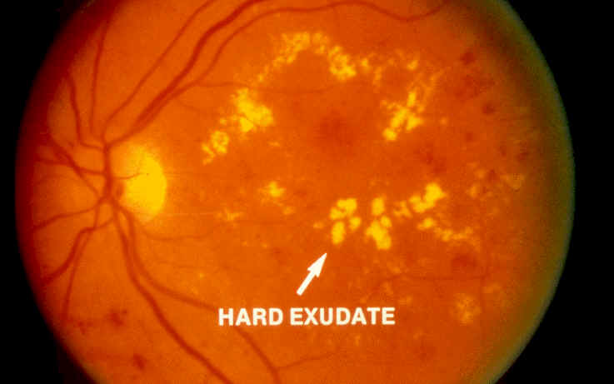
Background Retinopathy
Micro aneurisms
Scattered exudates
Hemorrhages(flame shaped, Dot and Blot)
Cotton wool spots (<5)
Venous dilatations
Background retinopathy

Slide 17
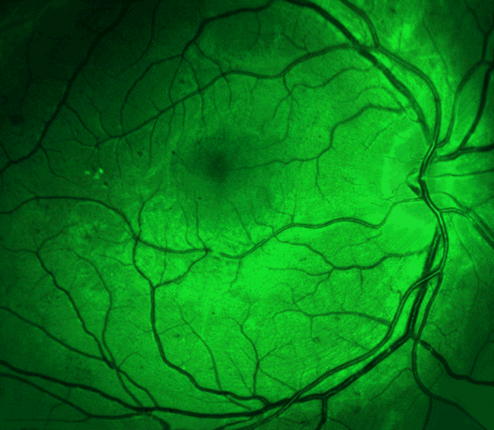
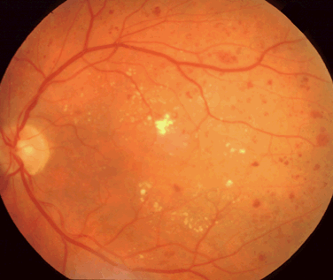
Background retinopathy

Slide 18
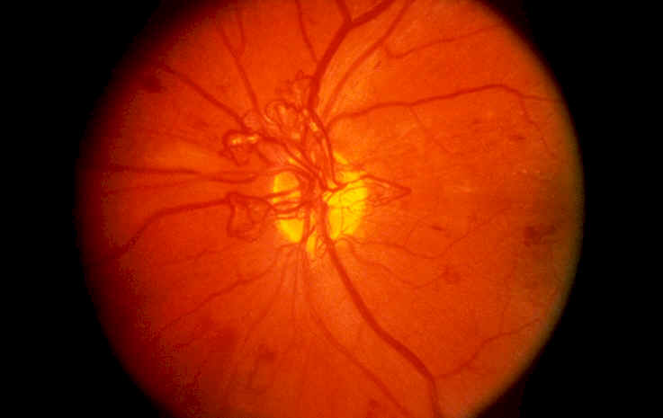
Pre-Proliferative Retinopathy
Rapid increase in amount of micro aneurisms
Multiple hemorrhages
Cotton wool spots (>5)
Venous beading, looping and duplication
Proliferative retinopathy

Slide 19
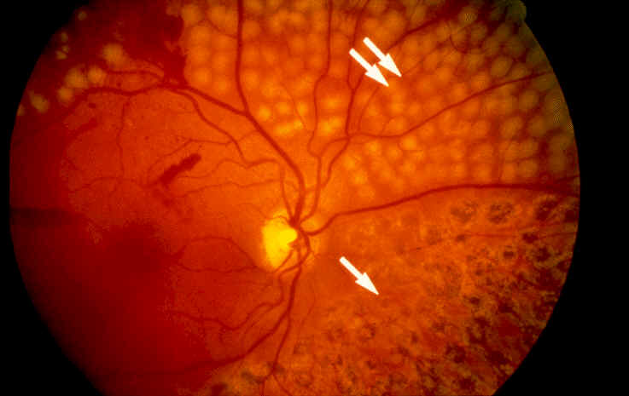
Proliferative Retinopathy
New vessels (on disc, elsewhere)
Fibrous proliferation (on disc, elsewhere)
Hemorrhages (preretinal, vitreous)
Panretinal photo-coagulation

Slide 20
Retinopathy Checklist
SCREEN regularly (fundoscopy or camera)
DELAY onset and progression with glycemic and blood pressure control ± fibrate
TREAT established disease with laser photocoagulation, intra-ocular injection of medications or vitreoretinal surgery
guidelines.diabetes.ca
Notes:
Use same check marks as Geetha

Slide 21
Diabetic Retinopathy Most Common
Cause of Blindness Among Working Age
Category | Proliferative Retinopathy Prevalence | Macular Edema Prevalence
Type 1 DM | 23% | 11%
Type 2 DM on insulin | 14% | 15%
Type 2 DM on oral agents | 3% | 4%
Klein R, et al. Diabetes care 1992;15(12):1875-91
Klein R, et al. Ophthalmology 1984;91(12):1464-74
guidelines.diabetes.ca

Slide 22
Retinopathy Increases Morbidity and Mortality
Visual loss is associated with:
  Increased falls
  More hip fractures
  A four-fold increase in mortality
  Early death (in T1DM)
guidelines.diabetes.ca

Slide 23
Risk Factors for Progression
Longer duration of diabetes
Elevated A1C
Hypertension
Dyslipidemia
Low hemoglobin level
Pregnancy (with T1DM)
Proteinuria
Severe retinopathy itself
guidelines.diabetes.ca

Slide 24
Delay of the Disease
Glycemic control: target A1C ≤7%
Blood pressure control: target BP <130/80
Lipid-lowering therapy: fibrates have been shown to decrease progression and may be considered (not in Primary Care)
guidelines.diabetes.ca

Slide 25
Diabetic Retinopathy CAN be Treated
Pan-retinal photocoagulation → laser therapy
  Reduces blindness by 90% in severe non-proliferative or proliferative retinopathy
Local (intra-ocular) pharmacologic intervention → VEGF antagonists
  Ranibizumab and bevacizumab improve vision
Surgical intervention → vitrectomy
guidelines.diabetes.ca

Slide 26
Sight-threatening Retinopathy
MUST be
Prevented with good blood sugar and
blood pressure control (± fenofibrate);
Detected through screening; and
Treated with laser therapy, anti-VEGF medications or vitrectomy
to save VISION
guidelines.diabetes.ca

Slide 27

Diabetic neuropathy and the diabetic foot

Slide 28
Foot Care: What are we trying to prevent?
Neuropathy
Increased plantar pressure
Charcot foot
Foot ulcers
Amputations

Slide 29
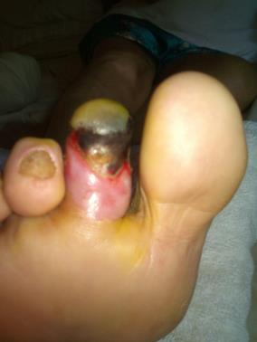
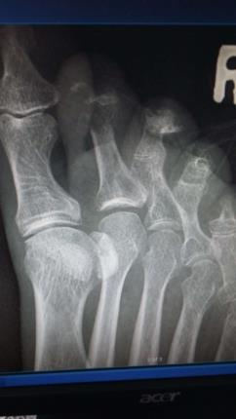
Mr E
60 year old male patient, smoker, T2DM for 20 years
What happened?
Why did this happen?
Could this have been prevented

Slide 30
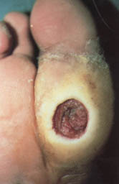
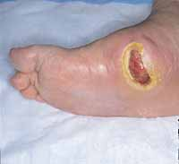

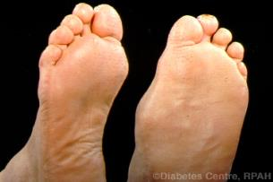
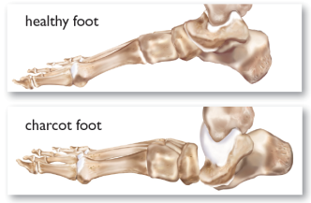


Slide 31
How common are these problems?
Diabetic foot complications are the most frequent reason for hospitalization in patients with diabetes, accounting for up to 25% of all diabetic admissions in the United States and Great Britain.
Diabetes Care 1990; 13: 513-21.

Slide 32
How common are these problems?
A non-healing foot ulcer precedes approximately 85% of all amputations.
Diabetic foot ulcers and lower extremity amputations are serious and expensive complications that occur in as many as 15% of people with diabetes during their lifetime.
Diabetes Care 1998; 21: 2161-77.

Slide 33
How common are these problems?
Diabetic foot complications are the commonest cause of non-traumatic lower extremity amputations in the industrialized world. The risk of lower extremity amputation is 15 to 46 times higher in diabetics than in persons who do not have DM.
South Med J 1997; 90: 384-9
Diabetes Care 1996; 19: 48-52

Slide 34
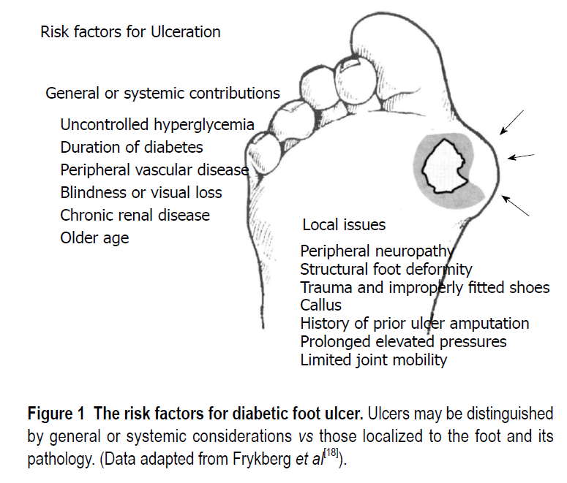
World J Diabetes 2015 February 15; 6(1): 37-53

Slide 35
Simplified Pathway to foot ulcers
Diabetes ( poorly controlled)
Neuropathy
Intrinsic foot muscles
Deformities
Wrong footware
Wrong environment
Ulcer
Foot with no sensation
Increased pressure
Nail or thorn or stone
±

Slide 36
Neuropathy Checklist
PREVENT with blood glucose control
SCREEN with monofilament or tuning fork or Touch the Toes Test
TREAT pain symptoms with anticonvulsants or antidepressants
guidelines.diabetes.ca
Notes:
Use Geetha’s check marks

Slide 37
40-50% of People with DM will have Detectable Neuropathy within 10 years
Sensorimotor poly- or mono-neuropathy
Typical painful/burning or numb feet
Increased risk for:
  Foot ulceration and amputation
  Neuropathic pain
  Significant morbidity
  Usage of health care resources
guidelines.diabetes.ca

Slide 38
Risk Factors
Elevated blood glucose
Elevated triglycerides
High BMI
Smoking
Hypertension
guidelines.diabetes.ca

Slide 39
Neuropathy

Slide 40
Annual Screening of the Foot
SKIN: ulcers, scars, fissures, corns, calluses
BONE: claw or hammer toes, bunions, pressure points, previous surgery
VASCULAR: dorsalis pedis/tibialis posterior pulses
NEUROLOGICAL: monofilament, tuning fork or Touch the Toes test

Slide 41
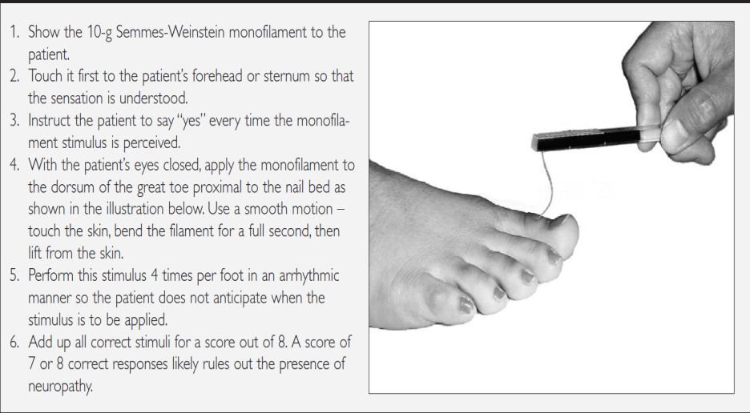
Canadian Guideline 2008
And SEMDSA 2017 (did not use updated Canadian guideline)
Treat everyone with > 1 not felt as high risk

Slide 42
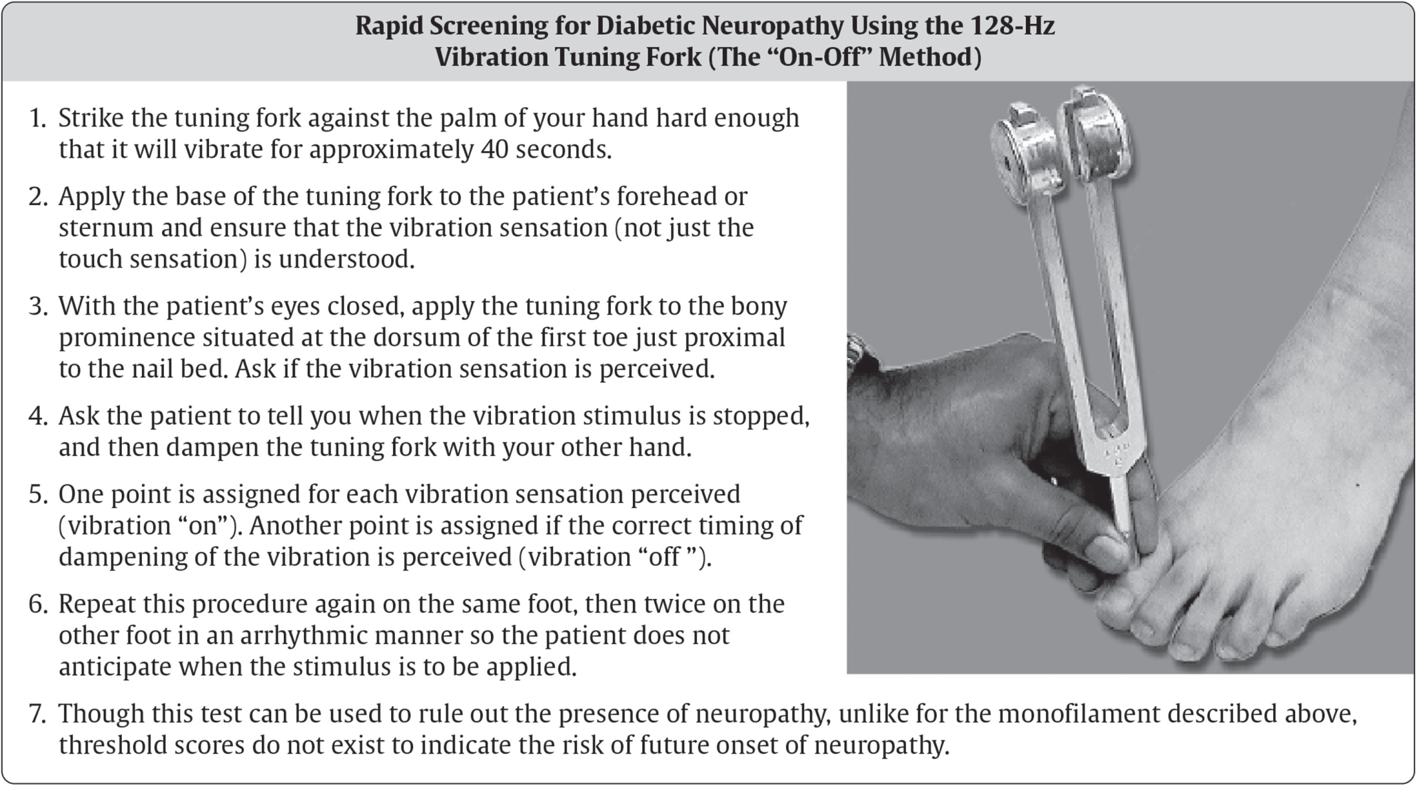
Refer to neurology if non-diabetic neuropathy is suspected

Slide 43
Ipswich Touch the Toes Test
                More than 1 site not felt=Neuropathy
The Ipswich Touch Test: a simple and novel method to screen patients with diabetes at home for increased risk of foot ulceration. Sharma S, Kerry C, Atkins H, Rayman G. Diabet Med. 2014 Sep;31(9):1100-3.

Slide 44
Glycemic Control is the Only Disease-Modifying Treatment
Glycemic control is effective for
  Primary prevention
  Secondary intervention (T1DM)
guidelines.diabetes.ca

Slide 45
Risk categories
Category | Risk profile | Follow-up frequency
Low risk | people with no risk factors and no previous history of foot ulcer/amputation | Once a year
Intermediate risk | people with one risk factor (neuropathy, peripheral arterial disease or foot deformity) and no previous history of foot ulcer/amputation | Every visit
High risk | high risk” - people with two or more risk factors (neuropathy,peripheral arterial disease or foot deformity) and/or a previous history of foot ulcer/amputation | Every visit

Slide 46
High Risk Foot
Manage non-ulcer pathology (podiatrist if possible)
Treat foot ulcers appropriately (primary care: refer)
Educate and evaluate feet frequently

Slide 47
The “DO’s”
DO …
Check your feet every day for cuts, cracks, bruises, blisters, sores, infections, unusual markings
Use a mirror to see the bottom of your feet if you can not lift them up
Check the colour of your legs & feet – seek help if there is swelling, warmth or redness
Wash and dry your feet every day, especially between the toes
Apply a good skin lotion every day on your heels and soles. Wipe off excess
Change your socks every day
Trim your nails straight across
Clean a cut or scratch with mild soap and water and cover with dry dressing
Wear good supportive shoes or professionally fitted shoes with low heels (under 5cm)
Buy shoes in the late afternoon since your feet swell by then
Avoid extreme cold and heat (including the sun)
See a foot care specialist if you need advice or treatment
Canadian Diabetes Association Clinical Practice Guidelines Expert Committee. Canadian Diabetes Association 2013 Clinical Practice Guidelines for the Prevention and Management of Diabetes in Canada. Can J Diabetes 2013;37(suppl 1):S1-S212.

Slide 48
The “DON’Ts”
DO NOT …
Cut your own corns or callouses
Treat your own in-growing toenails or slivers with a razor or scissors. See your doctor or foot care specialist
Use over-the-counter medications to treat corns and warts
Apply heat with a hot water bottle or electric blanket – may cause burns unknowingly
Soak your feet
Take very hot baths
Use lotion between your toes
Walk barefoot inside or outside
Wear tight socks, garter or elastics or knee highs
Wear over-the-counter insoles – may cause blisters if not right for your feet
Sit for long periods of time
Smoke
Canadian Diabetes Association Clinical Practice Guidelines Expert Committee. Canadian Diabetes Association 2013 Clinical Practice Guidelines for the Prevention and Management of Diabetes in Canada. Can J Diabetes 2013;37(suppl 1):S1-S212.

Slide 49
Diabetic Neuropathy
Pain:
Amitriptyline, oral, 10–25 mg at night increasing to 100 mg, if necessary.
Other options: gabapenting/pregabilin/valproate
Gastroparesis:
Metoclopramide, oral, 10 mg 8 hourly before meals.
Referral
if the above measures do not control symptoms adequately
Notes:
PHC 2014

Slide 50


Treatments for Neuropathic Pain have Limited Effects
guidelines.diabetes.ca
Few patients have complete relief
30-50% reduction in pain considered to be clinically meaningful
Pain Reduction
-50%
-30%
Minimum Pain
Maximum Pain

Slide 51
Diabetic foot ulcer
Always refer to secondary care or higher if possible:
This is a severe complication and patient may loose foot if not appropriately managed.
These patients often then also have other diabetes complications that need attention (eg Retinopathy or Nephropathy).
Patients may be referred back for continued care.
This implies that primary care providers should also know the principles of diabetic foot ulcer management.

Slide 52
Assessment
1. How large and how deep is the ulcer?
2. Is the vascular supply adequate?
3. Is there evidence of neuropathy?
4. Is the ulcer infected?

Slide 53
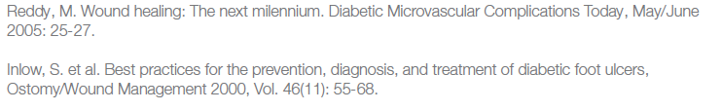
Treatment
“The VIPS” of diabetic foot
V Vascular supply is adequate
I Infection control is achieved
P Pressure offloading
S Sharp/surgical debridement has been considered

Slide 54
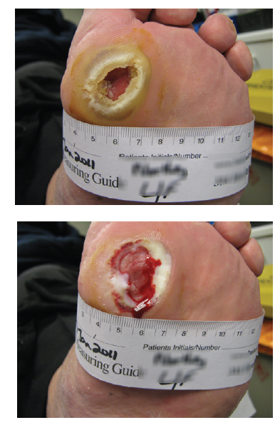
Debridement

Slide 55
Antibiotic selection
Critical: is this ulcer infected or not?
If infected is it limited (Can get Outpatient antibiotics)
Is the infection so severe that the foot is threatened or
Even worse the patient`s life is threatened

Slide 56
Clinical classification of infection
Classification
Uninfected: no systemic or local symptoms
or signs of infection
Infected:
- At least two of the following items are present:
• Local swelling or induration
• Erythema >0.5 cm* around the wound
• Local tenderness or pain
• Local warmth
• Purulent discharge - Other causes of an inflammatory response of the skin should be excluded (e.g. trauma, gout, acute Charcot neuro-osteoarthropathy, fracture, thrombosis and venous stasis)

Slide 57
Clinical classification of infection
Can vary from mild to severe /foot or life threatening
Mild infections can be managed as outpatients

Slide 58
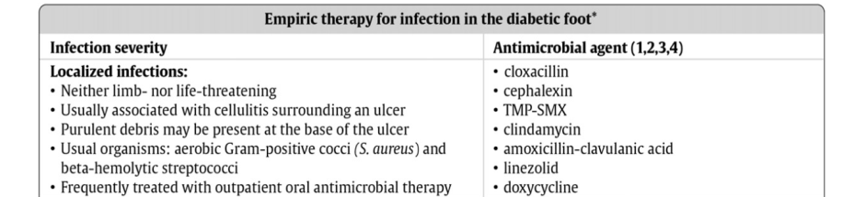
Antibiotic selection Outpatient Rx
Canadian Diabetes Association Clinical Practice Guidelines Expert Committee. Canadian Diabetes Association 2013 Clinical Practice Guidelines for the Prevention and Management of Diabetes in Canada. Can J Diabetes 2013;37(suppl 1):S1-S212.

Slide 59
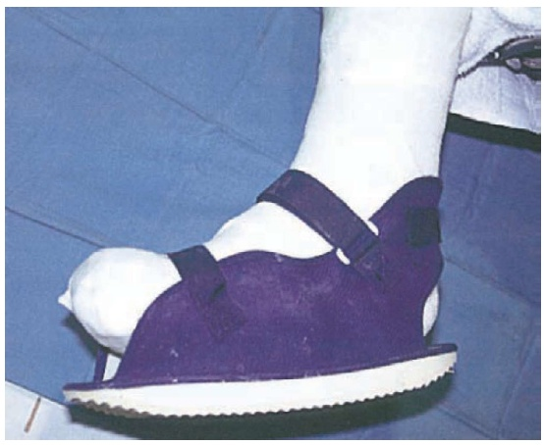
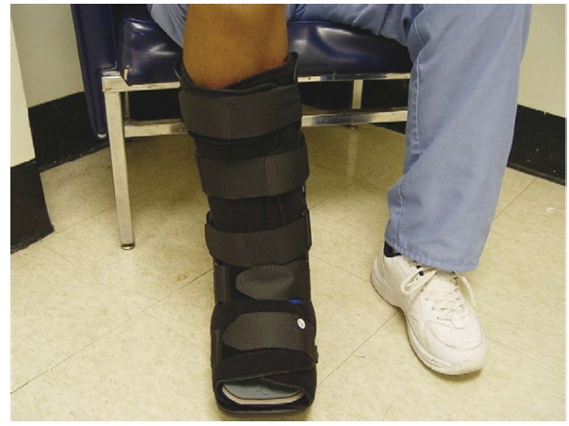
Off -loading
Crutches, moonboot, special shoes,
GET THEM OFF THEIR FEET
Total contact cast >>>>> than removable cast walker

Slide 60
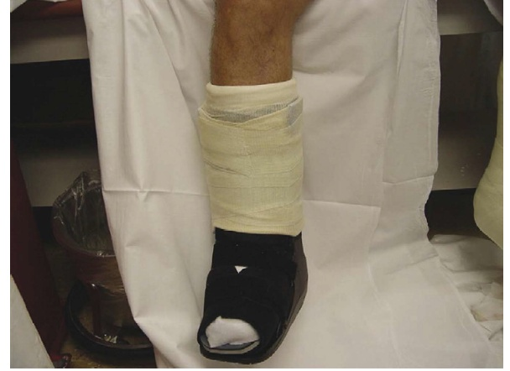
Off-loading
Modified cast walker === Total contact cast

Slide 61
Team based approach
Diabetes Educator
Podiatrist, Orthotist
Physician/Endocrinologist
Surgeon (General, Vascular, Orthopaedic)
Nurses
Community health care workers
Psychologists
Physiotherapist

Slide 62
Questions on Complication screening and management?

Slide 63
Putting it all in practice
1. Am I following a patient centered approach/ (Where and When and With Who does patient education and support take place?)
2. Do I know my patient`s Control status and I am acting accordingly?
3. Do I know my patient`s Complication status and am I acting accordingly?
4. Use an Annual Review Checklist

Slide 64
References
2017 SEMDSA Guideline: https://www.semdsa.org.za/images/647-4385-1-PB.pdf
2018 ADA Guideline: https://diabetesed.net/wp-content/uploads/2017/12/2018-ADA-Standards-of-Care.pdf (full version)
http://clinical.diabetesjournals.org/content/diaclin/early/2017/12/07/cd17-0119.full.pdf (abridged version)
2018 Canadian Guideline
http://guidelines.diabetes.ca/fullguidelines

