Slide 1
Comprehensive Diabetes Care
Continued 2

Slide 2
Blood pressure
The target for all diabetic patients is:
Systolic less than: 140 mmHg
Diastolic less than: 90 mmHg
Lower if nephropathy
ACE inhibitor (Enlaparil etc)
Calcium antagonist (Amlodipine)
Diuretic (Indapamide/HCTZ)

Slide 3
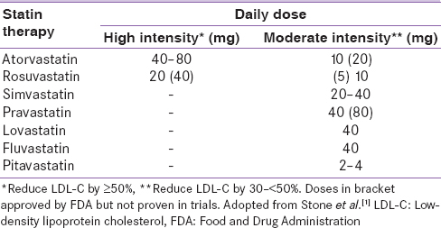
Statins
LIPIDS: statin therapy
6 % rule: double dose only additional 6% reduction in LDL
Notes:
This is according to the national guidelines

Slide 4
Statins:who to treat?
Age
Clinical Atherosclerotic Cardiovascular Disease (ASCVD)
Atherosclerotic Cardiovascular Disease Factors

Slide 5
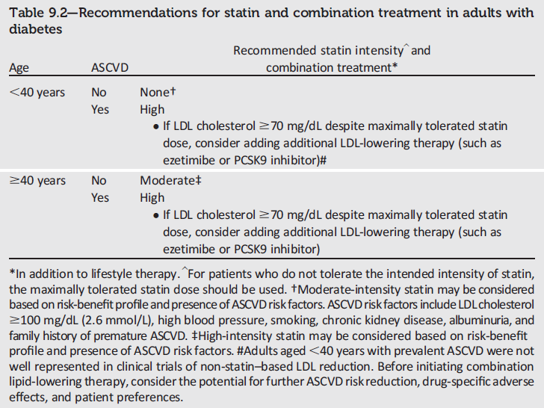
1.8 mmol/l
Notes:
The recommendations in Table 9.2 regarding statin and combination treatment in adults with diabetes have been revised for 2018 to stratify risk based on whether a patient is older or younger than 40 years of age and on whether a patient has ASCVD. For example, patients of any age with ASCVD should be placed on a high-intensity statin.
[SLIDE]

Slide 6
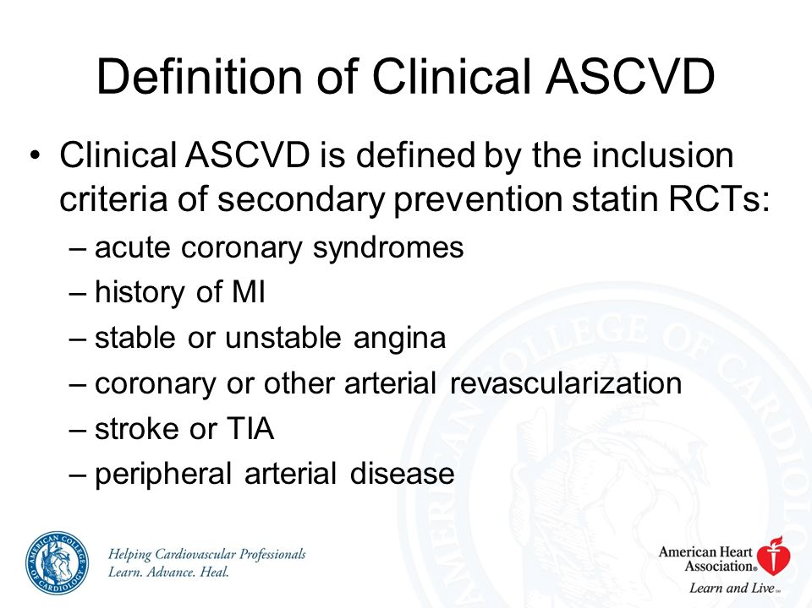

Slide 7
Statins: In who to avoid?
Statins must not be used in pregnant patients
HIV patients some statins should be avoided and others can be taken safely.
“In general, atorvastatin and pravastatin are safe and effective for patients treated with protease-inhibitor (PI) or non-nucleoside reverse transcriptase inhibitor-based ART.
Rosuvastatin is generally considered safe if started at a low dose, but should be avoided if possible in patients receiving PI-based ART.
Fluvastatin, lovastatin, and simvastatin should be avoided in patients receiving ART due to drug interactions, adverse events, and/or limited clinical data.”
Chastain DB, Stover KR, Riche DM. Evidence-based review of statin use in patients with HIV on antiretroviral therapy. Journal of Clinical & Translational Endocrinology. 2017;8:6-14. doi:10.1016/j.jcte.2017.01.004.

Slide 8
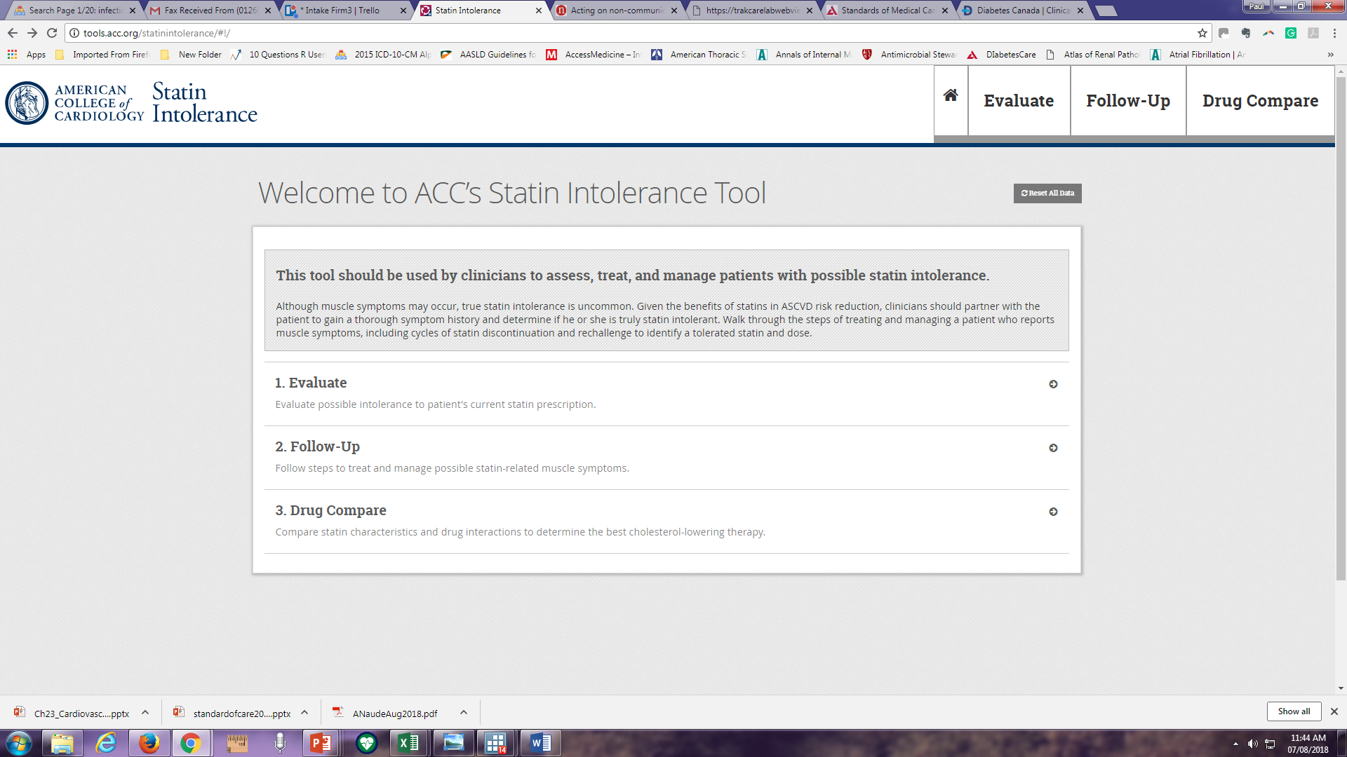
Statins: side effects

Slide 9
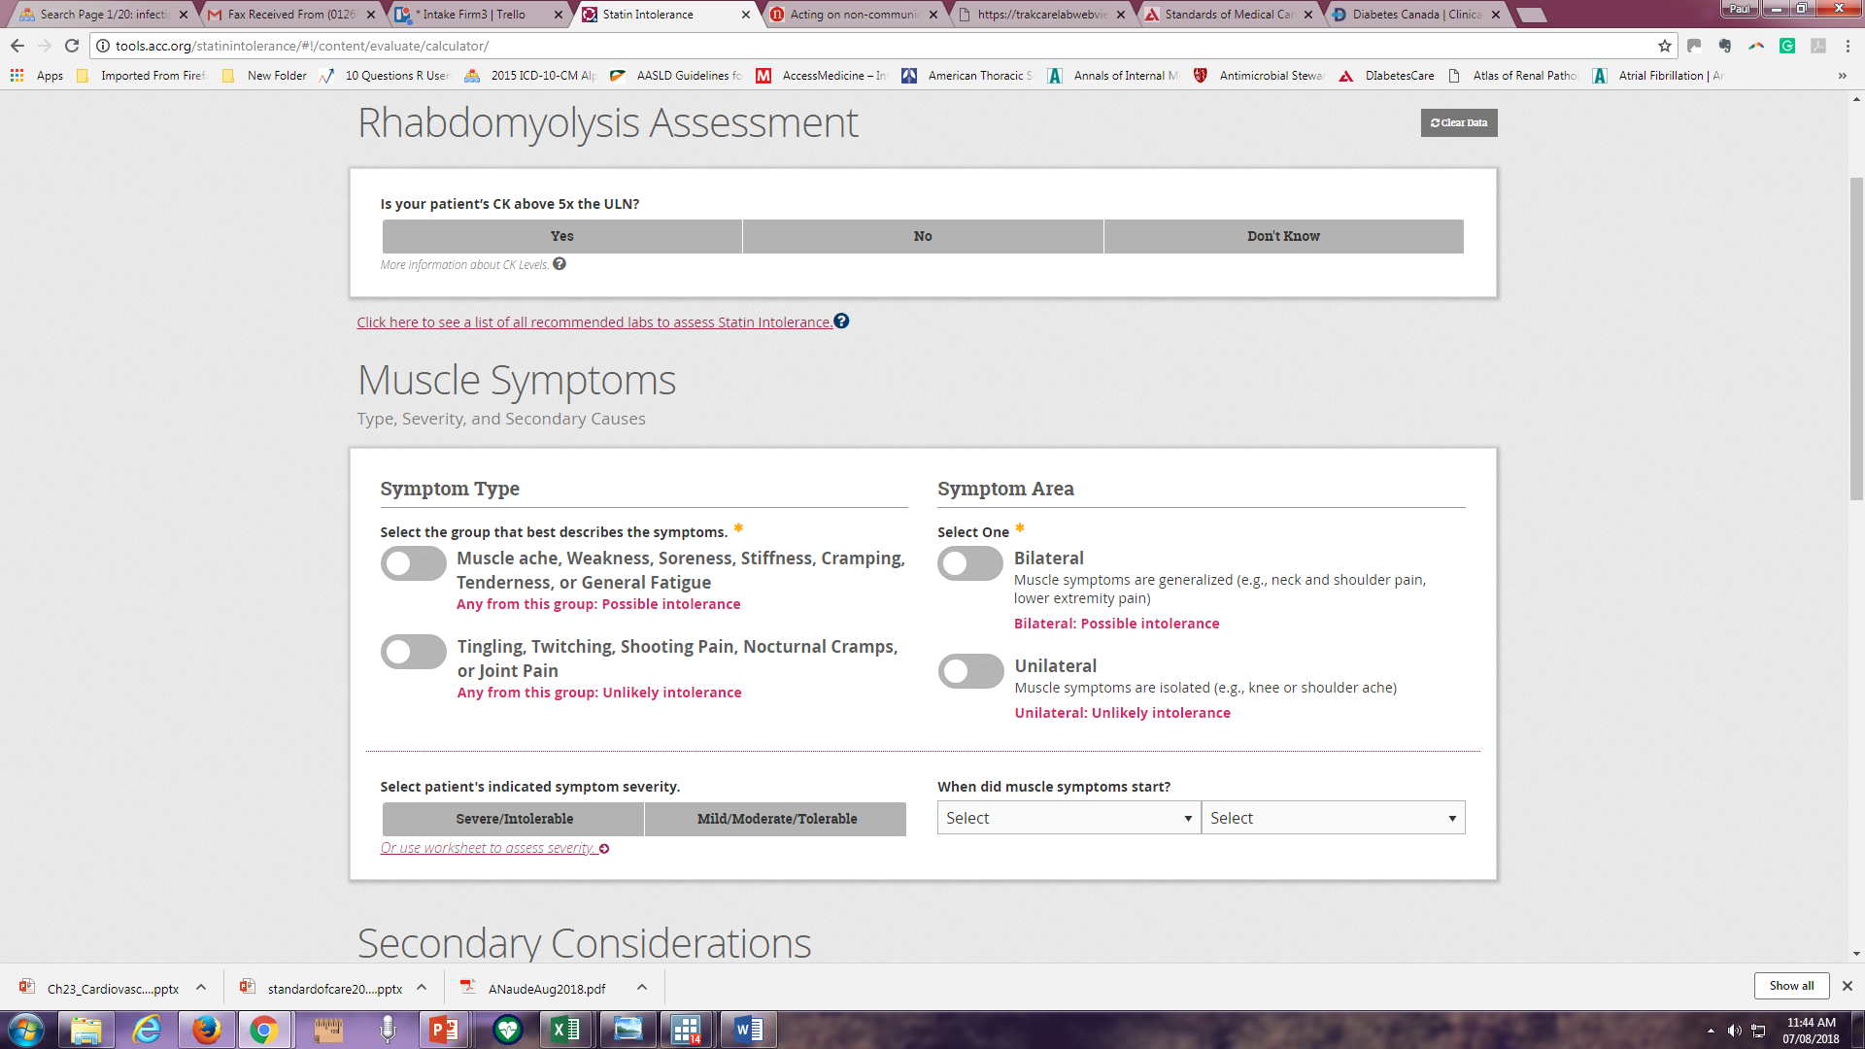

Slide 10
What about Triglycerides?
SEMDSA says Specialist referral should occur when triglyceride levels are > 5 mmol/l in the controlled diabetic, or > 15 mmol/l before treatment.
(high levels below 5 mmol/l diet manage with glucose management, alcohol restriction, weight loss, ideal < 1.5 mmol/l)

Slide 11
Other treatment

Slide 12
ADA 2018: Antiplatelet Agents: Recommendations
Use aspirin therapy (75-162 mg/day) as a secondary prevention strategy in those with diabetes and a history of ASCVD. A
For patients with ASCVD and documented aspirin allergy, clopidogrel (75 mg/day) should be used. B
Dual antiplatelet therapy (with low-dose aspirin and a P2Y12 inhibitor) is reasonable for a year after an acute coronary syndrome A and may have benefits beyond this period. B
Cardiovascular Disease and Risk Management:
Standards of Medical Care in Diabetes - 2018. Diabetes Care 2018; 41 (Suppl. 1): S86-S104
Notes:
Aspirin has been shown to be effective in reducing cardiovascular morbidity and mortality in high-risk patients with previous MI or stroke (secondary prevention). Its net benefit in primary prevention among patients with no previous cardiovascular events is more controversial, both for patients with and without diabetes.
Multiple recent well-conducted studies and meta-analyses reported a risk of heart disease and stroke that is equivalent if not higher in women compared to men with diabetes, including among non-elderly adults. Thus, the recommendations for using aspirin as primary prevention are now revised to include both men and women aged 50 years or older with diabetes and one or more major risk factors, to reflect these more recent findings.
Recommendations for the use of antiplatelet agents are summarized in two slides. The 2018 recommendations are as follows:
Use aspirin therapy (75-162 mg/day) as a secondary prevention strategy in those with diabetes and a history of ASCVD. A
For patients with ASCVD and documented aspirin allergy, clopidogrel (75 mg/day) should be used. B
Dual antiplatelet therapy (with low-dose aspirin and a P2Y12 inhibitor) is reasonable for a year after an acute coronary syndrome A and may have benefits beyond this period. B
[SLIDE}
12
References
American Diabetes Association. Standards of medical care in diabetes—2014. Diabetes Care 2014;37(suppl 1):S40–S41
Pignone M, Alberts MJ, Colwell JA, et al.; American Diabetes Association; American Heart Association; American College of Cardiology Foundation. Aspirin for primary prevention of cardiovascular events in people with diabetes: a position statement of the American Diabetes Association, a scientific statement of the American Heart Association, and an expert consensus document of the American College of Cardiology Foundation. Diabetes Care 2010;33:1395–1402

Slide 13
ADA 2018: Antiplatelet Agents: Recommendations
Aspirin therapy (75-162 mg/day) may be considered as a primary prevention strategy in those with type 1 or type 2 diabetes who are at increased CV risk. This includes most men and women with diabetes aged ≥50 years who have at least one additional major risk factor (family history of premature ASCVD, hypertension, dyslipidemia, smoking, or albuminuria) and are not at increased risk of bleeding. C
Cardiovascular Disease and Risk Management:
Standards of Medical Care in Diabetes - 2018. Diabetes Care 2018; 41 (Suppl. 1): S86-S104
Notes:
Aspirin therapy (75-162 mg/day) may be considered as a primary prevention strategy in those with type 1 or type 2 diabetes who are at increased CV risk. This includes most men and women with diabetes aged ≥50 years who have at least one additional major risk factor (family history of premature ASCVD, hypertension, dyslipidemia, smoking, or albuminuria) and are not at increased risk of bleeding. A
[SLIDE]
13
References
American Diabetes Association. Standards of medical care in diabetes—2014. Diabetes Care 2014;37(suppl 1):S40–S41
Pignone M, Alberts MJ, Colwell JA, et al.; American Diabetes Association; American Heart Association; American College of Cardiology Foundation. Aspirin for primary prevention of cardiovascular events in people with diabetes: a position statement of the American Diabetes Association, a scientific statement of the American Heart Association, and an expert consensus document of the American College of Cardiology Foundation. Diabetes Care 2010;33:1395–1402

Slide 14
What About ASA for 1⁰ Prevention of CVD?
2018 Diabetes Canada CPG – Chapter 23. Cardiovascular Protection in People with Diabetes
Included: Six studies, n = 10,117 participants
De Berardis G et al. BMJ 2009;339:b4531
Notes:
14

Slide 15
ASA for 1⁰
Prevention in Diabetes
Meta analysis of 6 studies
(n = 10,117)
No. of events/No. in group
ASA
Control/placebo
RR (95% CI)
RR (95% CI)
Major CV events
JPAD
POPADAD
WHS
PPP
ETDRS
Total
68/1262
105/638
58/514
20/519
350/1856
601/4789
86/1277
108/638
62/513
22/512
379/1855
657/4795
0.80 (0.59-1.09)
0.97 (0.76-1.24)
0.90 (0.63-1.29)
0.90 (0.50-1.62)
0.90 (0.78-1.04)
0.90 (0.81-1.00)
Myocardial infarction
JPAD
POPADAD
WHS
PPP
ETDRS
PHS
Total
28/1262
90/638
36/514
5/519
241/1856
11/275
395/5064
14/1277
82/638
24/513
10/512
283/1855
26/258
439/5053
0.87 (0.40-1.87)
1.10 (0.83-1.45)
1.48 (0.88-2.49)
0.49 (0.17-1.43)
0.82 (0.69-0.98)
0.40 (0.20-0.79)
0.86 (0.61-1.21)
No overall benefit for:
Major CV events
MI
Stroke
CV mortality
All-cause mortality
Stroke
JPAD
POPADAD
WHS
PPP
ETDRS
Total
12/1262
37/638
15/514
9/519
92/1856
181/4789
32/1277
50/638
31/513
10/512
78/1855
201/4795
0.89 (0.54-1.46)
0.74 (0.49-1.12)
0.46 (0.25-0.85)
0.89 (0.36-2.17)
1.17 (0.87-1.58)
0.83 (0.60-1.14)
Death from CV causes
JPAD
POPADAD
PPP
ETDRS
Total
1/1262
43/638
10/519
244/1856
298/4275
10/1277
35/638
8/512
275/1855
328/4282
0.10 (0.01-0.79)
1.23 (0.80-1.89)
1.23 (0.49-3.10)
0.87 (0.73-1.04)
0.94 (0.72-1.23)
JPAD = Japanese Primary Prevention of Atherosclerosis with Aspirin for Diabetes
POPADAD = Prevention of Progression of Arterial Disease and Diabetes
PPP = Primary Prevention Project
ETDRS = Early Treatment Diabetic Retinopathy Study
PHS = Physicians’ Health Study
WHS = Women’s Health Study
De Beradis G, et al. BMJ 2009; 339:b4531.
All-cause mortality
JPAD
POPADAD
PPP
ETDRS
Total
34/1262
94/638
25/519
340/1856
493/4275
38/1277
101/638
20/512
366/1855
525/4282
0.90 (0.57-1.14)
0.93 (0.72-1.21)
1.23 (0.69-2.19)
0.91 (0.78-1.06)
0.93 (0.82-1.05)
0.03
0.125
0.5
2
1
8
Favors ASA
Favors control/placebo
Notes:
This meta-analysis examined whether ASA is beneficial for patients with diabetes who have no clinical evidence of CVD. Of 6 eligible studies included in the meta-analysis of over 10,000 participants, there is no statistically significant reduction in the risk of Major CV events, MI, stroke, CV mortality or all-cause mortality when ASA was compared with placebo for primary prevention among patients with diabetes.
Of 157 studies in the literature searches, six were eligible (10,117 participants). When ASA was compared with placebo, there was no statistically significant reduction in the risk of major CV events (five studies, 9,584 participants; RR 0.90; 95% CI 0.81-1.00), CV mortality (four studies, 8,557 participants; RR 0.94; 95% CI 0.72-1.23), or all-cause mortality (four studies, 8,557 participants; RR 0.93; 95% CI 0.82-1.05).
Significant heterogeneity was found in the analyses for MI (I² = 62.2%; p = 0.02) and stroke (I² = 52.5%; p = 0.08). ASA significantly reduced the risk of MI in men (RR 0.57; 95% CI 0.34-0.94) but not in women (RR 1.08; 95% CI 0.71-1.65; p for interaction = 0.056). Evidence relating to harms was inconsistent.
These authors concluded that a clear benefit of ASA in the primary prevention of major CV events in people with diabetes remains unproved, that sex may be an important effect modifier, and that toxicity is to be explored further.
The analysis shows ASA has benefit for men in prevention of MI but not for stroke prevention, but no benefit in women for either MI or stroke prevention
Reference:
De Berardis G, Sacco M, Strippoli GF, et al. Aspirin for primary prevention of cardiovascular events in people with diabetes: meta-analysis of randomised controlled trials. BMJ 2009; 339:b4531.

Slide 16
Recommendations 5-7
2018 Diabetes Canada CPG – Chapter 23. Cardiovascular Protection in People with Diabetes
In people with established CVD, low-dose ASA therapy (81-162 mg) should be used to prevent CV events [Grade B, Level 2]
ASA should not be used routinely for the primary prevention of CVD in people with diabetes [Grade A, Level 1A]. ASA may be used in the presence of additional CV risk factors [Grade D, Consensus]
Clopidogrel 75 mg may be used in people unable to tolerate ASA [Grade D, Consensus
CV, cardiovascular; CVD, cardiovascular disease

Slide 17
SEMDSA

Slide 18
Questions on Blood pressure and lipid control?

