Slide 1
Addressing Climate Change through Agriculture: Policy and Institutional Opportunities and Challenges
Suresh Chandra Babu
Senior Research Fellow and Head of Capacity Strengthening Program
International Food Policy Research Institute and
Extraordinary Professor, University of Pretoria
The Centre for the Advancement of Scholarship (CAS)
Webinar in 2021 on ‘Engaging the Environmental Publics
May 31, 2021

Slide 2
Outline
Introduction
What Drives Climate Change Action?
Case Studies of Bangladesh, Ghana, India, and Vietnam?
What lessons of policy making process?
The way forward?

Slide 3
Introduction
Climate Change Action at the national level
Implications for national policy making?
What drives policy and institutional changes?
How to study these drivers?
Use a case study approach to track changes?
What lessons for strengthening policy systems and institutional architecture?
Concluding thoughts

Slide 4
Climate Change Implications of National Policy making
SDGs related to Climate Change
Global and Regional and National Framework for policy making and implementation.
What drives the policy process in developing countries?
What drives the sectoral policies and programs?
How can we improve the policy process and institutional architecture for climate change action?

Slide 5
Priority actions - what does the Evidence Show?
Agricultural Sector and food systems implications
Disruptions in Technology innovation and productivity
Farming affected by and affects climate change
35 -40 percent of land use – for agriculture
ecosystem change due to land and water use change in agriculture
National and regional ecosystem changes induces challenges for the food systems
Organizational weaknesses of research and extension
Business ecosystems – badly needed for the entrepreneurship in agriculture.
Employment opportunities for the New cadre of the agricultural business graduates
High level of competition in the value chains benefiting farmers

Slide 6
What problems to solve?
Increasing Food miles
Conventional food production’
Deforestation – burning forest for agricultural land
Land clearing for cattle production
Production of cattle - cattle feed demand
Palm oil production – land cleared as well
Methane from animal agriculture and rice production
Using fertilizer chemical – high levels use – release into nitrous oxide
Water pollution of nitrogen
Post harvest losses
Food waste and management

Slide 7
What solutions in Agriculture sector
Sources of GHG in agriculture
Agriculture contributes to 24% of the GHG
What are the sink opportunities
Climate smart agriculture
  Land use management
  Fertilizer use management
  Irrigation and water use management
  Soil protection and conservation
  Collectively make agriculture climate smart
  Food systems transformation

Slide 8
Food and ecosystem mangement
Improvement at the farm level?
Cover crops – soil and water managements
Precision agriculture – fertilizer management
Regenerative agriculture
Reduce emissions
Create new carbon sinks of Co2
Change the diets
Protected ecosystem
Forest – afforestation
What is happening on the farms?

Slide 10
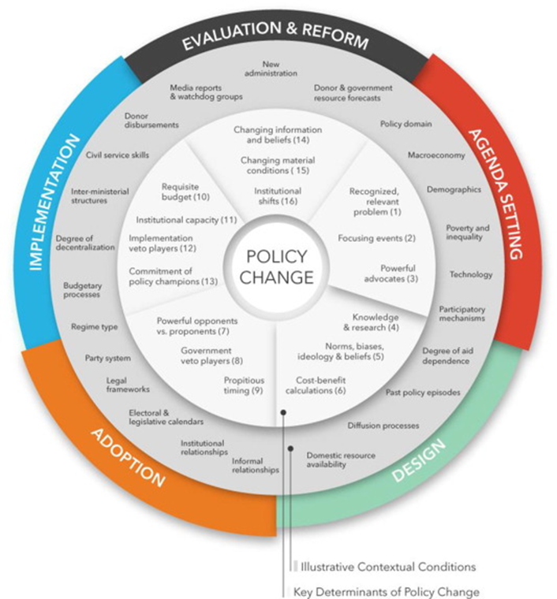

Slide 11
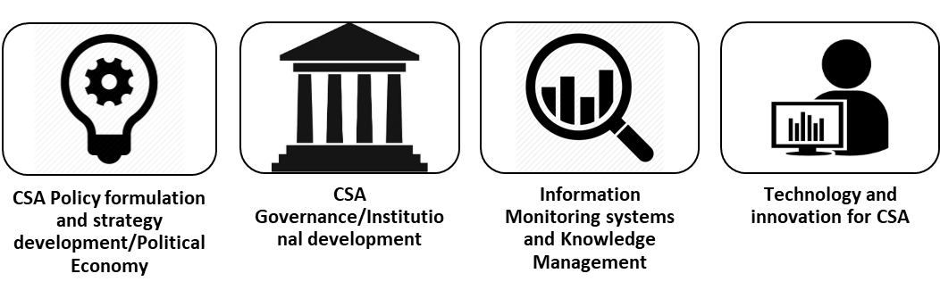
Key drivers?

Slide 12
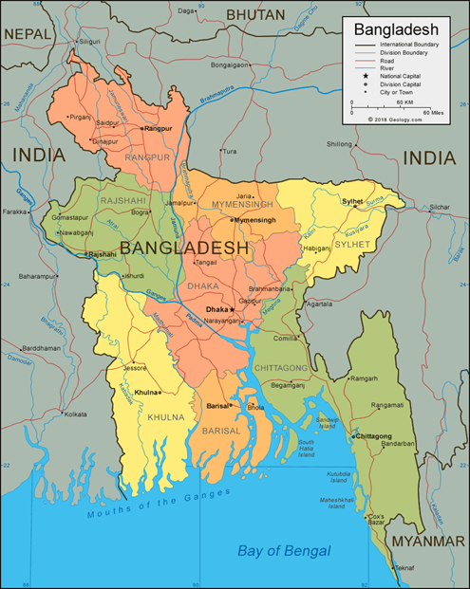

Slide 15
 | Bangladesh | Ghana | India | Vietnam
Systems Level | Satisfactory systems level capacity but exist in fragments. Need improved coordination among government ministries. Bangladesh requires investment to improve technology and innovation. | Lacks required systems level capacity for CSA implementation. Corruption and lack of government accountability persist. Funding and lack of ease of information remain a challenge. | Despite signs, inconsistencies among stakeholders and government remain. Endorsing CSA from national level would be a key. Allocation of budget for CSA needs increasing. | The government seems to have a will; however, corruption and limited innovation are holding Vietnam back. Increase in research and efforts to incorporate research into policies from national level would boost Vietnam’s CSA goals.

Slide 16
Individual/Capacity | Individual involvement in CSA activities is limited. To address the deficiency of technical capacity, Bangladesh needs to significantly invest in state-of-the-art technology and innovations. CSA focused trainings on improving research skills and leadership management would benefit Bangladesh. | Work needs to be done to make the policy process comprehensive and inclusive involving smallholders and relevant individuals. Technology and information availability to build individual capacity would accelerate CSA mission. Ghanaian individuals would benefit from CSA workshops and training. | Needs significant investment in in individual capacity development. Innovation and willingness to adopt CSA need to improve for better results. Being a large country, India needs state-specific individual capacity development programs that would help address existing capacity gaps. | Individuals' involvement in CSA monitoring activities needs to improve. Individuals not perceiving participation at CSA activities beneficial shows Vietnam needs to improve with ease and access to information. More workshops on CSA could improve enthusiastic individuals’ participation.

Slide 17
What Drives Climate Change Action?
At the policy making level:
Translating the global and regional framework into national priority
Translating evidence into action – policy and scientific research
Coordinating the multiple sectors in a country
Capacity to generate evidence – context and locality specific
Stakeholder consultations –at the national and local levels
Design and implementation of policies and programs
Institutional architecture
Funding and investment
Mutual accountability of actors and players

Slide 18
Way Forward
Debate and dialogue are fine – but action needed
Academics complain – there is uncertainty – no data to learn
Learning by doing is the option
Move forward with what we have – build on it
Policy is not a static concept – needs to be dynamic
Even laws should be amended to meet the changing needs
State governments should innovate?
Develop case studies for learning
Strengthen policy, institutional, and innovation systems to meet the CSA challenge

Slide 19
Thank you - Q & A

