Slide 1
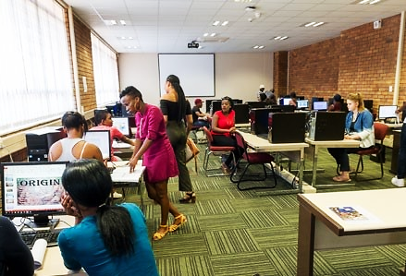
Faculty of Education Fakulteit van Opvoedkunde Lefapha la Thuto
Department of Humanities Education
2020 POSTGRADUATE CERTIFICATE IN EDUCATION (PGCE) at the Department of Humanities Education
www.up.ac.za/apply www.up.ac.za/ faculty-of-education
Application enquiries: Ms T Mngomezulu Tel: (+27) 012 420 5615 Email: thandi.mngomezulu@up.ac.za
Postgraduate degrees

Slide 2
2020
Postgraduate Certificate in Education
(PGCE)
Programme information
Requirements for admission
An appropriate Bachelor’s degree or accredited and approved diploma is required for all the programmes. All prospective students who hold a 360-credit diploma have to provide evidence that their diplomas are approved and accredited by the Department of Higher Education and Training.
This is a selection programme, and although prospective students may comply with all academic requirements, the selection committee and the relevant departments involved, may select a limited number of students due to capacity and resources available.
Particular subject requirements for each phase are stipulated below:
Senior Phase and Further Education and Training Teaching:
One (or more) degree modules passed at a second-year academic level (200) which correspond with one or more relevant subjects at school level for Senior Phase and one other / different (or more) degree modules passed at a third-year academic level (300) which corresponds with a relevant school subject at Further Education and Training Phase Teaching (check programme modules).
Further Education and Training Phase (FET) Teaching:
Option A: One-degree module passed at a third-year academic level (300) which corresponds with a relevant school subject and a research project for students who do not qualify for a 2nd teaching specialisation;
Option B: Two different degree modules passed at a third-year academic level (300) which correspond with a relevant school subject (check programme modules).
Computer literacy
All students had to complete a computer literacy course as part of their first degree. If not, it will be expected of students to enroll for such a course concurrently.
African language competency
All students who successfully complete the PGCE should be partially proficient in at least one official African language or in South African Sign Language, as language of conversational competence. Students can write an exemption examination to determine the language competence.
Demonstration of subject-related skills
Some school subjects require the demonstration of skills. Candidates who apply may be asked to demonstrate these skills by way of various activities (including theory, practical examination or 2 portfolios). Subjects include: Visual Art; Drama; Music; Geography; Natural Science; Physical Science, Life Science and African Languages.
the

Slide 3
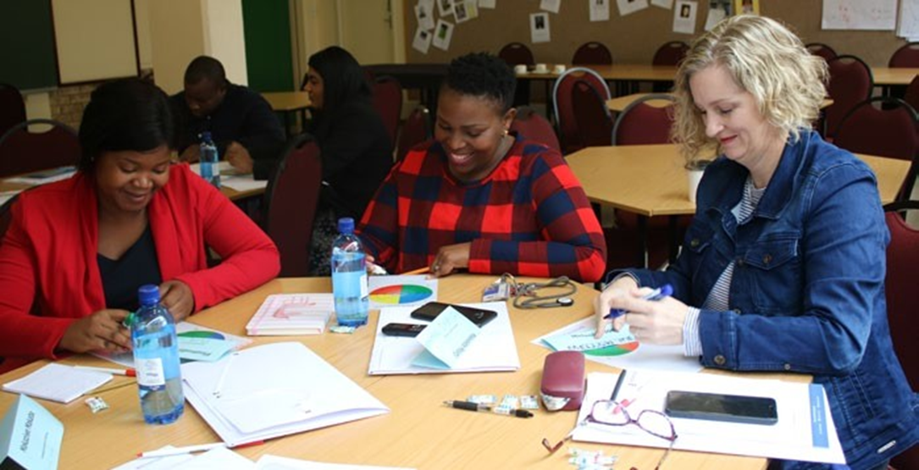
Programme delivery
The PGCE consists of academic and teaching practice components. The academic learning components are presented in the format of integrated modules during which students construct a practice theory of and for education. The academic components run throughout the year. For the purpose of the teaching practice component, students place themselves in various partnership schools. The first placement takes place in quarter one for a one week shadow week. The second placement takes place in quarter two for six weeks in a school in the Pretoria region. The second teaching practice takes place in quarter three for six weeks in a different school in the Pretoria region. Students are fully engaged at the schools during teaching practice while they are supported and assessed by qualified mentor teachers and university lecturers.
Duration
The programme extends over one year full-time.
Professional development
At the end of the year, students will have to submit a professional portfolio showing the integration of all the different modules during an oral examination. The date for submission will be announced at the beginning of the academic year.
Assessment
Continuous assessment is conducted on competence-based criteria. Assessment and feedback will be done at the end of the first semester. At the end of the year students will present and defend their professional portfolio before a panel of examiners (internal and external) for final examination.
Certificate with distinction
The certificate will be awarded with distinction to a student who obtained 75% in each of the Professional development (PPF 401), Facilitating learning (FCL 401) and the specialisation module(s), as well as an average of 75% in all the other modules, with a minimum of 70% per module.

Slide 4
Postgraduate Certificate in Education
(PGCE)
Fields of specialisation
Senior Phase and Further Education and Training Teaching (Grade 7 to 12)
Further Education and Training Phase Teaching (Grade 10 to 12)
This certificate is presented in the following two fields of specialisation:
Senior Phase and Further Education and Training Teaching (Grade 7 to 12)
Choose one of the following teaching specialisations in accordance with the admission requirements
Further Education and Training Phase Teaching (Grade 10 to 12)
Choose one or two of the following teaching specialisations in accordance with the admission requirements
Senior Phase subject choices | Languages | STEM
 | Afrikaans English African languages | Mathematics Natural Science
 | Humanities | Commerce
 | Social sciences Art and culture | Economic and management sciences
FET subject choices | Languages | STEM
 | African languages Afrikaans English | Life sciences Mathematics and Mathematical Literacy Physical sciences
 | Humanities | Commerce
 | Dramatic arts Geography History Visual arts Music Research Project (for those who do not qualify for a 2nd methodology) | Accounting Business studies Economics Tourism

Slide 5
Modules
Modules | Description | Code | Credits
Fundamental | Global and social perspectives in education | GPE 401 | 8
modules | Foundations of education | FOE 401 | 8
Core modules | Learning theories and assessment in teaching | LNT 401 | 18
 | Facilitating learning | FCL 401 | 12
 | Learning support | JLD 402 | 6
 | Information and communication technology | ICT 410 | 6
 | Professional ethics and law in teaching | PEL 410 | 6
 | Professional development | PPF 401 | 8
 | Teaching practice | PRO 410 | 12
 | Teaching practice | PRO 420 | 12
 | Conversational Competence: One of: IsiZulu, or Sepedi, or Setswana (An exemption exam can be written) | CCZ100, or CCI 100, or CCW 100 | 12
Senior Phase and Further Education and Training Teaching | Choose one of the following teaching specialisations in accordance with the admission requirements (relevant academic modules are indicated in brackets)
(09227031) | Languages | SPH 411 | 20
 | Mathematics | VWS 411 | 20
 | Social sciences (Both History and Geography) | SPH 414 | 20
 | Natural sciences (Physics, Chemistry, Biological sciences and Biology) | SPH 417 | 20
 | *The following specialisations will only be presented if the number of students who qualify is sufficient:
 | *Art and culture (Art, Drama, Dance and Music) *Economic and management sciences (Economics, Business economics, Entrepreneurship, Business management and Accounting) | SPH 413 SPH 416 | 20 20
Example: Natural Science teacher
Qualifying undergraduate modules:
Physics, Chemistry, Biological sciences and Biology
PGCE modules:
Global and social perspectives in education
Foundations of education
Learning theories and assessment in teaching
Facilitating learning
Learning support
Information and communication technology
Professional ethics and law in teaching
Professional development
Teaching practice
Teaching practice
Conversational Competence (isiZulu, Sepedi or SeTswana
Natural sciences

Slide 6
Modules | Description | Code | Credits
Further Education and Training Teaching (09227041) | Research Project (This module is compulsory for students who do not qualify for a 2nd teaching specialisation) Choose one of the following teaching specialisations in accordance with the admission requirements | JNM 400 | 20
 | Accounting | VRK 410 | 20
 | Afrikaans | VAF 410 | 20
 | African languages | VAT 410 | 20
 | Business studies | VBT 410 | 20
 | Economics | VEK 410 | 20
 | English | VES 410 | 20
 | Geography | VGG 410 | 20
 | History | VGS 410 | 20
 | Life sciences (Biology/Biological sciences, Botany and Zoology, | VLW 410 | 20
 | Biochemistry, Microbiology and Physiology) | VWS 411 | 20
 | Mathematics and Mathematical Literacy | VNS 410 | 20
 | Physical sciences (Physics and Chemistry) | VNS 410 | 20
 | Tourism | VTO 410 | 20
 | Visual arts (Art, Art history and demonstrated skill) | VVK 410 | 20
 | Music (Music theory and demonstrated skill) | VMU 410 | 20
 | *The following teaching specialisation (Methodologies) will only be presented if the number of students who qualify is sufficient:
 | *Consumer studies *Dance studies *Dramatic arts *Hospitality studies |  | 20 20 20 20
Example: Geography teacher
Qualifying undergraduate modules:
Geography, Geology and Environmental sciences
PGCE modules:
Global and social perspectives in education
Foundations of education
Learning theories and assessment in teaching
Facilitating learning
Learning support
Information and communication technology
Professional ethics and law in teaching
Professional development
Teaching practice
Teaching practice
Conversational Competence (isiZulu, Sepedi or SeTswana
Geography

Slide 7
Postgraduate Certificate in Education
(PGCE)
Interested in studying a PGCE at the University of Pretoria? Well you have made an excellent choice! We can understand if you still have questions though, that is why we have compiled a list of FAQs to help answer your questions immediately!
I have a degree or a diploma, but I do not know if I qualify?
As long as you have an undergraduate qualification, you are in the right place. However, with regards to diplomas, UP only considers students that have completed a diploma worth 360 credits. Please can you send your academic record to pgceassistant@gmail.com so that we can advise you accordingly. But remember, when it comes to final decision on admission, that lies with Student Administration.
Can I study PGCE part-time or through distance learning?
The PGCE programme at UP is a full-time one-year programme which has compulsory attendance of contact classes and teaching practicals.
Where can I apply for PGCE?
Please go to https://www.up.ac.za/online-application to apply online.
I am having problems with my registration or application. Please help?
The PGCE office does not deal directly with admissions, therefore we cannot help with registration or application problems. Please contact Ms Thandi Mngomezulu at thandi.mngomezulu@up.ac.za.
I did the AIM module, can I get exempted from the ICT 410 module?
ICT 410 is a compulsory module for all PGCE students. The AIM module and ICT module are separate modules. ICT 410 focusses on online teaching and learning platforms, as well as how to use applications to improve your practice as a teacher. No exemptions are made.
I have two/ three years of isiZulu/ Sepedi/ SeTshwana during my undergraduate year, can I be exempted from the Conversational Competency module?
The CC modules are compulsory and focus specifically on being able to communicate in a chosen African language within a classroom or school context. There is an option of writing an exemption test in the beginning of the year, however if you fail this test you will have to attend the chosen CC module classes until the end of the year.
How can I get a distinction for PGCE?
The certificate will be awarded with distinction to a student who obtained 75% in each of the Professional development (PPF 401), Facilitating learning (FCL 401) and the specialisation module(s), as well as an average of 75% in all the other modules, with a minimum of 70% per module.

Slide 8
POSTGRADUATE CERTIFICATE IN EDUCATION (PGCE)
at the Department of Humanities
PLEASE NOTE: NO LATE APPLICATIONS WILL BE CONSIDERED and the presentation of ALL programmes is subject to the number of students who qualify as well as the availability of staff.
Package coordinator: Dr S de Jager Tel: (+27) 012 420 5555 Email: sarina.dejager@up.ac.za | Administrative enquiries: Ms Dominique Kamffer Tel: (+ 27) 012 420 2904 Email: pgceassistant@gmail.com | Application enquiries: Ms M Tshabalala Tel: (+ 27) 012 420 5652 Email: mannana.tshabalala@up.ac.za
Make today matter
https://www.up.ac.za/faculty-of-education

