Slide 1
Department of African Languages
Kgoro ya maleme a Bathobaso
2021

Slide 2
Which languages are on offer?
Ndebele: for home language speakers only
Sepedi (Northern Sotho), Tswana and Zulu for:
Home language speakers; first additional language learners
Absolute beginners

Slide 3
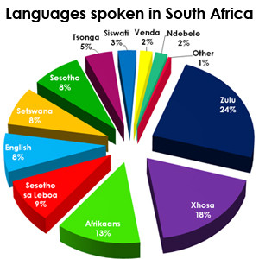
Which language should I take? Home language distribution by %

Slide 4
To be considered …
Consider the following:
23% of South Africans speak Zulu as home language, but
Languages are regionally based:
Ndebele: Mpumalanga, Gauteng
Sepedi: Limpopo, Gauteng
Tswana: Northwest, Gauteng (and Botswana)
Zulu: KZN, Mpumalanga, Gauteng
Some African languages are mutually understandable, e.g. Sepedi and Tswana, Zulu and Ndebele

Slide 5
Which language is the easiest to learn?
They are all equally difficult, but fun to learn!

Slide 6
My home language is an African language. Why should I bother?
Having an African language as home language does not mean that you have nothing more to learn about your language!
In-depth study of literature and linguistics

Slide 7
What are the relevant module codes?
For beginner learners: SEP 110 (Sepedi / Northern Sotho), ZUL 110 (Zulu), STW 110 (Tswana)
For first language speakers: SEP 111, ZUL 111, STW 111 and NDE 110

Slide 8
For further information
Visit the department in Humanities Building, level 9
Visit our web page: https://www.up.ac.za/african-languages
Send an e-mail to penelope.mdluli@up.ac.za

Slide 9
Ke a leboga! Ngiyabonga! Thank you! Baie dankie!

