Slide 1
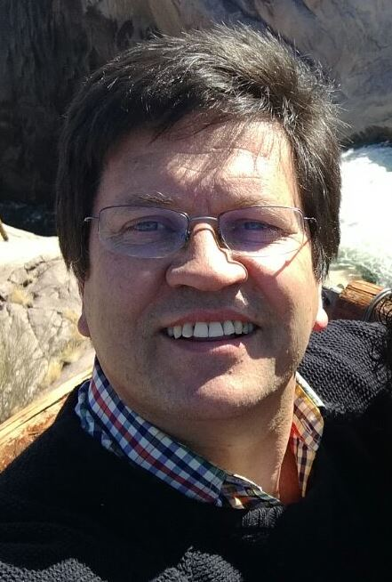
Department of Ancient and Modern languages and cultures Koos Kritzinger

Slide 2
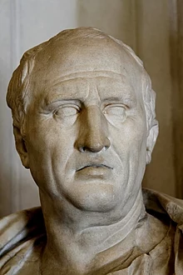
Salvete Amici – Greetings Friends! This is how Marcus Cicero would have greeted and welcomed you.

Slide 3
Latin is a classical language - the language which authors like Cicero, Vergil, Julius Caesar, Horace and Ovid used when they wrote their masterpieces.
VENI
I came
VIDI
I saw
VICI
I conquered

Slide 4
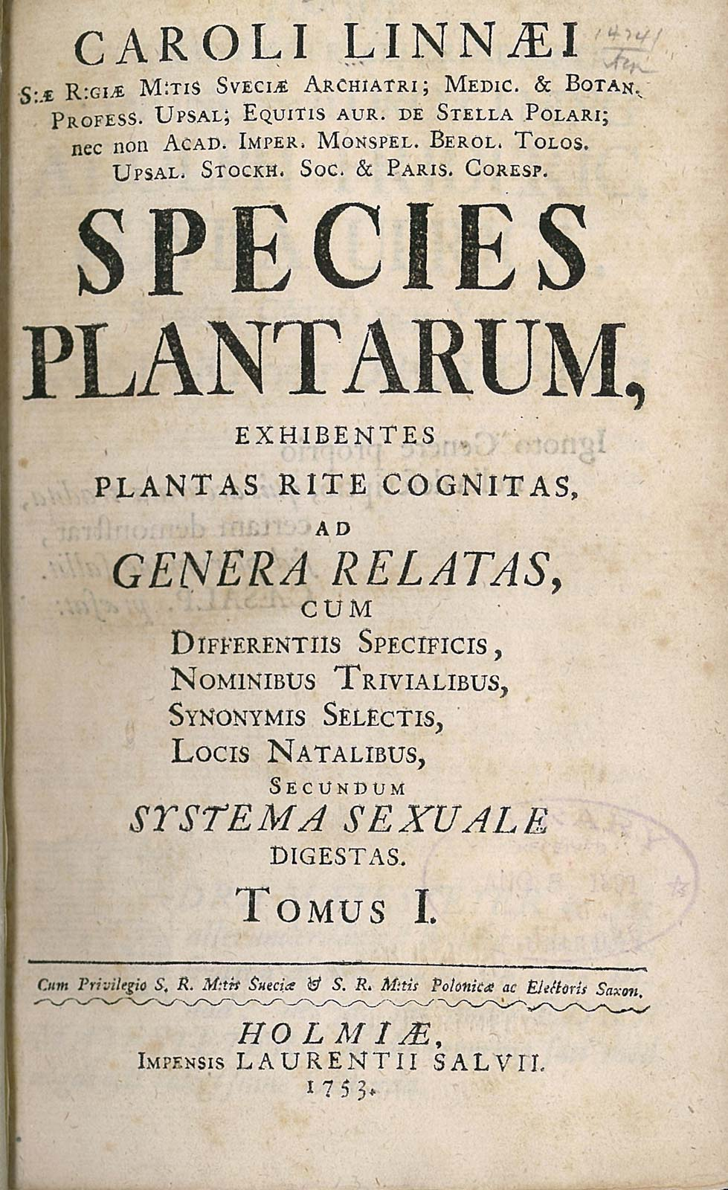
Latin played a very important role in the formation of scientific vocabularies, not only of Law, but also of Medicine, Biology, Theology, et cetera. It was the language of scholarship and it established a scientific language which is still used today.

Slide 5
The words university, faculty, humanities, professor, doctor, lecturer, student, library and campus all derive from Latin.
LINGUA
LATINA
VIVIT
The Latin
language is
alive

Slide 6
Words like philosophy and psychology derive from Greek. Others are hybrid forms, having Greek and Latin stems, like sociology, criminology and political science.
PHILOSOPHY
Love of wisdom
PSYCHOLOGY
Study of the soul
SOCIOLOGY
Study of society
CRIMINOLOGY
Study of crimes

Slide 7
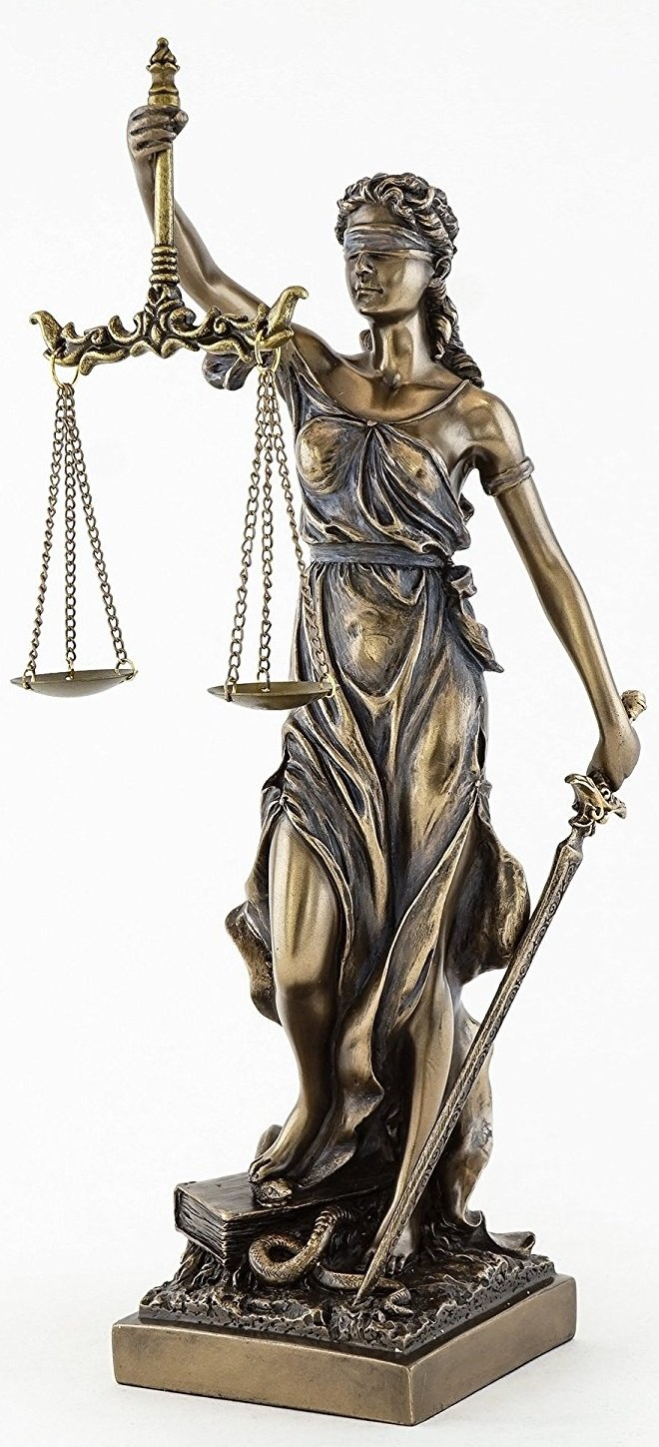
Two important Latin words
lex, legis – a law
Legal; legislation;
Baccalaureus Legum (LLB)
ius, iuris – the law
Jurisdiction (ius + dicere);
Jurisprudence (ius + prudentia);
Jury, injury (crimen iniuria);
Justice (Iustitia)

Slide 8
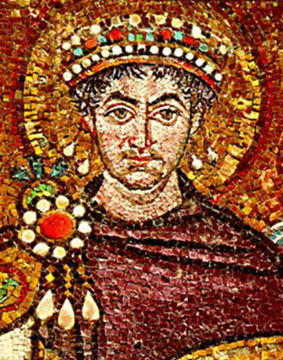
Example of word building:
caedo, caedere caesi caesum
cut, kill (word root: cid-)
Homicide (homo sapiens)
Suicide (sui generis)
Patricide (patrimony)
Matricide (matrix, matriarchy)
Fratricide (fraternity)
Infanticide (infancy)
Cf. also insecticide; fungicide, germicide, tyrannicide.

Slide 9
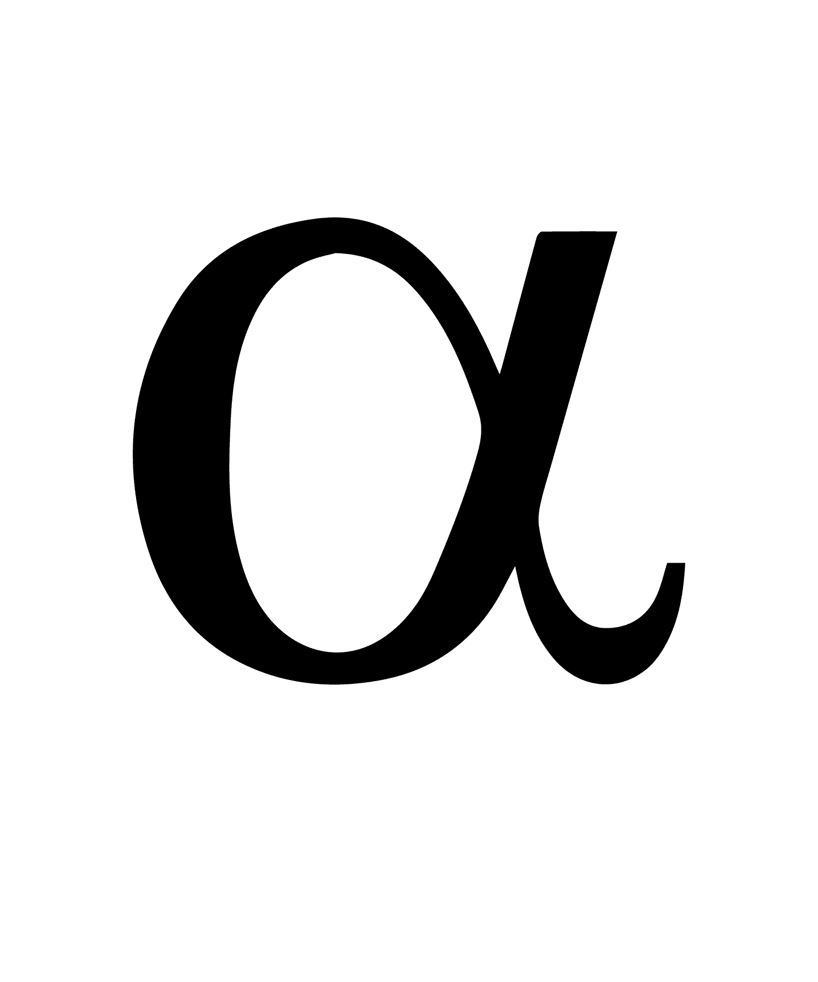
Study in ancient languages and cultures offers inter alia:

Slide 10
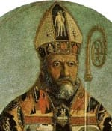
• critical reading and writing skills: indispensable for professionals, language and law practitioners, politicians, preachers and professors;

Slide 11
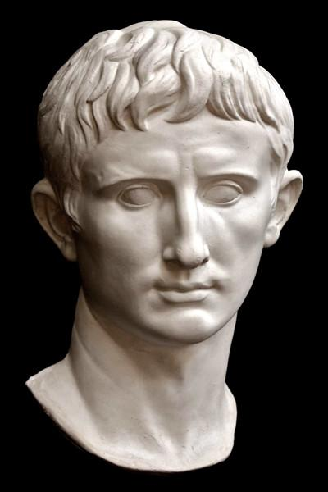
• insight in the grammar and syntax of ancient and modern languages
which provides an excellent basis for learning other foreign languages;

Slide 12
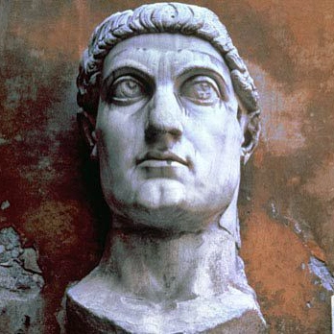
• introduction to the literature, religion, mythology, art, daily life
and other cultural aspects of the different ancient peoples who lived in the Mediterranean world.

Slide 13
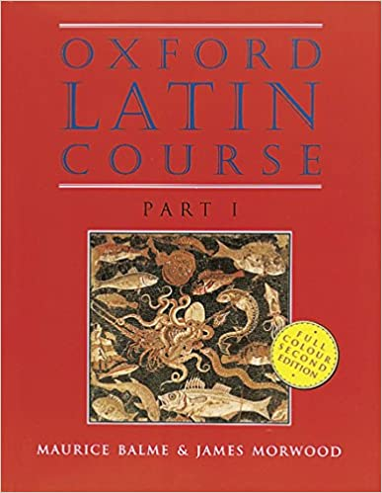
In the first year (Lat 110 and 120) we do the basic Latin grammar.
Textbook: Oxford Latin Course
Learn Latin by reading Latin. Equip yourself better for your further studies and professional career.
Small groups ensure that you’ll receive individual attention. LATIN IS FUN!

Slide 14
FINIS THE END GRATIAS MAXIMAS THANK YOU VERY MUCH Module code: LAT 110/120 For more information please contact me at koos.kritzinger@up.ac.za
F
I N I S
H

