Slide 1
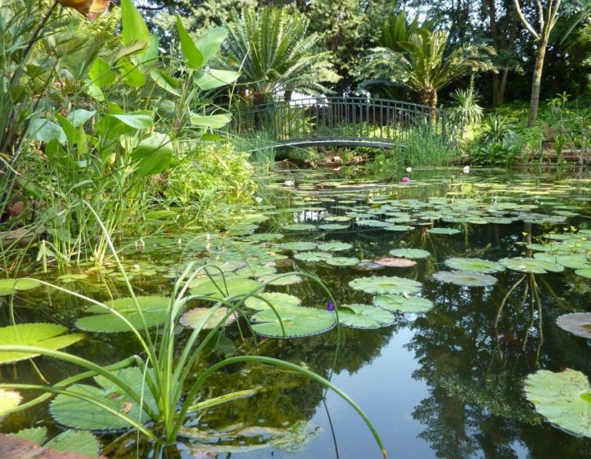
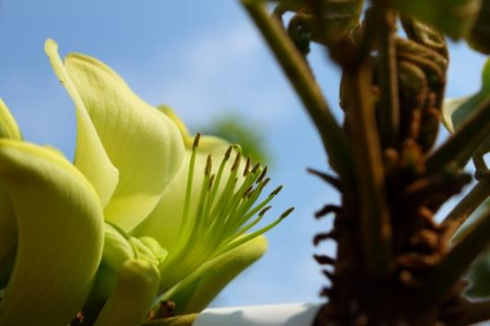

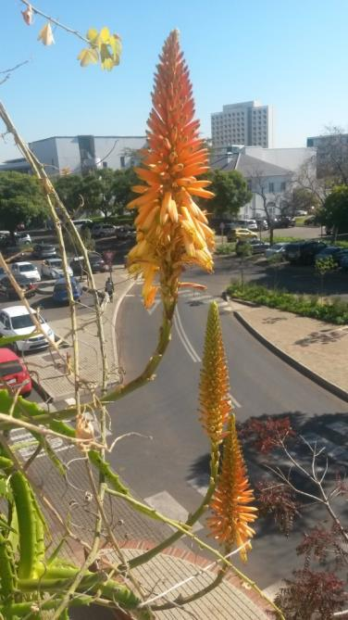
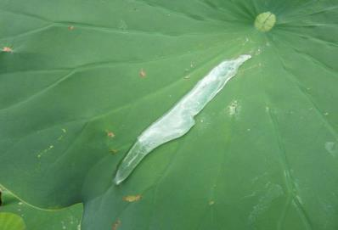
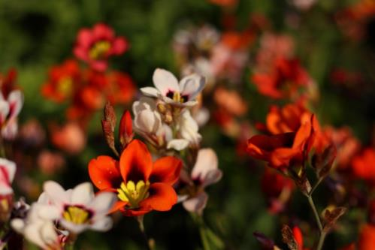
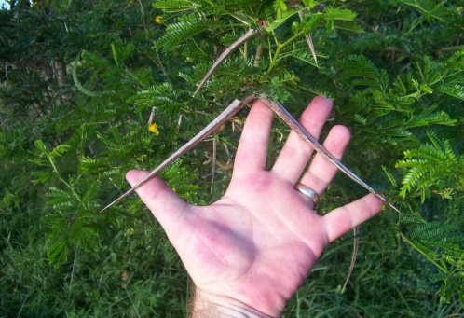
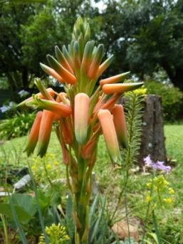
The Manie van der Schijff Botanical Garden
The living library of UP: resources for research and teaching

Slide 2
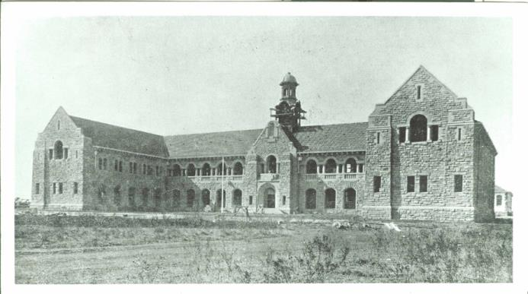
A (very) short history of the Garden
1924: Pavetta species for Research
  Prof. Elbrecht
  Monocot Garden
1930’s: the TUC maintained Department of
  Done on goodwill
  Taking over from the Department of Public Works.
‘Daar was altyd ’n gebrek aan geld en geen gebrek aan klagte nie.’ Ad Destinatum (1960)

Slide 3
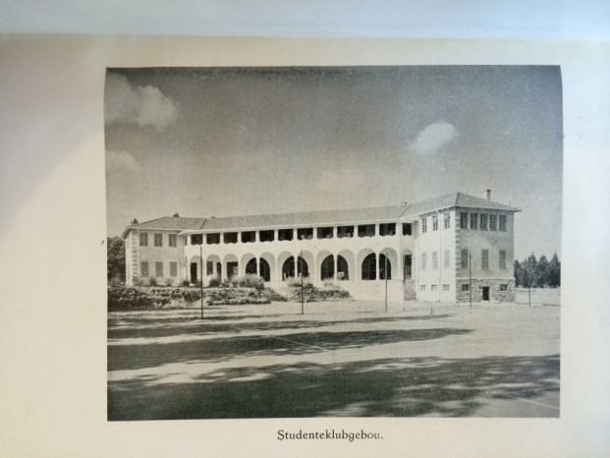
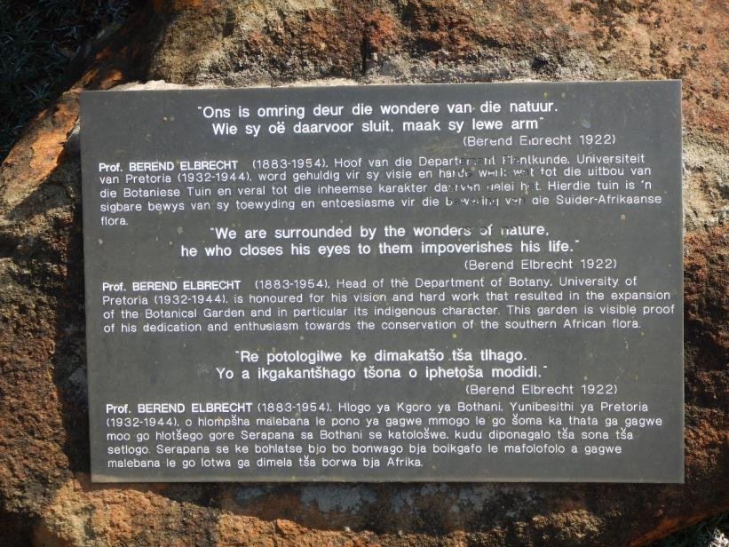
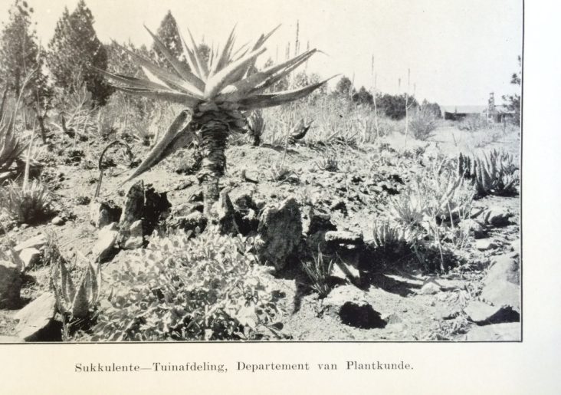
1931: Prof Elbrecht campus West
  Generally unmaintained section
  Acacia galpinii N of present day NW1; A. sieberiana Admin courtyard
Nursery south-west of Botany towards the present day AE du Toit Auditorium
  Many of the trees produced planted on other surrounding campuses
1965: Greenhouse Complex

Slide 4
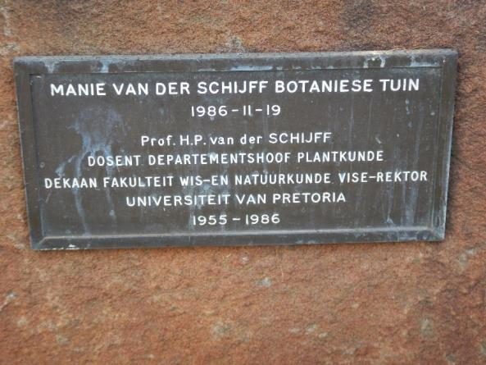
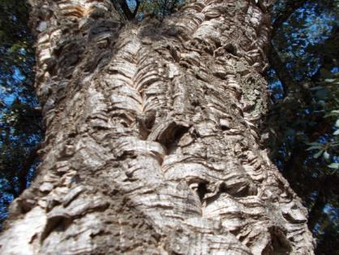
In 1961: officially declaration for Botany Department
  New landscape installations
  Maintenance of Botanical Garden on the Hatfield campus
Related developments University Council note 15 September 1971 R321/72
  Arboretum on Sports Campus
  Due to land lost to Facilities Maintenance building

Slide 5
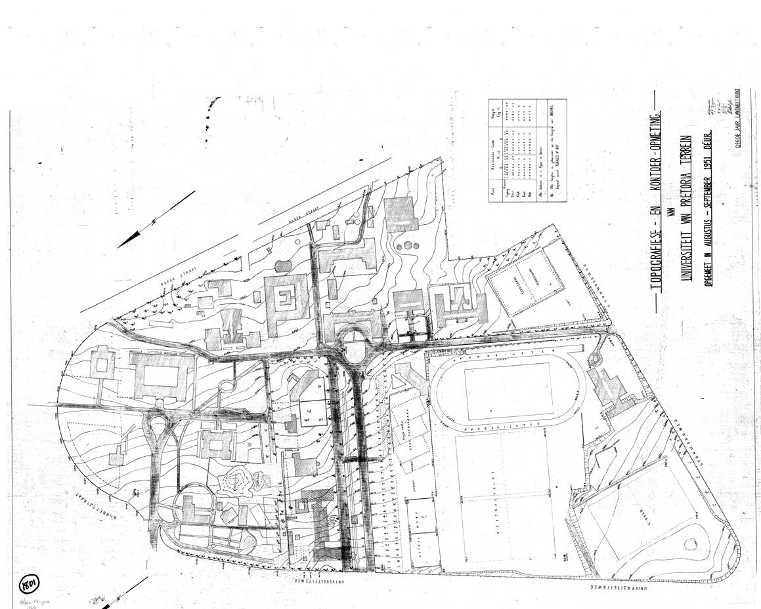
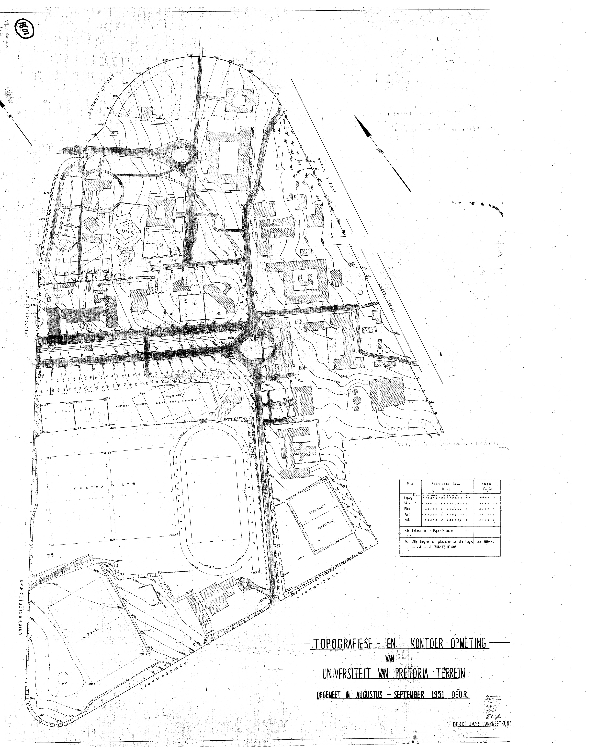

Slide 6
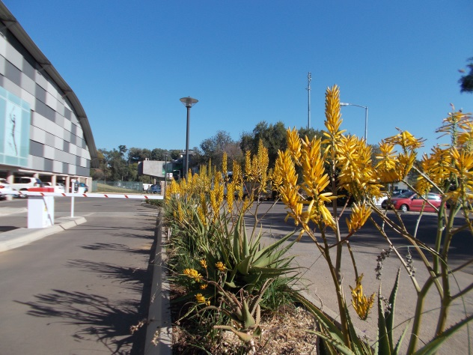
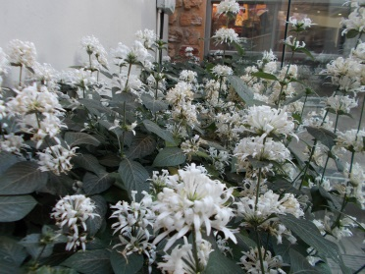
The Garden Today
Bottom section of Campus,
Approximately 1/3 of landscaped area
3000 species, more than 5000 accessions and counting
<180 families
Largely but not exclusively indigenous
  Advantage above National Botanical Gardens
Satellite and Collaborative gardens
Larger concept, ‘Botanical Collections” of the University.

Slide 7
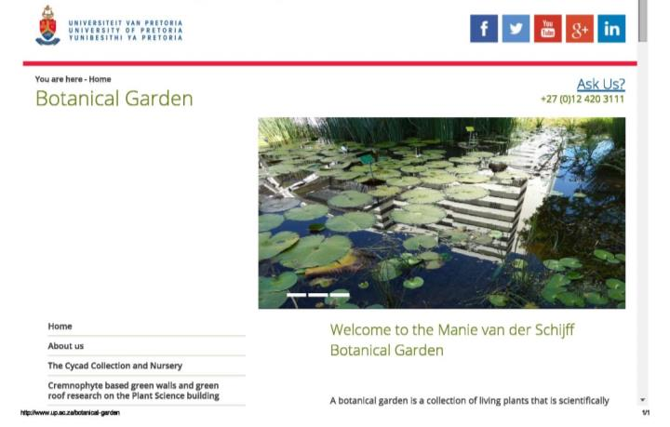
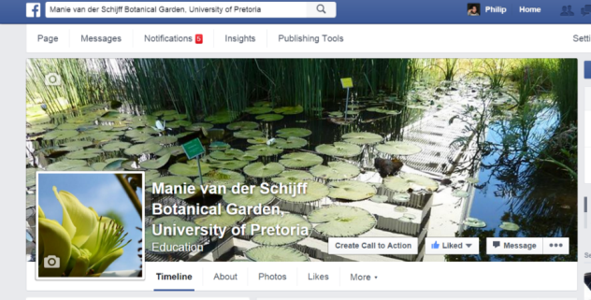
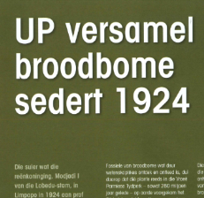
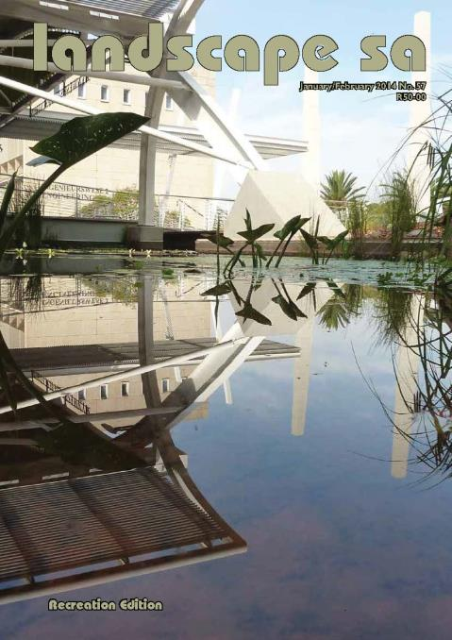
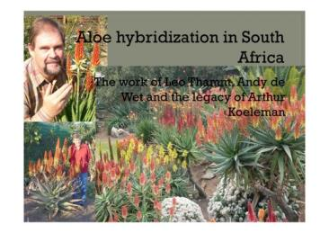
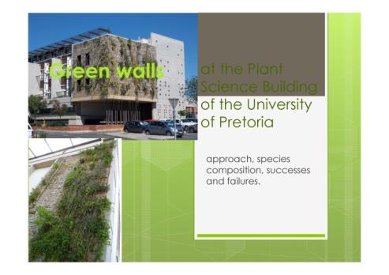
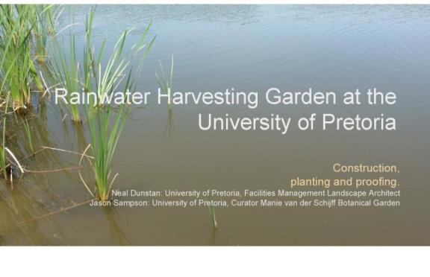
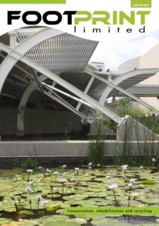

Public Relations and Publicity

Slide 8
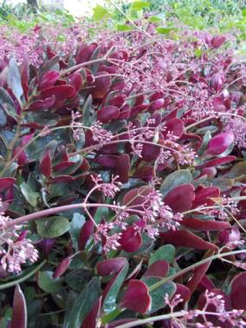
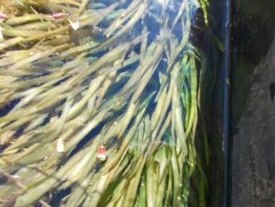
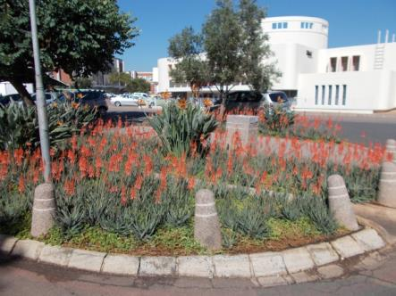
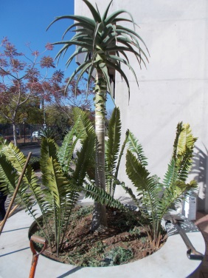
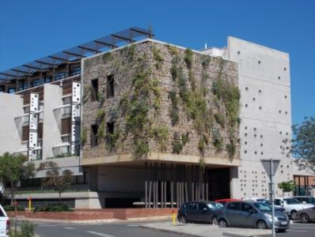
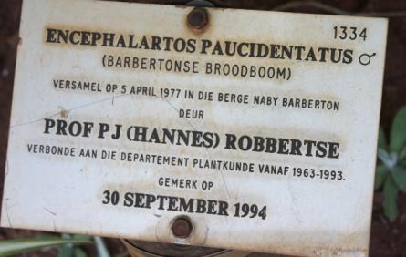
Special Collections
Monocot Garden
Succulent and Karoo
“Oom At” Arthur Koeleman hybrid aloe’s
Hydrophyte collection
Cremnophytes and chasmophytes
Agavaceae
Edible/culinary plants
Poisonous and/or medicinal plant
Carnivorous plants
Bromeliads
Cycad collection
  Own curator

Slide 9
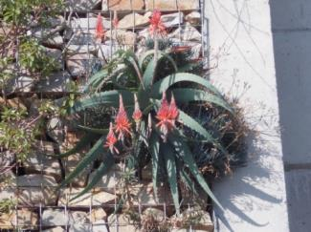
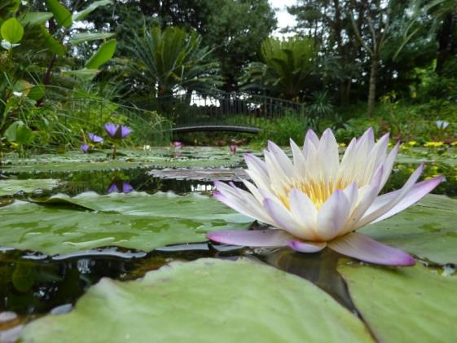
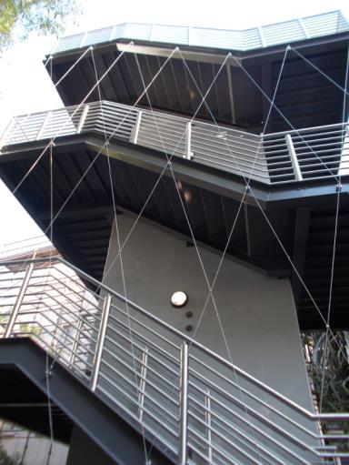
Special Developments
Automated irrigation system
Renovation programs
Green walls and balconies of Plant Science Complex
Rainwater Harvesting Garden
Tree audits and arboretums
Water-Wise gardening program in conjunction with FM
Other “experimental” projects

Slide 10
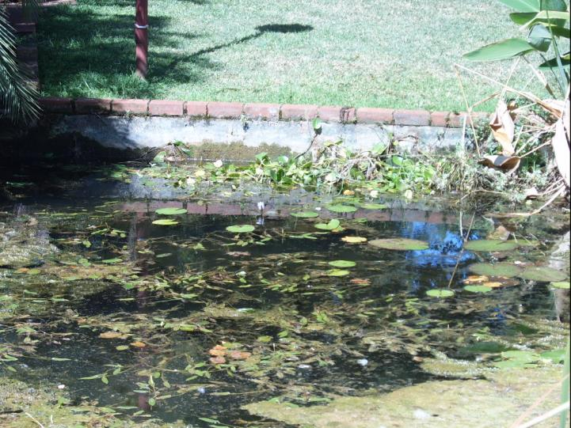
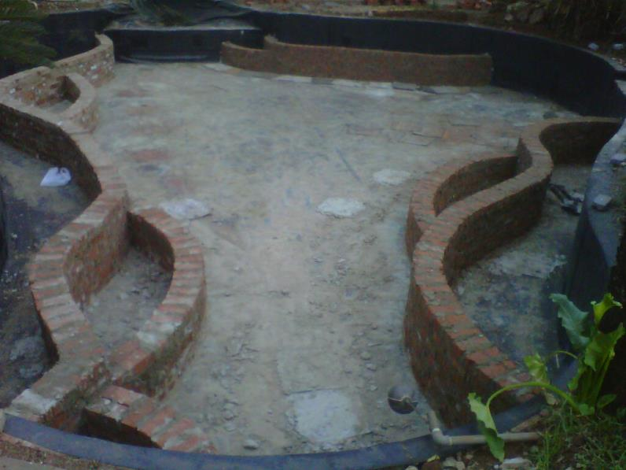
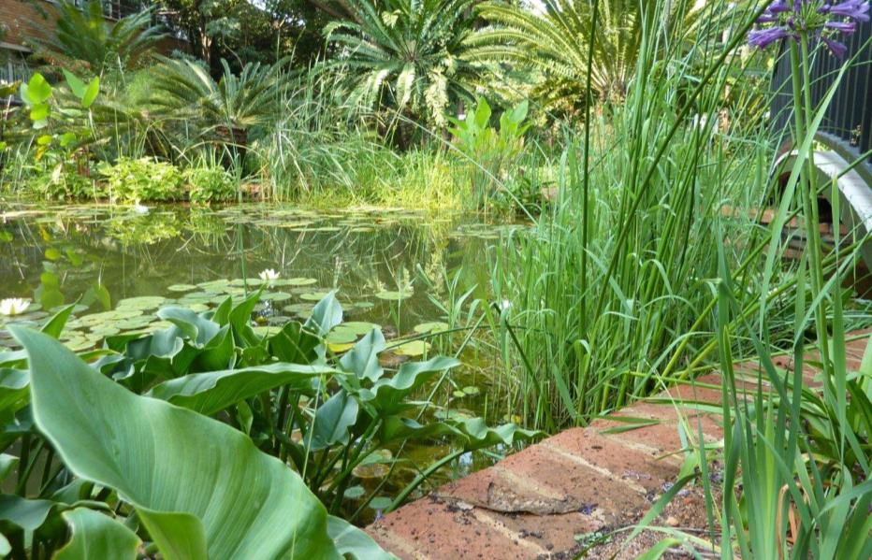
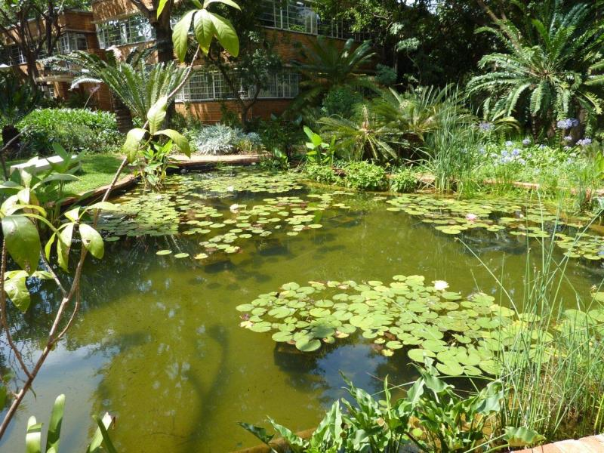

Slide 11
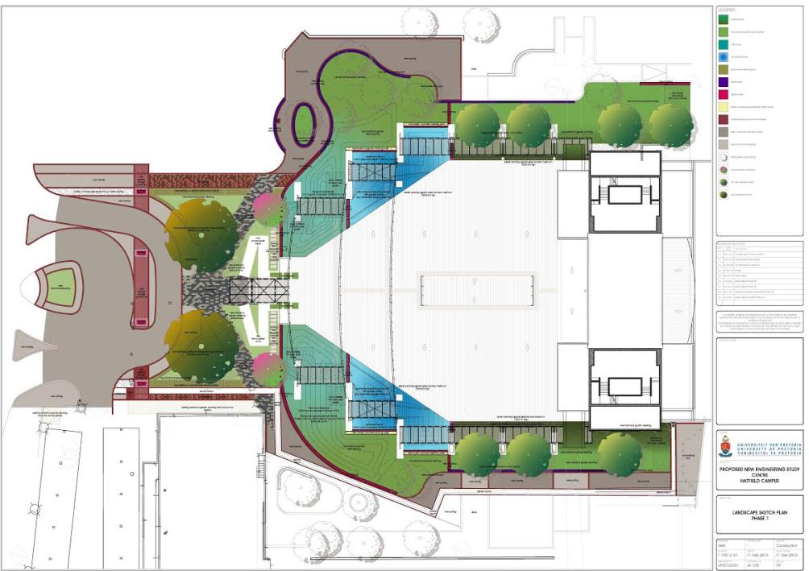
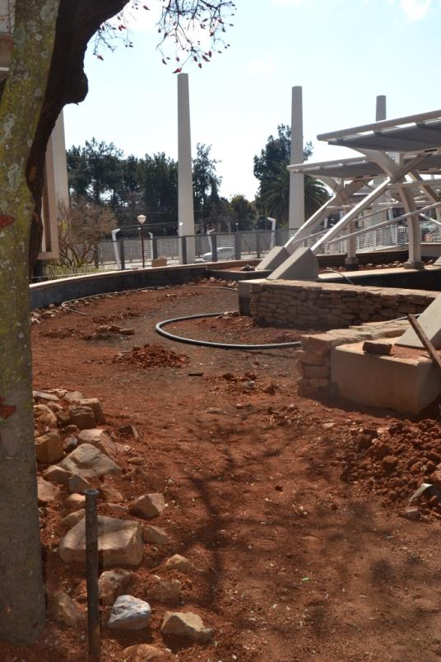
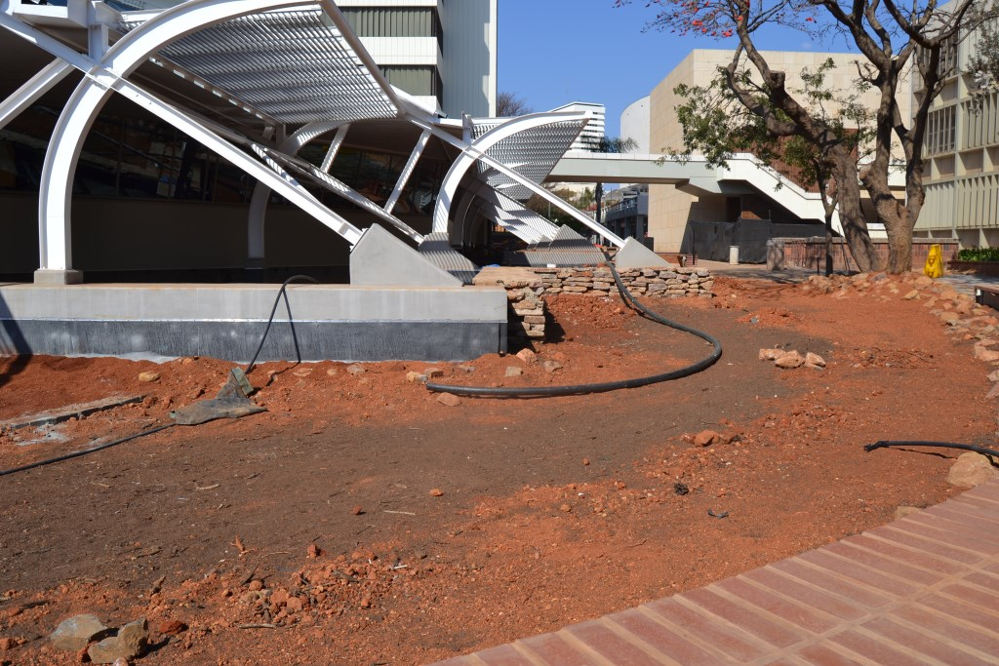
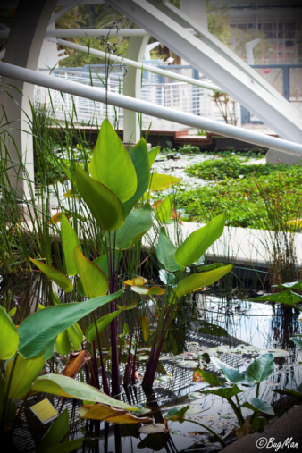
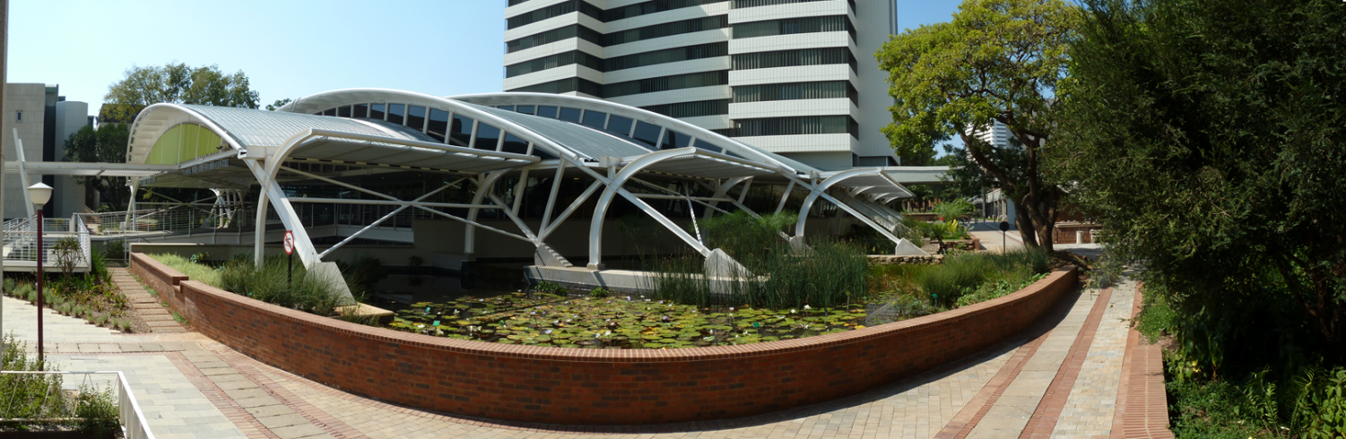

Slide 12
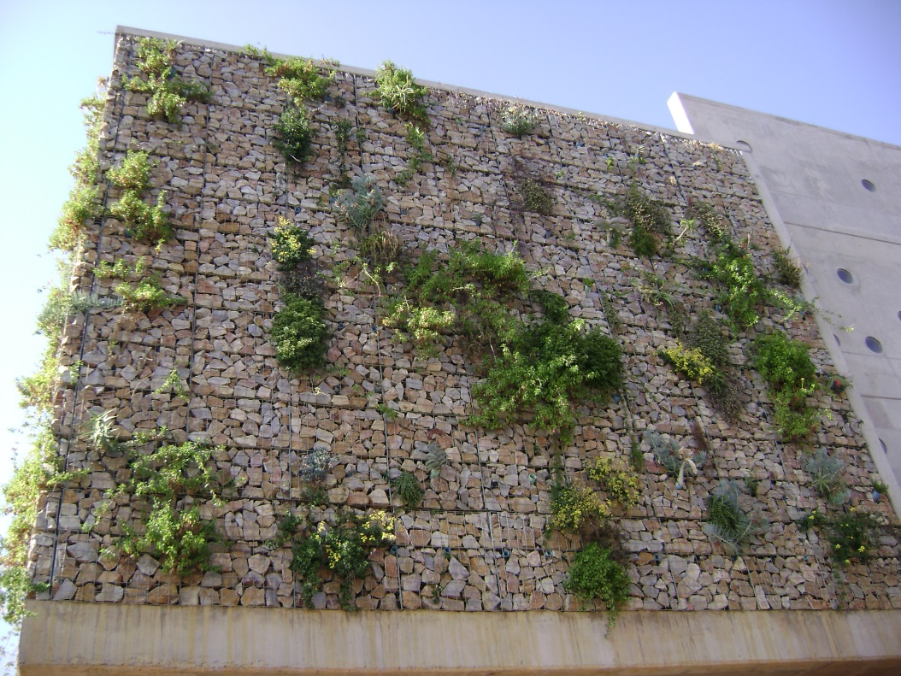
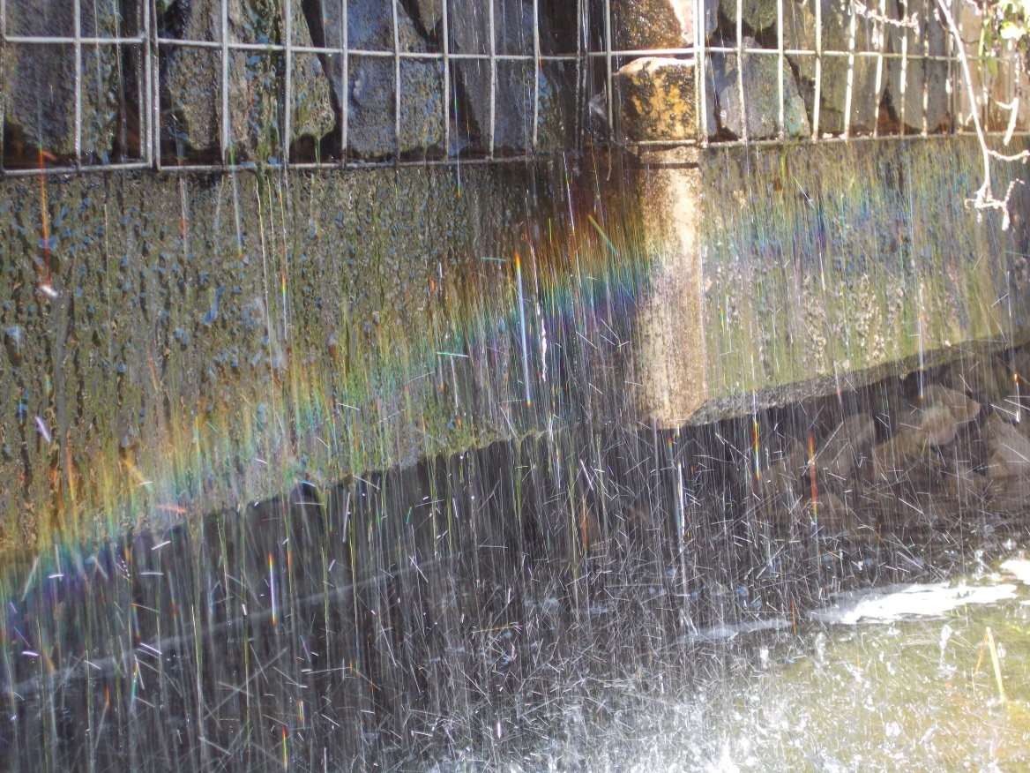
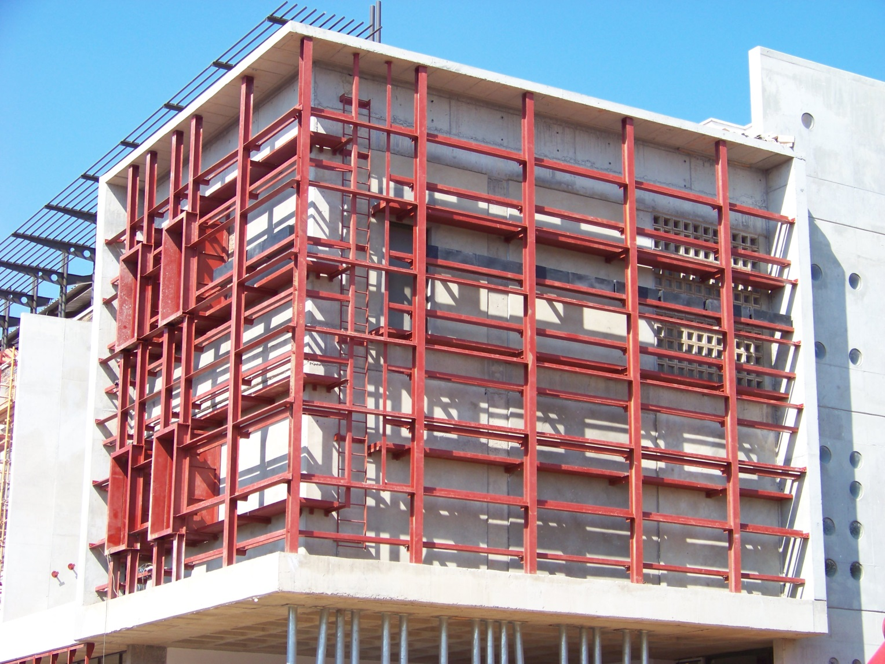
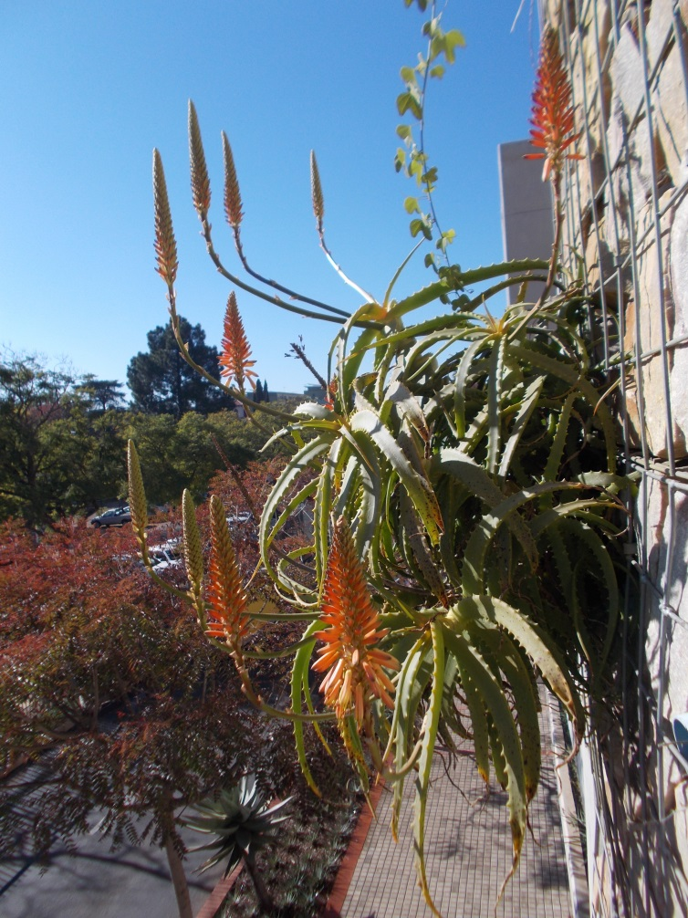

Slide 13
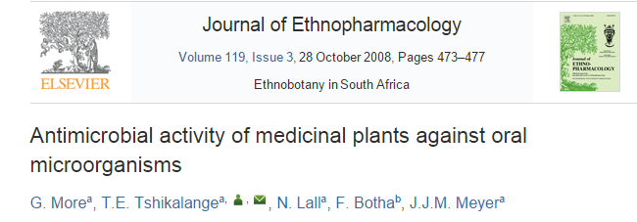
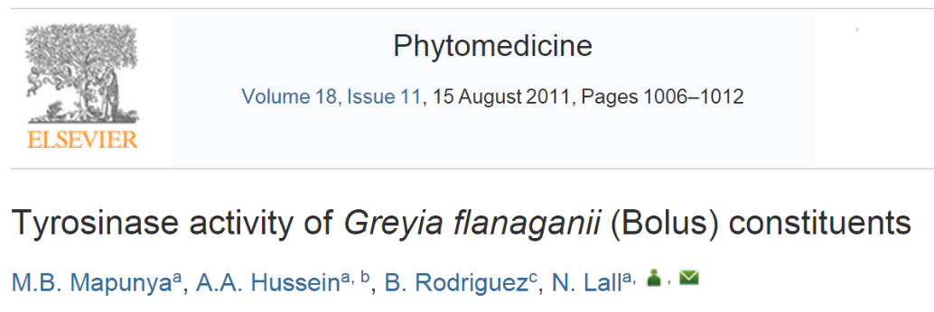
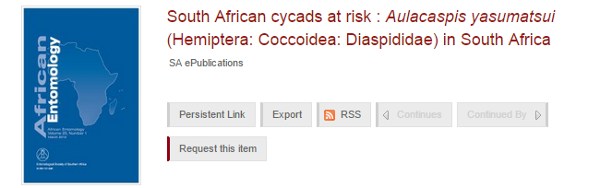



Research in living memory
Prof. Namrita Lall and graduates
Prof. Marion Meyer and graduates
Prof. Kobus Eloff & ethnobotanical research program
Prof. Yolanda Roux and graduates
Dr. Esch Mizrachi and current students
Prof. Braam van Wyk and graduates
Prof. Hannes Robbertse
Several theses produced on cycads
Other departments & faculties
  Consumer Science
  Landscape Architecture
  Zoology
Outside interests
  CSIR
  Horticultural researcher interests
  Durham University (UK)

Slide 14






Teaching and Learning
  Invest in our staff
    Trained Basic horticulture: Botanical garden: Supervisory
  BOT subjects
  French institute of landscape architecture internships (FR)
  UNISA interns and consultation
  Prospects
    Interns from plant production
    Mentorship program from faculty

Slide 15
Current and future projects
Grassland garden
Bromeliads
Rehabilitation of the Hartbeesspruit (LC de Villiers)
Aloes for Africa
Agaves the exotic alternative
Consumer sciences
Sci-Enza food scheme
Future Africa
Consumer sciences and herb/veld food garden spaces.
UP Art centre with associated gardens
Aloe collection expansion Admin

Slide 16











Current and future projects
Grassland: our home biome
University located in Grassland biome
Historically section in monocot garden
Grassland vegetation large monocot component
  Poaceae, Asparagaceae s.l., Cyperaceae
Three layers
  Grass “canopy”
  Herbaceous understory
  Geophytic subterranean
Indigenous Highveld taxa
Pyrogenic species
  Cycads
Fire on campus…

Slide 17










Current and future projects
Bromeliaceae: the most beautiful plants in the world
Over 50 species/cultivars
  Over 50 000 worldwide!
Almost exclusively South/Central American
  1 West African species
Most epiphytic, some terrestrial
Waterflowering with microfauna
Most monocarpic
  Some grow for decades
FOR SALE!

Slide 18



Current and future projects
Rehabilitation of spruit: ecologineering
Flooding & Erosion
Poor water quality
  Better quality leaving
Low species diversity
  Many exotics & invasives
Aesthetically unpleasing
Student hangout & visitor heavy section
2 Approaches
  Strictly engineering solutions
  Combined ecological
Highveld indigenous species
  Massive species & numbers at Rainwater Harvesting Garden

Slide 19





Current and future projects
Aloes: for Africa
HPC school
LC de Villiers road down to Astro
Hybrids from our test beds
  Prerequisite from rectorate
At Koeleman collection
Pièce De Résistance
  In front of Admin!

Slide 20


Current and future projects
Agave: the exotic alternative
HPC School
Kind donations from Gariep Succulent Center
Prof. Gideon Smit ex UP/SANBI
Intermixed with Aloes & other drought tolerant species
Waterwise gardening & low maintenance
  No pests and diseases
Super ethnobotanical plants
  Traditional dependency
  Religion
  Industrial and Utilarian

Slide 21


Current and future projects
Consumer science: Culinary adventures that wont kill you
Here taste this!
Herb garden to supply rare material
Palm fruits
Plectranthus as Origanum
Rose apple Syzigium
Salvia as Sage
Marog Replacement
Mentha longifolia Mint

Slide 22


Current and future projects
Tended by Sci-Enza
Scholar engagement
Harvested
Supplied to struggling students
Social responsibility

Slide 23



Current and future projects
Future Africa: going back(wards) to nature
Orphan crops
  Expanded forage garden
  Vertical stabilising walls
Evolutionary walk
  Primitive vascular plants
  Cycads

Slide 24








Future research
Facilities
Natural Moot grassland on Experimental Farm
  Low expense source of indigenous species (Permits still require in some cases)
Grassland garden
  Seed source for preliminary germination trails
Rainwater Harvesting Garden
  Seasonal levels
  Flowing water
Greenhouses
  Temperature control
  Moisture control
Open ground space Ex Farm
  Unparalleled opportunity with developments
Wet/Dry walls & Balcony gardens
  Unique space for specialist taxa

Slide 25


Slide 26




Future research
Teaching
Denis Barthel
BOT 161
  A picture might be worth a thousand words
    But a physical specimen is priceless
  Indigenous examples of metamorphic structures
  Spectacular plants in RSA
  Most important subject in our department
    Grasp the interest of students
BOT 251
  Class excursion into “biomes”
  Ecologically functional grassland section
  Ecologically functional wetland
  Microhabitats
earth (Talk)
Polypompholyx

Slide 27








Future research
Research
Consortium for Cycad Research (CCR)
  Taxonomy (Evolutionary history)
  Horticulture (Germination, Phenology, Hybridisation)
  Genomics and gene expression
  Ethnobotany
  Sex determination
  Ecology (Associated Fauna, Dispersal, Recruitment, Sex ratios, Population structure)
  Pathogens
Other gymnosperms
  Very rare and disjunctly distributed
C. Symes

Slide 28




The Manie van der Schijff
Diversity is key!
Normal garden and landscaping
  Purely aesthetic
  Large plantings of monocultures
Botanical garden
  High maintenance & specialised staff
  Cryptic attributes
  Convergent growth forms
  Phylogenetic diversity
  Sister taxa

Slide 29
The Manie van der Schijff
Advantages
Our services our free & without strings
No material transfer agreements in house
No profit sharing agreements to our researchers
Permit for restricted activities
  All activities concerning cycads needs to occur under this permit

Slide 30

I am using the Botanical Garden
Conclusion
Why aren’t you?

Slide 31



Bibliography
RAUTENBACH, C.H., ENGELBRECHT, S.P., PELZER, A.N., DU T SPIES, F.J., DE KOCK, AND W.J., CILLIERS, C.H. (Editors). 1960. Ad Destinatum: Gedenkboek van die Universiteit van Pretoria. Johannesburg: Voortrekkerpers Beperk.
Plant Science’s Archive letters
FOLLOW US ON
FACEBOOK!

