Slide 1
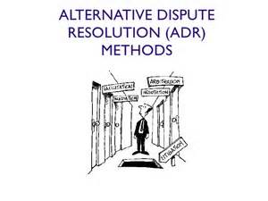
Alternative Dispute Resolution AGF 420
Lecturer: Rashri Baboolal-Frank
AGF 420 is presented in the SECOND SEMESTER
Assessment: semester test, multiple choice group quiz and an exam
Topics: negotiation, mediation, court-annexed mediation, divorce online mediation, arbitration, court of arbitration for sport, commercial arbitration, private arbitration institutions, international commercial arbitral awards, sectional titles arbitration, consumer ADR in Belgium, access to public justice through ADR, accessible and efficient dispute resolution, global directions, online ADR and transparency and ADR in Africa.
For more information contact: Rashri.Baboolal@up.ac.za

